Slide 1
Channel Access for NPCA Operation
Date: 2025-01-10
Authors:

Slide 2
Introduction
During the initial discussions of NPCA operation, defining an operation mode of triggered-only UL tranmissions has been discussed in some contributions [1–3].
The main rationale of this mode of operation is for the NPCA AP to gain control of the NPCA PCH, as there may be multiple STAs contending for the channel up on switching, the NPCA AP may not be able to gain control of the channel.
Following further discussions, TGbn has defined a mode of operation in NPCA where the NPCA non-AP STA does not use untriggered UL transmissions on the NPCA PCH.
In this contribution, we define a new mode of operation for NPCA non-AP STAs as a transition between “untriggered” and “triggered-only” UL transmissions on the NPCA PCH.

Slide 3
Recap: Triggered-only UL Transmission
UHR AP and UHR STA may switch from the PCH to the NPCA PCH on detecting an inter-BSS PPDU. They may perform UL/DL communications on the NPCA PCH, if the NPCA PCH is available.
As one enablement option in the NPCA operation, UHR STA may perform triggered-only uplink transmission on the NPCA PCH (e.g., mode of operation: NPCA non-AP STA does not use untriggered UL transmissions on the NPCA PCH [1]).
NPCA PCH
PPDU
Switch to PCH
PCH
UHR STA
NAV
BSS-1
Switch to NPCA PCH
ICF (TF)
BA
NPCA PCH
Switch to PCH
PCH
UHR AP
NAV
Switch to NPCA PCH
NPCA PCH
BSS-2
PCH
AP/STA
OBSS AP/STA communication within BSS-2

Slide 4
Problem During Triggered-only UL Transmission
On detecting an inter-BSS PPDU on the PCH and switching to NPCA PCH, UHR AP may detect another OBSS communication and may set the basic NAV on the NPCA PCH.
On detecting an inter-BSS PPDU on the PCH and switching to NPCA PCH, UHR STA may not detect OBSS communication (it may be far from the OBSS) on the NPCA PCH. Having the triggered-only UL transmission option enabled, UHR STA waits for UHR AP to trigger itself to transmit UL data.
Since not being triggered, UHR STA waits until the end of NAV duration to switch back to the PCH.
UHR STA does not hear OBSS TX on NPCA PCH
UHR STA has buffered UL data but cannot transmit
NPCA PCH
Switch to PCH
PCH
UHR STA
NAV
BSS-1
Switch to NPCA PCH
UHR AP reads TXOP duration
NAV(NPCA_PCH)
NPCA PCH
Busy channel due to another OBSS comm. on the NPCA PCH
PCH
Switch to PCH
UHR AP
NAV
Switch to NPCA PCH
NPCA PCH
BSS-2
PCH
AP/STA
OBSS AP/STA communication within BSS-2

Slide 5
Proposal: Defining a Duration for Triggered-only UL TX
In a triggered-only UL transmission mode, UHR STA may perform untriggered UL transmissions after a time period T.
UHR AP may transmit to UHR STA a frame indicating the time period or the time period T may be predetermined.
UHR AP may perform trigger-based UL transmissions or DL transmissions during and after the time period T, if the NPCA PCH is idle.
T
NPCA PCH
PPDU
Switch to PCH
PCH
UHR STA
NAV
BSS-1
Switch to NPCA PCH
UHR AP reads TXOP duration
BA
NAV(NPCA_PCH)
NPCA PCH
Busy channel due to another OBSS comm. on the NPCA PCH
PCH
Switch to PCH
UHR AP
Frame
NAV
Switch to NPCA PCH
NPCA PCH
BSS-2
PCH
AP/STA
OBSS AP/STA communication within BSS-2

Slide 6
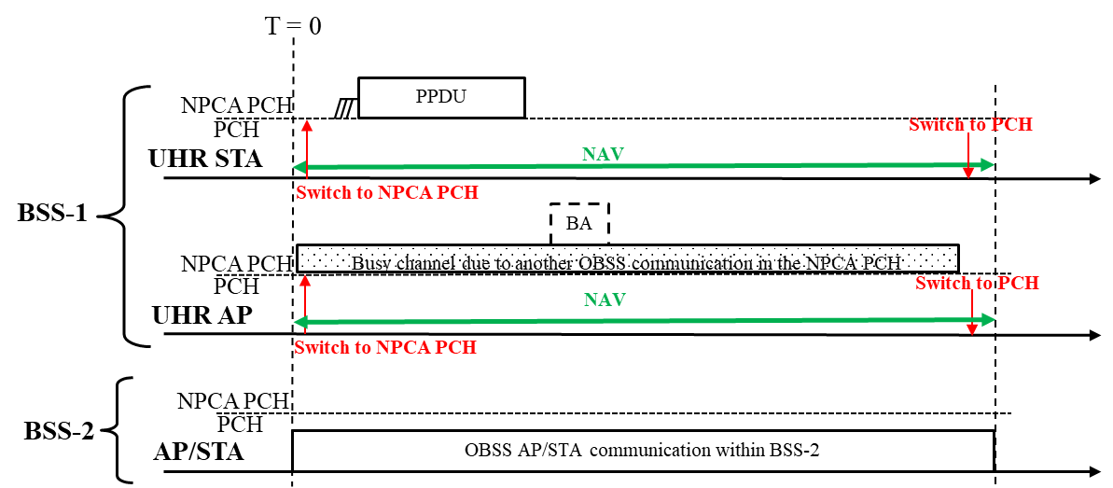
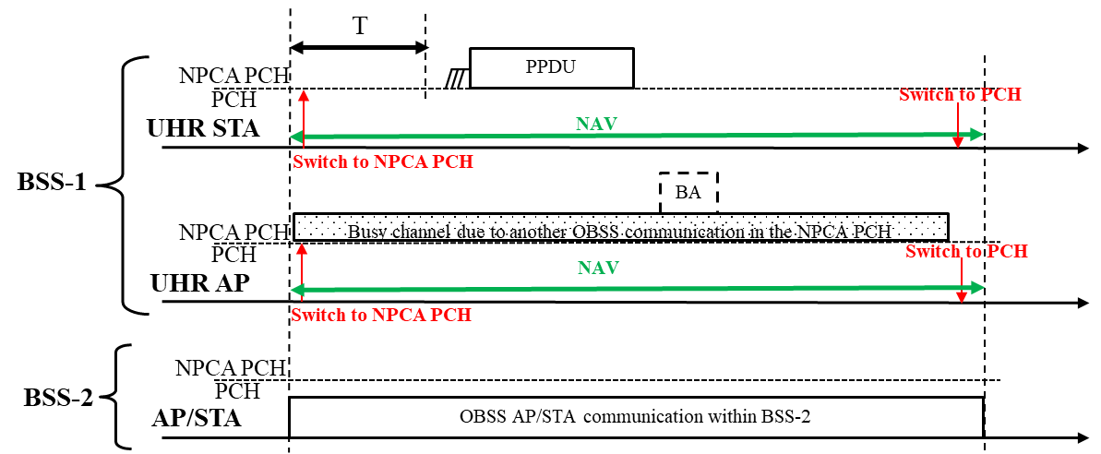
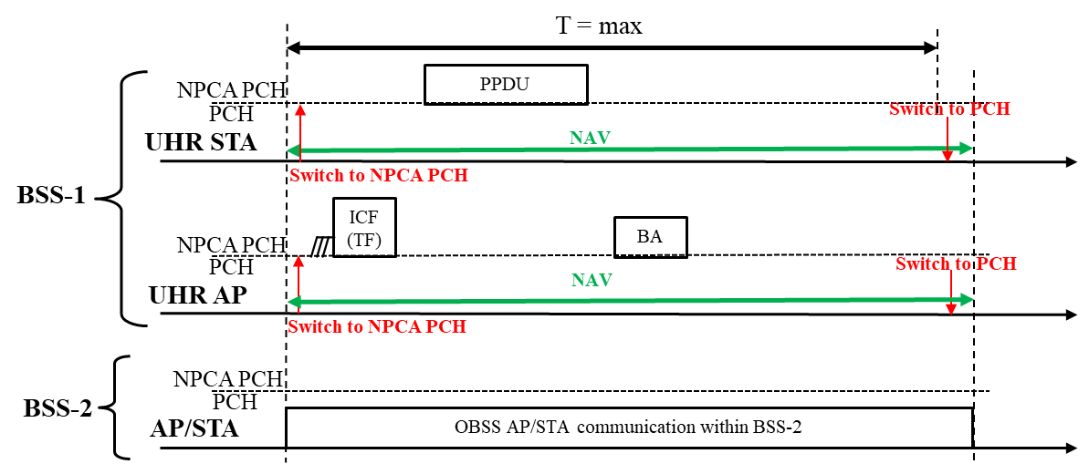
General Solution for Defining T
T = 0 → Untriggered UL allowed
T = a value → Untriggered UL allowed after T
T = max value (e.g., TXOP_duration) → Triggered UL only

Slide 7
Conclusion
In this contribution, we defined a new mode of operation for NPCA non-AP STAs as a transition between “untriggered” and “triggered-only” UL transmissions on the NPCA PCH.
By defining a duration (e.g., T) which indicates a time period during which a UHR STA, while operating on an NPCA PCH, is not allowed to initiate a TXOP on the NPCA PCH, UHR AP may inform a UHR STA of
  whether untriggered UL transmission is allowed (T = 0), or
  whether untriggered UL transmission is allowed after a duration T (T = a value), or
  whether triggered-only UL transmission is allowed (T = max value).
The proposed approach not only addresses an implementation of enabling/disabling untriggered UL transmissions on the NPCA PCH, but also brings flexibility to the NPCA operation by defining a duration where UHR STA is not allowed to initiate a TXOP on the NPCA PCH.

Slide 8
References
[1] 24/1218r1, NPCA – Next Level Discussions
[2] 24/1093r3, Special Scenarios in Non-Primary Channel Access
[3] 24/1842r1, Consideration on Cascading Channel Switching for NPCA

Slide 9
Straw Poll – 1
Do you agree to add the following text to the TGbn SFD?
In a triggered-only UL transmission mode, an NPCA non-AP STA may perform untriggered UL transmissions on the NPCA primary channel after a time period T.
  Details of the signaling are TBD.
  Yes
  No
  Abstain
  Y/N/A:

