Slide 1
Context transfer per TID for seamless roaming
Date: 2025-01-14
Authors:
Name | Affiliations | Address | Phone | email
Thomas Handte | Sony Group Corporation |  |  | Thomas.Handte@sony.com
Yusuke Tanaka |  |  |  | Yusuke.YT.Tanaka@sony.com
Dana Ciochina
Daniel Verenzuela
Ken Tanaka
Kosuke Aio
Ryuichi Hirata
Qing Xia

Slide 2
Introduction
Seamless roaming has been addressed in numerous contributions e.g. [1-13]
  Submissions address architecture, data flow, context transfer, and security aspects
  Six SFD entries and a PDT document capture the current consensus on seamless roaming operation [14, 15]
In order to make the roaming truly seamless, its critical phase needs to be carefully considered [1-3]
  The critical phase …
    … starts with initiation of the context transfer, and
    … ends after the DS mapping changed to target AP
  During this time span, the data service to/from a non-AP MLD is limited
    Only buffered downlink (DL) data can be conveyed to the non-AP MLD
    No uplink (UL) data can be conveyed to source or target AP
This submission addresses context information and its separation
  A context transfer per TID can limit the impact of the critical phase
    … contributing to enhanced user experience

Slide 3
Context information
Several submissions address information within the context
  Context information may be divided into a rather static and a dynamic part [1-8]
  Information to be included contains
    PMK/PTK [4, 7, 9]
    BAck context [4, 7-11]
    Agreements (e.g. SCS, MSCS, TWT) [7, 9, 11]
    Packet number [4-5, 9]
    Sequence number [1, 4-5, 8-10]
    Capabilities [4]
  Content of transmit buffer (aka data forwarding) may be useful [9, 12-13]
The context information above is
  Valid for all TIDs but rather static (e.g. PTK, agreements), or
  TID specific (e.g. sequence number, BAck context, transmit and receive buffer), or
  evaluated per TID (packet number)

Slide 4
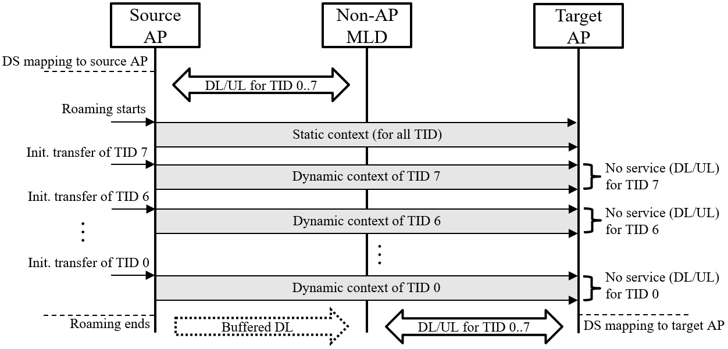
Context transfer per TID
Initially, static context is transferred
  Includes PMK/PTK, agreements, PN
    PN space may be split into lower and higher part; lower/ higher part stays with source/ target AP [5]
Subsequently, dynamic context is transferred per TID
  Order of transferred TIDs and/or context aggregation of several TIDs can be optimized
  and is implementation dependent
  For example,
    high priority TIDs can be
    transferred first
    TIDs with currently empty
    buffer can be transferred first
There is no DL/UL data
service for the currently
transferred TID
  except buffered DL

Slide 5
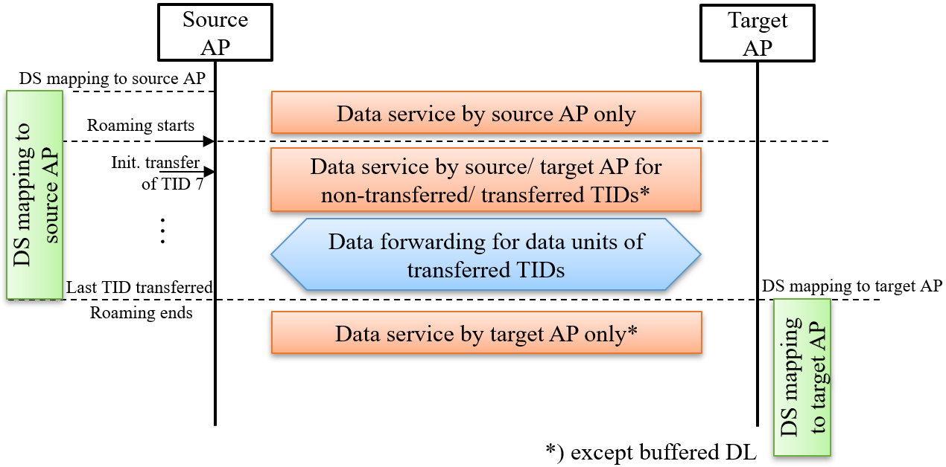
DS mapping and data forwarding
DS mapping
  Initially DS mapping is to source AP and stays with source AP even though the dynamic context of a TID has been transferred
Data forwarding
  While DS mapping is with
  source AP, data units of those
  TIDs whose context has been
  transferred to target AP …
    … are forwarded from source
    to target AP in downlink (DL)
    … are forwarded from target
    to source AP in uplink (UL)
  While DS mapping is with
  source AP, data units of those
  TIDs whose context has not
  been transferred to target AP
  are normally processed

Slide 6
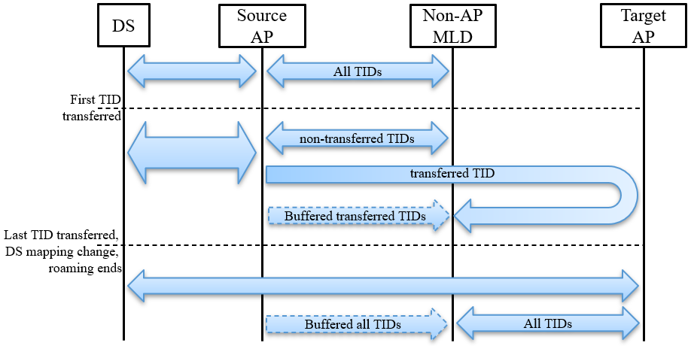
Data flows
The data flow to/from non-AP MLD depends on
  DS mapping, used TID, and status of the TID (transferred to target AP or not)
Note that
  Buffered DL data can be served by source AP at any time
  DS mapping change can happen before the last TID is transferred (example see Appendix)
The data flow is
(before first TID is transferred)
DS ⬄ source AP ⬄ non-AP MLD
(after first TID is transferred)
DS ⬄ source AP ⬄ non-AP MLD
for non-transferred TIDs or
DS ⬄ source AP ⬄ target AP ⬄ non-AP MLD
for transferred TIDs
(after DS mapping change)
DS ⬄ target AP ⬄ non-AP MLD

Slide 7
Benefits
Data service interruption during roaming is just for one TID, not for all
The information fragments transferred during context transfer are smaller
  Service interruption for one TID is shorter compared to all TID transfer
Roaming is future-ready i.e., two APs can serve a non-AP MLD at same time
  For the application of seamless roaming, this state is transient
Data forwarding just applies during a transient phase
  Thus, the DS load is only increased while not all TIDs are transferred
  Afterwards, the DS mapping is changed, and DS load is back to normal
Adjust context transfer to buffer status of certain TIDs
  Transferring TIDs with empty buffer saves time for emptying or forwarding the buffer content

Slide 8
Conclusion
Context transfer is the critical phase in seamless roaming
  During this phase data service to/ from non-AP MLD is limited which degrades user experience
We suggest to implement a TID specific context transfer
  Initially (rather) static context is transferred from source to target AP
  Subsequently, the dynamic context of each TID is transferred until the entire context is with target AP
DL/UL data service to a non-AP MLD can be maintained during the context transfer for all TIDs except the currently transferred TID
  Data service for non-transferred TIDs is provided by the source AP, which is connected to the DS
  Data service for transferred TIDs is provided by the target AP, which receives/ forwards data from/ to the source AP connected to the DS
We see significant benefits such as
  Quasi uninterrupted data flow during seamless roaming
  Future readiness of roaming architecture for applications beyond seamless roaming

Slide 9
References
[1] 11-24/1898 “Low Latency Roaming Flow”
[2] 11-24/1883 “Seamless Roaming”
[3] 11-24/1882 “Link Setup for Seamless Roaming”
[4] 11-24/1812 “Seamless roaming through a target AP follow up”
[5] 11-24/0052 “Seamless Roaming details”
[6] 11-24/1884 “Seamless Roaming”
[7] 11-24/0396 “Seamless roaming within a mobility domain - follow up”
[8] 11-24/0830 “Improve roaming between MLDs follow up”
[9] 11-24/101 “MLD roaming”
[10] 11-24/830 “Improve roaming between MLDs follow up”
[11] 11-24/679 “Thoughts on Functionality and Security Architecture for UHR Seamless Roaming”
[12] 11-24/1740 “UL Data Transmission for Seamless Roaming”
[13] 11-24/1517 “Seamless Roaming Data Transfer”
[14] 11-24/0209 “Specification Framework for TGbn”
[15] 11-24/1881 “PDT-MAC-Seamless-Roaming”

Slide 10
Appendix

Slide 11
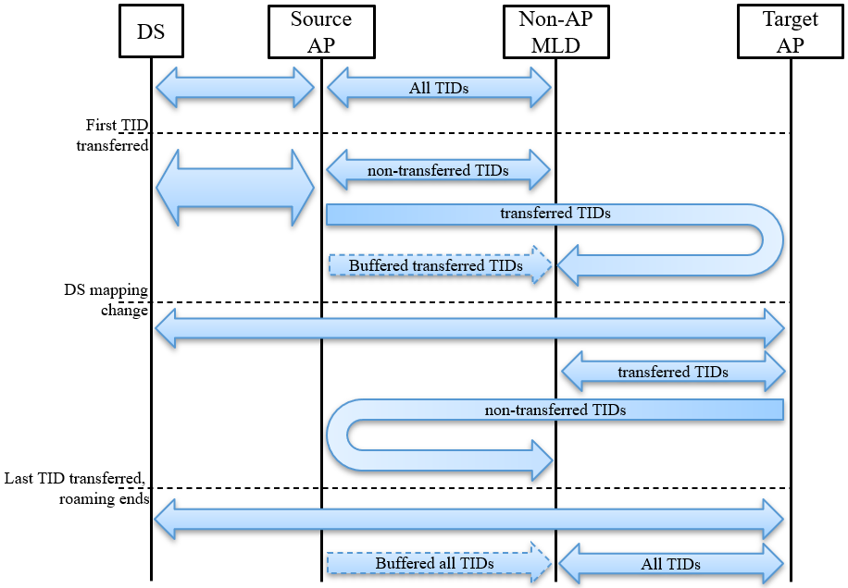
Data flows
The following diagram shows the data flows, when “DS mapping change” is before “last TID transferred”
  For example, a DS mapping change
  before the last TID is transferred may
  make sense when half of the TIDs have
  been transferred
    If TIDs are equally used, the DS load due
    to data forwarding is minimized

Slide 12
SP #1
Do you agree to add the following to the SFD?
As part of the seamless roaming procedure, the context information is transferred per TID from the current to the target AP MLD.

Slide 13
SP #2
Do you agree to add the following to the SFD?
As part of the seamless roaming procedure, during roaming,
the target AP MLD may forward uplink data to the current AP MLD.
- when and how to initiate the forwarding of uplink data is TBD.

Slide 14
SP #3
Do you agree to add the following to the SFD?
As part of the seamless roaming procedure, if the context information is transferred per TID from the current to the target AP MLD.
- The AP MLD which is connected to the DS (AP1) forwards DL data units to the AP MLD which is not connected to the DS (AP2) for TIDs that have been transferred to AP2.
- The AP MLD which is not connected to the DS (AP2) forwards UL data units to the AP MLD which is connected to the DS (AP1).

