Slide 1
Context transfer per TID for seamless roaming
Date: 2024-11-08
Authors:
Name | Affiliations | Address | Phone | email
Thomas Handte | Sony Group Corporation |  |  | Thomas.Handte@sony.com
Yusuke Tanaka |  |  |  | Yusuke.YT.Tanaka@sony.com
Dana Ciochina
Daniel Verenzuela
Ken Tanaka
Kosuke Aio
Ryuichi Hirata
Qing Xia

Slide 2
Introduction
Seamless roaming has been addressed in numerous contributions e.g. [1-7]
Submissions address architecture, data flow, context transfer, and security aspects
Four SFD entries capture the current consensus on seamless roaming operation [8]
In order to make the roaming truly seamless, its critical phase needs to be carefully considered
The critical phase …
… starts with initiation of the context transfer, and
… ends after the DS mapping changed to target AP
During this time span, the data service to/from a non-AP MLD is limited
Only buffered downlink (DL) data can be conveyed to the non-AP MLD
No uplink (UL) data can be conveyed to source or target AP
This submission addresses context information and its separation
A context transfer per TID can limit the impact of the critical phase
… contributing to enhanced user experience

Slide 3
Context information
The information within the context is not yet defined
Context information may be divided into a rather static and a dynamic part [1-7]
It seems reasonable to include
PMK/PTK [3]
Agreements (e.g. BAck, SCS, TWT) [3, 5]
Packet number [1]
Sequence number [1, 4]
BAck context [3, 4]
Content of transmit or reorder buffer may be useful [6 - 8]
The context information above is
Valid for all TIDs but rather static (e.g. PTK, agreements), or
TID specific (e.g. sequence number, BAck context, transmit and receive buffer), or
evaluated per TID (packet number)

Slide 4
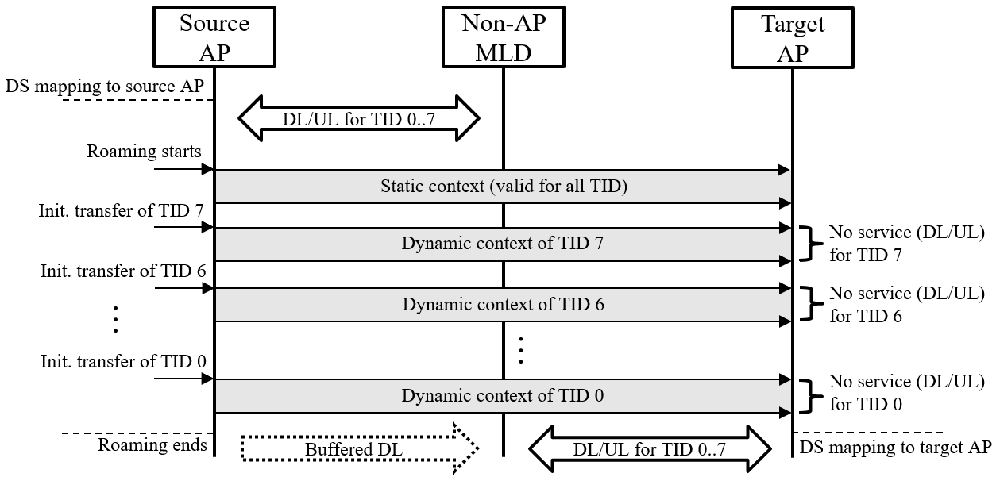
Context transfer per TID
Initially, static context is transferred
Includes PTK, agreements, PN
PN space may be split into lower and higher part; lower/ higher part stays with source/ target AP [1]
Subsequently, dynamic context is transferred per TID
Order of transferred TIDs and/or context aggregation of several TIDs can be optimized and is implementation dependent
For example,
high priority TIDs can be transferred first
TIDs with currently empty buffer can be transferred first
There is no DL/UL data service for the currently transferred TID
except buffered DL

Slide 5
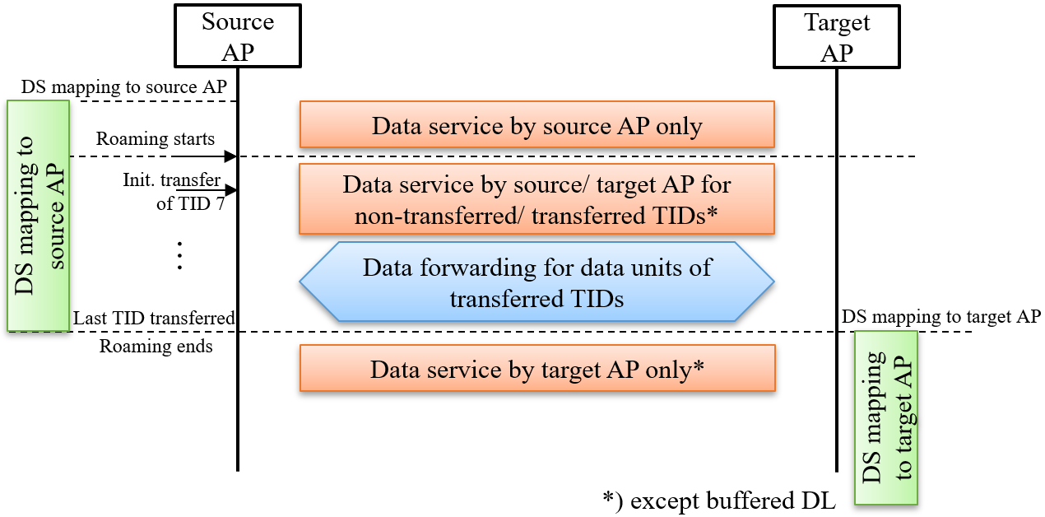
DS mapping and data forwarding
DS mapping
Initially DS mapping is to source AP and stays with source AP even though the dynamic context of a TID has been transferred
Data forwarding
While DS mapping is with source AP, data units of those TIDs whose context has been transferred to target AP …
… are forwarded from source to target AP in downlink (DL)
… are forwarded from target to source AP in uplink (UL)
While DS mapping is with source AP, data units of those TIDs whose context has not been transferred to target AP are normally processed

Slide 6
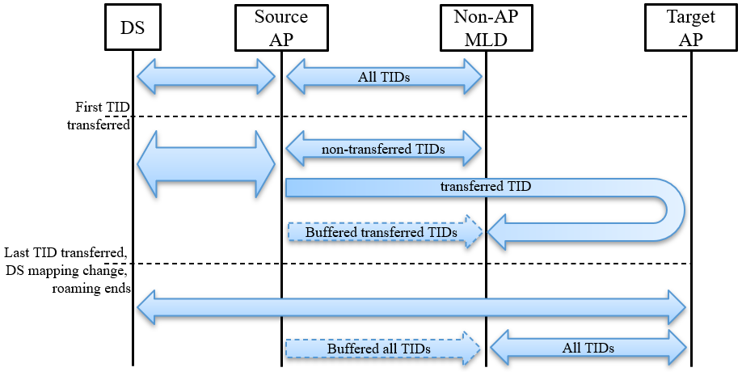
Data flows
The data flow to/from non-AP MLD depends on
DS mapping, used TID, and status of the TID (transferred to target AP or not)
Note that
Buffered DL data can be served by source AP at any time
DS mapping change can happen before the last TID is transferred (example see Appendix)
The data flow is
(before first TID is transferred) DS ⬄ source AP ⬄ non-AP MLD
(after first TID is transferred) DS ⬄ source AP ⬄ non-AP MLD for non-transferred TIDs or DS ⬄ source AP ⬄ target AP ⬄ non-AP MLD for transferred TIDs
(after DS mapping change) DS ⬄ target AP ⬄ non-AP MLD

Slide 7
Benefits
Data service interruption during roaming is just for one TID, not for all
The information fragments transferred during context transfer are smaller
Service interruption for one TID is shorter compared to all TID transfer
Roaming is future-ready i.e., two APs can serve a non-AP MLD at same time
For the application of seamless roaming, this state is only transient
Data forwarding just applies during a transient phase
Thus, the DS load is only increased while not all TIDs are transferred
Afterwards, the DS mapping is changed, and DS load is back to normal
Adjust context transfer to buffer status of certain TIDs
Transferring TIDs with empty buffer saves time for emptying or forwarding the buffer content

Slide 8
Conclusion
Context transfer is the critical phase in seamless roaming
During this phase data service to/ from non-AP MLD is limited which degrades user experience
We suggest to implement a TID specific context transfer
Initially (rather) static context is transferred from source to target AP
Subsequently, the dynamic context of each TID is transferred until the entire context is with target AP
DL/UL data service to a non-AP MLD can be maintained during the context transfer for all TIDs except the currently transferred TID
Data service for non-transferred TIDs is provided by the source AP, which is connected to the DS
Data service for transferred TIDs is provided by the target AP, which receives/ forwards data from/ to the source AP connected to the DS
We see significant benefits such as
Quasi uninterrupted data flow during seamless roaming
Future readiness of roaming architecture for applications beyond seamless roaming

Slide 9
References
[1] 11-24/0052 “Seamless Roaming details”
[2] 11-24/1884 “Seamless Roaming”
[3] 11-24/0396 “Seamless roaming within a mobility domain - follow up”
[4] 11-24/0830 “Improve roaming between MLDs follow up”
[5] 11-24/0679 “Thoughts on Functionality and Security Architecture for UHR Seamless Roaming”
[6] 11-24/1528 “Details on data forwarding for seamless roaming”
[7] 11-24/1820 “UL Data Continuity Improvement for Seamless Roaming”
[8] 11-24/0209 “Specification Framework for TGbn”

Slide 10
Appendix

Slide 11
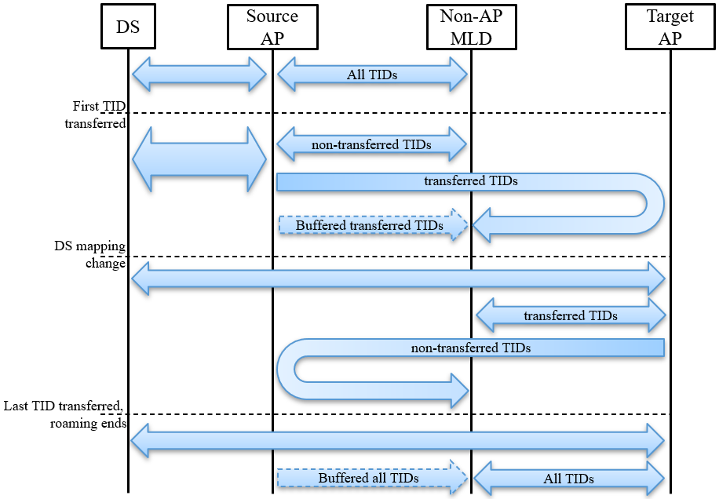
Data flows
The following diagram shows the data flows, when “DS mapping change” is before “last TID transferred”
For example, a DS mapping change before the last TID is transferred may make sense when half of the TIDs have been transferred
If TIDs are equally used, the DS load due to data forwarding is minimized

Slide 12
SP #1
Do you agree to add the following to the SFD? As part of the seamless roaming procedure, during roaming,
the target AP MLD may forward UL data to the current AP MLD.
- when and how to initiate the forwarding of UL data is TBD.

Slide 13
SP #2
Do you agree to add the following to the SFD? As part of the seamless roaming procedure, the context information is transferred per TID from the current to the target AP MLD.

Slide 14
SP #3
Do you agree to add the following to the SFD? As part of the seamless roaming procedure, if the context information is transferred per TID from the current to the target AP MLD. - The AP MLD which is connected to the DS (AP1) forwards DL data units to the AP MLD which is not connected to the DS (AP2) for TIDs that have been transferred to AP2. - The AP MLD which is not connected to the DS (AP2) forwards UL data units to the AP MLD which is connected to the DS (AP1).

