Slide 1
Frame Exchange Sequences for In-Device Coexistence
Date: 2024-11-08
Authors:

Slide 2
Introduction
TGbn has agreed to define a mechanism for reporting unavailability as follows: [1]
11bn defines a mechanism for a non-AP STA to report unavailability at TXOP level and define or reuse/update existing mechanism for a non-AP STA to report long term (periodic) unavailability
Signaling details have been defined in TGbn D0.1 (37.11):
For periodic unavailability operation (PUO) mode
Reusing P2P TWT signaling
For dynamic unavailability operation (DUO) mode
Unavailability start time/duration are reported via ICF, ICR and CRF
i.e., via BSRP TF and Multi-STA BlockAck
In this contribution, we discuss:
Medium synchronization recovery procedure after the end of the unavailable period
Management of the frame exchange sequences to provide opportunities for unavailability reporting

Slide 3
Problem 1: Medium access recovery after unavailable period
If a DUO/PUO non-AP STA is unable to perform CCA on the primary 20 MHz subchannel during its unavailable period, the non-AP STA loses medium synchronization
Similar to a STA operating on an NSTR/EMLSR link pair
A DUO/PUO non-AP STA that has lost medium synchronization needs to recover its medium synchronization before accessing the medium
The medium access recovery procedures in 11be (35.3.16.8) could be applied to the DUO/PUO non-AP STAs
There are two type of medium sync recovery procedures: ED-based recovery & AP assisted recovery
IDC service period (unavailable)
(Periodic or Aperiodic)
Non-AP STA
MediumSyncDelay timer > 0
Initiates MediumSyncDelay timer
Notes:
CCA 말고 보다 정확하게 표현할 방법 고민 (CCA+Rx 안되는 경우? _NAV를 설정못하게 된 경우)

Slide 4
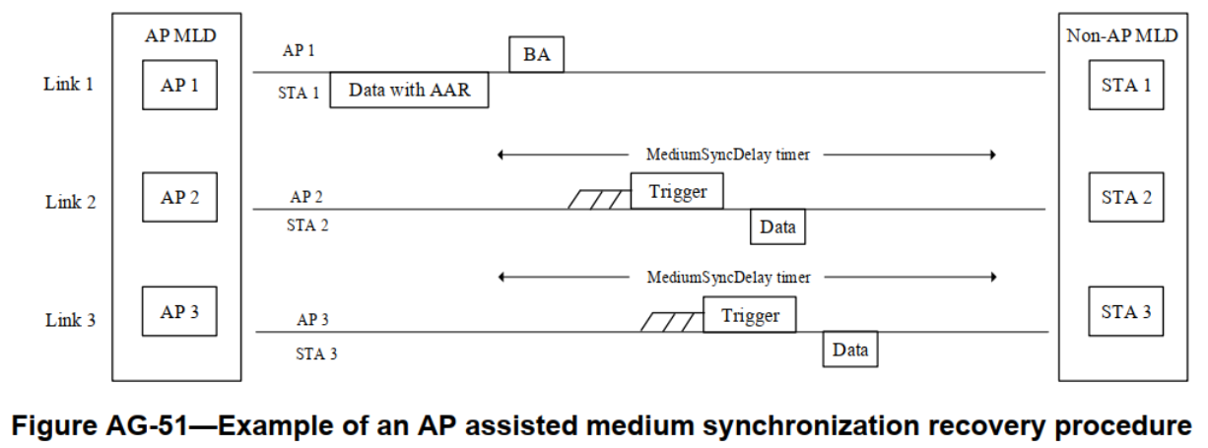
AP assisted medium synchronization recovery
Recap: (35.3.16.8.3) AP assisted medium synchronization recovery procedure
A non-AP MLD can transmit AAR Control subfield through one link to request trigger frame on the other link
The AP MLD should schedule a trigger frame to the requested link by the AAR Control subfield

Slide 5
Enhancements to the AP assisted medium synchronization recovery for the DUO non-AP STA
To enable AP assisted medium sync recovery procedure for DUO non-AP STAs, the request for a trigger frame should be made on the link where the DUO non-AP STA is operating
Since the defined AP assisted medium sync recovery procedure is MLD(cross-link) operation, a DUO non-AP STA that lacks any other non-AP STA affiliated with the same MLD is unable to utilize the AP assisted recovery procedure
Therefore, ICR/CRF transmitted by a DUO non-AP STA needs to include indication for requesting a trigger frame for that DUO non-AP STA
A DUO non-AP STA requests a trigger frame using ICR/CRF carrying unavailability info (e.g., start time & duration)
The AP may then schedule a trigger frame for the DUO non-AP STA after the reported unavailable period ends
Report IDC-related info.
+ TF request
Scheduled TF by the received request
AP
ICF
PPDU
TF
Non-AP STA
ICR
CRF
Unavailable
Data
MediumSyncDelay timer > 0

Slide 6
Problem 2: Unreportable unavailability information
There might be a case where a DUO non-AP STA has prior knowledge of an upcoming aperiodic unavailable period but does not have opportunities to report it until it begins
To prevent the issue described above, the AP should properly manage its frame exchange sequences
i.e., the AP should manage length of the DL PPDUs to ensure that the DUO non-AP STA can respond at least one ICR/CRF before the unavailable period begins
If the AP simply shortening length of its PPDU for this purpose, network efficiency would degrade
Therefore, the AP should manage length of its PPDU based on the capabilities of the recipient non-AP STA(s)
AP
ICF
Long PPDU
(re-Tx) Long PPDU
Non-AP STA
ICR
Unavailable
No IDC-related info.
t
IDC info is obtained internally
(will be unavailable from t)

Slide 7
Providing opportunities for unavailability reporting
Each STA may have different capabilities in acquiring its unavailability information in advance
The timing of acquiring unavailability information may vary depending on the implementation and the source of IDC interference
Therefore, a DUO non-AP STA should indicate its capability to acquire unavailability information in advance
An AP adjust the length of DL PPDUs based on the indicated capability as follows:
If a recipient STA has indicated that it can acquire unavailability information at least x ms before the unavailable period begins, the AP should manage its DL PPDU length to ensure that at least one CRF (M-BA) is solicited within x ms
(Managed length)
AP
ICF
DL PPDU
CF-End
No IDC-related info.
Report IDC-related info.
Capa. Info.
(x ms)
ICR
CRF
Unavailable
Non-AP STA
< x ms
t
x ms
IDC info is obtained internally
(will be unavailable from t)

Slide 8
Providing opportunities for unavailability reporting (cont’d)
If a DUO non-AP STA with a pre-acquisition capability of x ms responds with "No-IDC", its AP can confirm that the DUO non-AP STA will be available for the next x ms
In other words, when the DUO non-AP STA indicates "No-IDC", the AP obtains information about that DUO non-AP STA's available duration, which is useful for managing the frame exchange sequence
e.g., an AP may skip the ICF/ICR exchange sequence (for acquiring unavailability info.) if the TXOP responder of the new TXOP is expected to be available until the end of the TXOP
New TXOP
Last PPDU of the previous TXOP
Frame exchanges
(w/o ICF/ICR for IDC)
AP
No IDC
‘No IDC’ report is valid
Report IDC-related info.
Non-AP STA
CRF
CRF
Unavailable
x ms

Slide 9
Summary
Medium synchronization recovery
A non-AP STA that has lost medium synchronization during its unavailable period needs to recover medium synchronization
Reusing the AP assisted medium sync recovery procedure defined in 11be for the DUO non-AP STAs could be considered
Unreportable unavailability information
The AP should ensure that the DUO non-AP STA can respond at least one ICF/CRF before the unavailable period begins
To achieve this, a DUO non-AP STA should inform the AP of how early it can acquire unavailability information

Slide 10
Straw Poll 1
Do you agree to add the following to the TGbn SFD?
A STA that has lost medium synchronization during its unavailable period shall recover medium synchronization before accessing the medium.
Reuse/update existing mechanisms in 35.3.16.8 for the STAs operating in the DUO/PUO mode.

Slide 11
Straw Poll 2
Do you agree to add the following to the TGbn SFD?
A non-AP STA supporting DUO mode indicates to the DUO supporting AP its capability to acquire unavailability information in advance.
The DUO supporting AP should manage frame exchange sequences within its TXOP to ensure that a non-AP STA operating in DUO mode can report its acquired unavailability information before becoming unavailable.

Slide 12
References
[1] 11-24/0209 Specification Framework for TGbn
[2] 11-23/1964 Coexistence Protocols for UHR
[3] 11-23/2002 In-device coexistence and interference follow-up
[4] 11-24/0420 Enabling Flexible Coexistence Operation
[5] 11-24/0494 in-device coexistence follow up
[6] 11-24/0543 Coexistence Protocols for UHR – follow up
[7] 11-24/0834 Some Details on In-Device Coexistence
[8] 11-24/0856 Further Discussions on In-Device Coexistence
[9] 11-24/1109 More consideration for in-device-coexistence
[10] 11-24/1170 Further Considerations on In-Device Coexistence
[11] 11-24/1247 ICF ICR Design For Coex
[12] 11-24/1504 Considerations on Aperiodic In-device Coexistence
[13] 11-24/1558 In Device Coexistence-Follow Up
[14] 11-24/1559 In-device-coexistence next steps
[15] 11-24/1562 in-device coexistence follow up

