Slide 1
Frame Exchange Sequences for
In-Device Coexistence
Date: 2024-11-08
Authors:

Slide 2
Introduction
TGbn has agreed to define a mechanism for enhancing IDC as follows: [1]
  11bn defines a mechanism for a non-AP STA to report unavailability at TXOP level and define or reuse/update existing mechanism for a non-AP STA to report long term (periodic) unavailability
Some signaling details for IDC are under discussions: [2-15]
  For long term (periodic) IDC
    Reusing P2P TWT signaling
  For TXOP level (aperiodic) IDC
    IDC start time/duration signaling using ICR and CRF (Multi-STA BlockAck)
In this contribution, we discuss:
  Medium synchronization recovery procedure for a non-AP STA w/ IDC interference
  Management of the frame exchange sequences for a non-AP STA w/ IDC interference

Slide 3
Problem 1: Medium access recovery after IDC
If a non-AP STA is unable to perform CCA on the primary 20 MHz subchannel due to an IDC-related issue, the non-AP STA loses medium synchronization
  Similar to a STA operating on an NSTR/EMLSR link pair
A non-AP STA that has lost medium synchronization due to the IDC-related problems needs to recover its medium synchronization before accessing the medium
  The medium access recovery procedures in 11be (35.3.16.8) could be applied to the non-AP STAs with IDC-related problems
    There are two type of medium sync recovery procedures: ED-based recovery & AP assisted recovery
IDC service period (unavailable)
(Periodic or Aperiodic)
Non-AP STA
MediumSyncDelay timer > 0
Initiates MediumSyncDelay timer
Notes:
CCA 말고 보다 정확하게 표현할 방법 고민 (CCA+Rx 안되는 경우? _NAV를 설정못하게 된 경우)

Slide 4
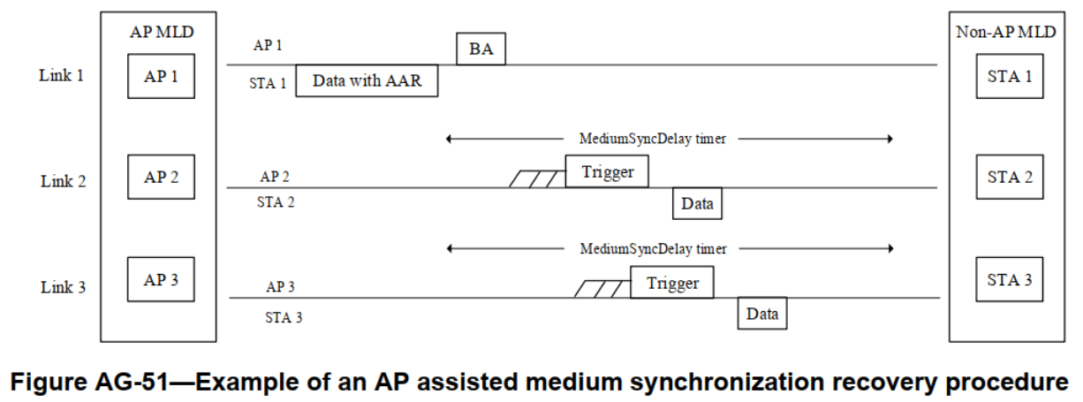
AP assisted medium synchronization recovery for IDC
Recap: (35.3.16.8.3) AP assisted medium synchronization recovery procedure
  A non-AP MLD can transmit AAR Control subfield through one link to request trigger frame on the other link
  The AP MLD should schedule a trigger frame to the requested link by the AAR Control subfield

Slide 5
Enhancements for the AP assisted medium synchronization recovery for IDC
To enable AP assisted medium sync recovery procedure for a non-AP STA after IDC, the request for a trigger frame should be made on the link where the non-AP STA is operating
  Since the defined AP assisted medium sync recovery procedure is MLD(cross-link) operation, a non-AP STA that lacks any other non-AP STA affiliated with the same MLD is unable to utilize the AP assisted recovery procedure
Therefore, ICR/CRF transmitted by a non-AP STA w/ IDC needs to include indication for requesting a trigger frame for the non-AP STA
  A non-AP STA requests a trigger frame using ICR/CRF carrying IDC info (e.g., start time & duration)
  The AP can schedule a trigger frame for the non-AP STA after the indicated IDC duration ends
Report IDC-related info.
+ TF request
Scheduled TF by the received request
AP
ICF
PPDU
TF
Non-AP STA
ICR
CRF
Unavailable
Data
MediumSyncDelay timer > 0

Slide 6
Problem 2: Unreportable IDC information
There might be a case where a non-AP STA has prior knowledge of an upcoming aperiodic unavailability duration but does not have opportunities to report it until it begins
To avoid the above scenario, the AP should properly manage frame exchange sequences
  i.e., the AP should manage length of the DL PPDUs to ensure that the non-AP STA can respond at least one ICR/CRF frame before the unavailability period begins
    If the AP simply shortening length of its PPDU for this purpose, network efficiency would degrade
    Therefore, the AP should manage length of its PPDU based on the capabilities of the recipient non-AP STA(s)
AP
ICF
Long PPDU
(re-Tx) Long PPDU
Non-AP STA
ICR
Unavailable
No IDC-related info.
t
IDC info is obtained internally
(will be unavailable from t)

Slide 7
Providing IDC info reporting opportunities
Each STA may have different capabilities in acquiring IDC information in advance
  The timing at which IDC information is acquired in advance may vary depending on the implementation and source of the IDC interference
  Therefore, a non-AP STA having aperiodic IDC-related interference should inform its capability on acquirement of IDC information in advance
An AP adjust the length of DL PPDUs based on the indicated capability as follows:
  If a recipient STA indicate that it can acquire IDC information at least x ms before the IDC starts
  The AP manage its DL PPDU length to ensure soliciting at least one CRF (M-BA) within x ms
(Managed length)
AP
ICF
DL PPDU
CF-End
No IDC-related info.
Report IDC-related info.
Capa. Info.
(x ms)
ICR
CRF
Unavailable
Non-AP STA
< x ms
x ms
IDC info is obtained internally
(will be unavailable from t)

Slide 8
Providing IDC info reporting opportunities (cont’d)
If a non-AP STA with a pre-acquisition capability of x ms responds with "No-IDC," its AP can confirm that the non-AP STA will not experience any IDC issues for the next x ms
  In other words, when the non-AP STA indicates "No-IDC," the AP obtains information about that non-AP STA's available duration, which is useful for managing the frame exchange sequence
    e.g., an AP may skip the ICF/ICR exchange sequence (for acquiring IDC info.) if the TXOP responder of the new TXOP is expected to be available until the end of the TXOP
New TXOP
Last PPDU of the previous TXOP
Frame exchanges
(w/o ICF/ICR for IDC)
AP
No IDC
‘No IDC’ report is valid
Report IDC-related info.
Non-AP STA
CRF
CRF
Unavailable
x ms

Slide 9
Summary
Medium synchronization recovery
  A non-AP STA that has lost medium synchronization due to IDC-related interference needs to recover medium synchronization based on 11be
  Reusing the AP assisted medium sync recovery procedure defined in 11be for the non-AP STAs having IDC-related problems could be considered
Unreportable IDC information
  The AP should ensure that the non-AP STA can respond at least one ICF/CRF frame before the unavailability period begins
  To do that, a non-AP STA experiencing aperiodic IDC-related issues should inform the AP in advance of its capability to acquire IDC information ahead of time

Slide 10
Straw Poll 1
Do you agree that a STA that has lost medium synchronization during its unavailability period should recover medium synchronization before accessing the medium?

Slide 11
Straw Poll 2
Do you agree that an AP should manage frame exchange sequences of its TXOP to ensure that a non-AP STA can report its known unavailability information if it is expected to occur within the TXOP ?

Slide 12
References
[1] 11-24/0209 Specification Framework for TGbn
[2] 11-23/1964 Coexistence Protocols for UHR
[3] 11-23/2002 In-device coexistence and interference follow-up
[4] 11-24/0420 Enabling Flexible Coexistence Operation
[5] 11-24/0494 in-device coexistence follow up
[6] 11-24/0543 Coexistence Protocols for UHR – follow up
[7] 11-24/0834 Some Details on In-Device Coexistence
[8] 11-24/0856 Further Discussions on In-Device Coexistence
[9] 11-24/1109 More consideration for in-device-coexistence
[10] 11-24/1170 Further Considerations on In-Device Coexistence
[11] 11-24/1247 ICF ICR Design For Coex
[12] 11-24/1504 Considerations on Aperiodic In-device Coexistence
[13] 11-24/1558 In Device Coexistence-Follow Up
[14] 11-24/1559 In-device-coexistence next steps
[15] 11-24/1562 in-device coexistence follow up

