Slide 1
UHR ELR Design Open Topics
Date: 2024-11
Authors:

Slide 2
Introduction
ELR preamble design is proposed in [1] to improve packet detection
In ELR PPDU, STA boosts L-STF and L-LTF by 3 dB
For UL, non-AP STA corrects CFO before transmission
The residual CFO requirement is TBD
ELR data encoding rate matching is proposed in [2]
Pre-FEC padding is fixed to end of OFDM symbol, i.e. a_factor = 4
PE value is undetermined

Slide 3
How to Define Residual CFO Limit?
For UL TB PPDU, residual CFO error of 350 Hz measured at -60dBm was defined based on
Multi-user Rx performance
Achievability of Trigger frame CFO estimation accuracy at -60dBm with immediate response
Similarly, ELR residual CFO error to be defined on
ELR Rx performance requirement
ELR Tx pre-compensation feasibility

Slide 4
ELR Residual CFO
In [1], the ELR Rx performance is evaluated from 15KHz to 150KHz with the loss is 0.07dB to 2dB
15kHz is a good value with negligible impact
15kHz CFO estimation error is achievable at MCS 0 sensitivity point
measured at the 10% point of the complementary cumulative distribution function (CCDF)

Slide 5
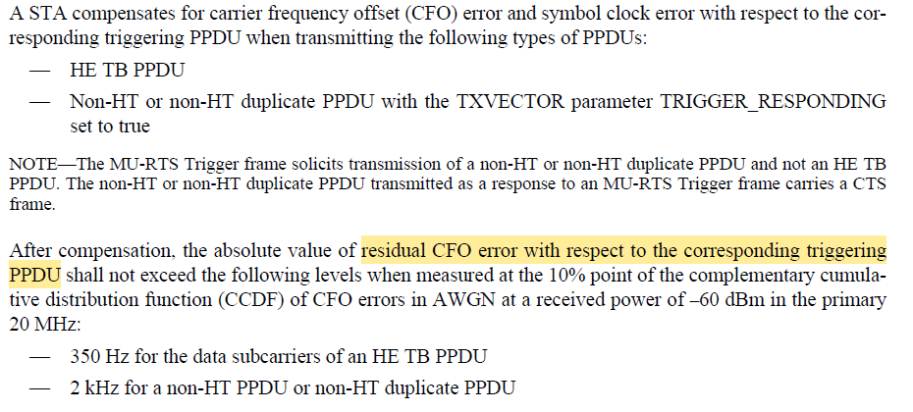
UL TB CFO pre-comp
Residual CFO error is defined with respect to triggering frame
SIFS before transmission of TB PPDU or MU-CTS

Slide 6
ELR CFO pre-comp
Two key items needs to be specified for CFO pre-compensation
Reference PPDU (where CFO is estimated)
Residual CFO value (when ELR Tx starts)
The ELR CFO reference PPDU
For ELR-CTS, ELR-ACK/BA, there is immediate preceding PPDU
STA initiated ELR transmission will not have specific immediately preceding PPDU
SIFS
TF
UL TB PPDU
~100ms or longer
Beacon
DL Data
…
Beacon
…
UL ELR

Slide 7
ELR CFO pre-comp (Cont.)
For STA initiated ELR Tx, the interval from last CFO estimate till the ELR Tx varies in wide range
Beacon: ~100ms
Interference case, may miss some beacon intervals
Data traffic interval varies depending on traffic load
Sleep operation: can be long at second/minutes/hours level
Wait for another beacon before any Tx?
Other cases: eMLSR, dual-role devices, etc.
At both AP and STA, crystal and LO may drift with temperature.
ELR STA may not guarantee to meet the residual CFO requirement across TXOPs for all scenarios

Slide 8
Proposal
Define ELR CFO pre-compensation requirement for the case of immediate response frame using ELR
Similar to UL TB PPDU definition
Specify the requirement as
15kHz residual CFO error at MCS 0 sensitivity (-82dBm)
For non-AP STA initiated ELR Tx, the STA will also try to meet the same requirement.
Note: in cases that the requirement is not met, it may impact AP’s Rx of the STA’s ELR PPDU Tx

Slide 9
T_PE for ELR
L-STF | LLTF
L-SIG | RL-SIG
U-SIG
ELR-Mark
UHR-STF
UHR-LTF | ELR-SIG | Data | T_PE
[2] propose simplified ELR encoding procedure to fix a_factor = 4
PE was defined since 11ax to accommodate Rx turnaround time need and the T_PE value is dependent on a_factor.
With fixed a_factor of 4, can fix T_PE definition too.
Suggest to define T_PE = 8us to accommodate more Rx support
two rates (MCS 0 and 1) for ELR

Slide 10
Summary
ELR Tx CFO pre-compensation accuracy definition to specify for immediate response frame in ELR
ELR to defined fixed T_PE of 8us.

Slide 11
SP1
Do you agree to add the following text to Section 38.3.19.2 (Pre-correction accuracy requirements) of the PDT 11-24/1981r3, and also reflect the changes in D0.1?
For the ELR PPDU carrying immediate response frame in response to a preceding soliciting frame, after compensation, the absolute value of residual CFO error with respect to the preceding PPDU carrying soliciting frame shall not exceed 15 kHz at the 10% point of the complementary cumulative distribution function (CCDF) of CFO error in AWGN at a received power of -82 dBm in the primary 20 MHz channel.

Slide 12
SP2
Do you agree to replace the TBD to 8us for the PE block in the Figure 38-xx (UHR ELR PPDU format) in Section 38.3.6 (UHR PPDU formats) in the PDT 11-24/1981r3, and also reflect the changes in D0.1?
Note: the PE value applies for UHR ELR PPDU.

Slide 13
Reference
[1] 11-24/573, An-elr-ppdu-follow-up
[2] 11-24/1590, Extended-long-range-signaling

