Slide 1
Considerations on Coordinated NPCA
Date: 2024-11-11
Authors:
Name | Affiliations | Address | Phone | Email
Mahmoud Hasabelnaby | Huawei |  |  | Mahmoud.Hasabelnaby@huawei.com
Osama Aboul-Magd
Jung Hoon Suh
Yan Xin
Sara Norouzi
Notes:
September 2012

Slide 2
Abstract
In this contribution, we propose a coordinated NPCA mechanism that enable efficient OBSS interference management.

Slide 3
Background (1/2): NPCA Primary Channel
To meet throughput and latency requirements and further utilize the channel and manage OBSS interference, non-primary channel access (NPCA) was proposed as a potential method [1].
NPCA was proposed in several contributions [2-12] with different problem statement, design principles, high-level concepts, and several options.
Although there are differences in the details of the proposals, there is an alignment on a high-level concept to enable non-primary channel access while the primary channel is busy.
AP announces the location and bandwidth of the NPCA primary channel to its associated non-AP UHR STAs.
frequency
Potential NPCA operation
NPCA primary channel (P2)
BSS Primary channel (P1)
time

Slide 4
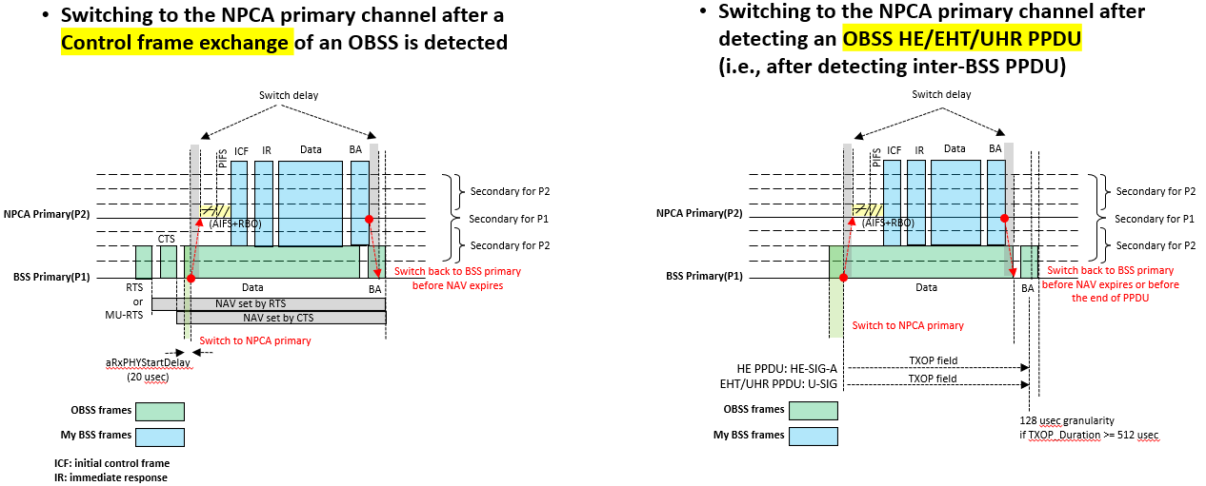
Background (2/2): Recap [24/495r0] Switching to NPCA primary channel

Slide 5
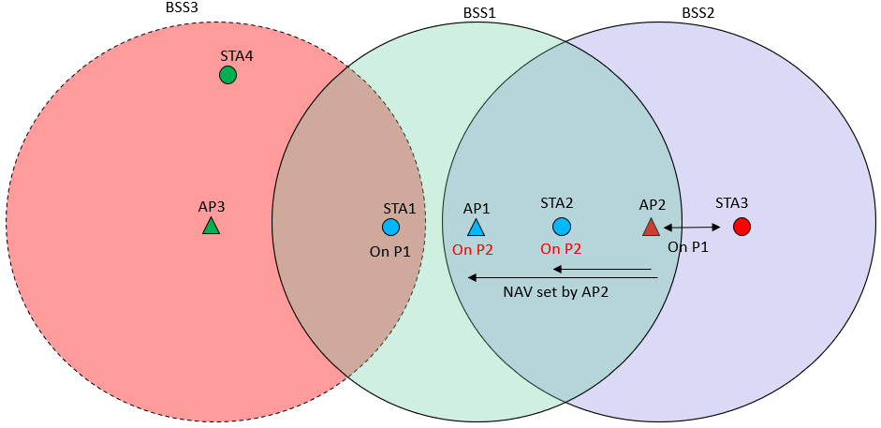
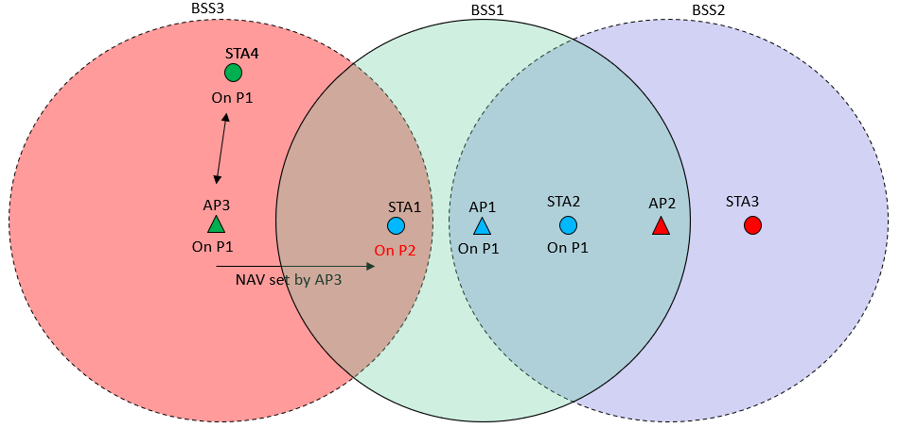
NPCA Identified Issues (1/2)
The lack of coordination between APs and their associated STAs renders NPCA unreliable and inefficient in many scenarios [3-5].
Not all NPCA-enabled STAs in the BSS will transit to the NPCA primary channel, e.g. hidden AP/non-AP STAs are unable to detect interference from neighboring OBSSs.
Case 1: AP1 on the NPCA primary channel while STA1 is still on primary channel.
Case 2: STA1 on the NPCA primary channel while AP1 is still on primary channel.
Case 1
Case 2

Slide 6
NPCA Identified Issues (2/2)
UHR non-AP STAs with NPCA-enabled capability that detect an OBSS interference may switch to the NPCA primary channel and remain there, regardless of their immediate communication needs, then switch back to their primary channel at the end of the OBSS TXOP duration [7].
Unnecessary channel switching may lead to excessive power consumption.
While an OBSS transmission is being detected on the primary channel, another OBSS transmission takes place on the NPCA primary channel at the same time [5].
This can happen when multiple OBSSs have overlapping NPCA primary channel locations.

Slide 7
Proposal: Coordinated NPCA
Inter-BSS coordination between APs within OBSSs and Intra-BSS coordination between APs and their associated non-AP STAs can help resolve various NPCA challenges.
In this contribution, we propose a coordinated NPCA scheme, as discussed next.
Inter-BSS NPCA Coordination
Intra-BSS NPCA Coordination
Co-NPCA TXOP Sharing

Slide 8
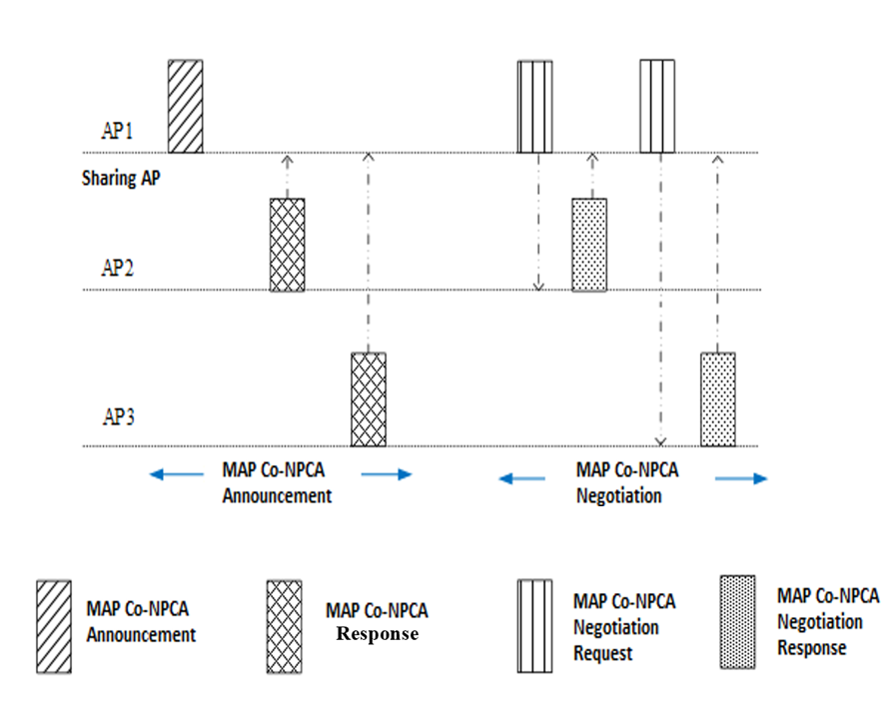
Inter-BSS NPCA Coordination: MAP Co-NPCA (1/3)
MAP Co-NPCA announcement: During this phase, the coordinating AP identifies other APs in neighboring OBSSs that are willing to participate in NPCA coordination.
The respective NPCA parameters for each AP (e.g., NPCA primary channel location and bandwidth, BSS operating bandwidth, …, etc.) can be exchanged during this phase.
If a neighboring AP is willing and prepared to participate in the NPCA coordination, it can inform the coordinating AP by responding to the Co-NPCA announcement received from the coordinating AP.
This phase essentially forms a NPCA coordination group.

Slide 9
Inter-BSS NPCA Coordination: MAP Co-NPCA (2/3)
MAP Co-NPCA Negotiation: During this phase, NPCA parameters for the NPCA coordination group are decided among the participating APs.
The coordinating AP can send an NPCA coordination request to other APs in the NPCA coordination group, along with recommended NPCA parameters for the participating APs if needed.
This ensures that each AP in the NPCA coordination group operates on an NPCA primary channel with minimal risk of OBSS interference, especially when neighboring OBSS networks are simultaneously using their own NPCA primary channels.
Upon receiving the request, the participating AP can either accept/reject the request or suggest an alternative set of NPCA parameters.

Slide 10
Intra-BSS NPCA Coordination
Since the BSS is part of NPCA coordination group, the associating AP announces to its associated STAs that the event triggering STAs switching to the NPCA primary channel is upon being triggered by the associating AP.
This solves the hidden node problem.
The associating AP has to (re)announce the location and bandwidth of the NPCA primary channel to all UHR non-AP STAs within its BSS (if updated).

Slide 11
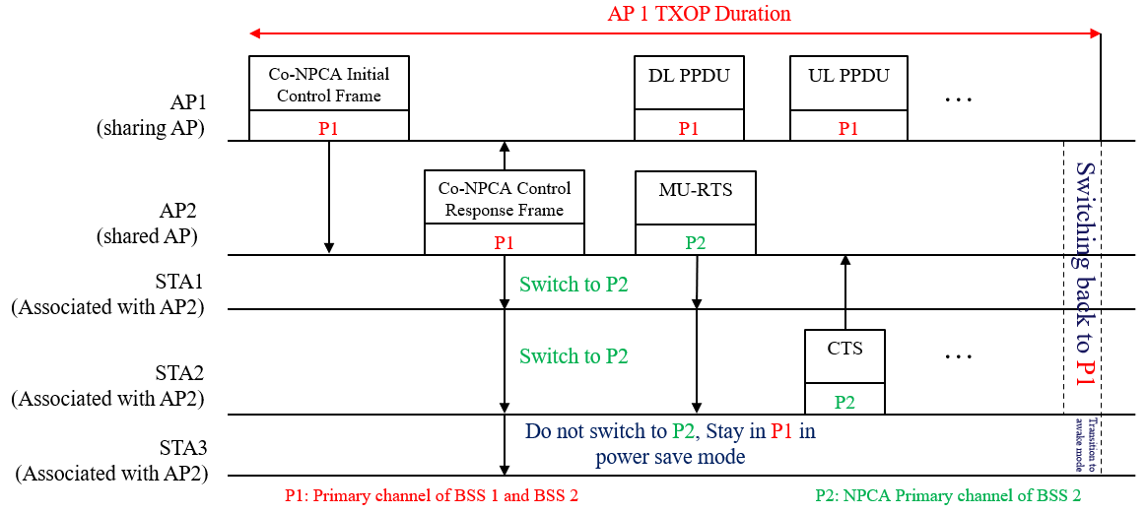
Co-NPCA TXOP Sharing
Once of one of APs in the NPCA coordination group obtains a TXOP, it shares it with other participating APs included in the NPCA coordination group by sending a Co-NPCA initial control frame to promote them to switch to their respective NPCA primary channels.
The shared AP will trigger its associated non-AP STAs to switch to the NPCA primary channel.
This solves the hidden node problem.
The design of the control response frame will promote some or all of the associated UHR STAs to transit to the NPCA primary channel based on the immediate communications needs and NPCA duration.
This saves unnecessary power consumption by avoiding unnecessary channel switching.

Slide 12
Summary
The lack of coordination among APs and their associated STAs in OBSSs makes NPCA unreliable and inefficient.
Not all NPCA-enabled STAs will switch to the NPCA primary channel, especially hidden STAs that can't detect interference from neighboring OBSSs.
There is a possibility to have multiple OBSSs with overlapping NPCA primary channels, causing interference when they switch to their NPCA primary channel simultaneously.
Additionally, unnecessary NPCA primary channel switching, resulting in unnecessary power consumption.
Coordination among APs in the OBSSs and AP and its associated STAs can address the aforementioned NPCA challenges.
We proposed a Coordinated NPCA mechanism, in which:
A group of APs in OBSSs forms an NPCA coordination group, in which they agree on the NPCA parameters for each OBSS.
Once one of APs obtains a TXOP, it shares it with other APs included in the NPCA coordination group by sending a Co-NPCA control frame to trigger them to switch to their respective NPCA primary channels.
The shared AP will respond with a Co-NPCA response frame which can be used also as a trigger for its associated STAs to switch to the NPCA primary channel, which solves the hidden node problem.
The design of the response frame will trigger some or all UHR STAs to transit to the NPCA primary channel based on the immediate communications needs, saving unnecessary power consumption by avoiding unnecessary channel switching.

Slide 13
References
11-24/0209r3, “Specification Framework for TGbn,” Ross Jian Yu
11-24/0495r0, “Non-Primary Channel Access (NPCA) – Follow Up,” Minyoung Park
11-23/0495r0, “Non-Primary Channel Access (NPCA),” Minyoung Park
11-24/0318r0, “Robust Secondary Channel Access,” Yanchun Li
11-24/1093r0, “Special scenarios in Non-Primary Channel Access,” Sindhu Verma
11-24/1155r0, “Further discussions on NPCA,” Sanghyun Kim
11-24/1077r0, “Discussions on Non-Primary Channel Access,” Jason Yuchen Guo
11-24/0070r2, “Some details about non-primary channel access,” Yunbo Li
11-24/0486r1, “Some considerations on non-primary channel access,” Ming Gan
11-24/0458r1, “Considerations on Non-Primary Channel Access,” Salvatore Talarico
11-23/2023r1, “Further discussion on Non-Primary Channel Access,” Sindhu Verma
11-23/1891r0, “Nonprimary channel access – follow up,” Gaurang Naik
11-24/0042r0, “Flexible Control Frames,” George Cherian
11-24/1256r1, “The Padding After Intermediate FCS”, Yunbo Li

Slide 14
Straw Poll 1
Do you agree that TGbn should define in the 11bn SFD a Coordinated NPCA (Co-NPCA) procedure for a sharing AP to trigger a set of shared APs to switch to their respective NPCA primary channels when it obtains the TXOP over the primary channel?

Slide 15
Straw Poll 2
Do you agree to include in the 11bn SFD the following in the NPCA operation? – In 802.11bn, the associating AP can trigger its associated non-AP STAs to switch to the NPCA primary channel as one of the triggering events for switching to the NPCA primary channel.

Slide 16
Straw Poll 3
Do you agree to define a mechanism in the 11bn SFD that enables APs in OBSSs to negotiate updating their NPCA primary channel location when their NPCA primary channels overlap?

