Slide 1
Backward Compatible Sounding for CoBF
Date: 2024-11-09
Authors:
Name | Affiliations | Address | Phone | email
Qinghua Li Juan Fang Laurent Cariou Dibakar Das Po-Kai Huang Dmitry Akhmetov Danny Alexander Shlomi Vituri Danny Ben-Ari Carlos Cordeiro | Intel |  |  | Qinghua.li@intel.com

Slide 2
Recap of Sequential Sounding
One AP per channel sounding subsequence [1]
Four subsequences are needed for both AP 1 and AP2
Already supported by EHT
Initiating AP1
NDPA
NDP
BFRP
NDPA
BFRP
NDP
Responding AP2
STA1 of AP1
STA2 of AP2

Slide 3

Recap of Joint Sounding
Two APs per channel sounding [1]
Initiating AP1
NDPA
NDP
BFRP
NDP
Responding AP2
NDP
NDPA
NDP
BFRP
STA1 of AP1
STA2 of AP2

Slide 4
No Change on STA
It is desirable that STA supporting EHT BF sounding/feedback doesn’t need any change to support UHR CoBF sounding/feedback
Reusable EHT components:
  NDP
  MU-MIMO BF report
STA doesn’t have to know from which AP(s) the NDP comes

Slide 5
Some Changes on AP
Initiating AP (iAP) needs to tell responding AP (rAP) by NDPA:
  Participation of the CoBF sounding
  Configuration of the channel sounding field, e.g., EHT LTF
  U-SIG subfield values of the NDP
Specifically, three types of information:
  rAP ID, i.e., an AID the iAP assigned to the rAP
  LTF parameters: P-matrix size, stream allocation, LTF+GI duration
  U-SIG parameters: PHY version identifier, BSS color, BW, punctured channel information
    The U-SIG symbols sent by the iAP and rAP should be the same because they are superimposed over the air

Slide 6
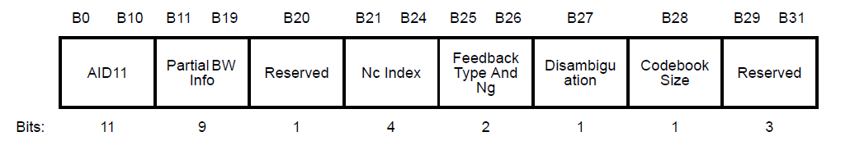
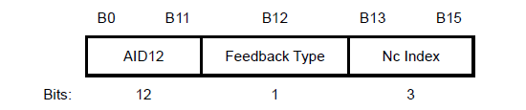
Comparison between VHT and EHT User Info fields
EHT User Info field is self-contained providing all the information the user needs
VHT User Info field doesn’t carry punctured channel information such that modifications are required for supporting CoBF [3]
EHT:
Punctured Channel Info
VHT:
SU/MU

Slide 7
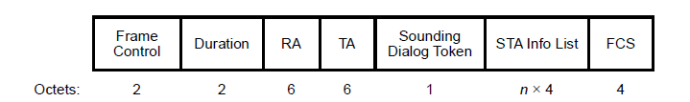
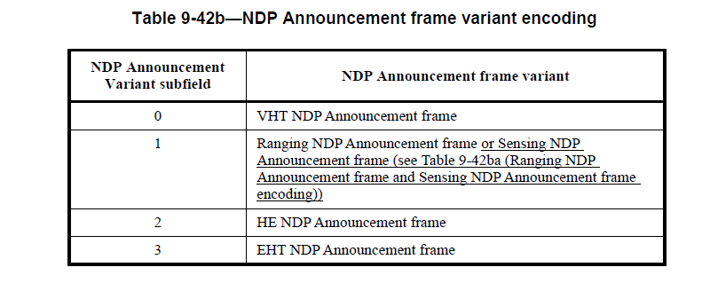
CoBF NDPA Format
CoBF NDPA can share the NDPA Variant indication with EHT NDPA [2]
When iAP requests rAP to join the sounding, the presence of special User Info field with AID11 2047 differentiates CoBF NPDA from EHT NDPA
  Similar approach is used by Sensing NDPA
Information for rAP
AID 2047
…
rAP AID
…
User 1 AID
…
User 2 AID
…
or CoBF NDPA

Slide 8
Special User Info Fields
When the rAP is requested to join the sounding, the first two User Info fields carry the configuration parameters of the sounding LTF symbols and U-SIG in the NDP
The AID11 of the 1st User Info field is set to 2047 and the rAP is identified by the AID11 of the 2nd User Info field
Bit | 0 - 10 | 11 | 12 | 13 | 14 | 15 | 16 | 16 | 17 | 17 | 18 | 18 | 19 | 20 - 26 | 27 | 28 | 29 | 30 | 31
1st User Info field | AID11: 2047 | NDPA Version Identifier |  |  | BSS Color | Number of UHR-LTF Symbols |  |  |  |  |  |  |  | TXOP | Disambiguation | Bandwidth | Sounding type |  | Reserved
2nd User Info field | AID11: AID of responding AP | Punctured Channel Information |  |  |  |  |  | Number of LTF Symbols | Starting Spatial Stream |  | Number of Spatial Streams |  | LTF+GI | Reserved | Disambiguation | Reserved |  | GI+LTF Size | Reserved

Slide 9
Backward Compatibility
For legacy EHT STA,
  Special AID 2047 and rAP’s AIDs are not assigned to normal users
  Normal users don’t need to read User Info fields with unmatched AIDs
  Normal User Info field remains the same as EHT’s
  Beamforming feedback for EHT MU-MIMO is reused

Slide 10
Thoughts about Complexity Reduction
For the ease of CoBF implementation/testing,
  The number of antennas may be restricted to 4 or 8
  The LTF symbol duration may be limited to 2x LTF
  GI may be limited to 0.8 and 1.6 microsecond
  P matrix size may be limited to 4x4 and 8x8

Slide 11
Summary
Proposed an NDPA design for CoBF sounding, which is backward compatible with EHT STA

Slide 12
SP 1
Do you support to add the following to UHR SFD?
NDPA Announcement Variant subfield shall be set to 3 for CoBF NDPA in UHR.
Y: N: A:

Slide 13
SP 2
Do you support to add the following to UHR SFD?
When initiating AP requests responding AP to join CoBF sounding, the information for the responding AP shall be in the first and second User Info fields of the NDPA.
Y: N: A:

Slide 14
SP 3
Do you support to add the following to UHR SFD?
When initiating AP requests responding AP to join CoBF sounding, the format of the first and second User Info fields of the NDPA shall be as follows.
Y: N: A:
Bit | 0 - 10 | 11 | 12 | 13 | 14 | 15 | 16 | 16 | 17 | 17 | 18 | 18 | 19 | 19 | 20 - 26 | 27 | 28 | 29 | 30 | 31
1st User Info field | AID11: 2047 | NDPA Version Identifier |  |  | BSS Color | Number of UHR-LTF Symbols |  |  |  |  |  |  |  |  | TXOP | Disambiguation | Bandwidth | Sounding type |  | Reserved
2nd User Info field | AID11: AID of responding AP | Punctured Channel Information |  |  |  |  |  | Number of LTF Symbols | Starting Spatial Stream |  | Number of Spatial Streams |  | LTF+GI |  | Reserved | Disambiguation | Reserved |  | GI+LTF Size | Reserved

Slide 15
SP 4
Do you support to add the following to UHR SFD?
When the initiating AP requests the responding AP to join the CoBF sounding, the red subfields in the first and second User Info fields of the NDPA shall be set as follows.
  NDPA Version Identifier is set to 0 for CoBF sounding in UHR
  Number of LTF symbols is set to 0 and 1 for 4 and 8 symbols, respectively
  Starting Spatial Stream is set to 0 and 1 for the 1st and 5th streams, respectively
  Number of spatial streams is set to 0 and 1 for the 4 and 8 streams, respectively
  LTF+GI is set to 0 and 1 for 2x LTF+0.8us GI and 2x LTF+1.6us GI, respectively
Y: N: A:
Bit | 0 - 10 | 11 | 12 | 13 | 14 | 15 | 16 | 17 | 18 |  | 19 | 20 - 26 | 27 | 28 | 29 | 30 | 31
1st User Info field | AID11: 2047 | NDPA Version Identifier |  |  | BSS Color |  |  |  |  |  |  | TXOP | Disambiguation | Bandwidth |  |  | Reserved
2nd User Info field | AID11: AID of responding AP | Punctured Channel Information |  |  |  |  | Number of LTF Symbols | Starting Spatial Stream |  | Number of Spatial Streams | LTF+GI | Reserved | Disambiguation | Reserved

Slide 16
Reference
[1] 11-24-1542-00-00bn, Sounding Schemes for Coordinated Beamforming, Sameer Vermani, et al., Qualcomm
[2] 11-24-1865-02-00bn, Universal Sounding and NDPA Signaling, You-Wei Chen, , et al., MediaTek
[3] 11-24-1837-01-00bn, UHR NDPA Signaling, Mahmoud Hasabelnaby, et al., Huawei

Slide 17
Backup

Slide 18
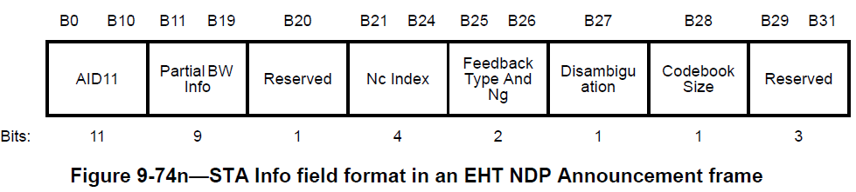

Slide 19
