Slide 1
Trigger Frame Design for UHR
Date: 2024-11-09
Authors:
Name | Affiliations | Email
Alice Chen | Qualcomm | alicel@qti.qualcomm.com
Alfred Asterjadhi |  | aasterja@qti.qualcomm.com
Lin Yang |  | linyang@qti.qualcomm.com
Youhan Kim |  | youhank@qti.qualcomm.com
Sameer Vermani |  | svverman@qti.qualcomm.com
Bin Tian |  | btian@qti.qualcomm.com

Slide 2
Introduction
Two contributions discussed on the Trigger Frame format and expansion for UHR [1-2]
Trigger Frame for UHR needs changes to accommodate the following
  PHY Version Identifier set to 1 for UHR [3]
  4 new MCSs in 11bn [4]
  Longer LDPC codewords including 2x1944 in 11bn [5]
  DRU transmission in UHR TB PPDUs [6-7]
In this presentation, we propose our Trigger Frame design for UHR
Outline
  Signaling changes to accommodate new PHY features
  Trigger Frame format
    Common info field / special user info field / UHR variant user info field

Slide 3
Signaling for New MCS & DRU
New MCS
  To add 4 new MCSs to 11bn, need to expand the UL UHR-MCS subfield from 4 bits to 5 bits
DRU
  Follow same signaling approach as in [8]
    Use one RU Allocation subfield table in UHR trigger frame for both RRU and DRU allocation
    Use a 4-bit bitmap in Common Info field/Special User Info field for DRU or RRU transmission for each 80 MHz frequency subblock
    Re-purpose 2 bits of SS Allocation subfield in the UHR variant user info field for distribution BW indication in the case of DRU
  Based on DRU has no MU-MIMO and supports up to 2ss [9], we propose the following changes to the SS allocation subfield in the case of DRU
    Remove the starting stream index subfield
    Repurpose 1 bit for the number of streams (Nss) indication (1ss or 2ss)
    Leave remaining bits as reserved bits

Slide 4
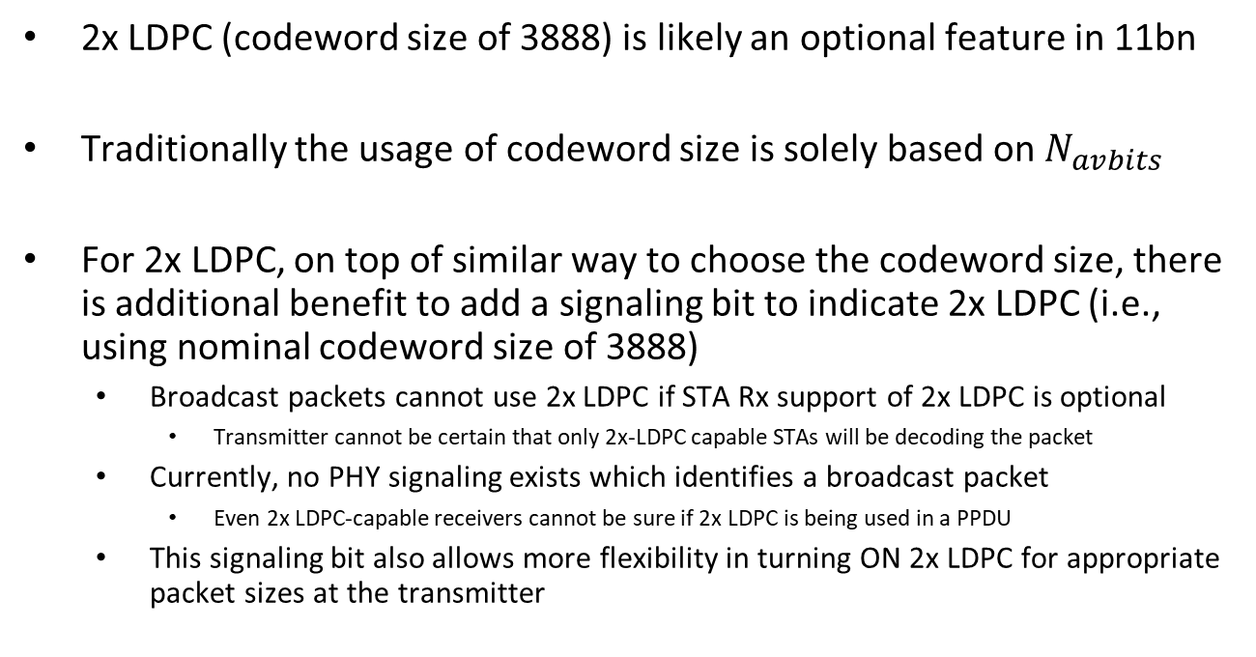
Signaling Discussion for 2x LDPC (1/2)
2x LDPC (codeword size of 3888) is likely an optional feature in 11bn
Traditionally the usage of codeword size is solely based on $N_{avbits}$
For 2x LDPC, on top of similar way to choose the codeword size, there is additional benefit to add a signaling bit to indicate 2x LDPC (i.e., using nominal codeword size of 3888)
  Broadcast packets cannot use 2x LDPC if STA Rx support of 2x LDPC is optional
    Transmitter cannot be certain that only 2x-LDPC capable STAs will be decoding the packet
  Currently, no PHY signaling exists which identifies a broadcast packet
    Even 2x LDPC-capable receivers cannot be sure if 2x LDPC is being used in a PPDU
  This signaling bit also allows more flexibility in turning ON 2x LDPC for appropriate packet sizes at the transmitter

Slide 5
Signaling Discussion for 2x LDPC (2/2)
Signaling design & Rx behavior
  Propose to use 1 bit in user (info) fields to signal the use of the nominal codeword size of 3888 in a PPDU
    If this bit indicates ON, codeword size of 3888 is used in a PPDU
    If this bit indicates OFF, codeword size of 3888 is not used; Rx uses the existing codeword size selection procedure to choose codeword size
Tx Side 2x Codeword Size Selection
  Tx has freedom in choosing the nominal codeword size
  Still want to follow similar way as using the existing codeword size selection table so that Rx doesn’t have to deal with arbitrary usage of 2x LDPC
  Need basic guidelines to use the nominal codeword size of 3888
    If the packet size is smaller than a threshold, 2x LDPC is not used; use the existing codeword size selection to choose codeword size
    If the packet size is larger than the threshold, 2x LDPC may be used

Slide 6
Trigger Frame Format for UHR
Propose to reuse the EHT variant approach, to solicit TB PPDUs of a single post-HE generation
  Use only one special user info field, located immediately after the Common Info field
  Set PHY Version Identifier to 1 for UHR (value 0 is currently used for EHT)
No size change in user info fields
  Our signaling design could fit in current agreed upon new features
 |  |  |  |  |  | User Info List
 |  |  |  |  |  | Only 1 Special User Info field | User Info fields for specific non-AP STAs
 | Frame Control | Duration | RA | TA | Common Info | Special User Info Field (PHY Ver. Id = 1) | User Info Field #1 | … | User Info Field #M | Padding | FCS
Octets: | 2 | 2 | 6 | 6 | 8 or more | 5 or more | 5 or more | variable | 5 or more | variable | 4
Figure A -- Trigger frame format (with a special user info field) for UHR

Slide 7
Trigger Frame Format for UHR (Cont’d)
The Trigger Frame format for UHR contains the following
  UHR variant Common Info field
  Special User Info field (PHY Version Identifier differentiates between UHR and EHT)
  UHR variant User Info field
The UHR variant Common Info field and the UHR variant User Info fields are expected to use the same bit settings for B54, B55 of the Common Info field, and B39 of the User Info field as those of the EHT variant counterparts
The differentiation between EHT variant and UHR variant is expected to be based on the value of the PHY Version Identifier of the Special User Info field
Table B -- Valid combinations of B54 and B55 in the Common Info field, B39 in the User Info field, and solicited TB PPDU format
Common Info field B54 | Common Info field B55 | User Info field B39 | Presence of Special User Info field | User Info field variant | TB PPDU type
1 | 1 | 0 | No | HE variant | HE
0 | 0 | 0 | Yes | EHT/UHR variant | EHT/UHR
0 | 0 | 1 | Yes | EHT/UHR variant | EHT/UHR
1 | 0 | 1 | Yes | EHT/UHR variant | EHT/UHR
1 | 0 | 0 | Yes | HE variant | HE

Slide 8
UHR Variant Common Info Field
The UHR variant Common Info field is largely expected to be like the EHT variant Common Info field except that the 7-bit EHT reserved subfield becomes a 4-bit dRU indication subfield (on a per-80 MHz basis) [8] and a 3-bit UHR Reserved subfield
 | B0 | B3 | B4 | B15 | B16 | B17 | B18 | B19 | B20 | B21 | B22 | B23 | B25
 | Trigger Type |  | UL Length |  | More TF | CS Required | UL BW |  | GI And HE/EHT-LTF Type/Triggered TXOP Sharing Mode |  | Reserved | Number Of HE/EHT-LTF Symbols
Bits: | 4 |  | 12 |  | 1 | 1 | 2 |  | 2 |  | 1 | 3
 | B26 |  | B27 |  | B28 | B33 | B34 | B35 | B36 | B37 | B52 | B53 | B54
 | Reserved |  | LDPC Extra Symbol Segment |  | AP Tx Power |  | Pre-FEC Padding Factor |  | PE Disambiguity | UL Spatial Reuse |  | Reserved | HE/EHT P160
Bits: | 1 |  | 1 |  | 6 |  | 2 |  | 1 | 16 |  | 1 | 1
 | B55 |  | B56 | B59 | B60 | B62 | B63
 | Special User Info Field Flag |  | dRU Indication |  | UHR Reserved |  | Reserved |  | Trigger Dependent Common Info
Bits: | 1 |  | 4 |  | 3 |  | 1 |  | variable
Figure C -- UHR variant Common Info field format

Slide 9
Special User Info Field
Reuse the Special User Info field as defined in EHT
  The AID12 subfield is set to 2007 to indicate that this is a Special User Info field
  Set PHY Version Identifier to 1 for UHR. Values 2-7 are reserved
  The remaining subfields are assumed to be the same as EHT
 | B0 | B11 | B12 | B14 | B15 | B16 | B17 | B20 | B21 | B24 | B25 | B36 | B37 |  | B39
 | AID12 |  | PHY Version Identifier |  | UL Bandwidth Extension |  | EHT/UHR Spatial Reuse 1 |  | EHT/UHR Spatial Reuse 2 |  | U-SIG Disregard And Validate |  | Reserved |  |  | Trigger Dependent User Info
Bits: | 12 |  | 3 |  | 2 |  | 4 |  | 4 |  | 12 |  | 3 |  |  | variable
Modified Figure 9-87d—Special User Info field format

Slide 10
UHR Variant User Info field Design
Propose the following design
  Expand the UL UHR-MCS subfield to 5 bits
  Add a 1-bit 2x LDPC indication
  Reduce the SS Allocation subfield to 5 bits and let it depend on RRU [2] or DRU
 | B0 | B11 | B12 | B19 | B20 | B21 | B25 | B26 | B27 | B31 | B32 | B38 | B39
 | AID12 |  | RU Allocation |  | UL FEC Coding Type | UL UHR-MCS |  | 2x LDPC | SS Allocation |  | UL Target Receive Power |  | PS160 | Trigger Dependent User Info
Bits: | 12 |  | 8 |  | 1 | 5 |  | 1 | 5 |  | 7 |  | 1 | variable
Figure X: UHR variant User Info field format
 | B0 |  | B2 | B3 | B4
 | Starting Stream Index |  |  | Number of Spatial Streams
Bits: | 3 |  |  | 2
 | Figure Y1: SS Allocation subfield format of a UHR variant User Info field in the case of RRU
 | B0 | B1 | B2 | B3 | B4
 | Distribution BW |  | Reserved |  | Number of Spatial Streams
Bits: | 2 |  | 2 |  | 1
 | Figure Y2: SS Allocation subfield format of a UHR variant User Info field in the case of DRU

Slide 11
Summary
We propose a Trigger frame design for UHR that reuses the majority of the EHT variant designs, aiming at
  Soliciting TB PPDUs of a post-HE generation
  Differentiating EHT and UHR by the value of PHY Version Identifier being 0 or 1
The Trigger Frame design includes signaling support for new PHY features, including new MCS, 2x LDPC and dRU

Slide 12
Reference
11-24/1179r0, Trigger frame expansion, Vishnu V. Ratnam, et al. (Samsung)
11-24/1507r0, UHR Trigger Frame Design, Mahmoud Hasabelnaby, et al. (Huawei)
11-24/0876r0, UHR PPDU PHY Version, Rui Cao, et al. (NXP)
11-24/1186r1, New MCSs for 11bn Follow-up, Shengquan Hu, et al. (MediaTek)
11-23/1985r5, Longer LDPC Codeword, Rethna Pulikkoonattu, et al. (Broadcom/Qualcomm)
11-23/1988r2, Considerations On DRU design And Application, et al. Lin Yang (Qualcomm)
11-23/1919r1, DRU Proposal, Eunsung Park, et al. (LG Electronics)
11-24/1489r0, Signaling for dRU Transmission, Shengquan Hu, et al. (MediaTek)
11-24/1510r0, Open Issues On DRU, Lin Yang, et al. (Qualcomm)

Slide 13
SP 1
Do you agree to include the following to the 11bn SFD?
  Reuse the EHT variant Trigger Frame format for UHR, with one special user info field immediately after the common info field
  Differentiate EHT and UHR variant by the value of the PHY Version Identifier in the special user info field being 0 or 1
  Reuse the EHT variant common info field and special user info field for UHR
  Reserved bits in the UHR variant common info field and special user info field may be used for other UHR features
Y
N
A

Slide 14
SP 2
Do you agree to include the following to the 11bn SFD?
  Add a 1-bit 2x LDPC subfield in the UHR variant user info field
  The 2x LDPC subfield is set to 1 to indicate 2x LDPC (nominal codeword size of 3888) is used, or set to 0 to indicate it’s not used, if the coding scheme is LDPC
  The 2x LDPC subfield is set to 1 and validated at Rx if Coding is BCC (0)
Y
N
A

Slide 15
SP 3
Do you agree to include the following to the 11bn SFD?
  Repurpose 1 bit in the SS Allocation subfield in the UHR variant User Info field to indicate Nss (1ss or 2ss) in the case of DRU
Y
N
A

Slide 16
SP 4
Do you agree to include the following to the 11bn SFD?
  Use the following UHR variant user info field design
  The SS Allocation subfield design depends on RRU or DRU
Y/N/A
 | B0 | B11 | B12 | B19 | B20 | B21 | B25 | B26 | B27 | B31 | B32 | B38 | B39
 | AID12 |  | RU Allocation |  | UL FEC Coding Type | UL UHR-MCS |  | 2x LDPC | SS Allocation |  | UL Target Receive Power |  | PS160 | Trigger Dependent User Info
Bits: | 12 |  | 8 |  | 1 | 5 |  | 1 | 5 |  | 7 |  | 1 | variable
Figure X: UHR variant User Info field format
 | B0 |  | B2 | B3 | B4
 | Starting Stream Index |  |  | Number of Spatial Streams
Bits: | 3 |  |  | 2
 | Figure Y1: SS Allocation subfield format of a UHR variant User Info field in the case of RRU
 | B0 | B1 | B2 | B3 | B4
 | Distribution BW |  | Reserved |  | Number of Spatial Streams
Bits: | 2 |  | 2 |  | 1
 | Figure Y1: SS Allocation subfield format of a UHR variant User Info field in the case of DRU

Slide 17
Appendix

Slide 18
Recap: EHT Variant Common Info Field
 | B0 | B3 | B4 | B15 | B16 | B17 | B18 | B19 | B20 | B21 | B22 | B23 | B25
 | Trigger Type |  | UL Length |  | More TF | CS Required | UL BW |  | GI And HE/EHT-LTF Type/Triggered TXOP Sharing Mode |  | Reserved | Number Of HE/EHT-LTF Symbols
Bits: | 4 |  | 12 |  | 1 | 1 | 2 |  | 2 |  | 1 | 3
 | B26 |  | B27 |  | B28 | B33 | B34 | B35 | B36 | B37 | B52 | B53 | B54
 | Reserved |  | LDPC Extra Symbol Segment |  | AP Tx Power |  | Pre-FEC Padding Factor |  | PE Disambiguity | UL Spatial Reuse |  | Reserved | HE/EHT P160
Bits: | 1 |  | 1 |  | 6 |  | 2 |  | 1 | 16 |  | 1 | 1
 | B55 |  | B56 | B62 | B63
 | Special User Info Field Flag |  | EHT Reserved |  | Reserved | Trigger Dependent Common Info
Bits: | 1 |  | 7 |  | 1 | variable
Figure 9-87b -- EHT variant Common Info field format

Slide 19
Recap: EHT Variant User Info Field
EHT Variant User Info Field
6-bit SS Allocation subfield
 | B0 | B11 | B12 | B19 | B20 | B21 | B24 | B25 | B26 | B31 | B32 | B38 | B39
 | AID12 |  | RU Allocation |  | UL FEC Coding Type | UL EHT-MCS |  | Reserved | SS Allocation |  | UL Target Receive Power |  | PS160 | Trigger Dependent User Info
Bits: | 12 |  | 8 |  | 1 | 4 |  | 1 | 6 |  | 7 |  | 1 | variable
Figure 9-87i—EHT variant User Info field format
 | B0 | B3 | B4 | B5
 | Starting Spatial Stream |  | Number of Spatial Streams
Bits: | 4 |  | 2
Figure 9-87j—SS Allocation subfield format of an EHT variant User Info field

