Slide 1
Stream Parser for Unequal Modulation
Date: 2024-11-09
Authors:
Name | Affiliations | Address | Phone | email
Qinghua Li | Intel |  |  | qinghua.li@intel.com
Juan Fang
Shlomi Vituri
Assaf Gurevitz
Robert Stacey
Carlos Cordeiro

Slide 2
Introduction
Nov 2024
Unequal modulation across spatial streams was introduced in HT [2]
It has been revisited and adopted in UHR SFD [1]
A stream parser is needed to distribute coded bits to the spatial streams according to the modulation order of each stream, respectively
In this work, we investigate whether HT stream parser can be reused by UHR
Qinghua Li, Intel

Slide 3
Stream Parser in EHT
Nov 2024
After post-FEC padding, coded bits are distributed into different spatial streams in a round robin fashion according to the modulation order
If the allocated bandwidth is greater than 80 MHz, the distributed bits per stream are then distributed to each frequency segment in a round robin fashion
Segment Parser
Stream Parser
Pre-FEC PHY Padding
Scrambler
LDPC Encoder
Post-FEC Padding
Segment Parser
Qinghua Li, Intel

Slide 4
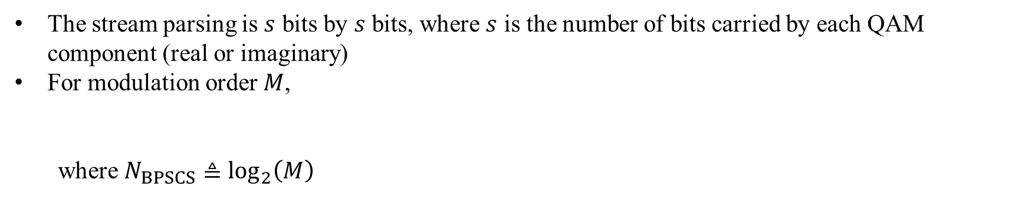
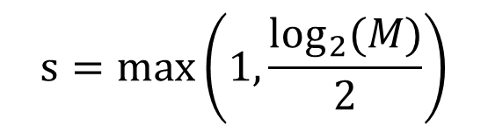
2-Stream Parsing in EHT
Nov 2024
…
s
s
s
…
s
s
s
s
s
s
…
s
s
s
The stream parsing is $s$ bits by $s$ bits, where $s$ is the number of bits carried by each QAM component (real or imaginary)
For modulation order $M$,
where $N_{BPSCS}≜\log_{2}\left(M\right)$
$$s=max\left(1, \frac{\log_{2}(M)}{2}\right)$$
Qinghua Li, Intel

Slide 5
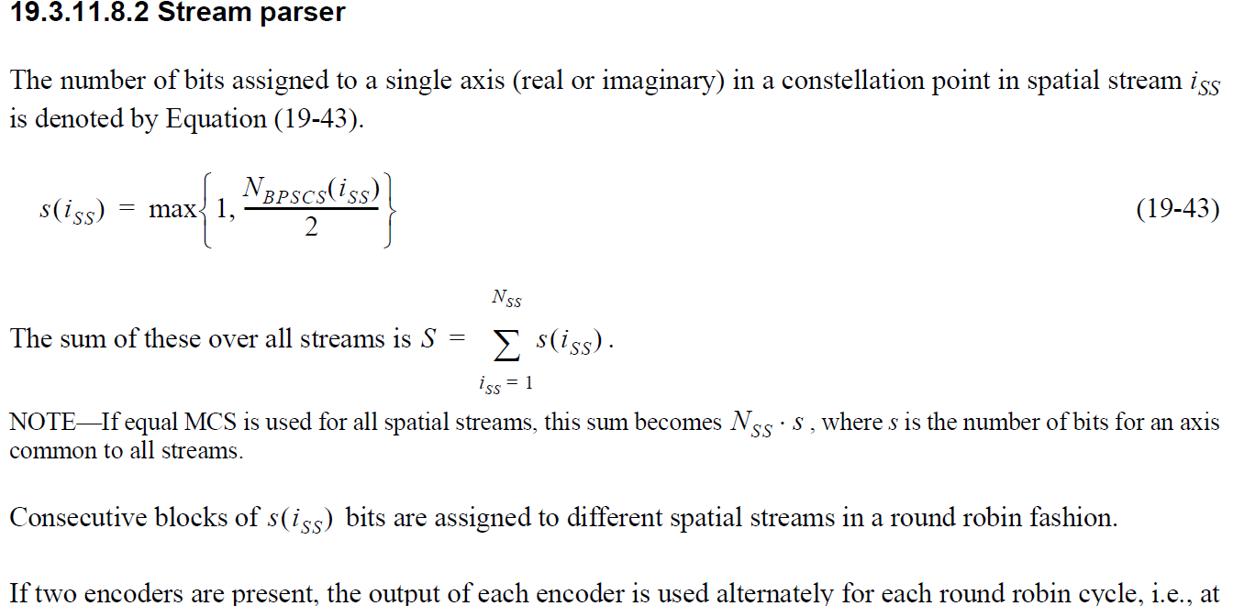
HT Stream Parser
Nov 2024
Qinghua Li, Intel

Slide 6
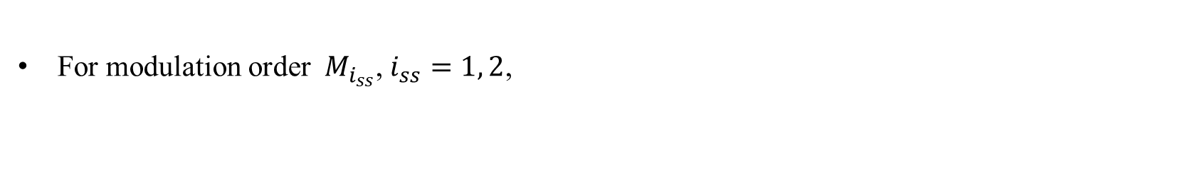

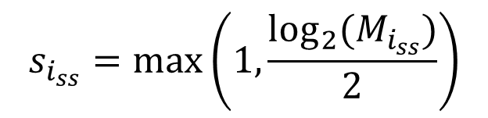
2-Stream Parsing in HT
Nov 2024
For modulation order${ M}_{i_{ss}}$, $i_{ss}=1, 2$,
$$s_{i_{ss}}=max\left(1, \frac{\log_{2}(M_{i_{ss}})}{2}\right)$$
$$N_{BPSCS}(i_{ss})≜\log_{2}\left(M_{i_{ss}}\right)$$
…
s₁
s₁
s₁
…
s₂
s₁
s₂
s₁
s₂
s₁
…
s₂
s₂
s₂
Qinghua Li, Intel

Slide 7
Exclusion of BPSK from UEQM
Nov 2024
BPSK has only one axis, the real axis, while the other QAMs has two axes
The per-axis round-robin parsing can’t be applied to BPSK without modification [3]
For implementation simplicity, it is desired that BPSK is excluded from UEQM
Qinghua Li, Intel

Slide 8
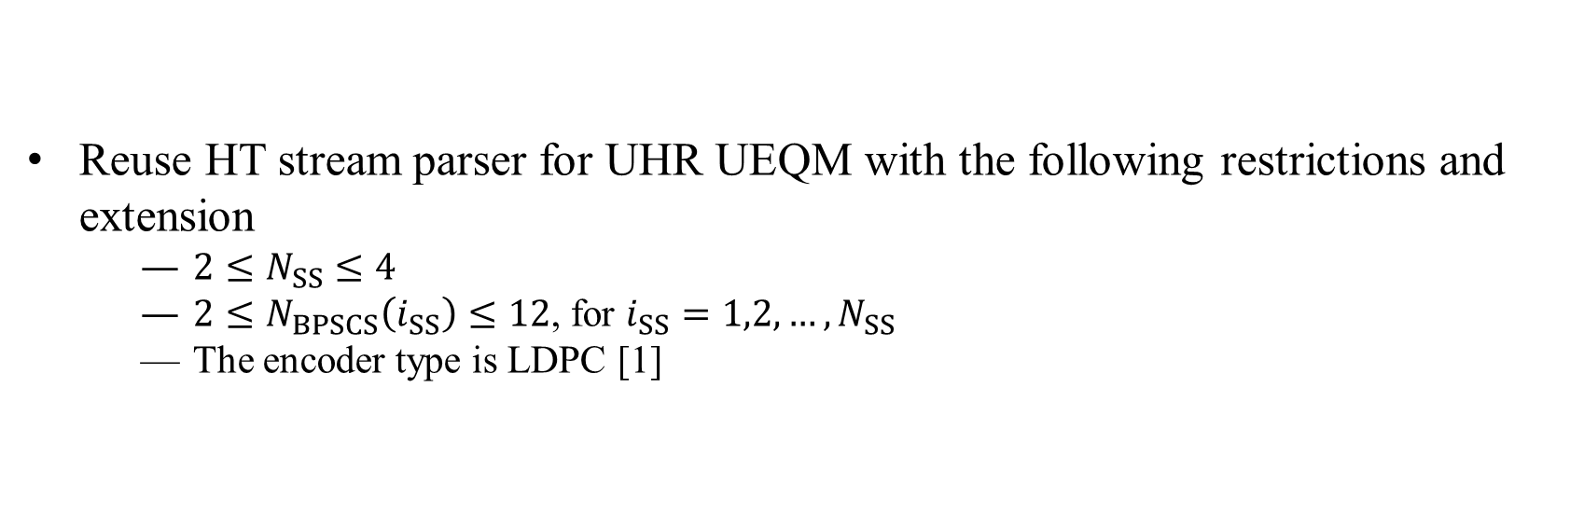
Reuse of HT Stream Parser for UHR UEQM with Slight Modifications
Nov 2024
Reuse HT stream parser for UHR UEQM with the following restrictions and extension
  $2≤N_{SS}≤4$
  $2≤N_{BPSCS}\left(i_{SS}\right)≤12$, for $i_{SS}=1,2,…,N_{SS}$
  The encoder type is LDPC [1]
Include 4K QAM and exclude BPSK
Qinghua Li, Intel

Slide 9
Nov 2024
Summary
Propose to reuse HT stream parser for UHR UEQM with slight modifications
Qinghua Li, Intel

Slide 10
Reference
Nov 2024
[1] 11-24-0209-06-00bn-specification-framework-for-tgbn, Ross Jian Yu
[2] IEEE Std 802.11‐2020
[3] 11-24-1451-02-00bn-ueqm-transmission-over-spatial-streams, Ying Wang
Qinghua Li, Intel

Slide 11
Nov 2024
SP 1
Do you support to add the following to UHR SFD?
Exclude BPSK from UHR UEQM.
Y:
N:
A:
Qinghua Li, Intel

Slide 12
Nov 2024
SP 2
Do you support to add the following to UHR SFD?
Include 4K QAM in UHR UEQM.
Y:
N:
A:
Qinghua Li, Intel

Slide 13
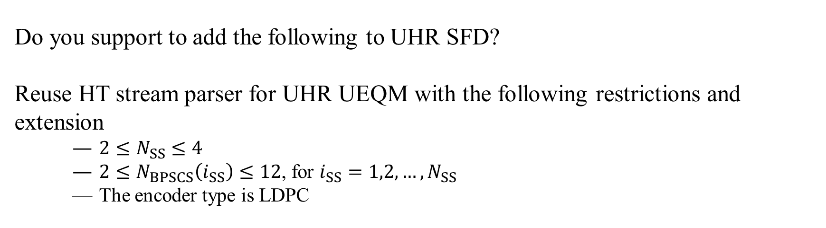
SP 3
Nov 2024
Do you support to add the following to UHR SFD?
add the following to UHR SFD?
Reuse HT stream parser for UHR UEQM with the following restrictions and extension
  $2≤N_{SS}≤4$
  $2≤N_{BPSCS}\left(i_{SS}\right)≤12$, for $i_{SS}=1,2,…,N_{SS}$
  The encoder type is LDPC
Y:
N:
A:
Qinghua Li, Intel

Slide 14
Nov 2024
SP 4
Do you support to add the following to UHR SFD?
For equal modulation, UHR stream parser remains the same as EHT.
Y:
N:
A:
Qinghua Li, Intel

Slide 15
Nov 2024
SP 5
Do you support to add the following to UHR SFD?
For bandwidths greater than 80 MHz, the coded bit parsing of UHR is stream parsing first followed by segment parsing.
Y:
N:
A:
Qinghua Li, Intel

Slide 16
Nov 2024
SP 6
Do you support to add the following to UHR SFD?
Reuse HT stream parser in Slide 5 with the modifications in Slide 8 for UHR UEQM.
Y:
N:
A:
Qinghua Li, Intel

