Slide 1
2xLDPC Encoding Parameters
Date: 2024-11-08
Authors:
Name | Affiliations | Address | Phone | Email
Shengquan Hu | Mediatek | 2840 Junction Ave. San Jose, CA, 95134 |  | Shengquan.hu@mediatek.com
Jianhan Liu |  |  |  | jianhan.liu@mediatek.com
Thomas Pare

Slide 2
Introduction
Existing LDPC encoding parameters table used for 11n/ac/ax/be specifies codeword length of 648, 1296, and 1944.
New LDPC codes with codeword length of 3888 bits (2xLDPC) was introduced in UHR [1] to improve error correction capability and achieve better performance gains
To accommodate the LDPC codes with codeword length of 3888, the existing LDPC encoding parameter table need be updated.
In this contribution, we propose 2xLDPC codeword length selection method based on the simple modifications of existing LDPC encoding parameter table

Slide 3
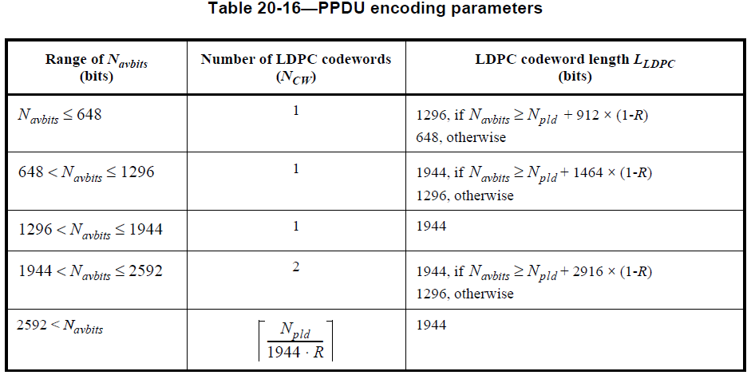
Recap: LDPC Encoding Parameters
There are three codeword lengths in pre-UHR Wi-Fi: 648, 1296 and 1944
The codeword length selection is based on the following PPDU encoding parameter table with the inputs of N_{avbits}, N_{pld,} and code rate R
Slide 3
Shengquan Hu, Mediatek Inc.

Slide 4
2xLDPC Indication
Traditionally, legacy LDPC CW length selection is mainly based on N_{avbits} in pre-UHR
However, for 2xLDPC
  Mandatory/or optional support 2xLDPC for AP/no-AP STA and RX/TX is still under discussion
  2xLDPC encoding/decoding capability is different for each user
Therefore, per-user based signaling to indicate 2xLDPC is preferred to allow more flexibility for transmitter to turn on/off 2xLDPC codes
Slide 4
Shengquan Hu, Mediatek Inc.

Slide 5
2xLDPC Codeword Length Selection
Transmitter should have the freedom/flexibility to chose using legacy LDPC or 2xLDPC
It would be desirable for 2xLDPC to follow the similar CW length selection procedure/rule as legacy/or pre-UHR LDPC, i.e. using the similar encoding parameter look up table, but need some updates with appropriate CW length selection threshold for 2xLDPC.
The general considerations of 2xLDPC CW length selection threshold:
  Payload size should be large enough for having at least one 2xLDPC codeword to avoid more puncturing which causes performance degradation
  Meanwhile, payload size or N_{avbits} should be larger enough to avoid latency/or timing budget issue for implementation.
  For an example, MAC header is only available after 1st CW is decoded and start to prepare for ACK/BA, etc. If packet has only one 2xLDPC CW, the timing budget becomes very tight and could become a bottleneck to use 2xLDPC, thus it is desirable to have at least 2 CWs in a PPDU for using 2xLDPC
Slide 5
Shengquan Hu, Mediatek Inc.

Slide 6
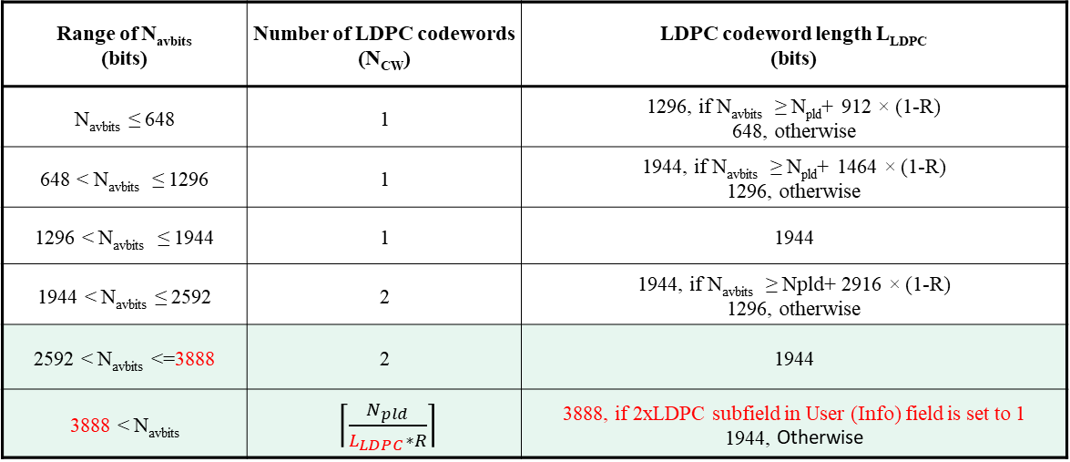
Proposal: 2xLDPC Encoding Parameters
If FEC coding scheme is LDPC and N_{avbits} ≤ 3888, the 2xLDPC subfield shall be set to 0 and the LDPC codeword length selection shall follow the pre-UHR LDPC procedure, specifically using codeword lengths (648, 1296, or 1944) bits based on the table below
If N_{avbits} ≤ 3888
Range of N_{avbits} (bits) | Number of LDPC codewords (N_{CW}) | LDPC codeword length L_{LDPC} (bits)
N_{avbits} ≤ 648 | 1 | 1296, if N_{avbits} ≥ N_{pld}+ 912 × (1-R) 648, otherwise
648 < N_{avbits} ≤ 1296 | 1 | 1944, if N_{avbits} ≥ N_{pld}+ 1464 × (1-R) 1296, otherwise
1296 < N_{avbits} ≤ 1944 | 1 | 1944
1944 < N_{avbits} ≤ 2592 | 2 | 1944, if N_{avbits} ≥ Npld+ 2916 × (1-R) 1296, otherwise
2592 < N_{avbits} <=3888 | 2 | 1944
3888 < N_{avbits} | $\left\lceil \frac{N_{pld}}{L_{LDPC}∗R}\right\rceil$ | 3888, if 2xLDPC subfield in User (Info) field is set to 1 1944, Otherwise
Same as existing for 11n/ac/ax/be
Slide 6
Shengquan Hu, Mediatek Inc.

Slide 7
Reference
[1]. 11-23-1985-06-00bn-longer-ldpc-codeword, by Rethna
Slide 7
Shengquan Hu, Mediatek Inc.

Slide 8

Straw Poll #1
Do you agree to add the following text to the TGbn SFD?
update the LDPC PPDU encoding parameter table for UHR as below:
If FEC coding scheme is LDPC and N_{avbits} ≤ 3888, the 2xLDPC subfield shall be set to 0 and the LDPC codeword length selection shall follow the pre-UHR LDPC procedure, specifically using codeword lengths (648, 1296, or 1944) bits based on the table below
Range of N_{avbits} (bits) | Number of LDPC codewords (N_{CW}) | LDPC codeword length L_{LDPC} (bits)
N_{avbits} ≤ 648 | 1 | 1296, if N_{avbits} ≥ N_{pld}+ 912 × (1-R) 648, otherwise
648 < N_{avbits} ≤ 1296 | 1 | 1944, if N_{avbits} ≥ N_{pld}+ 1464 × (1-R) 1296, otherwise
1296 < N_{avbits} ≤ 1944 | 1 | 1944
1944 < N_{avbits} ≤ 2592 | 2 | 1944, if N_{avbits} ≥ Npld+ 2916 × (1-R) 1296, otherwise
2592 < N_{avbits} <=3888 | 2 | 1944
3888 < N_{avbits} | $\left\lceil \frac{N_{pld}}{L_{LDPC}∗R}\right\rceil$ | 3888, if 2xLDPC subfield in User (Info) field is set to 1 1944, Otherwise

