Slide 1
Discussion on Context Transfer in Seamless Roaming
Date: 2024-11-08
Authors:

Slide 2
Abstract
Roaming is one of the main topics discussed by the TGbn group. Multiple presentation have focused on how to enable seamless/improved roaming [1-12].
In this presentation we will discuss how to enable TWT context transfer in seamless roaming.

Slide 3
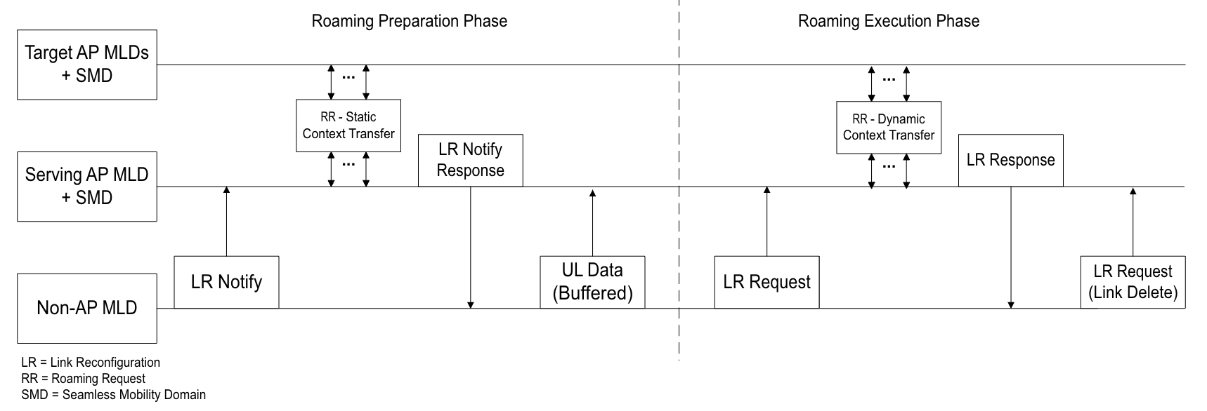
Recap
Multiple presentations [1-5] have discussed seamless roaming defining a new controller entity handling the process.
Two main phases in the roaming process have been proposed [2-3]: preparation and execution phase.
During the preparation phase, the non-AP MLD indicates desire to perform roaming.
Static context is transferred to a subset of target AP MLDs to proactively reserve resources.
Serving AP MLD responds with an indication of available target MLD APs.
Static context may consist of SCS, BA, TWT/r-TWT,..
During execution phase, non-AP MLD indicates target AP MLD to roam to.
Dynamic context may consist of SN, PN.

Slide 4
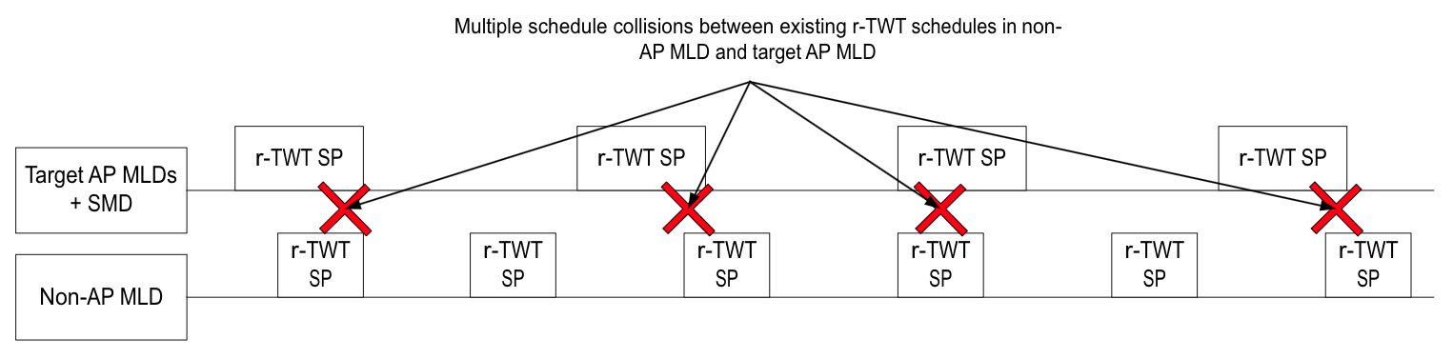
Transferring current TWT session during roaming may not be possible.
Candidate AP MLDs try to reserve resources and respond back to serving AP MLD. In some scenarios, some candidate AP MLDs may respond that only part of the static context can be guaranteed.
Transferring current TWT session may not be possible [6]:
  There may be potential collisions between solicited implicit TWT schedule and already existing implicit TWT schedule in candidate AP MLD.
Notes:
Make it specific to r-TWT SP overlap

Slide 5
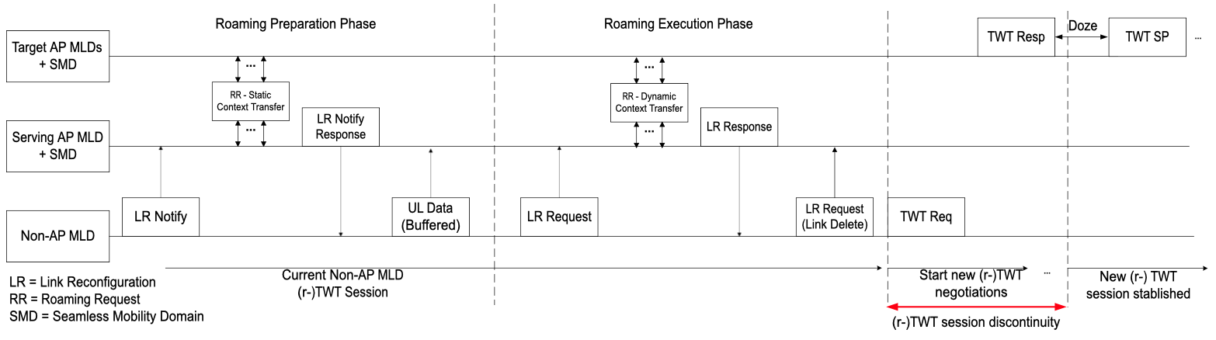
Establishing new TWT session may have negative QoS effects in non-AP MLD communications
Non-AP MLD may indicate that it wants to roam to target AP MLD even though current TWT session won’t be roamed.
Once non-AP MLD successfully roams to new target AP MLD, it begins a new TWT negotiation.
  Depending on channel conditions and TWT requirements, negotiation can take longer than multiple TWT/rTWT Wake intervals.
Having a transition period between previous TWT session and new TWT session may cause degradation of non-AP MLD QoS.
  Example: Low latency (LL) traffic might be scheduled using implicit r-TWT. In this scenario, long TWT negotiations might cause such traffic to be delivered late since no r-TWT SPs are available during the negotiation.
Notes:
Add numbers here. How long does it take for the TWT negotiation to happen?
Address this issues:
Maybe nice-to-have in theory, but complex to transfer synchronized timing state, and may need renegotiation
e.g. conflict with existing TWT agreement at Target AP MLD
Generally less impactful on link performance even if state is not transferred and need to be reestablished

Slide 6
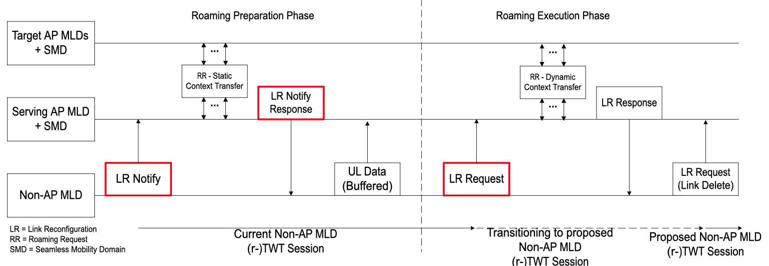
TWT Negotiation Initiated by Non-AP MLD
During Roaming Preparation Phase
Non-AP MLD notifies through LR Notify it is open for TWT negotiation.
Target AP MLDs respond through LR Notify Response if they accommodate for current TWT session or not. Additionally, they also can respond with an alternative TWT schedule.
Non-AP MLD responds through LR request either indicating if the accept TWT suggestion or not with the AP MLD they decide to roam.
Notes:
Don’t use negotiation (we are actually negotiating) → Using different term
Go broader – Maybe multiple patent applications

Slide 7
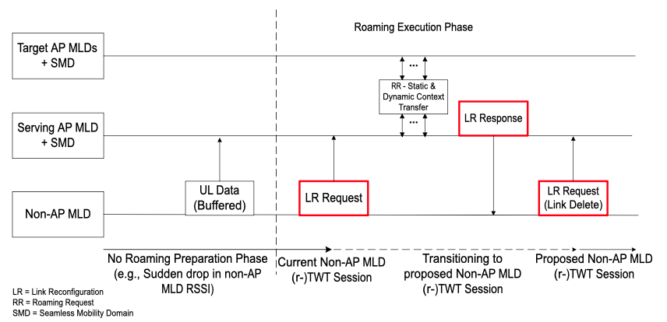
TWT Negotiation Initiated by non-AP AP MLD During Roaming Execution Phase
Roaming preparation phase is not possible (e.g., sudden drop of non-AP MLD RRSI)
Non-AP MLD notifies through LR Request it is open for TWT negotiation.
Target AP MLDs respond through LR Response if they accommodate for current TWT session or not. Additionally, they also can respond with an alternative TWT schedule.
Non-AP MLD responds through LR request (link delete) either indicating if the accept TWT suggestion or not with the AP MLD they decide to roam.
Notes:
Frame format similar to

Slide 8
Conclusions
According to [3], seamless roaming is a low/moderate complexity solution to roam clients with low frames lost both in UL and DL.
  Control plane context (association, security, capabilities) is transferred during roaming.
Transferring TWT context during roaming might not be possible and might have to be renegotiated.
We propose TWT negotiation during the roaming procedure.
Successful TWT negotiation during roaming may allow non-AP MLD STA to maintain its TWT session or to join/establish a new one with minimal QoS impact in the associated data streams.

Slide 9
References
[1] 11-24/1595r0 Scope of MAPC and Roaming Standardization (Brian Hart, Cisco Systems)
[2] 11-23/2157r2 Seamless Roaming within a Mobility Domain (Binita Gupta, Cisco Systems)
[3] 11-24/0396r1 Seamless Roaming within a Mobility Domain – Follow Up (Binita Gupta, Cisco Systems)
[4] 11-24/398r0 Coordinated Roaming through Target AP MLD (Binita Gupta, Cisco Systems)
[5] 11-24/0052r0 Seamless Roaming Details (Duncan Ho, Qualcomm)
[6] 11-24/0679r3 Thoughts on Functionality and Security Architecture for UHR Seamless Roaming (Thomas Derham, Broadcom)
[7] 11-23/0322r0 Improve Roaming between MLDs (Po-Kai Huang, Intel)
[8] 11-23/1996r0 Improve Roaming between MLDs (Po-Kai Huang, Intel)
[9] 11-24/0830r1 Improve Roaming between MLDs follow up (Po-Kai Huang, Intel)
[10] 11-24/0881r0 Improving Stability during Roaming Process (Tuncer Baykas, Ofinno LLC)
[11] 11-23/1897r0 Thought on Improving Roaming under Existing Architecture (Guogang Huang, Huawei)
[12] 11-23/1908r0 Seamless Roaming Procedure (Yelin Yoon, LG Electronics)

