Slide 1
CSI in Sounding in CBF
Date: 2024-11-10
Authors:

Slide 2
Abstract
Coordinated Beamforming (CBF) is already in SFD [11-24/209r5], and sounding is an important part to realize CBF.
Some methods for sounding were already proposed. [1-3]
This presentation discusses CSI feedback in sounding for CBF and proposes two methods for protected CSI delivery.

Slide 3
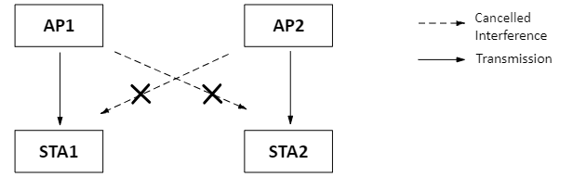
Introduction
CBF is a multi-AP coordination feature where multiple APs arrange their transmissions in a way that each AP directs its transmissions to its own users while avoiding interference towards the STAs of the other APs.
  For simplicity, refer to the figure below with two APs and two STAs.
Sounding is needed so that APs collect relevant CSI to determine the appropriate precoders.

Slide 4
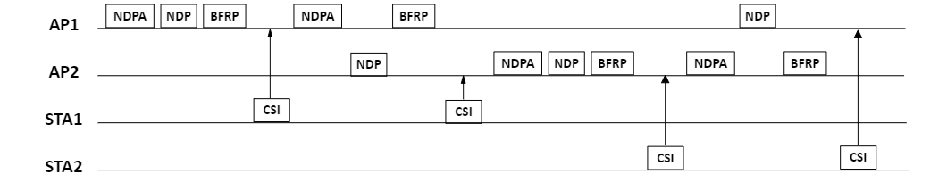
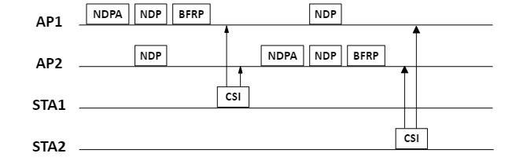
Introduction
There are several submissions that propose sounding for CBF [1-3]
Basically, two kinds of sounding mechanisms were proposed:
1- Sequential Sounding
2- Joint sounding

Slide 5
Problem Statement
Referring to the figures in slide 4, STA1 is associated with AP1 and STA2 is associated with AP2.
In both sequential and joint sounding, CSI from unassociated STA to AP is sent. Specifically,
    STA1 is not associated with AP2 but it sends CSI to AP2
    STA2 is not associated with AP1 but it sends CSI to AP1.
Note: As a reference, sequential sounding is shown (the same goes for joint sounding)

Slide 6
Problem Statement
Since there is no association between STA1 and AP2 nor between STA2 and AP1, CSI between STA1&AP2 and between STA2&AP1 can’t be protected because of lack of security context (such as encryption key etc.)
  Unprotected CSI poses privacy risks to user (e.g., tracking etc.)
  Note that 802.11bi, enhanced privacy group, is defining CSI protection between associated STA and AP (note that in the baseline, CSI is still unprotected); however, CSI protection from un-associated STA to AP is still not addressed.

Slide 7
Proposal
Between associated STA and its AP (e.g., STA1 to AP1), CSI can be protected based on 802.11bi.
Between un-associated STA and AP (e.g., STA1 to AP2), we propose (one of the) two methods for protected CSI delivery:
  Method 1 - Delivering CSI via "associated" AP
  Method 2 - Establishing a secure connection between un-associated STA and AP

Slide 8
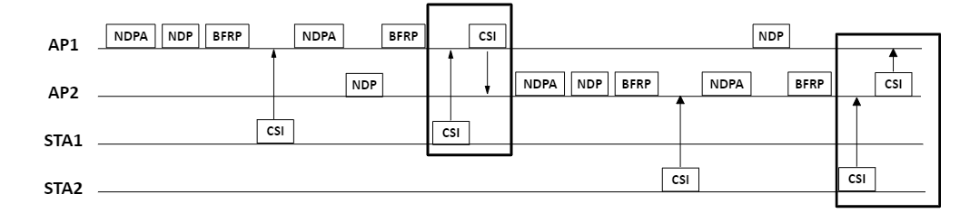
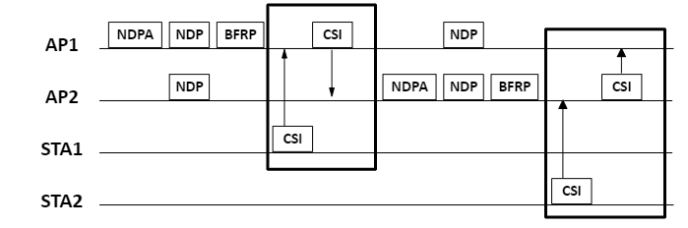
Proposal – method 1
Delivering CSI via "associated" AP
  Un-associated STA can send its CSI to the AP it is associated with, which can then forward the CSI to the other AP (over the air or over the DS). ⇒ This works for both sequential and joint sounding.
  Since all frame exchanges take place between secure nodes (e.g., STA1→AP1→AP2), CSI is delivered securely. (assuming a secure connection exists between the APs as well).
Sequential Sounding becomes this →
Joint Sounding becomes this →

Slide 9
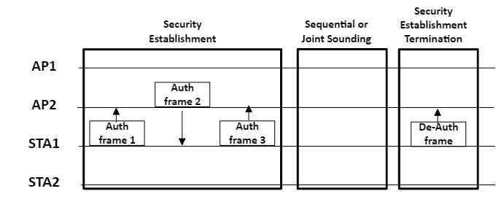
Proposal – method 2
Establishing a secure connection between un-associated STA and AP
  Un-associated STA and AP establish a secure connection, allowing un-associated STA to send protected CSI to the AP. After CSI is delivered, the secure connection can be terminated.
  This idea is similar to PASN as defined in 802.11az:
  [recap] In 802.11az, an un-associated STA can securely send location-related frames to an AP. PASN enables a secure connection (e.g., key establishment) for the un-associated STA to exchange location-related frames with the AP, which can be terminated after the exchange.
  This approach does not modify joint or sequential sounding frame exchange; It simply adds PASN to the process.

Slide 10
Summary
Unprotected CSI delivery between un-associated STA and AP in sounding in CBF is discussed.
Two methods to deliver protected CSI between un-associated STA and AP were proposed.
  Method 1 - Delivering CSI via "associated" AP
  Method 2 - Establishing a secure connection between un-associated STA and AP

Slide 11
Straw Poll
Do you agree that 802.11bn should include protected CSI delivery between un-associated STA and AP into the sounding in CBF?
  Yes
  No
  Abstain

Slide 12
References
[1] 11-24-1542-00-00bn-sounding-schemes-for-coordinated-beamforming
[2] 11-24-1568-00-00bn-sounding-design-for-c-bf
[3] 11-24-1582-00-00bn-coordinated-sounding-for-cobf

