Slide 1
COBF Design for UHR
Date: 2024-11-11
Authors:
Name | Affiliations | Address | Phone | email
Sameer Vermani | Qualcomm Technologies Inc. |  |  | svverman@qti.qualcomm.com
Alice Chen
Bin Tian
Manideep Dunna
Youhan Kim
Meriam Rezk
Alice Chen
Deniz Rende
Ahmed Elsherif

Slide 2
Outline
Number of users and spatial streams in COBF
COBF PPDU design details
Common pre-UHR portion preamble across two APs
PPDU type indication: COBF as a separate PDDU type
How to resolve BSS color for per-user SIG fields in COBF PPDUs
BSS-wise partitioning of per-user SIG field section
Design for NDPA
NDPA variant remains same as EHT
Using special STA info field; Unified design for Joint and Sequential
We show that just one STA info field is enough
Straw-polls related to above

Slide 3
Number of users and spatial streams in COBF
In 11-1542r0, we proposed restricting the number of APs to two in a COBF transmission
We would further like to restrict the max number of STAs to 4 in a COBF transmission
For the typical scenario, if we have more than 3 users belonging to an AP in a transmission, the AP is unlikely to have spare dimensions for nulling
4 total users provides opportunities for good amount of spatial multiplexing while keeping the processing at STA similar to regular MU-MIMO
To further simplify the signaling and testing, we propose
Limit max total spatial streams to 4
Limit the per-STA spatial streams to 2

Slide 4
Preamble Design: Common section of preamble across APs
Propose having a non-BFed pre-UHR section of the preamble
Simpler precoding
U-SIG can be decoded at by-stander devices
Closer to single cell MU-MIMO PPDU format
Obvious consequence: Pre-UHR portion needs to be identical across two APs
Need most things in the pre-UHR portion to be pre-negotiated
Non-BFed Pre-UHR portion
BFed UHR
portion
L-STF
L-LTF
L-SIG
RL-SIG
U-SIG
UHR-SIG
UHR-STF
UHR-LTF
Data
Common contents across two APs

Slide 5
Indication for COBF in U-SIG
COBF transmission needs indication in U-SIG that the packet is for COBF
Special treatment of BSS Colors
Multiple BSS colors for the participant APs may be needed in COBF PPDU’s preamble
Per-user SIG field differentiation and for more accurate medium-use information
The per-user SIG fields need to be differentiated
Which AP are they coming from ?
More on next slide
Some preamble content may be simplified compared to regular UHR PPDU
Maybe spatial reuse field is not needed for these PPDUs
UHR-SIG MCS maybe fixed to a low MCS as we have longer delay spread to deal with
Proposal: U-SIG to carry an indication when the PPDU is for COBF

Slide 6
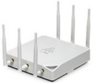
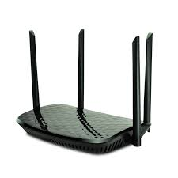
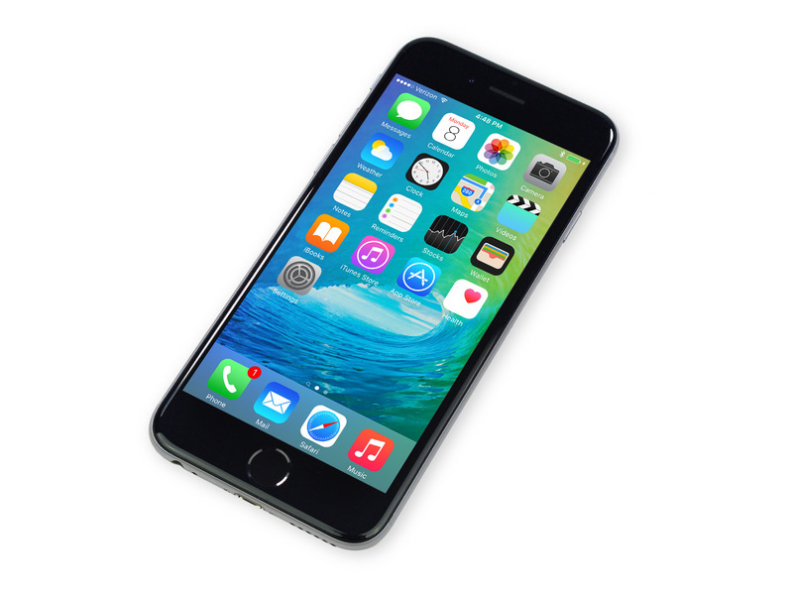
Per-user-SIG fields Issue: Need to resolve BSS label
AP1
Nulls
Need to differentiate the per-user SIG fields in the common preamble
Which BSS/AP do they belong to?
Our proposal for differentiating the per-user SIGs of the two APs
Place the two BSS colors in the preamble
Have a 1-bit field in the per-user SIG field to differentiate between the two APs
AP2
Same STAID (collision)
BSS1
How does the STA know which
per-user SIG field to decode?
BSS2

Slide 7
Per-user SIG Field Partitioning
Prefer to separate the two BSSs per user-field sections
E.g., All BSS-1 user fields and then all the BSS-2 user-fields or vice-versa
An AP transmits on contiguous spatial stream indices
With Nss_total <=4, it is possible, with some restrictions to the order of BSSs, to preserve the old spatial config field design
See table below for more details
Scenario | Nss/User in AP1 | Nss/User in AP2 | Ordering of User Fields According to BSS
Each BSS has a user with 2ss | [2] | [2] | The user field of either BSS can go first
Only one BSS has a user with 2ss | [2] | [1] or [1 1] | The user field of BSS1 goes first
 | [1] or [1 1] | [2] | The user field of BSS2 goes first
No BSS has a user with 2ss | [1] or [1 1] | [1] or [1 1] | The user field(s) of either BSS can go first

Slide 8
New NDPA or NDP variants ?
The NDPA in UHR can still use the EHT variant
Special STA info field to convey information to a second AP for COBF case
No need to define a UHR NDP
Can reuse the EHT NDP, even for the joint NDP
But the BSS color needs to be the BSS color of the AP transmitting the NDPA

Slide 9
NDPA Design for UHR
Exchange the information needed for sounding between APs for sounding via NDPA
A special STA info field with a STAID addressed to the AP is needed
Unified design for joint sounding as well as cross-BSS section of sequential sounding
Prefer a self-contained design so may need two STA info fields to convey this information
Special STA info field addressed to shared AP gives info about how to transmit the NDP, e.g.,
BW, TxOP and punctured channel information
NLTF in NDP (P-matrix size)
4 or 8
Starting stream index for shared AP and Nsts for shared AP in NDP
Which rows of P-matrix to use
GI+LTF (at-least for joint NDP)

Slide 10
Summary
We proposed the following
Maximum of 4 users in a COBF transmission
Max total Nss of 4 for COBF with per-STA streams limited to 2
For COBF PPDU
Identical preamble across 2 APs for the pre-UHR portion
Two BSS colors with shared AP’s color in the version independent section
1 bit in per-user SIG to resolve BSS color
Per-user fields of one BSS and then per-user fields of the other BSS
NDPA for COBF with a special STA info field
Unified design for joint and sequential sounding cases

Slide 11
SP1
Do you support transmitting the pre-UHR portion of the COBF packet in a non-beamformed (omni) manner?

Slide 12
SP2
Do you support that the pre-UHR portion of a COBF PPDU will have identical content across two APs?

Slide 13
SP3
Do you support to indicate a COBF data transmission in U-SIG for 802.11bn?

Slide 14
SP4
Do you support that in a COBF transmission the maximum spatial streams given to one user will be 2?

Slide 15
SP5
Do you support to have 2 BSS colors in the preamble of a COBF PPDU
One BSS color for the sharing AP and another BSS color for the shared AP

Slide 16
SP6
Do you support to have a 1-bit indication in the per-user SIG field to resolve the BSS color for COBF transmissions?
The coding bit is re-purposed for this indication
LDPC is the only coding mode for COBF

Slide 17
SP7
Do you support that we can re-use EHT variant for the NDPA and re-use the EHT NDP for sounding in UHR?

Slide 18
SP8
Do you support that for COBF case, the information in the NDPA for the responding AP has a unified design for joint-NDP based sounding as well as cross-BSS section of sequential sounding?

Slide 19
SP9
Do you support that the spatial config field in the user-SIG field of COBF PPDUs in UHR will re-use the same design as in UHR DL MU-MIMO?
Encoding table will be same as 11ax

Slide 20
SP10
Do you support that for a COBF PPDU, all the user-fields in UHR-SIG belonging to an AP and the corresponding spatial streams are contiguous?
The user fields of one AP are together followed by the ones of the other AP and the same holds for spatial streams

Slide 21
appendix
Other details

Slide 22
Protection for COBF transmissions
Note that there are going to be some frames exchanged between the two APs before the COBF transmission
A frame from initiating AP (e.g., a COBF trigger) may be used to set the NAV in BSS1
We may also place the responding AP’s BSS color in the version independent section of the U-SIG for protection inside BSS2
Note that even WiFi 7 devices understand the BSS color in U-SIG at that location
Additionally, suggest having a rule in the specification for the case when the STA can decode U-SIG with a version number it doesn’t understand
Disable OBSS_PD based SR for such cases
Note that SR field is not in the version independent section so whenever a WiFi 7 STA sees a UHR PPDU, it will not have access to the SR field

Slide 23
Explanation of protection mechanism for COBF
Below we show protection mechanisms to achieve good protection in both BSSs
Contains BSS color
of shared AP in U-SIG version
independent section
Protects in sharing AP’s BSS
Sharing AP
COBF
COBF
trigger
DL PPDU
Invite
Shared AP
COBF
DL PPDU
Response

