Slide 1
Downlink Sync Sequence Design
Nov. 2024
Date: 2024-11-11
Authors:
Name | Affiliations | Address | Phone | Email
Bin Qian | Huawei | Shenzhen, China |  | qianbin14@huawei.com
Lei Huang |  | Singapore
Panpan Li |  | Singapore
David, Xun Yang |  | Singapore
Notes:
September 2012

Slide 2
Introduction
Nov. 2024
Link budget analysis has been conducted for both integrated [1] and non-integrated [2] energizer deployments
In the integrated energizer deployment, the energizer link (AP to STA) is a bottleneck
  High SNR at the STA allows for a shorter Sync field than WUR, which reduces the PPDU packet duration
In the non-integrated energizer deployment, coverage depends on the AP-STA communication link
  A longer Sync field may be needed for extended distances and higher interference levels
This contribution presents the design considerations for the Sync sequence

Slide 3
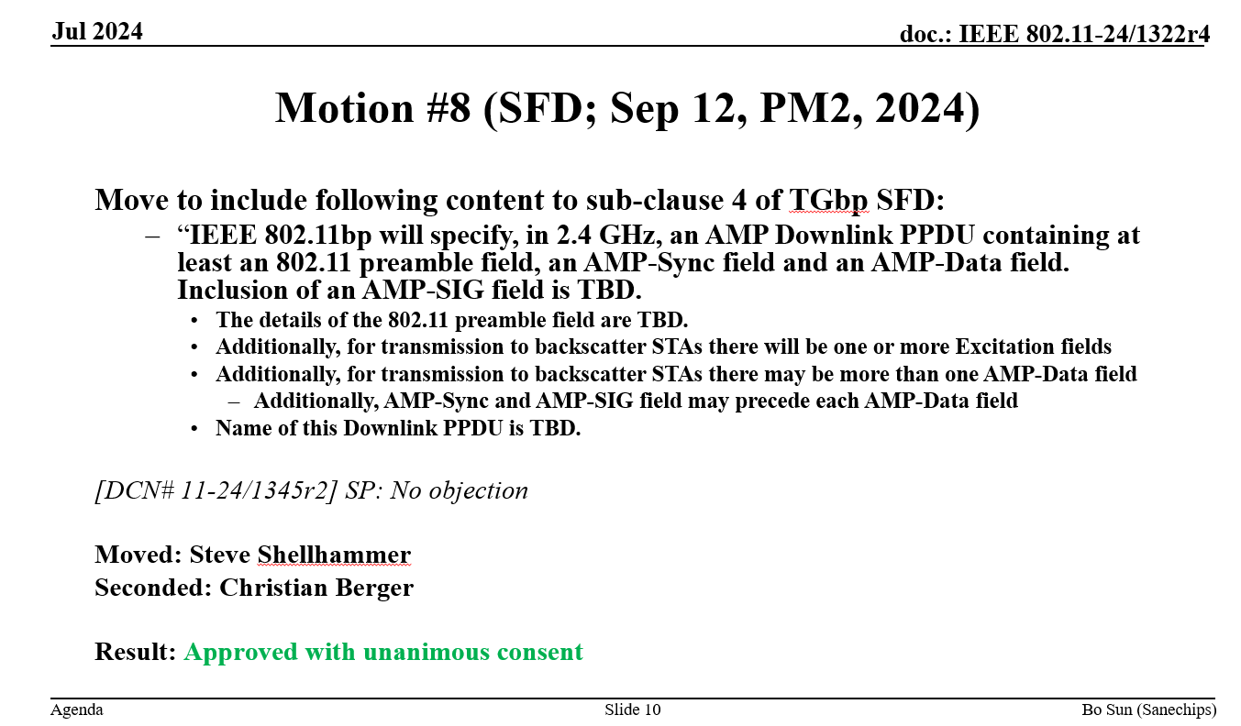
AMP Downlink PPDU Format (1/2)
Nov. 2024
The 11bp group has reached consensus on the AMP DL PPDU format [3]
The AMP-Sync field and AMP-Data field in the AMP Downlink PPDU will use On-Off Keying (OOK) modulation

Slide 4
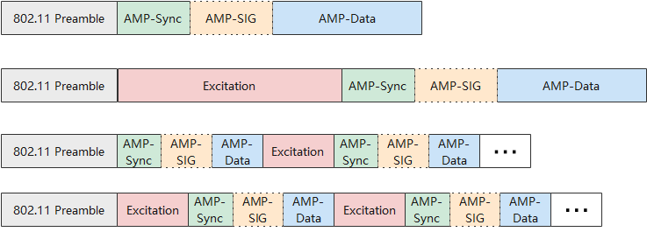
AMP Downlink PPDU Format (2/2)
Nov. 2024
Possible variations in AMP DL PPDU formats
The AMP-Sync field should support both integrated and non-integrated energizer deployments, as well as both backscatter and non-backscatter use cases
Downlink Data Transmission
Combined Downlink Data and Excitation Signal Transmission

Slide 5
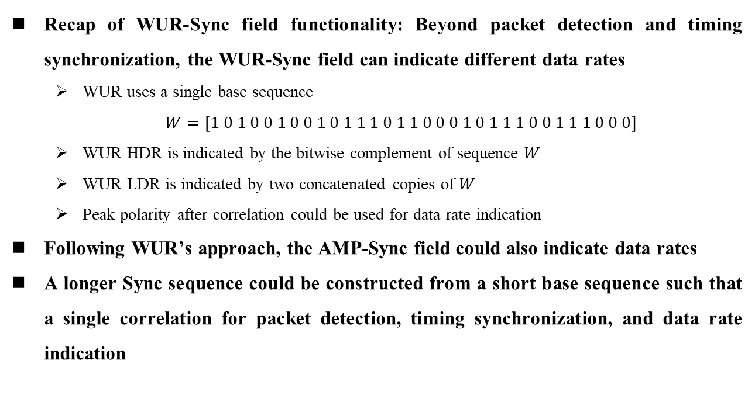
AMP-Sync Field Functionality
Nov. 2024
Recap of WUR-Sync field functionality: Beyond packet detection and timing synchronization, the WUR-Sync field can indicate different data rates
  WUR uses a single base sequence
  $W=\left[1 0 1 0 0 1 0 0 1 0 1 1 1 0 1 1 0 0 0 1 0 1 1 1 0 0 1 1 1 0 0 0\right]$
  WUR HDR is indicated by the bitwise complement of sequence $W$
  WUR LDR is indicated by two concatenated copies of $W$
  Peak polarity after correlation could be used for data rate indication
Following WUR’s approach, the AMP-Sync field could also indicate data rates
A longer Sync sequence could be constructed from a short base sequence such that a single correlation for packet detection, timing synchronization, and data rate indication

Slide 6
Sync Sequence Design Criteria
Nov. 2024
The Sync sequence design criteria, as discussed in [4], include:
  Invalid Manchester code patterns
  Maximum of three consecutive OFF symbols
  Zero-DC balance
  Good cross-correlation property
Preceding ON symbols: Sync sequence accounts for preceding ON symbols from 802.11 Preamble and Excitation fields to prevent false alarms
Data rate indication support: Both positive and negative sidelobes should be minimized to ensure timing and data rate accuracy
  Large positive/negative sidelobes could impair timing synchronization when the first peak is positive/negative
  Large negative/positive sidelobes could reduce data rate detection accuracy under similar conditions

Slide 7


Simulation Results
Nov. 2024
DL Sync sequence example
  $S_{1}$: [1 1 0 0 1 0 0 1 1 1 0 0 1 0 1 0]; $S_{2}$: [0 0 1 1 1 1 0 1 0 1 0 0 1 0 0 1]; $S_{3}$: [1 0 0 1 0 0 1 1 1 1 0 0 1 0 1 0]
Simulation settings
  Local sequence $L=2∗S_{1}−1$
  Six preceding ON symbols
$S_{1}$, $\left|max\left(sidelobe\right)\right|=2$

Slide 8
Summary
Nov. 2024
The Sync sequence should accommodate various topologies and device capabilities, ensuring reliable Sync performance and flexibility across use cases
A single base Sync sequence could be used to construct all necessary Sync sequences
The Sync field could also serve as an indicator of data rate
Proposed Sync sequence design considerations
  Management of preceding ON symbols
  Minimization of positive and negative sidelobe magnitudes

Slide 9
References
Nov. 2024
[1] 11-24-1345-02-00bp-high-level-requirements-for-downlink-phy-in-2-4-ghz
[2] 11-24-1215-00-00bp-feasibility-study-on-long-range-backscatter-operation
[3] 11-24-1322-04-00bp-tgbp-motion-dock
[4] 11-24-1797-00-00bp-design-considerations-of-dl-data-rate-and-sync

