Slide 1
AP Identification in Multi-AP
Date: 2024-11-11
Authors:
Name | Affiliation | Address | Phone | Email
Geonhwan Kim | LG Electronics | 19, Yangjae-daero 11gil, Seocho-gu, Seoul 137-130, Korea |  | geonhwan.kim@lge.com
Insun Jang |  |  |  | insun.jang@lge.com
Jinsoo Choi |  |  |  | js.choi@lge.com
Sunhee Baek |  |  |  | sunhee.baek@lge.com
Yelin Yoon |  |  |  | yl.yoon@lge.com
Dongju Cha |  |  |  | dongju.cha@lge.com
Hongwon Lee |  |  |  | hongwon.lee@lge.com
Hangyu Cho |  |  |  | hg.cho@lge.com
Sanggook Kim |  | 10225 Willow Creek Rd, San Diego, CA, USA |  | sanggook.kim@lge.com

Slide 2
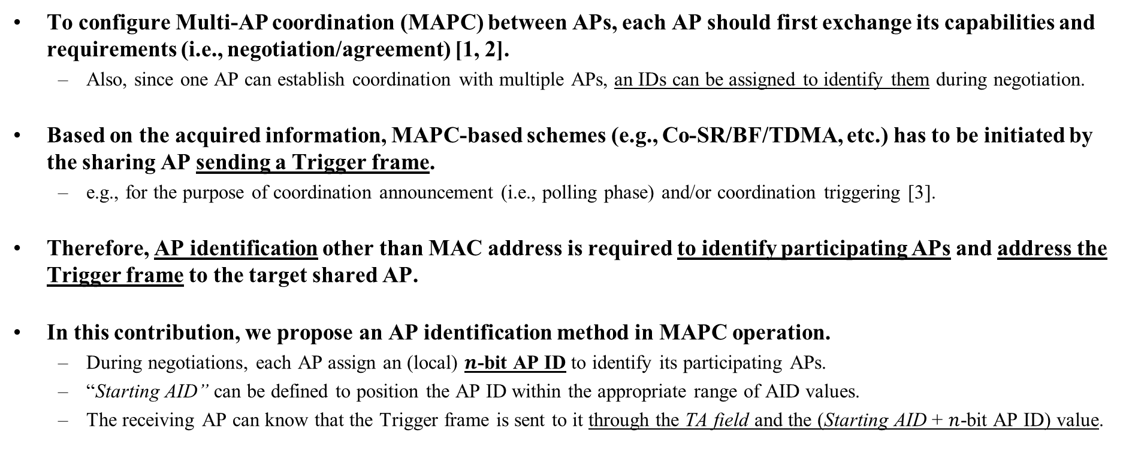
Introduction
To configure Multi-AP coordination (MAPC) between APs, each AP should first exchange its capabilities and requirements (i.e., negotiation/agreement) [1, 2].
  Also, since one AP can establish coordination with multiple APs, an IDs can be assigned to identify them during negotiation.
Based on the acquired information, MAPC-based schemes (e.g., Co-SR/BF/TDMA, etc.) has to be initiated by the sharing AP sending a Trigger frame.
  e.g., for the purpose of coordination announcement (i.e., polling phase) and/or coordination triggering [3].
Therefore, AP identification other than MAC address is required to identify participating APs and address the Trigger frame to the target shared AP.
In this contribution, we propose an AP identification method in MAPC operation.
  During negotiations, each AP assign an (local) $n$-bit AP ID to identify its participating APs.
  “Starting AID” can be defined to position the AP ID within the appropriate range of AID values.
  The receiving AP can know that the Trigger frame is sent to it through the TA field and the (Starting AID + $n$-bit AP ID) value.

Slide 3
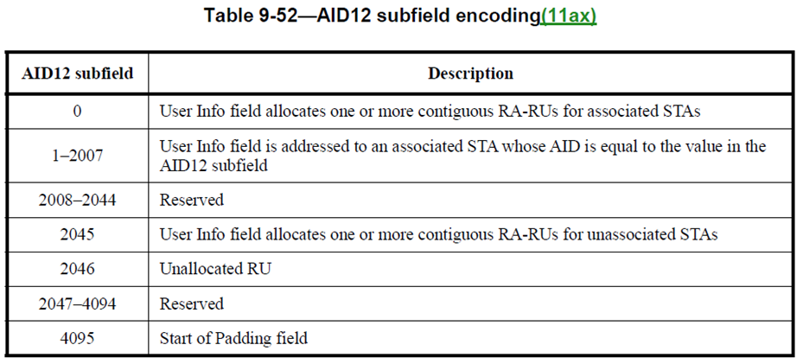
AID12 subfield encoding
In order for the receiving AP to identify the frame based on the TA field and AID11 or AID12 field, some AID12 values will need to be defined for AP identification.
As shown in the AID12 subfield encoding table [4], many values ​​are already being used for associated STAs (0, 1–2007, 2046), unassociated STAs (2045), and padding (4095).
  There are also many reserved values that are not being used yet.
To avoid misunderstandings on the legacy STA side and to use the AID11 and AID12 fields for AP identification, reserved values within 2008–2044 should be used.

Slide 4
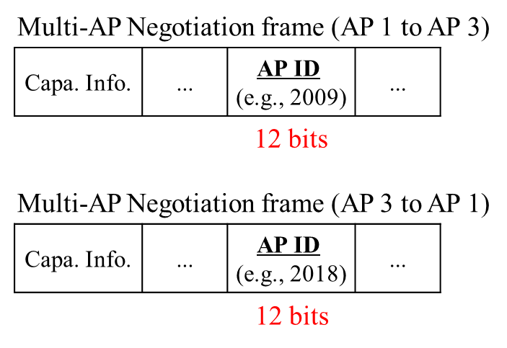
Use 11 or 12 bit AID value as AP ID
The simplest identification method may be to use the AID11 or AID12 value itself to assign an AP ID.
  For example, AID12 subfield encoding table is modified and values between 2008–2044 are assigned to APs.
  These AID values are included in the frames transmitted during the MAPC negotiation/agreement procedure.
However, since the AID12 field is rather long in itself, it seems unnecessary to use the 12 bit AID value as is for AP ID assignment during MAPC negotiation.
  Also, the number of APs that actually try to collaborate with other APs will probably not be that large.
  By defining a (local) AP ID less than 12 bits, the length of the AP ID field in the Multi-AP negotiation frame can be reduced.
AID12 subfield encoding
AP ID = 2008 (to AP 2)
AID12 subfield | Description
1–2007 | ...
2008–2044 | User Info field is addressed to an AP whose AID is equal to the value in the AID12 field
... | ...
AP 1
AP ID = 2010 (to AP 1)
AP 2
nego.
2018 (to AP 1)
2011 (to AP 3)
2009 (to AP 3)
nego.
2017 (to AP 2)
AP 3

Slide 5
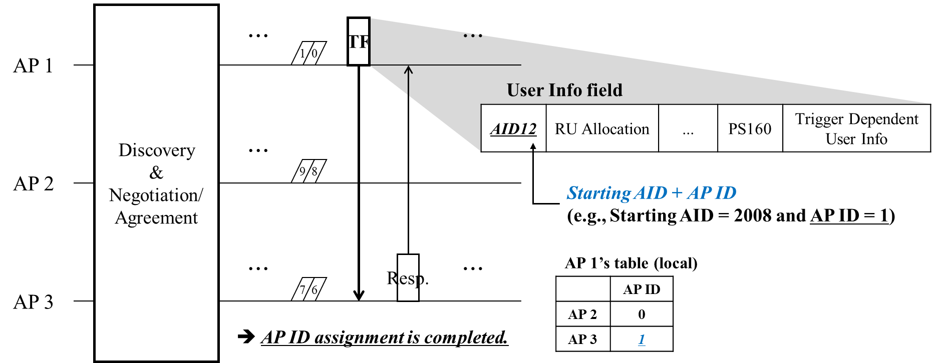
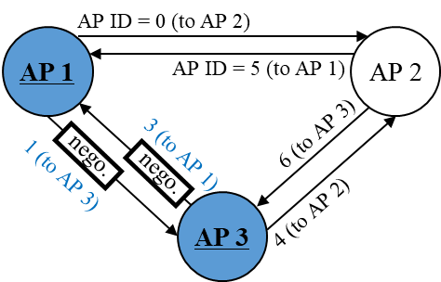
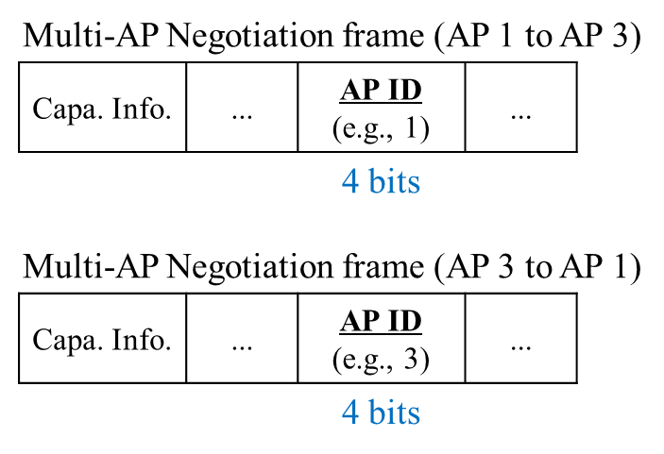

AP ID for MAPC
Each AP can assign a $n$-bit AP ID to the APs participating in MAPC through a negotiation/agreement.
  e.g., the AP that initiates the negotiation delivers the AP ID assigned to that recipient AP.
    If the receiving AP accepts the MAPC request, it responds by assigning an AP ID for the transmitting AP.
    So that both APs are aware of the AP ID assigned locally by the other AP.
The mutually agreed AP ID can be used to identify the AP in subsequent MAPC operations.
  i.e., the Trigger frame transmitted to the participating AP(s) may include the corresponding AP ID in the AID12 field.
  The assigned AP ID can be interpreted as $(AP ID+Starting AID)$, which matches the AID12 value.

Slide 6

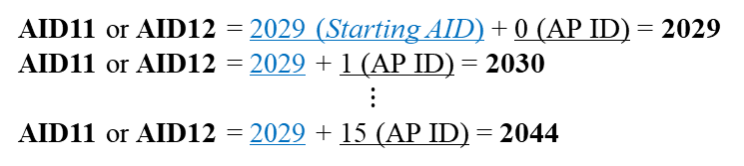
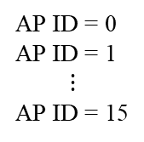
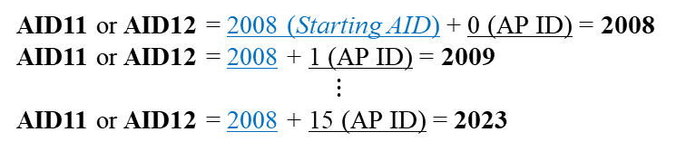
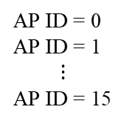
AID12 field configuration
Assuming that the AP ID is defined as 4 bits, an AP ID can be assigned to up to 16 APs.
  There are many variations in configuring the AID11/12 field, depending on the size of the AP ID and the Starting AID value.
    e.g., for 4-bit AP IDs, 2008–2023, 2009–2024, ...., 2029–2044 can be used.
Alternatively, an option could be considered to put the AP ID on $n$ consecutive bits including the LSB and fix the remaining bits to a specific value.
  Detailed examples are covered in the Appendix #1.
AP ID = 0
AP ID = 1
$$⋮$$
AP ID = 15
AID11 or AID12 = 2008 (Starting AID) + 0 (AP ID) = 2008
AID11 or AID12 = 2008 + 1 (AP ID) = 2009
$$⋮$$
AID11 or AID12 = 2008 + 15 (AP ID) = 2023
AP ID = 0
AP ID = 1
$$⋮$$
AP ID = 15
AID11 or AID12 = 2029 (Starting AID) + 0 (AP ID) = 2029
AID11 or AID12 = 2029 + 1 (AP ID) = 2030
$$⋮$$
AID11 or AID12 = 2029 + 15 (AP ID) = 2044

Slide 7
Conclusion
In this contribution, we propose an AP identification method for MAPC.
  Since AP identification is essential to configuring and operating Multi-AP, a method to identify APs participating in MAPC should be implemented.
The simplest way is to identify the AP using the AID11 or AID12 value itself.
  However, using full 12-bit AID value to assign an AP ID during the negotiation/agreement procedure seems to be inefficient because only a small fraction of AID12 values will actually be used.
Therefore, we can define an (local) AP ID used for MAPC negotiation and management.
  By defining a AP ID less than 12 bits, the size of the Multi-AP negotiation frame can be reduced.

Slide 8
References
[1] 23/1871, “M-AP Coordinated Transmission framework”
[2] 24/0842, “Multi-AP set configuration for C-TDMA”
[3] 24/0843, “Some details on TXOP sharing in C-TDMA”
[4] Draft P802.11REVme_D7.0

Slide 9
Straw Poll 1
Do you agree to add the following text to the TGbn SFD?
  During multi-AP negotiation between two APs, an AP assigns a unique ID to the other AP.
    The ID is indicated as a numerical value.
    The size of the field including ID is TBD.
    NOTE: For example, the assigned ID is expected to be used to identify the corresponding AP in the AID12 field of the Trigger frame.
    NOTE: For example, the assigned ID is expected to be used to identify the corresponding AP in the AID11 field of the UHR NDP Announcement frame.

Slide 10
Straw Poll 2
Do you agree to add the following text to the TGbn SFD?
  An AP, that transmits a Trigger frame as part of a transmission sequence in a M-AP coordinated transmission scheme, identifies another AP via an AP ID in the AID12 field of the User Info field of the frame where the AP ID is set to the Starting AID plus the ID that has been assigned to that another AP during multi-AP negotiation.
    The value of starting AID is TBD.
Reference: Motion #135

Slide 11
Straw Poll 3
Do you agree to add the following text to the TGbn SFD?
  An AP, that transmits an UHR NDP Announcement frame as part of a sounding sequence in a M-AP coordinated transmission scheme, identifies another AP via an AP ID in the AID11 field of the STA Info field of the frame where the AP ID is set to the Starting AID plus the ID that has been assigned to that another AP during multi-AP negotiation.
    The value of starting AID is TBD.
Reference: Motion #135

Slide 12
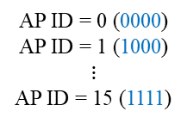

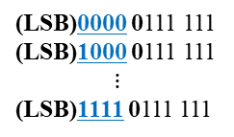
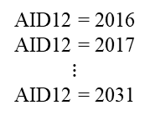
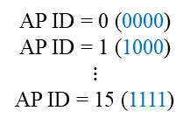
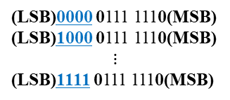
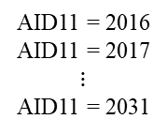
Appendix #1
Ex) 4-bit AP ID can be mapped to 2016–2031;
  Requirements: MSB should be set to 0 (for AID12) & bits 5$–$10 (i.e., AID12[5:10]) should be set to 1.
Ex 1) AID12
LSB
MSB
AP ID = 0 (0000)
AP ID = 1 (1000)
$$⋮$$
AP ID = 15 (1111)
AID12 = 2016
AID12 = 2017
$$⋮$$
AID12 = 2031
(LSB)0000 0111 1110(MSB)
(LSB)1000 0111 1110(MSB)
$$⋮$$
(LSB)1111 0111 1110(MSB)
AID12:
xxxx 0111 1110
AP ID (4 bits)
Ex 2) AID11
LSB
AP ID = 0 (0000)
AP ID = 1 (1000)
$$⋮$$
AP ID = 15 (1111)
AID11 = 2016
AID11 = 2017
$$⋮$$
AID11 = 2031
(LSB)0000 0111 111
(LSB)1000 0111 111
$$⋮$$
(LSB)1111 0111 111
AID11:
xxxx 0111 111
AP ID (4 bits)

