Slide 1
OFDM-based WPT Waveform
Date: 2024-11-13
Authors:
Name | Affiliation | Address | Email
Panpan Li | Huawei | Singapore | lipanpan25@huawei.com
Lei Huang |  | Singapore
Bin Qian |  | Shenzhen, China

Slide 2
Abstract
This contribution intends to discuss the benefits of OFDM-based WPT waveform.

Slide 3
Background
11bp PAR [1]:
  at least one mode of wireless power transfer in the sub-1 GHz (S1G) band is defined to support RF energy harvesting
WPT regulation:
  [2] and [3] presented regional S1G and RFID regulations which may be used for WPT.
WPT MAC:
  WPT protocols and power-related status report/negotiation are discussed in [4-9].
WPT PHY:
  [10] discussed WPT coexistence issues and presented WPT PPDU including preamble and charging part.
  [11] started WPT waveform discussion and pointed out the potential of OFDM/DSSS-based WPT waveform, which can be generated by current Wi-Fi systems.
Considering various regional regulations and energy-limited use cases, WPT waveform with high efficiency should be designed/recommended.

Slide 4
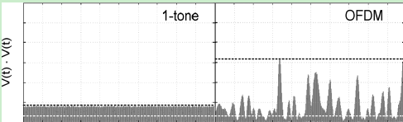
OFDM-based WPT Waveform (1/2)
May achieve high PAPR, thus increasing RF-to-DC conversion efficiency
  Various papers [12,13] show that waveforms with high peak to average power ratio (PAPR) increase RF-to-DC conversion efficiency of the rectifiers.
  However, too high PAPR also brings problems, such as spectrum expansion; and given the same PA maximizing PAPR will decrease transmitted power to maintain linearity (backoff is needed), and hence will degrade RF to DC efficiency.
Instantaneous power of single carrier signal and OFDM signal [12]

Slide 5
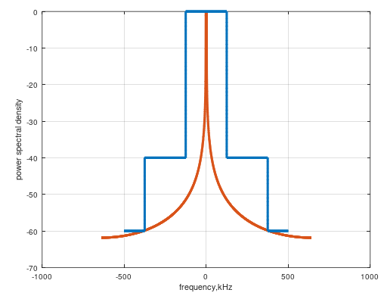
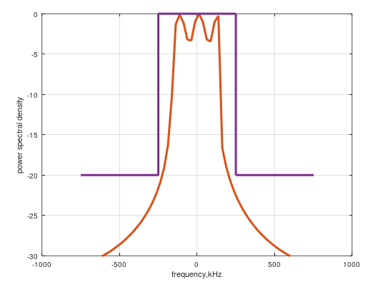
OFDM-based WPT Waveform (2/2)
May flexibly satisfy different regulations
  Can utilize bandwidth flexibly by adjusting number of subcarriers with non-zero coefficients
    For example, for wider bandwidth and relaxed TX mask, may use more subcarriers with non-zero coefficients; for narrower bandwidth and strict TX mask, may use less subcarriers with non-zero coefficients.
Use less subcarriers, China RFID regulation transmit mask [14]
Use more subcarriers, US S1G regulation transmit mask [15]
Notes:
Both US and China example

Slide 6
Why not use existing PPDUs as AMP WPT PPDU
Theoretically any PPDU in S1G can be used for AMP WPT, but existing PPDUs may have problems and developing new AMP WPT PPDU brings benefits.
Problems adopting 11ah PPDU for AMP WPT:
  China has only RFID spectrum in S1G and doesn’t support 11ah channelization.
Benefits developing new AMP WPT PPDU:
  AMP WPT PPDU may have specific preamble, for potential coexistence and power management.
    If other devices identify an AMP WPT PPDU, it may postpone sending other PPDUs.

Slide 7
Summary
This contribution discusses the benefits of OFDM-based WPT waveform
  May achieve high PAPR, thus increasing RF-to-DC conversion efficiency
  May flexibly satisfy different regulations

Slide 8
Reference
[1] 11-24-0575-01-0amp-p802-11bp-par.
[2] 11-24-0835-00-00bp-overview-of-s1g-and-rfid-spectrum.
[3] 11-24-0900-00-00bp-wireless-power-transfer-and-frequency-regulation.
[4] 11-24-1208-00-00bp-thoughts-on-the-amp-wpt-protocol.
[5] 11-24-1524-02-00bp-follow-up-on-the-amp-wpt-protocol.
[6] 11-24-1381-00-00bp-amp-device-power-status.
[7] 11-24-1520-00-00bp-charging-and-discharging-intervals-in-passive-amp-stas.
[8] 11-24-1539-00-00bp-energy-level-status-reporting-for-amp-devices.
[9] 11-24-1561-02-00bp-amp-power-budget-negotiation.
[10] 11-24-1536-00-00bp-wireless-power-transfer-for-amp.
[11] 11-24-1551-01-00bp-wpt-waveform-discussion.
[12] Collado, Ana, and Apostolos Georgiadis. "Optimal waveforms for efficient wireless power transmission." IEEE microwave and wireless components letters 24.5 (2014): 354-356.
[13] B. Clerckx and E. Bayguzina, "Waveform Design for Wireless Power Transfer," in IEEE Transactions on Signal Processing, vol. 64, no. 23, pp. 6313-6328, 1 Dec.1, 2016.
[14] 关于发布800/900MHz 频段射频识别（RFID）技术应用试行规定的通知.
[15] https://www.law.cornell.edu/cfr/text/47/15.247.

Slide 9
SP
Do you agree to add following content to sub-clause 4 of SFD:
  IEEE 802.11bp shall specify OFDM-based WPT PPDU format in sub-1 GHz. The detailed WPT PPDU format is TBD.
  Yes
  No
  Abstain

Slide 10
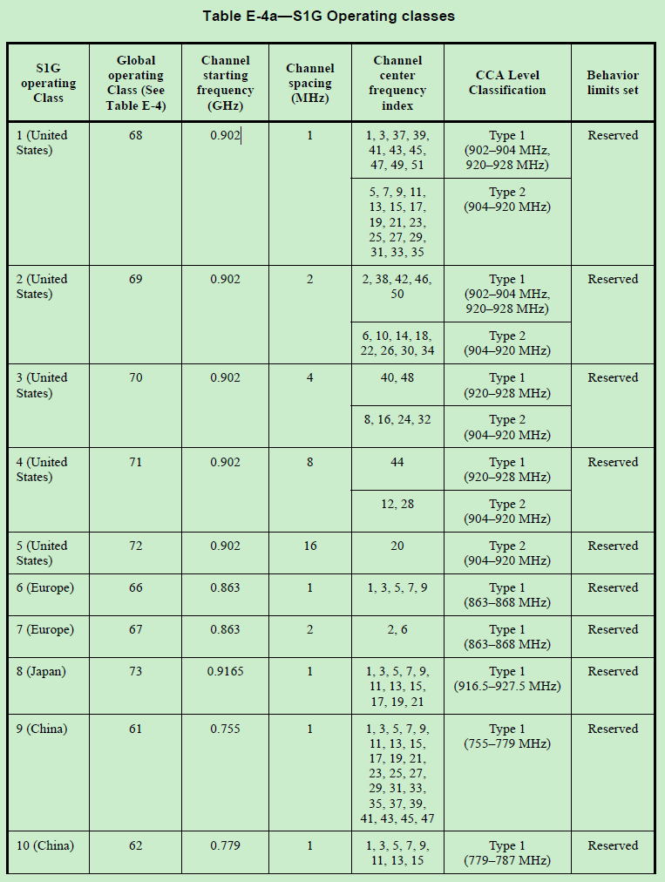
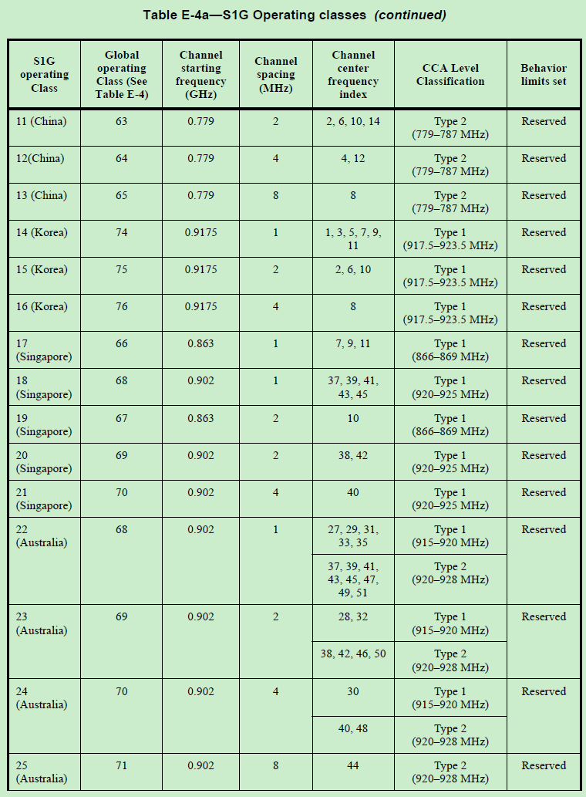
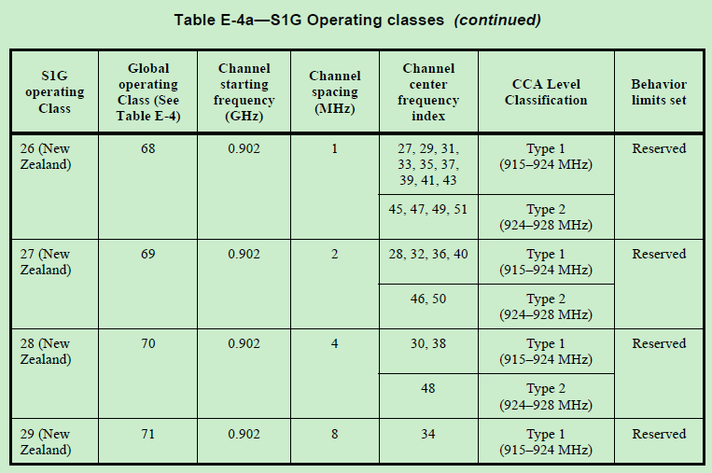
Appendix 1: 11ah Operating Class

Slide 11
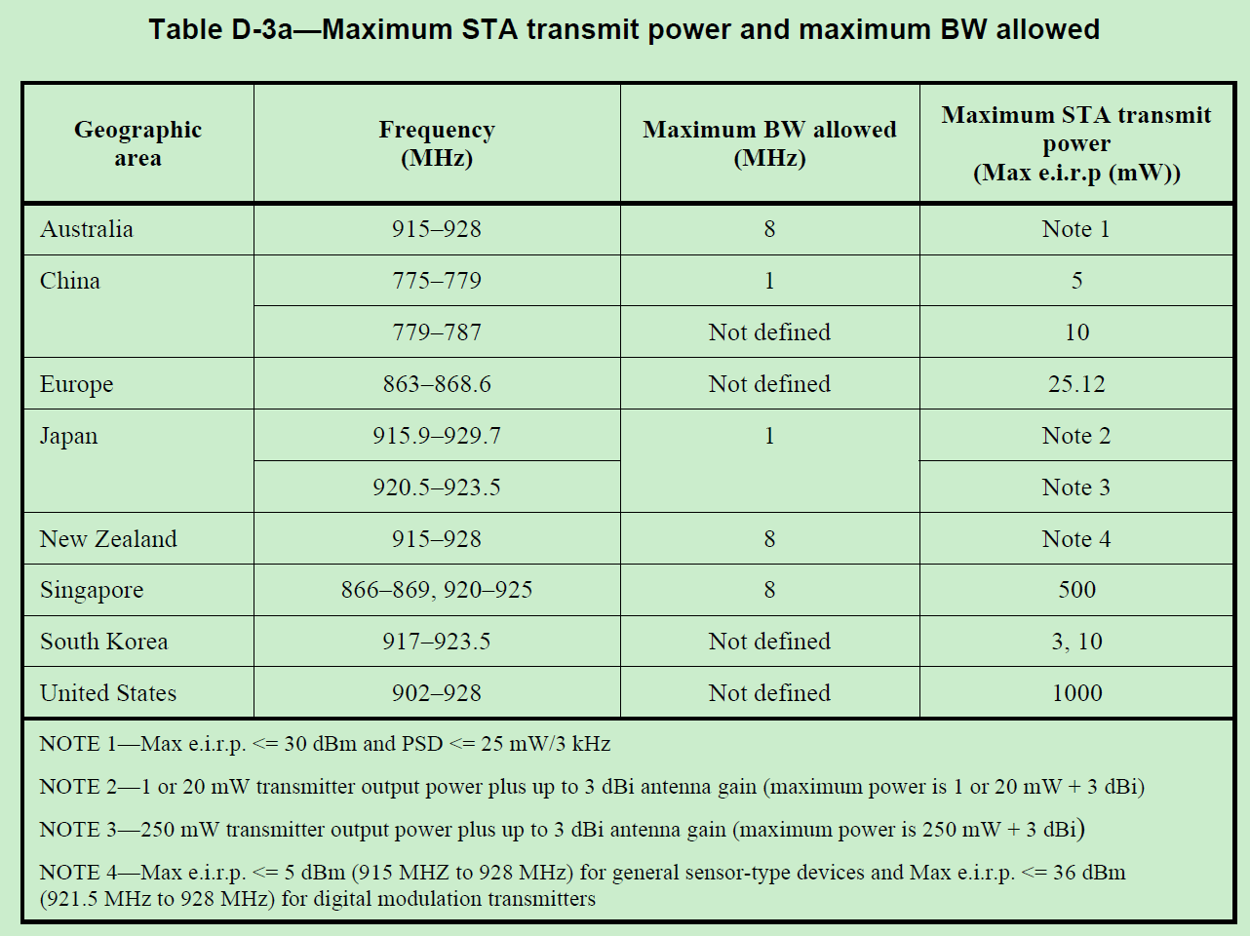
Appendix 2: 11ah max TX Power

Slide 12
Appendix 3: China and US S1G regulation
Europe TBD.
 | China [i] | US [ii]
 | RFID | Frequency hopping spread spectrum | Digital modulated systems
Bands (MHz) | 840-845, 920-925 | 902-928
Bandwidth | 250 kHz
TX power | 2W (ERP) =35.15 dBm(EIRP)) | >=50 channel: 36 dBm (EIRP) <50 channel: 30 dBm (EIRP) | 36 dBm (EIRP); <=8 dBm in any 3 kHz
Transmit mask | Adjacent Channel Power Ratio (ACPR): 40dB (first adjacent channel), 60 dB (second adjacent channel) | Channel<250kHz, at least 50 channels; Channel>250kHz, at least 25 channels; Maximum allowed 20dB bandwidth is 500kHz | minimum 6 dB bandwidth shall be at least 500 kHz
[i] 关于发布800/900MHz 频段射频识别（RFID）技术应用试行规定的通知.
[ii] https://www.law.cornell.edu/cfr/text/47/15.247.

