Slide 1
AMP time-based channel access for Active tags
Date: 5 November 2024
Name | Affiliation | Address | Phone | Email
Rojan Chitrakar | Huawei | Singapore |  | rojan.chitrakar@huawei.com
Lei Huang
Ian Bajaj
Notes:
Jul 12, 2010
Page 1

Slide 2
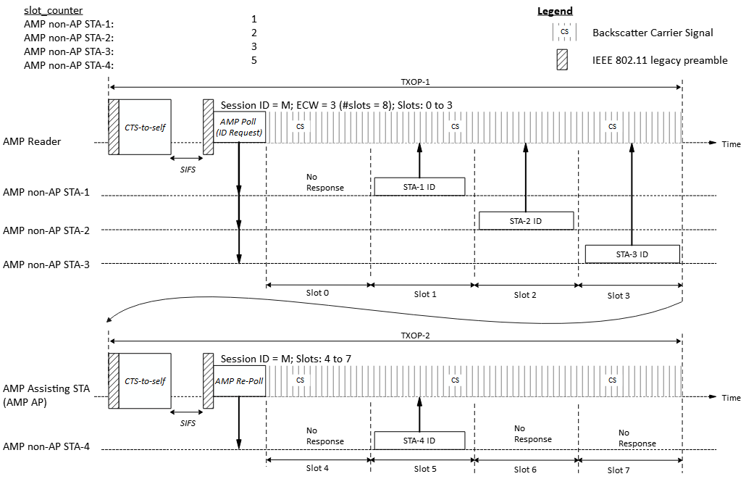
Recap: Time-slot based random access
Time based channel access schemes are discussed in [1], [2].
In [3] we shared a potential time-slot based random access scheme:
AMP AP gains access to wireless medium and transmits an AMP Poll frame to starts a random access session with 2^{ECW} time slots.
Upon receiving the AMP Poll frame, eligible AMP STAs randomly choose a slot and transmit in the slot.
A second AMP frame (AMP Re-Poll) continues the random access session in a different TXOP.
Example: 8 slots spread across two TXOPs and four backscattering AMP STAs contending
In [4] we shared time-slot based selective retransmission.

Slide 3
Discussion
The active AMP tags are expected to have higher hardware capabilities compared to backscatter AMP tags:
Clock accuracy ±10³ ppm => scheduled/polled events are possible.
Larger energy capacity => Transactions can continue across TXOPs.
Higher TX Power => Longer charging time => Conducive to batch operation
In [5] we proposed: Two different channel access mechanisms for Active AMP tags and Backscatter AMP tags:
For backscatter AMP tags, the logical interface of the UHF protocol is reused (using AMP frames that encapsulates UHF commands).
For active AMP tags, more efficient time-slot based channel access scheme may be used.

Slide 4
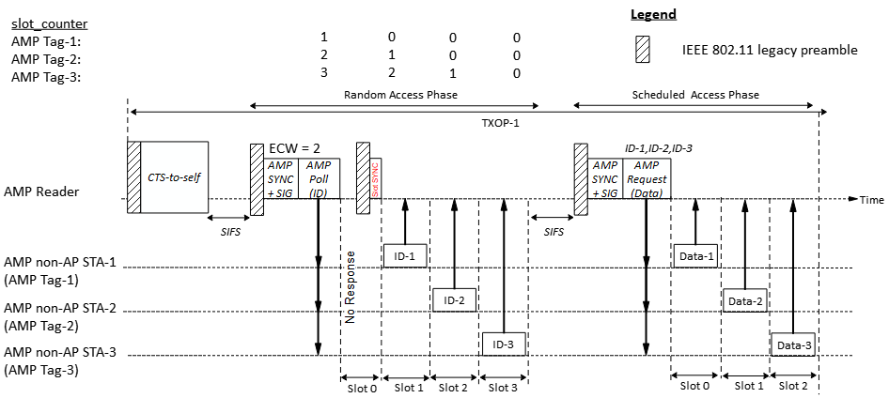
Active AMP tags (1)
For active AMP tags, time-slot based channel access may be used. 1. During random access phase:
Multiple tags may respond during the random access phase.
A short downlink transmission may be used to shorten slots without any responses, while guard time may be used in slots with responses.

Slide 5
Active AMP tags (2)
2. During scheduled access phase:
The AMP Reader transmits an AMP Request frame to schedule multiple tags to respond in different time-slots.
The scheduled Access phase may occur in the same TXOP as the random access phase.

Slide 6
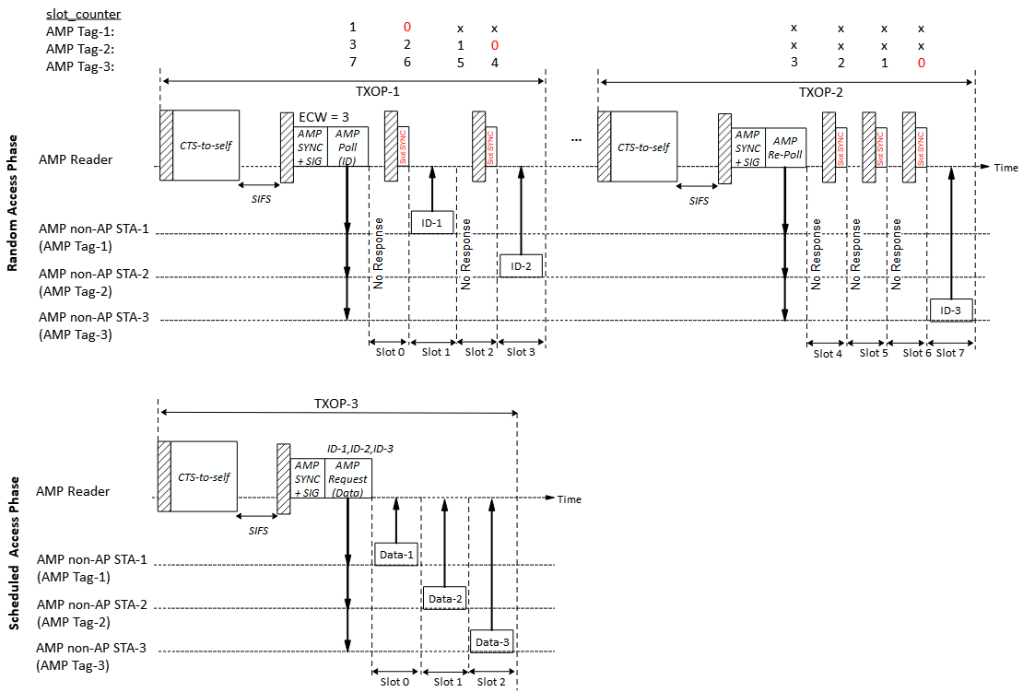
Active AMP tags (3)
A random access session may span multiple TXOPs.
The scheduled Access phase may occur in a different TXOP.

Slide 7
Summary
We discussed the capabilities of active AMP tags and proposed that time-slot based channel access be considered for active AMP tags:
Multiple tags may respond during a random access phase.
A random access session may span multiple TXOPs.
The scheduled Access phase may occur in the same or a different TXOP.

Slide 8
SP 1
Do you agree that:
802.11bp supports a time-slot based random access mechanism for Active Uplink Tx non-AP AMP STA?

Slide 9
SP 2
Do you agree that:
The time-slot based random access mechanism for Active Uplink Tx non-AP AMP STA may span multiple TXOPs?

Slide 10
References
[1] 23/827r0, AMP IoT Medium Access (Sebastian Max et. al.).
[2] 24/421r0, AMP link access (Solomon Trainin et. al.).
[3] 24/1212r0, Discussions on AMP Channel access (Rojan Chitrakar et. al.)
[4] 24/1549r0, Follow-up on AMP Channel access (Rojan Chitrakar et. al.)
[5] 24/18050r0, AMP time-based channel access discussion (Rojan Chitrakar et. al.)

