Slide 1
Sync field for AMP PPDU
Nov. 2024
Doc.: IEEE 802.11-24/1803r0
Date: 2024-09-03
Authors:
Name | Affiliation | Address | Phone | Email
Wang Ke | OPPO |  |  | wangke6@oppo.com
Jinyu Zhang |  |  |  | xuweijie@oppo.com
Weijie Xu |  |  |  | v-qiyinan@oppo.com
Yinan Qi
Sehngjiang Cui

Slide 2
Abstract
Doc.: IEEE 802.11-24/1803r0
In this contribution, we will firstly discuss the requirement the Sync field and then propose candidate sync sequence.

Slide 3
Requirements for AMP sync
Doc.: IEEE 802.11-24/1803r0
The following requirements need to be considered for AMP sync.
Different sync sequences for DL/UL for indication.
Support two different AMP DL rate
1Mbps and 250kbps using 2 different sync
A correlator can distinguish between Sync length 16 and 32.
The Sync sequence has the same number of 1 and 0.
Good auto-correlation
The sequence have 3 consecutive 1/0, which can help distinguish synchronization field and data field with Manchester coding.

Slide 4
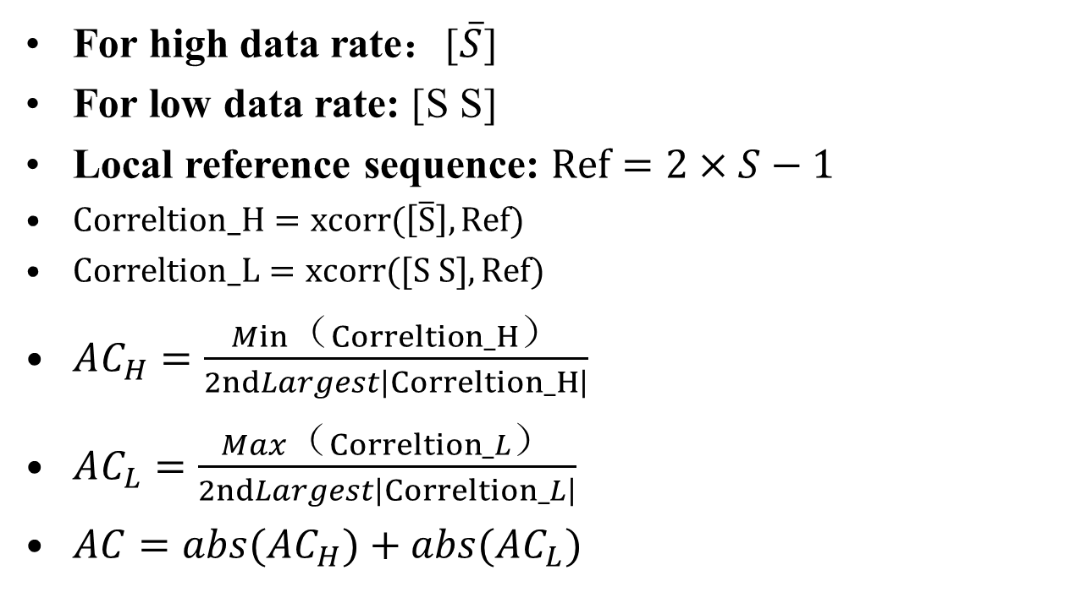
Auto-Correlation Metrics
Doc.: IEEE 802.11-24/1803r0
For high data rate：[$\overline{S}$]
For low data rate: [S S]
Local reference sequence: $Ref=2×S−1$
$Correltion_H=xcorr(\left[\overline{S}\right], Ref)$
$Correltion_L=xcorr([S S], Ref)$
$AC_{H}=\frac{Min（Correltion_H）}{2ndLargest\left|Correltion_H\right|}$
$AC_{L}=\frac{Max（Correltion_L）}{2ndLargest\left|Correltion_L\right|}$
$AC=abs(AC_{H})+abs(AC_{L})$

Slide 5
Cross-Correlation Metrics
Doc.: IEEE 802.11-24/1803r0
The Sync sequence will be correlated with other filed of the UL/DL PPDU e.g., random Manchester coding symbols to see the cross-correlation property
The sync sequence shall maintain low cross-correlation with other filed of UL/DL PPDU

Slide 6
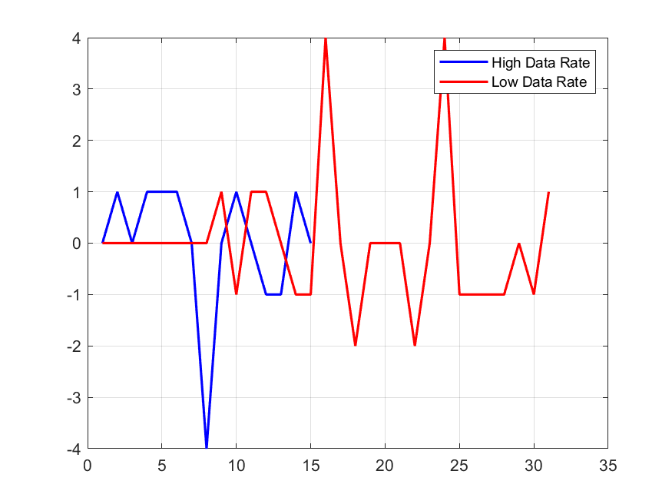
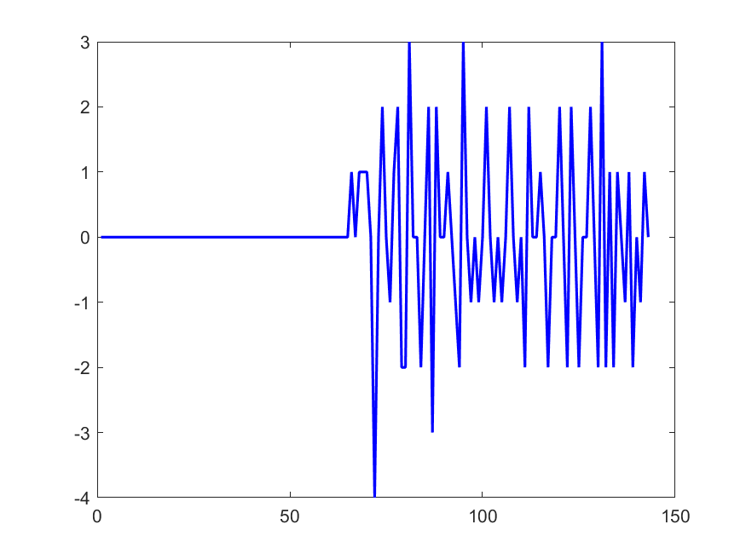
Sync sequence length(1)
Doc.: IEEE 802.11-24/1803r0
For length 8, the auto-correlation is not so good and cross-correlation with random Manchester symbols become unacceptable.
The best sequence after computer searching is '10001101'
AC_H: -4 AC_L: 2
Cross-correlation with Random Manchester symbols

Slide 7
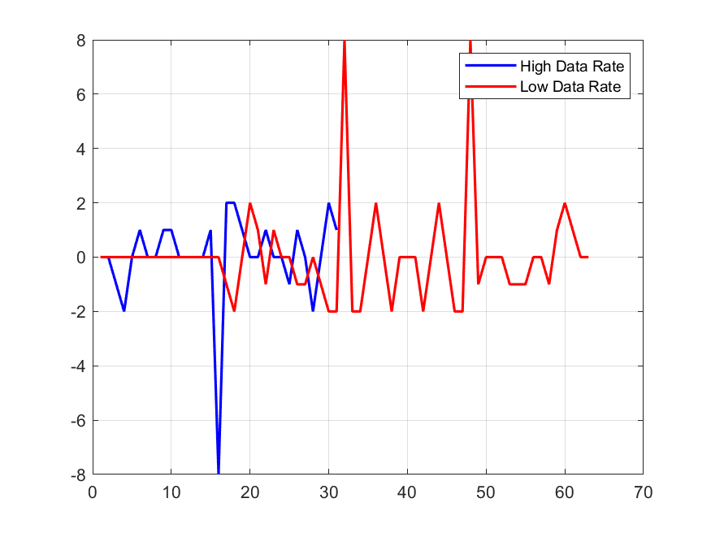
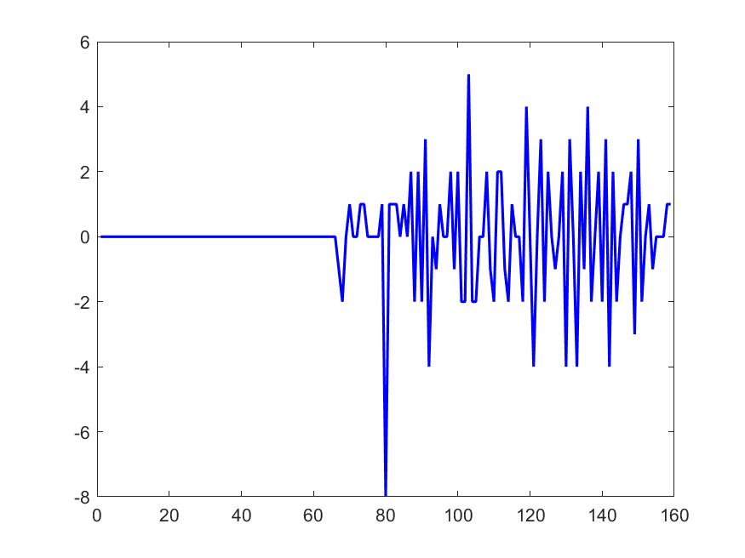
Sync sequence length(2)
Doc.: IEEE 802.11-24/1803r0
For length 16, the auto-correlation is better and cross-correlation with random Manchester symbols is good
One candidate sequence after computer searching is '1100100101011100'
AC_H: -4 AC_L: 2
Cross-correlation with Random Manchester symbols

Slide 8
Summary
Doc.: IEEE 802.11-24/1803r0
In this submission, sync sequence for AMP is discussed. Based on the discussion, the following is proposed.
Basic sync length is 16, one proposed sequence is
S1= '1100100101011100’

