Slide 1
Robust Method for AMP Active Uplink Multiple Data Rate Support
Date: 2024-11-11
Authors:
Name | Affiliations | email
Steve Shellhammer | Qualcomm | shellhammer@ieee.org
Pooria Pakrooh |  | ppakrooh@qti.qualcomm.com
Bin Tian |  | btian@qti.qualcomm.com

Slide 2
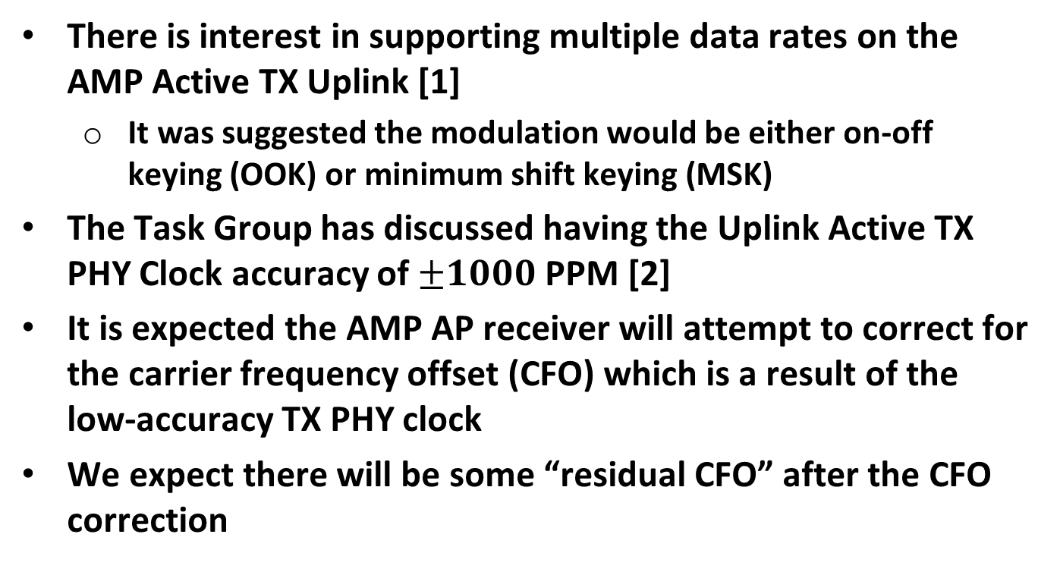
Introduction
There is interest in supporting multiple data rates on the AMP Active TX Uplink [1]
  It was suggested the modulation would be either on-off keying (OOK) or minimum shift keying (MSK)
The Task Group has discussed having the Uplink Active TX PHY Clock accuracy of $±1000$ PPM [2]
It is expected the AMP AP receiver will attempt to correct for the carrier frequency offset (CFO) which is a result of the low-accuracy TX PHY clock
We expect there will be some “residual CFO” after the CFO correction

Slide 3
Background
In [1] they suggested several data rates could be supported using different modulation rates, and inclusion of a rate ½ convolutional FEC code for some data rates
The different modulation rates results in different signal bandwidths, varying between 1 MHz and 16 MHz
They pointed out in [1] that the AMP Uplink Transmitter power consumption does not vary much with the different modulation rates

Slide 4
Advantages of Wider Bandwidth Signals
There are several advantages of wider bandwidth signals
More Robust to Narrowband Fading
  As is well known, in a Multipath environment, there is narrowband fading, and a narrowband signal is susceptible to large drops in receive power level
  Wider band signals, will likely have only a fraction of the signal affected by narrowband fading, and still have good receive power level
More Robust to Residual CFO
  The residual CFO will affect MSK demodulation, particularly for lower modulation rates
  More details in subsequent slides

Slide 5
MSK Frequency Deviation versus Modulation Rate
Here we provide a little more background on MSK
In MSK the frequency deviation is half the symbol rate
Here we use the symbol rates from [1]
MSK Symbol Rate | MSK Frequency Deviation
1 MHz | 0.5 MHz
2 MHz | 1 MHz
4 MHz | 2 MHz
8 MHz | 4 MHz
16 MHz | 8 MHz

Slide 6
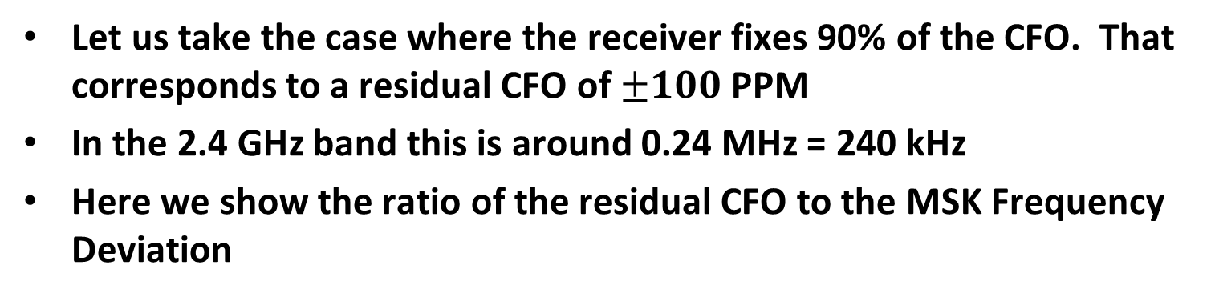
Relationship between Residual CFO and MSK Frequency Deviation
Let us take the case where the receiver fixes 90% of the CFO. That corresponds to a residual CFO of $±100$ PPM
In the 2.4 GHz band this is around 0.24 MHz = 240 kHz
Here we show the ratio of the residual CFO to the MSK Frequency Deviation
MSK Symbol Rate | MSK Frequency Deviation | Residual CFO | Ratio of Residual CFO to Frequency Deviation
1 MHz | 0.5 MHz | 0.24 MHz | 0.48
2 MHz | 1 MHz | 0.24 MHz | 0.24
4 MHz | 2 MHz | 0.24 MHz | 0.12
8 MHz | 4 MHz | 0.24 MHz | 0.06
16 MHz | 8 MHz | 0.24 MHz | 0.03

Slide 7
Observations
1 MHz Bandwidth
  We see that for the 1 MHz bandwidth case the residual CFO is 0.24 MHz, and the frequency deviation is 0.5 MHz
  The residual CFO is almost as large as the MSK frequency deviation, making MSK demodulation difficult
16 MHz Bandwidth
  We see that for the 16 MHz bandwidth case the residual CFO is 0.24 MHz, and the frequency deviation is 8 MHz
  The residual CFO is much smaller than the MSK frequency deviation, making MSK demodulation much easier

Slide 8
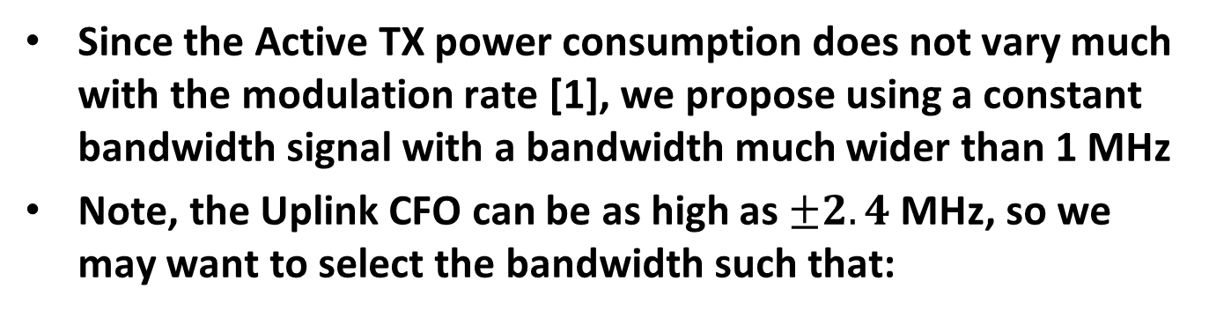
Proposal
Since the Active TX power consumption does not vary much with the modulation rate [1], we propose using a constant bandwidth signal with a bandwidth much wider than 1 MHz
Note, the Uplink CFO can be as high as $±2.4$ MHz, so we may want to select the bandwidth such that:
$$BW<20 −\left(2×2.4\right)=15.2 MHz$$
The exact bandwidth is TBD in this proposal

Slide 9
Multiple Data Rate Support
How do we support multiple data rates?
We know that the AMP AP has a rate ½ convolutional decoder, used in other 802.11 standards
At the AMP STA Transmitter we can combine a rate ½ convolutional encoder with several repetition codes, depending on the desired data rates
At the AMP AP Receiver we can use soft combining of the repetition coded and the rate ½ convolutional decoder

Slide 10
Example
Use MSK
Bandwidth = 12 MHz (other choices are possible)
In some case, more than 3 dB steps between data rates, to obtain a wide SNR dynamic range without too many data rates
This general approach works with OOK, different data rates, etc.

Slide 11
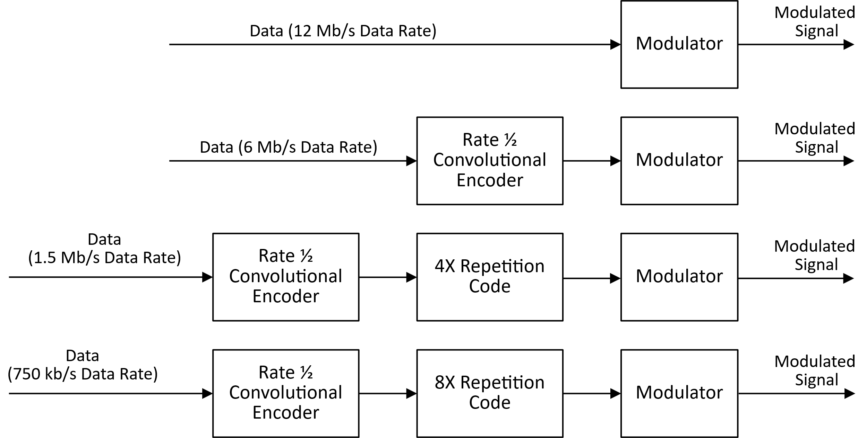
Example – AMP STA Transmitter

Slide 12
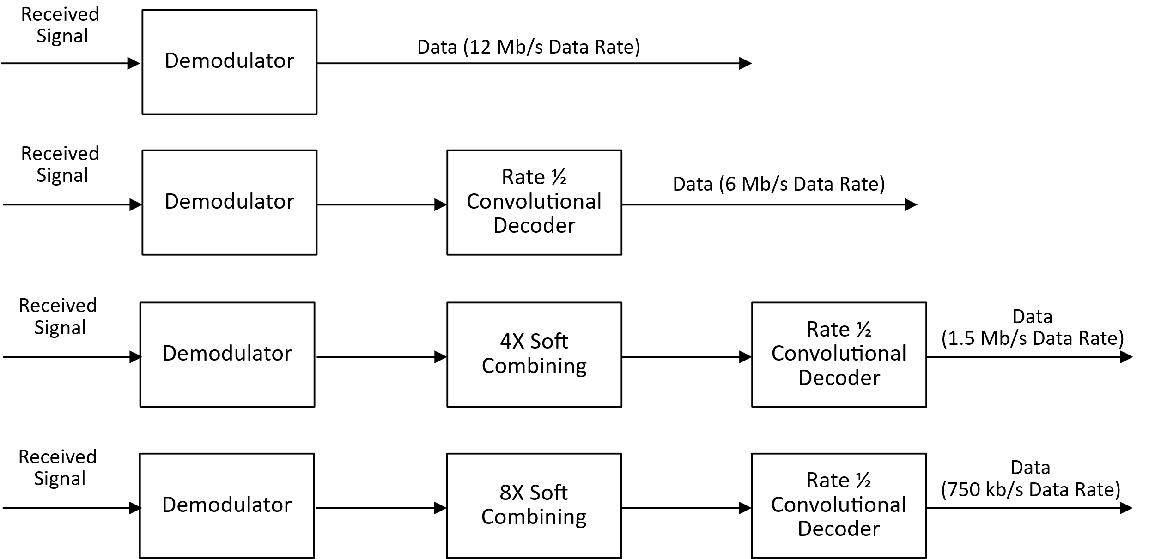
Example – AMP AP Receiver

Slide 13
Summary
We identified advantages of wideband waveforms
We proposed using a constant bandwidth much larger than 1 MHz
We showed how combing a rate ½ convolutional encoder with repetition codes can be used to support a range of data rates, while maintaining a constant bandwidth
We provided an example at the AMP STA Transmitter and the AMP AP Receiver

Slide 14
Straw Poll #1
Do you agree to add following content to sub-clause 4 of SFD:
  The AMP Active TX Uplink will use a constant bandwidth waveform, much larger than 1 MHz, and will support multiple data rates with the use of a rate ½ convolutional encoder and one or more repetition codes

Slide 15
References
Amichai Sanderovich, et. al., “Uplink Rates for Active Transmission,” IEEE 802.11-24/1497r0, September 2024
Weijie Xu, et. al., “Discussion on ultra-low power timing clock,” IEEE 802.11-24/1475r1, September 2024

