Slide 1
AMP Downlink Data Rates
Date: 2024-11-13
Authors:
Name | Affiliations | email
Steve Shellhammer | Qualcomm | shellhammer@ieee.org
Bin Tian |  | btian@qti.qualcomm.com
Pooria Pakrooh |  | ppakrooh@qti.qualcomm.com

Slide 2
Introduction
At the September meeting the Task Group made several decisions about the AMP Downlink PPDU [1]
  Some Details on the Structure of the Downlink PPDU
  AMP Sync field and AMP Data field with use OOK
  AMP Data field (for non-backscatter case) will use Manchester encoding. Encoding scheme for backscatter case is TBD.
In July [2] we presented some initial thoughts on the Downlink for the Integrated Energizer case
In September [3] there was a presentation on the Downlink Design considerations
Here we will focus on the selection of the downlink Data Rates

Slide 3
Supported STA Types
The Task Group has agreed to support the following STA Types operating in 2.4 GHz [1]
Device Type
Low-power Legacy STA
Active TX Uplink
Bi-static backscatter
Close-range mono-static backscatter

Slide 4
Background
In [2] we proposed a Downlink data rate of 1 Mb/s using a single carrier OOK waveform
In [3] they proposed supporting two data rates
  One high rate of at least 1 Mb/s
  One low rate of at most 250 kb/s
In [4] they propose three data rates to support Bi-static Backscatter STAs
  250, 125, and 62.5 kb/s
In [5] they propose two downlink data rates
  1 Mb/s
  250 kb/s

Slide 5
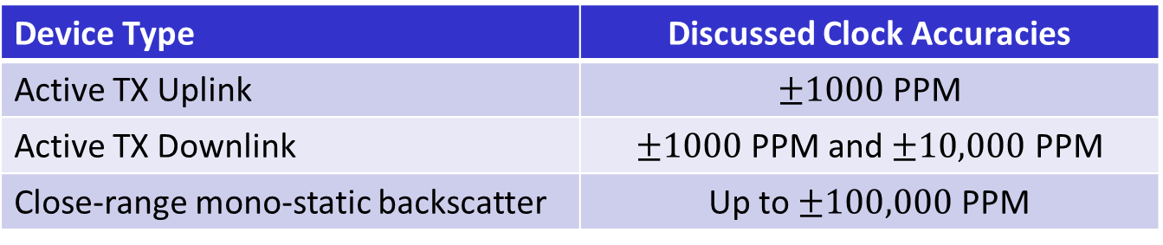
Capabilities of Different STA Types
Task Group has discussed the following clock accuracy values
Device Type | Discussed Clock Accuracies
Active TX Uplink | $±1000$ PPM
Active TX Downlink | $±1000$ PPM and $±10,000$ PPM
Close-range mono-static backscatter | Up to $±100,000$ PPM
It is possible that different STA types may have different receiver clock accuracies
It was suggested in [3] that some STA types may support a maximum clock rate based on power consumption constraints
Summary
  Different device types may have different receiver capabilities

Slide 6
Impact of Receiver Clock Accuracy and Clock Rate
The receiver clock accuracy will lead to carrier frequency offset (CFO) and sample clock offset (SCO)
The receiver bandwidth need to consider the CFO
The sample clock offset requires the receiver to correct its sampling of the OOK symbols
The maximum clock rate combined with the sample clock offset can put a limit on the supported data rate [3]
Hence, we will likely want to support two data rates
  A higher data rate for more capable devices
  One or more lower data rate(s) for less capable devices

Slide 7
High Data Rate
The bandwidth in IEEE 802.11ba is 4 MHz
There were to reasons to select this bandwidth:
  To allow for a low complexity receiver filter that provides some adjacent channel rejection
  To transmit at an acceptable power level, based on PSD regulations in ETSI and China
Here we are suggesting for the high data rate, to keep the bandwidth at 4 MHz
This can be implemented by a single-carrier OOK waveform with a 2 MHz symbol rate (see next slide)
With Manchester encoding (as agreed to for the non-Backscatter case) this provides a 1 Mb/s data rate

Slide 8
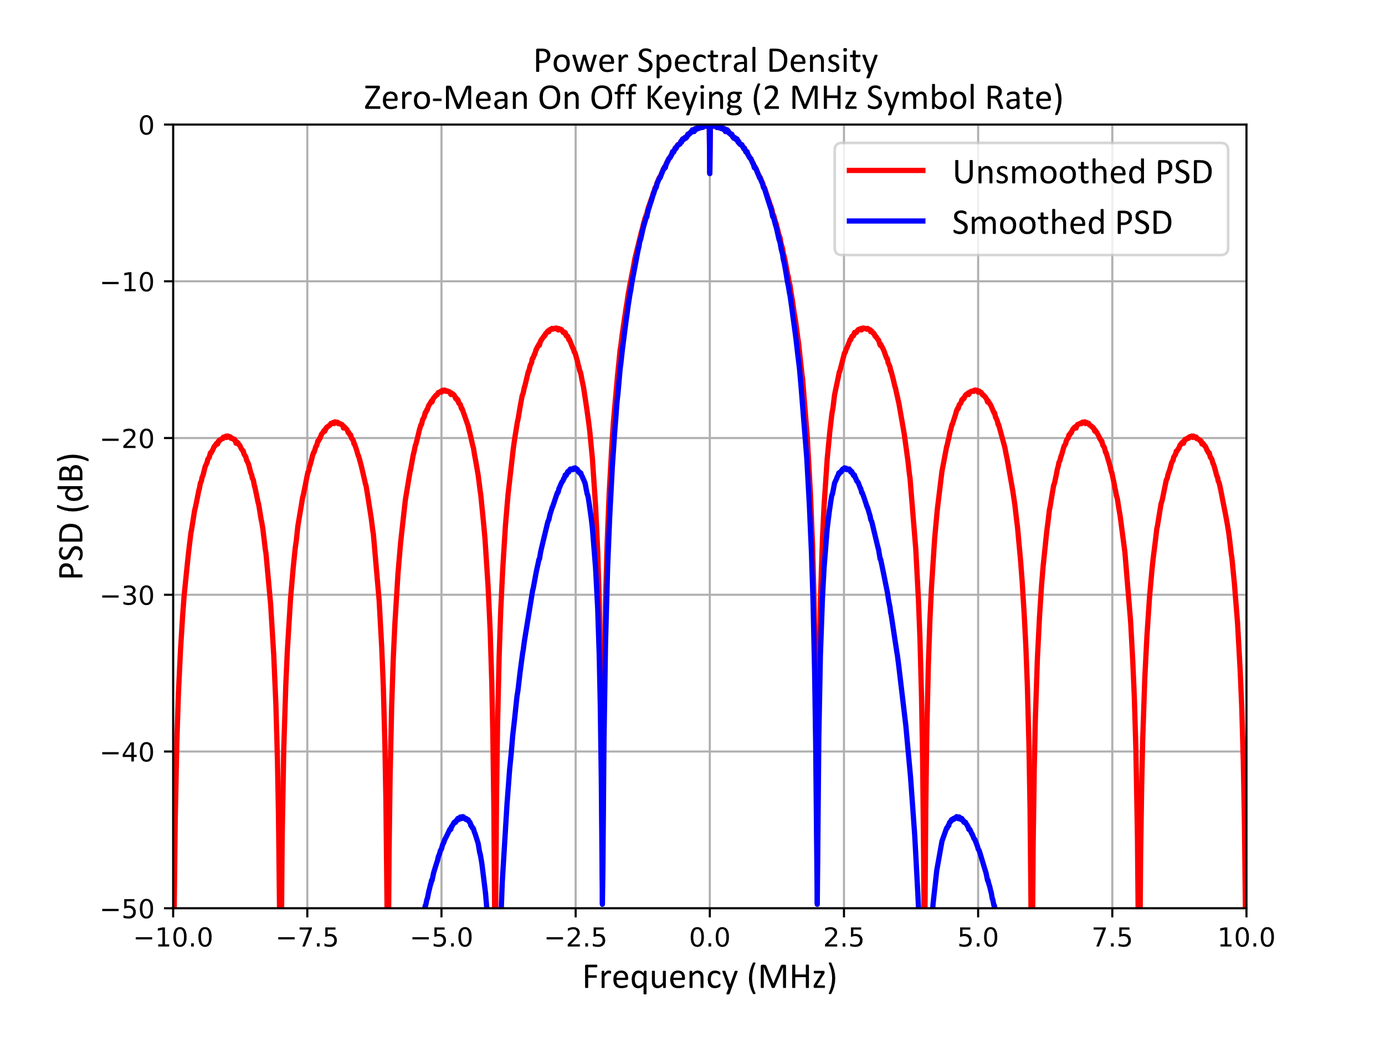
Power Spectral Density
Single carrier OOK with a symbol rate of 2 MHz
Smoothed PSD with a simple Butterworth filter for spectral filtering

Slide 9
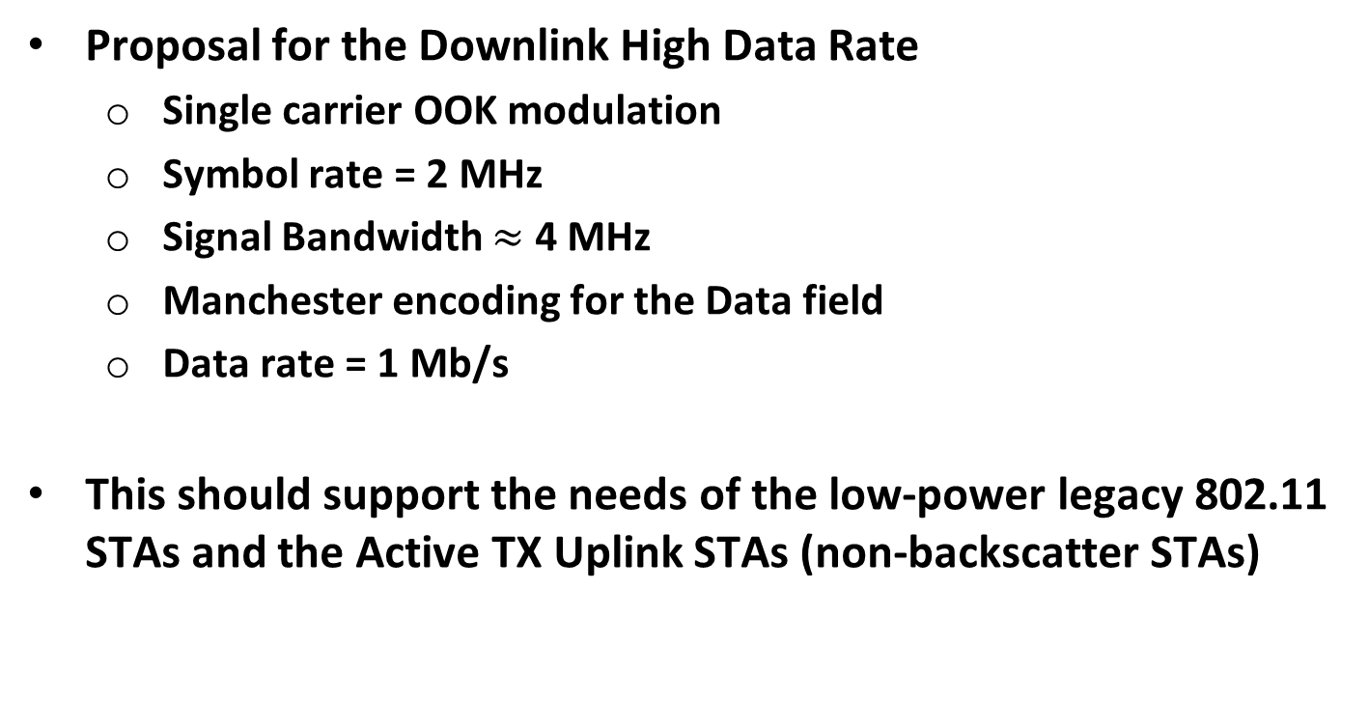
Proposal for the Downlink High Data Rate
Proposal for the Downlink High Data Rate
  Single carrier OOK modulation
  Symbol rate = 2 MHz
  Signal Bandwidth $≈$ 4 MHz
  Manchester encoding for the Data field
  Data rate = 1 Mb/s
This should support the needs of the low-power legacy 802.11 STAs and the Active TX Uplink STAs (non-backscatter STAs)

Slide 10
Low Data Rate (for Backscatter STAs)
As suggested in [3] Backscatter STAs will require a lower symbol rate, based on clock accuracy and maximum clock rate constraints
It is also possible to support more than one lower data rate as suggested in [4]
  However, we prefer not to support too many downlink data rates
In [5] they suggested one lower data rate of 250 kb/s
Selection of that data rate(s) less than 1 Mb/s TBD
  Discussion needed on best Downlink data rate(s) for backscatter devices

Slide 11
Summary
Discussed two Downlink data rates to support devices with different receiver capabilities
Proposed a High Data Rate of 1 Mb/s
Proposed a Low Data Rate of 250 kb/s

Slide 12
Straw Poll #1
Do you agree to add the following content to sub-clause 4 of SFD:
  The AMP Downlink PPDU shall support the following data rates:
    1 Mb/s (for non-Backscatter STAs only)
    250 kb/s

Slide 13
References
Yinan Qi, “Specification Framework for TGbp,” IEEE 802.11-24/1613r2, September 2024
Steve Shellhammer, Bin Tian, and Pooria Pakrooh, “WUR for Integrated Energizer Case,” IEEE 802.11-24/1163r0, July 2024
Rui Cao, et. al., “AMP DL PPDU Design Considerations,” IEEE 802.11-24/1557r0, September 2024
Bin Qian, Lei Huang, Panpan Li, David, Xun Yang, “Downlink Data Rates for Bi-static Backscattering,” IEEE 802.11-24/1731r1, November 2024
Weijie Xu, et. al., “Data rates for AMP,” IEEE 802.11-24/1801r0, November 2024

