Slide 1
CoBF: Partial Nulling Feedback Types
Date: November 2024
Authors:

Slide 2
Introduction
Partial-nulling CoBF has been discussed in multiple contributions [1-9] and its advantages compared to full nulling have been shown (for ex. [7]). We agree with the observations that refer to partial nulling as being superior compared to full nulling and therefore becoming the prevalent use-case.
Two different types of feedback have been proposed for supporting partial nulling:
  Separate channel decomposition for the direct channel and the interference channel [2]
  Joint channel decomposition of the concatenated direct and interference channels [7-9]
In this contribution we analyze these two feedback types and compare them based on the figures of merit proposed in [10]

Slide 3
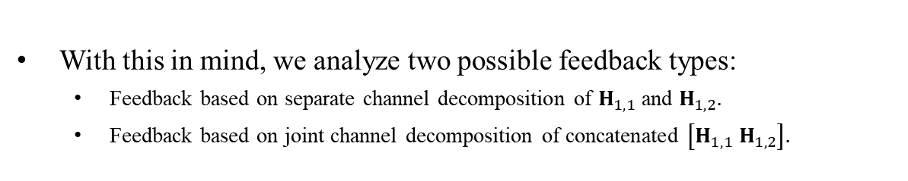


Partial Nulling Scenario
Discussed scenario:
  2APs, each with 4TX antennas
  Each AP has 2 associated STAs, each with 2RX antennas
  Each STA receives 1SS and feedbacks 1 singular vector
  Consequently: AP TX-DoF allow nulling of only one singular mode towards each OBSS STA and STA RX-DoF allow only rank-1 interference mitigation
The received signal at STA1, for instance, is:
For efficient interference mitigation @STA1, the (feedback-based) precoder design should ensure that the covariance matrix of total interference $g_{2}+g_{3,4}$is rank-1.
STA1
AP1
STA2
$$H_{1,1}$$
AP2
STA3
STA4
With this in mind, we analyze two possible feedback types:
  Feedback based on separate channel decomposition of $H_{1,1}$ and $H_{1,2}.$
  Feedback based on joint channel decomposition of concatenated $\left[H_{1,1} H_{1,2}\right].$

Slide 4

Separate Channel Decomposition
STA1 first decomposes (its estimate of) $H_{1,1}$:
AP1 sets $w_{2}$ in the null-space of the reported ${{\overline{v}}_{1,1}}^{∗}$, so the interference $g_{2}$ becomes:
i.e. interference modulated over ${\tilde{u}}_{1,1}$.
STA1
AP1
STA2
$$H_{1,1}$$
AP2
STA3
STA4
The derivation above (and in the following slides) assumes zero-forcing like precoding for simplicity. Obviously, similar precoding variations (e.g. LMMSE) can also be used.

Slide 5

Separate Channel Decomposition (cont.)
STA1 also decomposes $H_{1,2}$ in a similar way:
AP2 sets $w_{3}$, $w_{4}$ in the null-space of reported ${{\overline{v}}_{1,2}}^{∗}$, so the interference $g_{3,4}$ becomes:
i.e. interference modulated over ${\tilde{u}}_{1,2}$.
Covariance matrix of total interference $g_{2}+g_{3,4}$ is rank-2, since it is modulated over both ${\tilde{u}}_{1,1}$and ${\tilde{u}}_{1,2}$. Thus, interference cannot be mitigated by STA1 ☹
STA1
AP1
STA2
$$H_{1,1}$$
AP2
STA3
STA4

Slide 6

Separate Channel Decomposition (cont.)
Alternatively, if STA1 decomposes ${{\overline{u}}_{1,1}}^{∗}H_{1,2}$ (rank-1):
AP2 can set $w_{3}$, $w_{4}$ in the null-space of the reported ${{\overline{v}}_{1,2}}^{∗}$, so the interference $g_{3,4}$ becomes:
  i.e. interference modulated over ${\tilde{u}}_{1,1}$!
Now both $g_{2}$ and $g_{3,4}$ are modulated over ${\tilde{u}}_{1,1}$ so covariance matrix of total interference $g_{2}$ + $g_{3,4}$ is rank-1. Thus, interference can be efficiently mitigated by STA1.
STA1
AP1
STA2
$$H_{1,1}$$
AP2
STA3
STA4

Slide 7
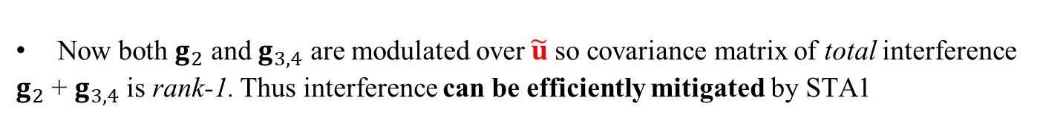

Joint Channel Decomposition
STA1 jointly decomposes the concatenated channel:
  This leads to an SVD-like decomposition of the separate channels:
  [Note: ${\hat{V}}_{1,1}$ and ${\hat{V}}_{1,2}$ are not orthonormal and are different from $V_{1,1}$ and $V_{1,2}$]
AP1 sets $w_{2}$ in the null-space of reported ${{\overline{\hat{v}}}_{1,1}}^{∗}$ and AP2 sets $w_{3}$, $w_{4}$ in the null-space of reported ${{\overline{\hat{v}}}_{1,2}}^{∗}$, so the interferences become:
STA1
AP1
STA2
$$H_{1,1}$$
AP2
STA3
STA4
Now both $g_{2}$ and $g_{3,4}$ are modulated over$\tilde{u}$so covariance matrix of total interference $g_{2}$ + $g_{3,4}$ is rank-1. Thus interference can be efficiently mitigated by STA1

Slide 8
Performance Comparison
We’ve shown that both feedback types can support CoBF schemes with partial nulling by leading to interference alignment.
However, data decoding performance may be different due to:
  Different beamforming gain of the direct communication channels
  Different orthogonality levels between desired signals and residual interference at the STAs.
In next slide we’ll show that separate channel decomposition better fits a CoBF scheme with respect to performance.

Slide 9
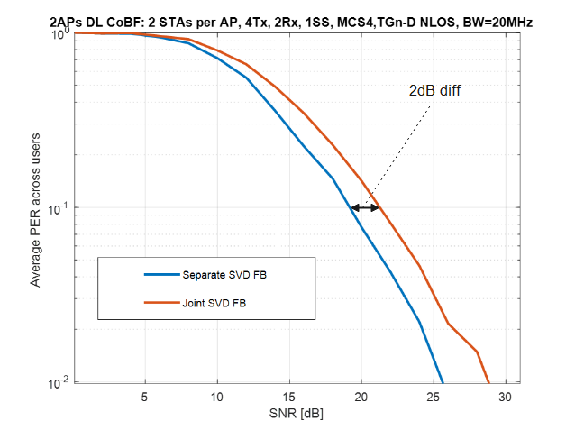
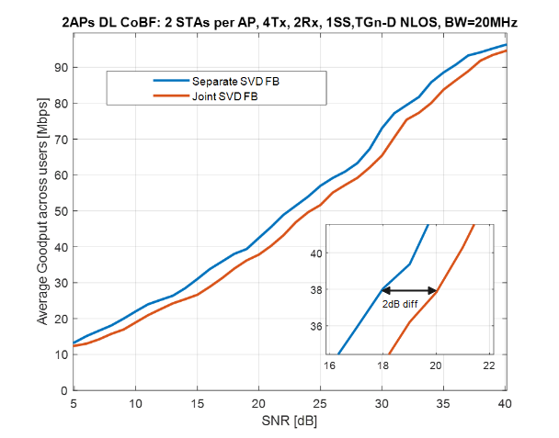
Performance Comparison – Simulation Results
CoBF performance was compared between separate SVD and joint SVD feedback (FB) types.
Linear MMSE equalizer, aware of the interference covariance.
Results: Separate SVD feedback outperforms joint SVD feedback by 2dB.
See Appendix for some intuitive discussion about the source of performance gap.

Slide 10
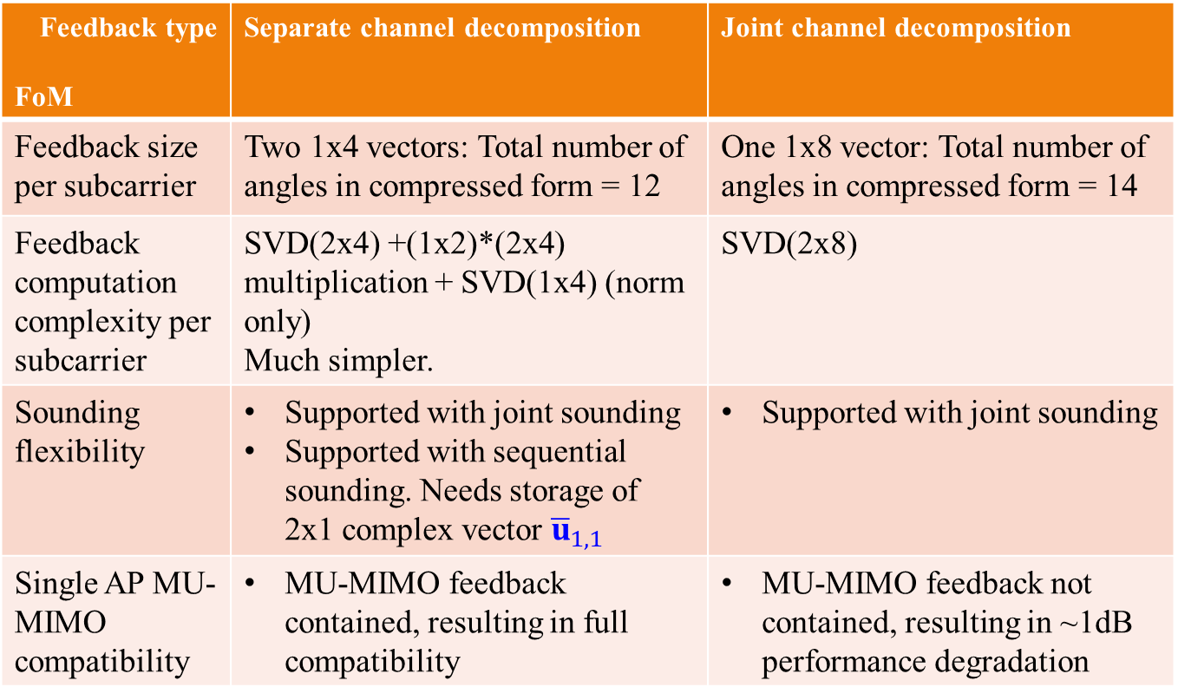
Comparison – other figures of merit
Feedback type FoM | Separate channel decomposition | Joint channel decomposition
Feedback size per subcarrier | Two 1x4 vectors: Total number of angles in compressed form = 12 | One 1x8 vector: Total number of angles in compressed form = 14
Feedback computation complexity per subcarrier | SVD(2x4) +(1x2)*(2x4) multiplication + SVD(1x4) (norm only) Much simpler. | SVD(2x8)
Sounding flexibility | Supported with joint sounding Supported with sequential sounding. Needs storage of 2x1 complex vector ${\overline{u}}_{1,1}$ | Supported with joint sounding
Single AP MU-MIMO compatibility | MU-MIMO feedback contained, resulting in full compatibility | MU-MIMO feedback not contained, resulting in ~1dB performance degradation

Slide 11
Summary
We’ve compared two types of feedback for partial-nulling CoBF with respect to performance and other figures of merit.
We’ve shown that separate channel decomposition based feedback achieves better performance by 2dB compared to joint channel decomposition.
Separate channel decomposition based feedback has additional advantages in terms of feedback size, feedback complexity and MU-MIMO compatibility.
We propose defining the feedback for partial nulling CoBF based on separate channel decomposition.

Slide 12
Straw Poll #1
Do you agree to add the following to the TGbn SFD?
  CoBF feedback based on per-AP channel decomposition with U_used* projection for the OBSS part of the feedback.

Slide 13
References
[1] 11-23-776r1: Performance of C-BF and C-SR, Ron Porat (Broadcom)
[2] 11-23-1998r0: Zero MUI Coordinated BF, Shimi Shilo (Huawei)
[3] 11-24-1204r0: Coordinated Beamforming for 11bn, Insik Jung (LGE)
[4] 11-24-11r0: Coordinated Spatial Nulling Concept, Rainer Strobel (Maxlinear)
[5] 11-24-12r0: Coordinated Spatial Nulling Simulations, Rainer Strobel (Maxlinear)
[6] 11-24-1515r0: Coordinated Beamforming for 11bn – Follow Up, Insik Jung (LGE)
[7] 11-24-1542r0: Sounding Schemes for Coordinated Beamforming, Sameer Vermani (Qualcomm)
[8] 11-24-1568r0: Sounding Design for C-BF, Ron Porat (Broadcom)
[9] 11-24-1582r0: Comparison of Joint and Sequantial Sounding, You-Wei Chen (Mediatek)
[10] 11-24-1484r0: Coordinated BF: Figures of Merit, Shimi Shilo (Huawei)
Notes:
at least one mode of operation capable of improved support, compared to 802.11be, for applications with stringentworst-case latency and jitter requirementscompared to 802.11be // i.e., avoid “worst-case”

Slide 14
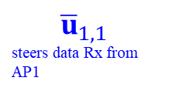
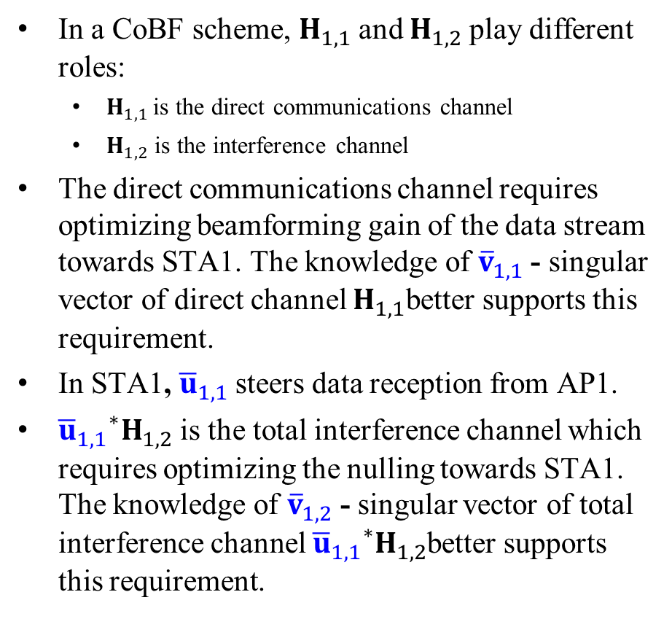
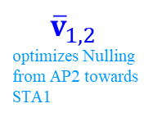
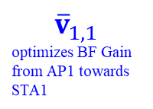
Appendix: Separate Channel Decomposition– Intuitive Discussion
In a CoBF scheme, $H_{1,1}$and $H_{1,2}$play different roles:
  $H_{1,1 }$is the direct communications channel
  $H_{1,2}$ is the interference channel
The direct communications channel requires optimizing beamforming gain of the data stream towards STA1. The knowledge of ${\overline{v}}_{1,1}$- singular vector of direct channel $H_{1,1}$better supports this requirement.
In STA1, ${\overline{u}}_{1,1}$steers data reception from AP1.
${{\overline{u}}_{1,1}}^{∗}H_{1,2}$ is the total interference channel which requires optimizing the nulling towards STA1. The knowledge of ${\overline{v}}_{1,2}$ - singular vector of total interference channel ${{\overline{u}}_{1,1}}^{∗}H_{1,2}$better supports this requirement.
$${\overline{v}}_{1,1}$$
optimizes BF Gain from AP1 towards STA1
$${\overline{u}}_{1,1}$$
steers data Rx from AP1
STA1
AP1
AP2
$${\overline{v}}_{1,2}$$
optimizes Nulling from AP2 towards STA1

Slide 15
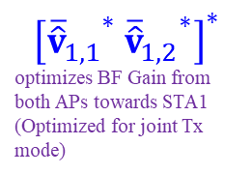
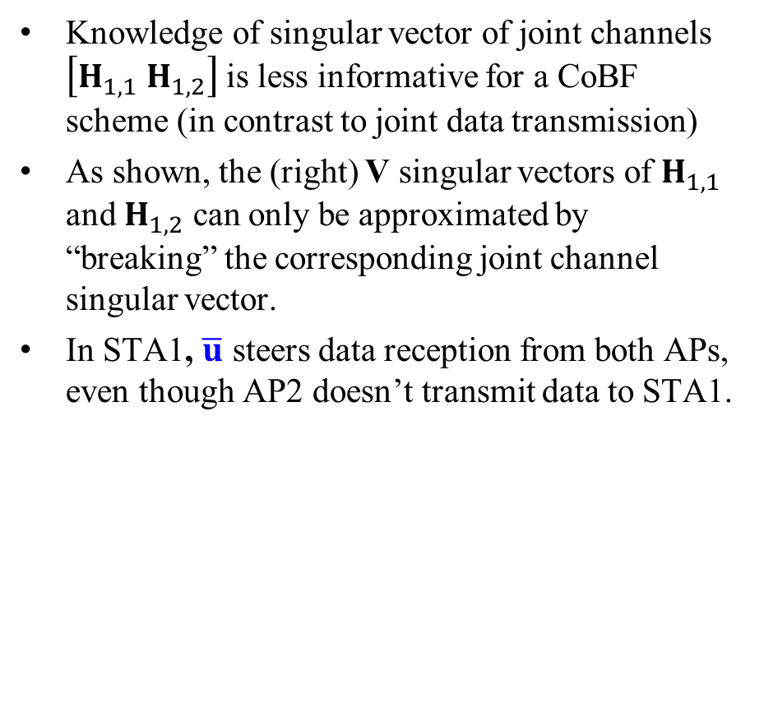

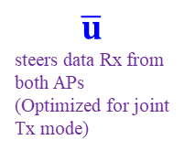
Appendix: Joint Channel Decomposition – Intuitive Discussion
Knowledge of singular vector of joint channels $\left[H_{1,1} H_{1,2}\right]$ is less informative for a CoBF scheme (in contrast to joint data transmission)
As shown, the (right) V singular vectors of $H_{1,1}$ and $H_{1,2}$ can only be approximated by “breaking” the corresponding joint channel singular vector.
In STA1, $\overline{u}$ steers data reception from both APs, even though AP2 doesn’t transmit data to STA1.
STA1
AP1
$$\overline{u}$$
steers data Rx from both APs (Optimized for joint Tx mode)
$$\left[H_{1,1} H_{1,2}\right]$$
AP2
$${\left[{{\overline{\hat{v}}}_{1,1}}^{∗} {{\overline{\hat{v}}}_{1,2}}^{∗}\right]}^{∗}$$
optimizes BF Gain from both APs towards STA1 (Optimized for joint Tx mode)

