Slide 1
Tradeoffs - Active and Backscattering AMP Tags
Date: 2024-11-11
Authors:

Slide 2
Abstract
Link and harvesting performance as well as attributes, of Active versus Backscattering AMP STAs are analyzed and compared.

Slide 3
Background: AMP Active and Backscattering Tags
Passive STA receivers [1], consuming low RX power, are assumed to have considerably poorer sensitivity than the reader sensitivity [2].
However, uplink transmitted power in active tags (-25 dBm @ 2.4 GHz, in [2]) is significantly lower than the downlink transmitted power (20 dBm @ 2.4 GHz, in [1]).
While uplink transmitted power for active STAs is dictated by the tag [2], for backscatter STAs it also depends on the EIRP of the carrier source and the path loss from it to the tag.
In [1] & [2], downlink and uplink maximum ranges of 50 meters were indicated respectively as feasible in free-space for active tags.
Scenarios where the reader-tag communication range is uplink limited are likely for backscattering tags. Mainly, when the carrier source EIRP is 20 dBm @ 2.4 GHz, and the total of the path and backscattering losses is higher than 45 dB.

Slide 4
2.4 GHz Backscattering Communication
The sensitivity of passive STA receivers can be assumed as similar to [1], hence downlink range may be similar as well.
For uplink, the EIRP of the carrier source and the source-tag path loss as well as the backscattering loss, limit the range.
Backscattering loss is dependent on the tag modulation scheme, design, operation frequency, orientation and the respective object material absorption.
The carrier source may be collocated or utilized as the energizer as well
Backscattering loss may be offset by a TX amplifier
P_{T} – Carrier power transmitted
P_{BS}- Power Backscattered
P_{RX} - Power received at the reader
T_{n} – Tag n
Backscattering
AP
D_{B2}
T₂
P_{RX1}
D_{B1}
D_{A2}
Backscattering Loss
P_{BS1}
T₁
D_{B3}
D_{A1}
P_{T}
BS Loss Factors:
Modulation
Design
Frequency
Tag orientation
Object Absorption
Carrier Source
D_{A3}
T₃

Slide 5
2.4 GHz Bistatic Backscattering Uplink Performance
Link Assumptions
Tag Operational Range
is limited by the
harvesting range
P_{T} – Carrier power transmitted
P_{BS}- Power Backscattered
P_{RX} - Power received at the reader
T_{n} – Tag n
Carrier Source EIRP | 20 dBm
Backscattering Loss | 10 dB
Reader NF [2] | 9 dB
Reader min SNR [2] | 3 dB
FRIIS & SNR [dB]
AP
D_{B2}
BW |  |  | 1 MHz | 2 MHz | P_{Ant} [dBm]
D_{A}, D_{B} [m] | P_{BS} [dBm] | P_{RX} [dBm] | SNR | SNR | for Harvesting
1, 10 | -30 | -90 | 15 | 12 | -20
2, 10 | -36 | -96 | 9 | 6 | -26
4, 8 | -42 | -100 | 5 | 2 | -32
5, 5 | -44 | -98 | 7 | 4 | -34
8, 4 | -48 | -100 | 5 | 2 | -38
10, 2 | -50 | -96 | 9 | 6 | -40
10, 1 | -50 | -90 | 15 | 12 | -40
T₂
P_{RX1}
D_{B1}
D_{A2}
Backscattering Loss
P_{BS1}
T₁
D_{B3}
D_{A1}
BS Loss Factors:
Modulation
Design
Frequency
Tag orientation
Object Absorption
P_{T}
D_{A3}
T₃
Uplink range may theoretically achieve 10m and beyond
Friis harvesting range is limited to 5- 10m @ 2.4 GHz
Carrier

Slide 6
2.4 GHz Uplink Performance for Amplified Backscattering
Link Assumptions
Carrier Source EIRP | 20 dBm
Backscattering Gain | 5 dB
Reader NF [2] | 9 dB
Reader SNR [2] | 3 dB
A 15 dB gain TX amplifier
is added to the STA
P_{T} – Carrier power transmitted
P_{BS}- Power Backscattered
P_{RX} - Power received at the reader
AP
FRIIS & SNR_{UL} [dB]
D_{B2}
P_{RX1}
BW |  |  | 1 MHz | 2 MHz | P_{Ant} [dBm]
D_{A}, D_{B} [m] | P_{BS} [dBm] | P_{RX} [dBm] | SNR | SNR | for Harvesting
4, 8 | -27 | -85 | 20 | 17 | -32
10, 10 | -35 | -95 | 10 | 7 | -40
10, 20 | -35 | -101 | 4 | 1 | -40
20, 10 | -41 | -101 | 4 | 1 | -46
8, 4 | -33 | -85 | 30 | 27 | -38
D_{B1}
D_{A2}
Backscattering Loss
P_{BS1}
D_{B3}
D_{A1}
BS Loss Factors:
Modulation
Design
Frequency
Tag orientation
Object Absorption
P_{T}
D_{A3}
A BS amplifier increases the UL range but not the EH range
Carrier

Slide 7
Preliminary Findings
The uplink range of active tags is theoretically 5-10 times higher than for backscattering tags.
A TX backscattering amplifier can theoretically increase the BS/UL range, yet practically will be limited by the EH range.
Balanced operation and deployment of AMP use cases requires that the EH range will roughly match that of the UL & DL ranges.
It is known that EH power levels available for active STAs at 0.9 GHz and backscattering STAs at 2.4 GHz have different energizer power levels and path losses.
However we will show that when normalized to the respective uplink ranges, the required EH power sensitivities of different tags may be very similar.

Slide 8
Comparison Table: Bistatic Backscatter vs. Active Tag
 | Antenna Frequencies [GHz] | EH Capacitor [nF] | EH Sensitivity [dBm] | EH Charging [mSec] | Uplink Range [m] @ 2.4 GHz | Downlink Range [m] @ 2.4 GHz | Implementation Challenge
Backscatter | 2.4 | C | -34 @ 5m, 2.4 GHz | T | 1-10 @ 1 MHz BW | ~ 1-10 @ -45 dBm sensitivity | Direct carrier leakage into reader
Active | 0.9 & 2.4 (Larger Footprint) | ≈ 10-50 ∙ C (Larger Size) | -34 @ 40m, 0.9 GHz [1] | ≈ 10-50 ∙ T (Longer Idle-time) | 1-50 @ 1 MHz BW [2] (Longer Range) | 1-50 @ 0.25 Mbps [1] | +/- 1000 ppm oscillator [3]
Active and backscattering STA ranges are frequently limited by EH ranges
Balanced active and backscattering EH ranges at 0.9 and 2.4 GHz respectively, require similar EH sensitivity.
Slide 8

Slide 9
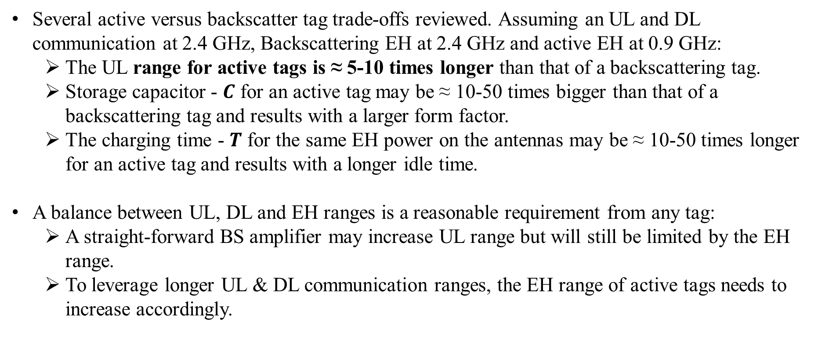
Summary of Results
Several active versus backscatter tag trade-offs reviewed. Assuming an UL and DL communication at 2.4 GHz, Backscattering EH at 2.4 GHz and active EH at 0.9 GHz:
  The UL range for active tags is ≈ 5-10 times longer than that of a backscattering tag.
  Storage capacitor - $C$ for an active tag may be ≈ 10-50 times bigger than that of a backscattering tag and results with a larger form factor.
  The charging time - $T$ for the same EH power on the antennas may be ≈ 10-50 times longer for an active tag and results with a longer idle time.
A balance between UL, DL and EH ranges is a reasonable requirement from any tag:
  A straight-forward BS amplifier may increase UL range but will still be limited by the EH range.
  To leverage longer UL & DL communication ranges, the EH range of active tags needs to increase accordingly.
Slide 9

Slide 10
Discussion
Active and backscatter tags support different operation ranges that serve different use cases and both are frequently limited by their respective EH ranges.
AMP tags fulfil a direct relationship between operation range and idle time dictated by EH constraints.
Interestingly, active and backscattering EH ranges at 0.9 and 2.4 GHz, respectively, require similar EH sensitivity.
Minimal tag EH sensitivity and re-charge power level specifications enable interoperable AMP deployment for various use cases.
We encourage the AMP sub-group to agree on tag minimal EH sensitivity and re-charge power level specification
874973
Slide 10

Slide 11
References
11-24-1513r0 Downlink link budget of passive receivers; Amichai Sanderovich (Wiliot)
11-24-1497r0 Uplink Rates for Active Transmission; Amichai Sanderovich (Wiliot)
11-24-1535r2 PPDU Design for AMP ; Yinan Qi (Oppo)
Slide 11

