Slide 1
Further Consideration of WPT for AMP
November 2024
Doc.: IEEE 802.11-24/1781r2
Date: 2024-11-11
Authors:
Name | Affiliation | Address | Phone | Email
Yinan Qi | OPPO |  |  | v-qiyinan@oppo.com
Weijie Xu
Chuanfeng He

Slide 2
Abstract
Doc.: IEEE 802.11-24/1781r2
In this contribution, we further discuss Wireless Power Transfer (WPT) including energizer control, AMP devices feedback/reporting, WPT signal waveform, WPT frame, etc., with focus on S1G.

Slide 3
November 2023
Doc.: IEEE 802.11-24/1781r2
Recap of Views
  Behaviour of energizers are fully controlled by the AP[1].
    Energizers and AP can be connected via either wired or wireless connections;
    Controlling mechanisms and how to implement such mechanisms can be left to implementation.
  Power related signalling [2].
    In some case (e.g. sensors), AP can collect energy related information, e.g., remaining energy, energy harvesting capability, etc., from the AMP STA.
    In some case (e.g. sensors), AMP STA can report its energy related information upon request from the AP.
  Co-existence with other S1G systems needs to be considered [1]
Slide 3
Yinan Qi (OPPO)

Slide 4
November 2023
Doc.: IEEE 802.11-24/1781r2
Definition of Energizer Type
  Integrated Type A: AP and energizer are integrated
    AP can operate in both 2.4G and S1G frequency bands
    No signalling exchange between AP and energizer
    Same deployment density of AP
  Independent Type B: energizer is an independent device
    Signalling between AP and energizer
    Denser deployment for energizer
    Low cost/complexity
Slide 4
Yinan Qi (OPPO)

Slide 5
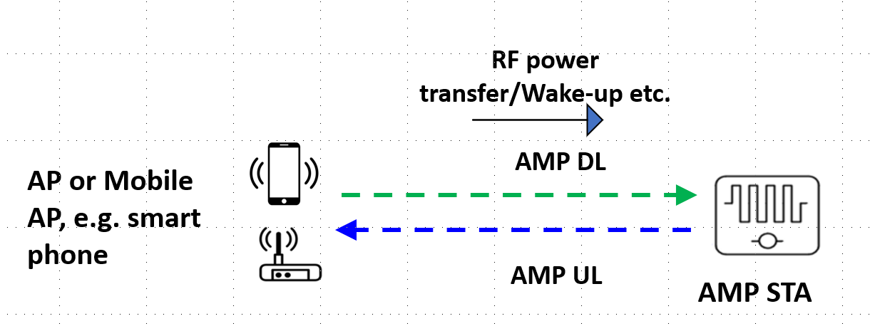
November 2023
Doc.: IEEE 802.11-24/1781r2
Energizer Topology 1
  Energizer is physically integrated with the AP/mobile AP, e.g. smart phone.
  No control signalling exchange between AP and energizer.
    Smart phone can serve as an mobile AP.
    All AMP UL/DL, WPT and wake-up signals are exchanged between AP/smart phone and AMP STA
Slide 5
Yinan Qi (OPPO)

Slide 6
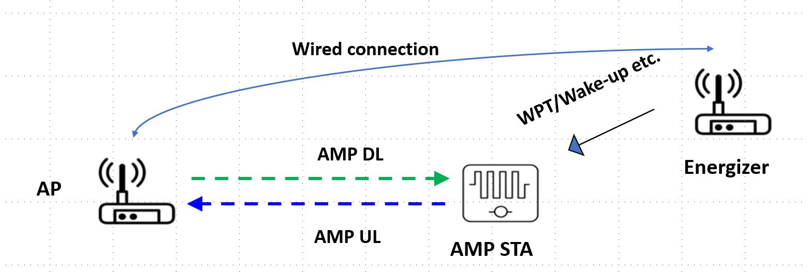
November 2023
Doc.: IEEE 802.11-24/1781r2
Energizer Topology 2
  Energizer is connected to the AP with wired connection.
  Control signalling between AP and energizer can be via high layer signalling, e.g., application layer.
    Energizer can be always on and constantly transmits power transfer signal for AMP device energy harvesting.
    WPT signal can be transmitted periodically from the energizer but the period can be configured/controlled by the AP.
    WPT signal can be transmitted upon the request of the AP due to, e.g., the emerging DL traffic
Slide 6
Yinan Qi (OPPO)

Slide 7
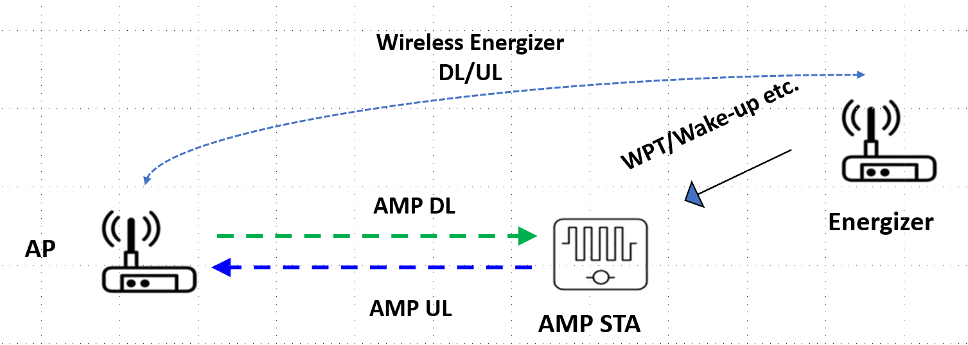
November 2023
Doc.: IEEE 802.11-24/1781r2
Energizer Topology 3
  Energizer is connected to the AP with wireless connection.
  Control signalling between AP and energizer is via wireless interface.
  Considering Wi-Fi as the wireless interface
    Case 1: Energizer and AP are independent and energizer is regarded as a non-AP STA associated with the AP
      Energizer should indicate to the AP that it is an energizer
      AP only activate the energizer when WPT signal or wake-up signal needs to be sent
    Case 2: Energizer and AP can be logically integrated
      AP does not see the energizer as an associated non-AP STA
Slide 7
Yinan Qi (OPPO)

Slide 8



November 2023
Doc.: IEEE 802.11-24/1781r2
WPT Protocol
  Part 1: define the control and signalling between AP and energizer
    Can be OOB but some key WPT info elements need to be defined, e.g., on/off indication, duty cycle related, e.g., on time, period, etc.
  Part 2: define the reporting signalling between AP and AMP devices
AMP STA
Part 2
Part 1
Energizer
AP
Slide 8
Yinan Qi (OPPO)

Slide 9
November 2023
Doc.: IEEE 802.11-24/1781r2
How/When to initiate WPT?
  Option 1: Periodic WPT
    Light control and signalling
    Can be initiated by Energizer autonomously
    On/off, duty cycle can still be controlled by the AP
    Consistent and predictable interference to co-existing systems
  Option 2: On demand WPT
    Initiated by the AP autonomously based on long-term/short term reporting from AMP devices
    Requested by the AMP devices
      Only for limited use cases, e.g. sensor
      Power status reporting may not be no longer needed
Slide 9
Yinan Qi (OPPO)

Slide 10
November 2023
Doc.: IEEE 802.11-24/1781r2
WPT Protocol Part 2
  Long-term/Non-periodic feedback
    Feedback info
      Harvesting capability
      Energy storage capability
      Etc.
    Feedback once during activation or based upon the request of AP
    Separate feedback reporting may be inefficient → joint reporting of power category
    Applied for all use cases
  Short-term/Periodic feedback
    Power status/requirements
    Feedback more frequently, can be optionally switched on/off
    Only for limited use cases, e.g., sensor
Slide 10
Yinan Qi (OPPO)

Slide 11
November 2023
Doc.: IEEE 802.11-24/1781r2
WPT Protocol Part 2: Power Category
  Power categories (PC) can be defined based on the power features of the AMP devices [2]
    PC0: devices with extremely limited energy harvesting and power storage capability;
    PC1: devices with limited energy harvesting and power storage capability;
    PC2: devices with reasonable energy harvesting and power storage capability.
  The definition of PC can be based on the following features
    Energy harvesting capability including
      Power source(s)
      Energy harvesting efficiency
    Energy storage capability
      Whether or not energy storage is supported;
      The amount of energy that can be stored;
      Energy storage draining rate;
    Others
      RF energy harvesting operation frequency
Slide 11
Yinan Qi (OPPO)

Slide 12
November 2023
Doc.: IEEE 802.11-24/1781r2
WPT Signal Waveform
  Need to define waveform?
    Specification: recommend one or multiple waveforms for WPT
    Can be left to implementation
  Proactive v.s. Passive WPT
    Proactive WPT: AP, energizer and AMP devices know exactly when and how to start or stop the WPT procedure.
      No need to always activate the RF harvesting circuit
    Passive WPT: once the AMP devices detect signal strength above certain threshold, RF harvesting begins
      RF harvesting circuit needs to be on
    Both should be allowed
  Legacy waveforms
    Pros: easy to implement, minimal specification/implementation efforts
    Candidates: OFDM, DSSS, single carrier, etc.
Slide 12
Yinan Qi (OPPO)

Slide 13
November 2023
Doc.: IEEE 802.11-24/1781r2
WPT Signal Waveform
  Legacy waveforms
    OFDM
      High PAPR → High efficiency
      Existing tech.
      Easy to implement
    DSSS
      Existing tech.
      Easy to implement
      Spreading code → noise like signal → Low PAPR
    Single Tone/Carrier
      Subset of OFDM
      Simple implementation
Slide 13
Yinan Qi (OPPO)

Slide 14
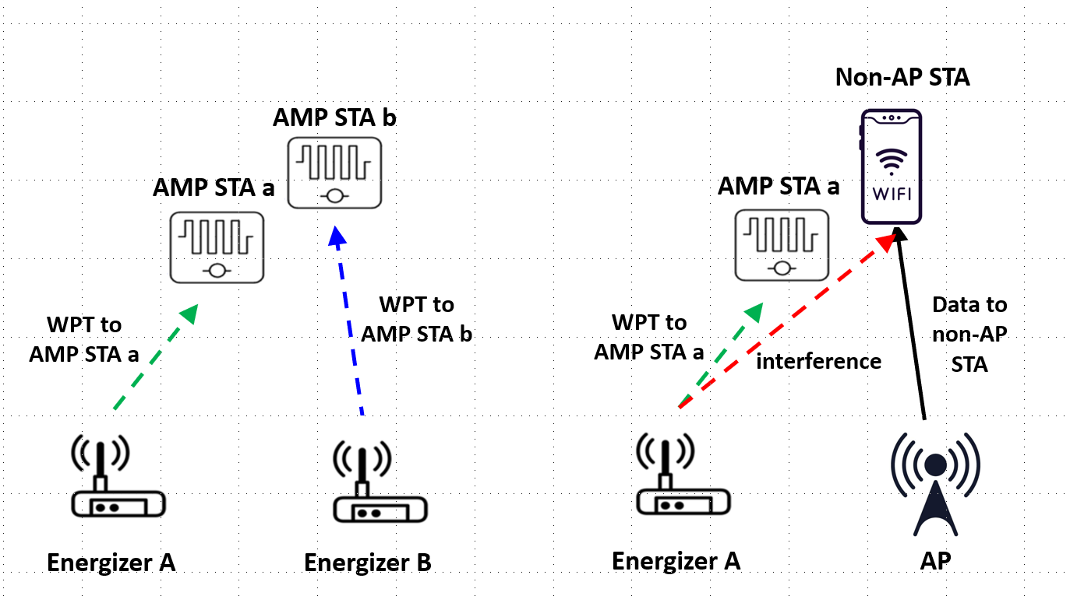
November 2023
Doc.: IEEE 802.11-24/1781r2
Co-existence Issue
  Dual frequency operation: WPT in S1G but communication in 2.4G
    Difficult for the nodes to coordinate between WPT and communication of AMP devices.
Slide 14
Yinan Qi (OPPO)

Slide 15
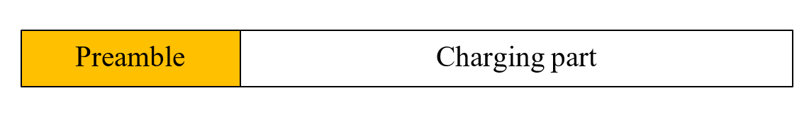
November 2023
Doc.: IEEE 802.11-24/1781r2
WPT Frame
  Basically, communication signal needs to be avoided by the energizer but WPT signal can co-exist.
  Design WPT signal that can be fully or partially understood by the energizer.
  WPT signal can contain both WPT preamble and charging segment and the WPT preamble can be understandable to energizers.
Slide 15
Yinan Qi (OPPO)

Slide 16
November 2023
Doc.: IEEE 802.11-24/1781r2
WPT Frame
  Co-existence is not only WiFi compliant but also for other S1G systems
    Energizer needs to understand not only Wi-Fi PPDU, e.g., 11ah, but also other S1G systems, leading to complicated design of preamble
      Smart Utility Networks, 470–510 MHz, 863–870 MHz, 902–928 MHz, and 920–925 MHz
      Low Energy, Critical Infrastructure Monitoring, operation frequency similar as SUN
      Low-Rate WPANs, operation frequency similar as SUN
      RFID, LoRa, etc.
    New preamble design only to be understood by energizer
      Other systems can detect WPT signal via ED since their power is high
Slide 16
Yinan Qi (OPPO)

Slide 17
November 2023
Doc.: IEEE 802.11-24/1781r2
LBT for Energizers
  The energizer can do ED first.
  In the case of collision, the energizer needs to keep listening to the channel. If a preamble is detected, the energizer knows the signal is WPT signal and it can transmit its own WPT signal.
  Otherwise, it no preamble is detected, the energizer assumes the signal in the air is communication signal and does backoff.
Energy Detection (ED)
Channel occupied (energy level > threshold_{ED})
Energizer does backoff
N
Y
N
WPT preamble detected?
Y
Transmit WPT signal
Slide 17
Yinan Qi (OPPO)

Slide 18
November 2023
Doc.: IEEE 802.11-24/1781r2
Summary
  In this submission, we discuss the following issues for WPT:
    Energizer definition
    WPT protocols
    WPT waveforms
    WPT frame design
    LBT procedure for energizer
Slide 18
Yinan Qi (OPPO)

Slide 19
Reference
November 2023
Doc.: IEEE 802.11-24/1781r2
IEEE 802.11-24/1536r0 Wireless Power Transfer for AMP
IEEE 802.11-24/1381r0 AMP Device Power Status

Slide 20
November 2023
Doc.: IEEE 802.11-24/1781r2
SP1
  Do you agree that the following topologies as shown in the below figures for energizer should be considered in 11bp and captured in SFD?
    Topology 1: Energizer is physically integrated with the AP.
    Topology 2: Energizer is connected to the AP with wired connection.
    Topology 3: Energizer is connected to the AP with wireless connection.
      The details of the wireless connection are TBD
Topology 1
Topology 2
Topology 3
Slide 20
Yinan Qi (OPPO)

Slide 21
November 2023
Doc.: IEEE 802.11-24/1781r2
SP2
  Do you agree to capture the following text to TGbp SFD?
  AMP devices shall report power category to the AP during activation or upon the request of the AP?
    The details on how to define power category are TBD
Slide 21
Yinan Qi (OPPO)

Slide 22
November 2023
Doc.: IEEE 802.11-24/1781r2
SP3
  Do you agree to capture the following text to TGbp SFD?
  11bp supports OFDM and single carrier as WPT waveforms?
Slide 22
Yinan Qi (OPPO)

Slide 23
November 2023
Doc.: IEEE 802.11-24/1781r2
SP4
  Do you agree to capture the following text to TGbp SFD?
  11bp specifies, in S1G, WPT PPDU format with at least a preamble and a charging field?
Slide 23
Yinan Qi (OPPO)

