Slide 1
Further Discussion on AMP PPDU Design
November 2024
Doc.: IEEE 802.11-24/1780r2
Date: 2024-11-11
Authors:
Name | Affiliation | Address | Phone | Email
Yinan Qi | OPPO |  |  | v-qiyinan@oppo.com
Weijie Xu
Chuanfeng He
Ke Wang
Shengjiang Cui

Slide 2
Abstract
Doc.: IEEE 802.11-24/1780r2
In this contribution, we further discuss the DL and UL PPDU design for AMP covering synchronization, SIG field, data rate, format, etc.

Slide 3
September 2024
Doc.: IEEE 802.11-24/1780r2
Recap of the Agreements [1]
  Motion #8 for DL PPDU
    IEEE 802.11bp will specify, in 2.4 GHz, an AMP Downlink PPDU containing at least an 802.11 preamble field, an AMP-Sync field and an AMP-Data field. Inclusion of an AMP-SIG field is TBD.
        The details of the 802.11 preamble field are TBD.
        Additionally, for transmission to backscatter STAs there will be one or more Excitation fields
        Additionally, for transmission to backscatter STAs there may be more than one AMP-Data field
            Additionally, AMP-Sync and AMP-SIG field may precede each AMP-Data field
        Name of this Downlink PPDU is TBD.
  Motion #9 for DL modulation
    The AMP Downlink PPDU AMP-Sync field and the AMP-Data field will use On-Off Keying (OOK) modulation.
  Motion #10 for DL coding
    The AMP Downlink PPDU AMP-Data field will use Manchester encoding for non-backscatter operation.
      For the Backscatter case, the AMP-Data field encoding scheme is TBD
  Motion #11 for UL PPDU
    IEEE 802.11bp shall specify, in 2.4 GHz, an AMP uplink PPDU for AMP STA supporting active transmission that contains an AMP-Sync field and AMP-Data field. Inclusion of an AMP-SIG field in the AMP uplink PPDU is TBD.
      The bandwidth of the AMP uplink PPDU is less than 20 MHz
Slide 3
Yinan Qi (OPPO)

Slide 4
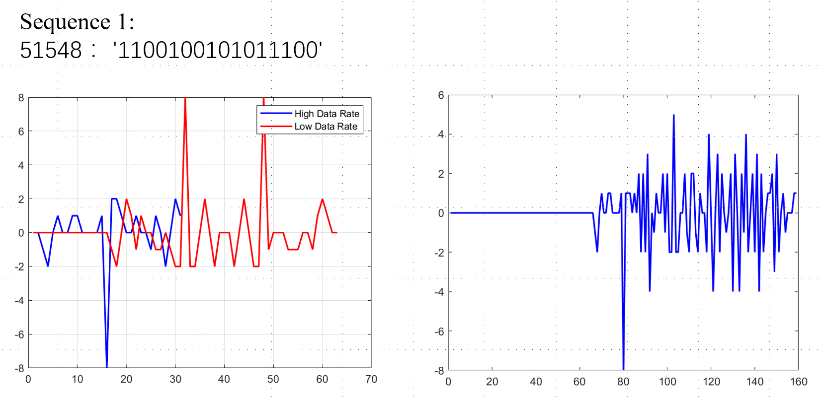
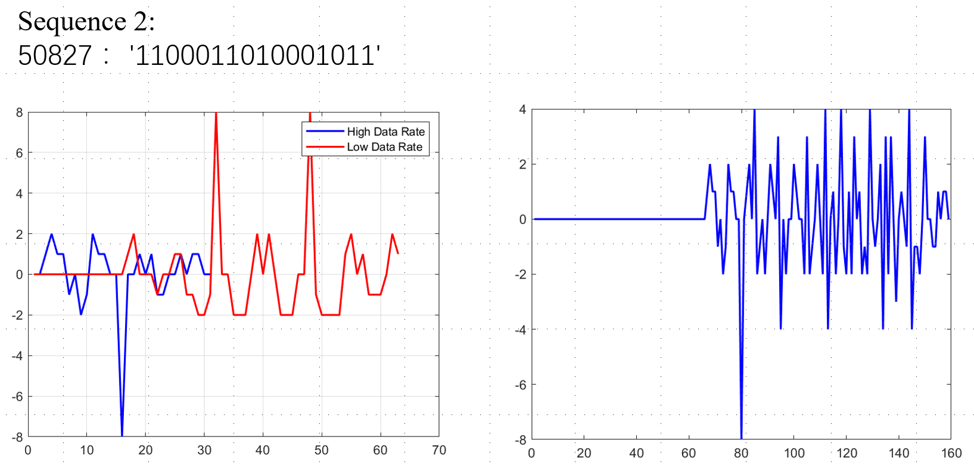
September 2024
Doc.: IEEE 802.11-24/1780r2
Synchronization
  Asymmetric Sync sequences
    Different sync sequences for DL/UL for indication
      No need for rate indication in SIG field
      AMP devices will not process UL PPDU to save energy
  Sync length
    DL: 32 as baseline for 250kbps and 16 for 1Mbps
    UL: 32 as baseline for 250kbps and 16 for 1, 2 and 4Mbps
  Example sync sequences and correlation properties can be found in companion contribution[2]
Slide 4
Yinan Qi (OPPO)

Slide 5
September 2024
Doc.: IEEE 802.11-24/1780r2
Payload Size
  Typical payload size for AMP [3]
    Inventory: 128 bits
    Sensor: 96 bits
    Others, e.g., positioning: 256 bits
  Assuming 50% signalling overhead, up to 64 bytes seems to be a reasonable size
    Flexible size: 6 bits to indicate actual size
    Pre-define fixed sizes
      AMP payload size tends to be discrete values
      E.g., 8, 16, 32 and 64 bytes with only 2 bits length indication
      Padding for the payload without matching to the pre-defined sizes
Slide 5
Yinan Qi (OPPO)

Slide 6
September 2024
Doc.: IEEE 802.11-24/1780r2
DL PPDU Design: Preamble
  Legacy preamble design
    20MHz OFDM
    11ba: 11a preamble with two BPSK mark symbols for spoofing legacy devices
    New design: 11a preamble with one Q-BPSK mark symbol and one BPSK mark symbol
      Differentiate from 11a and 11ba (2 BPSK symbols), 11n (2 Q-BPSKsymbols) and 11ac (1 BPSK symbol and 1 Q-BPSK symbol) SP
11a
STF
LTF
SIG
DATA
11ba
L-STF
L-LTF
L-SIG
BPSK-Mark1
BPSK-Mark2
DATA
11n
L-STF
L-LTF
L-SIG
Q-BPSK
Q-BPSK
Other
11ac
L-STF
L-LTF
L-SIG
BPSK
Q-BPSK
Other
11bp
L-STF
L-LTF
L-SIG
Q-BPSK-Mark1
BPSK-Mark2
AMP
Slide 6
Yinan Qi (OPPO)

Slide 7
September 2024
Doc.: IEEE 802.11-24/1780r2
DL PPDU Design: BW and Waveform
  AMP part BW
    ~ 4MHz as baseline BW
      Reserve sufficient guard band on both sides to ease simple receiver implementation
      Transmission power, subject to regulation, e.g., PSD requirement, max PSD is 10dB/MHz in some country
      Balance between energy consumption and transmission power
  Waveform
    SIG and data: DSSS, see analysis in companion contribution [4]
    Excitation: OFDM/DSSS for backscattering
Slide 7
Yinan Qi (OPPO)

Slide 8
September 2024
Doc.: IEEE 802.11-24/1780r2
DL PPDU Design: SIG
  SIG
    Rate 1 bits: 250kbps and 1Mbps
    Length 6 bits for flexible length or 2 bits for pre-defined length with up to 64 bytes
    Backscatter indication 1 bit
      Indication of whether this PPDU is to trigger active device or backscattering device
    CRC
      Parity check (1 bit)
    UL configuration n bits
      Configure the following UL transmission in followed excitation field
    Total: 9+n or 5+n bits
Slide 8
Yinan Qi (OPPO)

Slide 9
September 2024
Doc.: IEEE 802.11-24/1780r2
DL PPDU Design: PPDU Format
  Combination of components including preamble, sync, data, excitation and SIG if agreed.
  Possible PPDU formats
    Format 1 and 2: only for AMP device with energy storage
Preamble
DL Rx
Format 1a
SYNC
Data
Preamble
DL Rx
Format 1b
SYNC
SIG
Data
Preamble
DL Rx + WPT/backscattering for UL
Format 2
SYNC
SIG
Data
Excitation
Slide 9
Yinan Qi (OPPO)

Slide 10
September 2024
Doc.: IEEE 802.11-24/1780r2
DL PPDU Design: PPDU Format
  Possible PPDU formats
    Format 3 to 5: can be used for AMP device without energy storage
Preamble
WPT + DL Rx
Format 3
Excitation
SYNC
SIG
Data
WPT + DL Rx + backscattering for UL Data
Preamble
Format 4
Excitation
SYNC
SIG
Data
Excitation
WPT + DL + charging/backscattering for UL and WPT + DL + charging/backscattering for UL…
Preamble
Format 5
Excitation
SYNC
SIG
Data
Excitation
SYNC
SIG
Data
Excitation
Slide 10
Yinan Qi (OPPO)

Slide 11
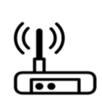
September 2024
Doc.: IEEE 802.11-24/1780r2
DL PPDU Design: Additional DL PPDU Format
  New DL/UL format needs to be supported
    Can be interpreted as UL PPDU from perspectives of other nodes in the same network receiving this PPDU
    Assistant node/energizer can send preamble on behalf of the AMP device and then the excitation part to AMP device for backscattering
    AMP device can be assumed with energy storage so the excitation part is purely for backscattering
    Sync may be needed for AMP devices to know when the backscattering begins
    AP has full control of the energizer to avoid misuse of excitation field
Control
AP
Preamble
SYNC
Excitation
Slide 11
Yinan Qi (OPPO)
Notes:
Preamble + Sync + excitation

Slide 12
September 2024
Doc.: IEEE 802.11-24/1780r2
UL PPDU Design
  Sync
    The sync sequence length can be 16 bits
  SIG is not needed
    Configured by the AP, e.g., polling frame for active Tx, DL SIG for backscattering
  BW
    Depending on data rate, e.g., 4MHz for 2MHz bps
  Data
    Rate: 250k, 1M, 2M, 4M
    Coding: Manchester coding. Further consider convolutional coding to provide extra coding gain with negligible complexity for coding
  Waveform
    Baseline waveform: OOK
    Optional: MSK for active Tx
Slide 12
Yinan Qi (OPPO)

Slide 13
September 2024
Doc.: IEEE 802.11-24/1780r2
UL PPDU Design: UL PPDU Format
  Active Tx
  Backscattering
    The excitation part should be further defined including at least sync and data for AP reception, i.e., UL.
    UL PPDU for backscattering should be defined as follows:
      IEEE 802.11bp shall specify, in 2.4 GHz, an AMP UL PPDU for AMP STA supporting backscattering transmission that contains an AMP-UL-Sync field and AMP-UL-Data field.
      Note: This UL PPDU is backscattered by AMP device in one excitation field which is contained in a DL PPDU
SYNC
Data
UL Sync+ UL Data
WPT + DL Rx + backscattering UL for Data
Preamble
Excitation
SYNC
SIG
Data
Excitation
Slide 13
Yinan Qi (OPPO)

Slide 14
September 2024
Doc.: IEEE 802.11-24/1780r2
Summary
  The following issues are discussed and analysed in this contribution
    Synchronization sequence design for both DL and UL
    Payload size and PPDU length
    DL PPDU design including preamble, SIG, BW and format, a new PPDU format is proposed
    UL PPDU design including synchronization, SIG, BW and format.

Slide 15
Reference
September 2024
Doc.: IEEE 802.11-24/1780r2
[1] “IEEE 802.11 TGbp Motion Dock,” IEEE 802.11-24/1322r4, Sept. 2024
[2] “Sync field for AMP PPDU,” IEEE 802.11-24/1803r0, Nov. 2024
[3] “AMP Device Channel Occupancy Analysis,” IEEE 802.11-23/1354r0, Aug. 2023
[4] “Date rates for AMP IoT,” IEEE 802.11-24/1801r0, Nov. 2024

Slide 16
SP 1
September 2024
Doc.: IEEE 802.11-24/1780r2
  An AMP Downlink PPDU shall contain one Q-BPSK mark symbol and one BPSK mark symbol immediately following 802.11a preamble.

Slide 17
SP 2
September 2024
Doc.: IEEE 802.11-24/1780r2
  An AMP Downlink PPDU shall contain an AMP-SIG field containing at least following information:
    Rate indication bit
    Length indication
      Flexible or pre-defined length TBD
    Backscatter indication bit
    Parity check bit
    UL configuration
      Details TBD

Slide 18
SP 3
September 2024
Doc.: IEEE 802.11-24/1780r2
  IEEE 802.11bp will specify additionally, in 2.4 GHz, an AMP Downlink PPDU containing at least an 802.11 preamble field and an Excitation field.
  AMP-Sync field is TBD

Slide 19
SP 4
September 2024
Doc.: IEEE 802.11-24/1780r2
  IEEE 802.11bp shall specify, in 2.4 GHz, an AMP UL PPDU for AMP STA supporting backscattering transmission that contains an AMP-UL-Sync field and AMP-UL-Data field.
  Note: This UL PPDU is backscattered by AMP device in one excitation field which can be contained in a DL PPDU.

Slide 20
SP 5
September 2024
Doc.: IEEE 802.11-24/1780r2
  The AMP Uplink PPDU AMP-Sync field and the AMP-Data field will use On-Off Keying (OOK) modulation

