Slide 1
Multi-AP Sounding and Precoding
Date: 11-Nov-24

Slide 2
Introduction
Previous contributions on coordinated beamforming and spatial nulling
  Coordinated spatial re-use and spatial nulling is accepted for TGbn [8]
  In [6, 7] the high-level concept and a performance evaluation is presented
  Proposals for the sounding procedure were recently presented in [1, 2]
This contribution
  Joint sounding vs. independent sounding
  Sounding information exchange between APs
  Joint optimization of spatial nulling

Slide 3
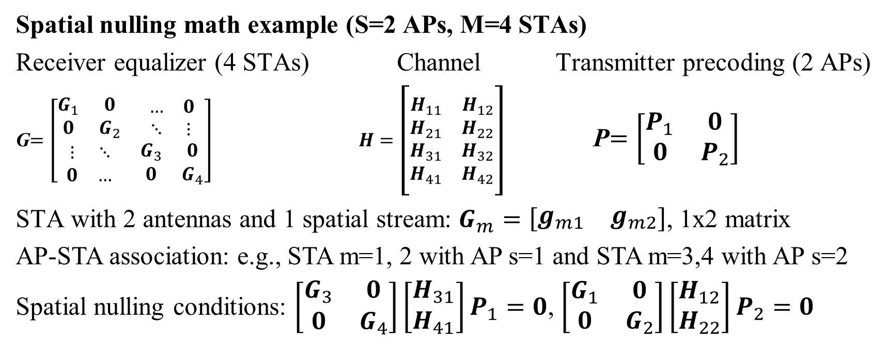
Spatial Nulling Math
Spatial nulling math example (S=2 APs, M=4 STAs)
Receiver equalizer (4 STAs) Channel Transmitter precoding (2 APs)
G$=\left[\begin{matrix}\begin{matrix}G_{1} & 0 \\ 0 & G_{2}\end{matrix} & \begin{matrix}… & 0 \\ ⋱ & ⋮\end{matrix} \\ \begin{matrix}⋮ & ⋱ \\ 0 & …\end{matrix} & \begin{matrix}G_{3} & 0 \\ 0 & G_{4}\end{matrix}\end{matrix}\right]$ $H=\left[\begin{matrix}\begin{matrix}H_{11} \\ H_{21}\end{matrix} & \begin{matrix}H_{12} \\ H_{22}\end{matrix} \\ \begin{matrix}H_{31} \\ H_{41}\end{matrix} & \begin{matrix}H_{32} \\ H_{42}\end{matrix}\end{matrix}\right]$ P$=\left[\begin{matrix}P_{1} & 0 \\ 0 & P_{2}\end{matrix}\right]$
STA with 2 antennas and 1 spatial stream: $G_{m}=\left[\begin{matrix}g_{m1} & g_{m2}\end{matrix}\right]$, 1x2 matrix
AP-STA association: e.g., STA m=1, 2 with AP s=1 and STA m=3,4 with AP s=2
Spatial nulling conditions: $\left[\begin{matrix}G_{3} & 0 \\ 0 & G_{4}\end{matrix}\right]\left[\begin{matrix}H_{31} \\ H_{41}\end{matrix}\right]P_{1}=0$, $\left[\begin{matrix}G_{1} & 0 \\ 0 & G_{2}\end{matrix}\right]\left[\begin{matrix}H_{12} \\ H_{22}\end{matrix}\right]P_{2}=0$

Slide 4
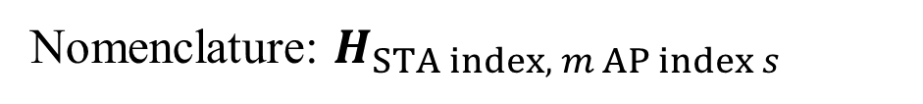
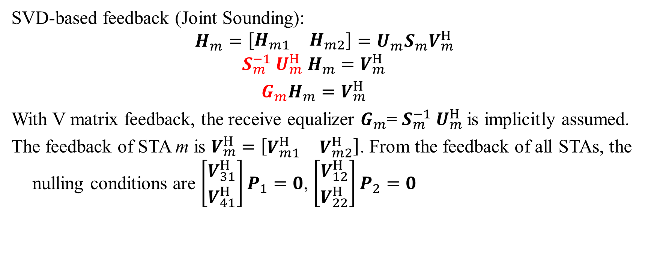
Sounding Math (Joint Sounding)
SVD-based feedback (Joint Sounding):
$$H_{m}=\left[\begin{matrix}H_{m1} & H_{m2}\end{matrix}\right]=U_{m}S_{m}V_{m}^{H}$$
$$S_{m}^{−1} U_{m}^{H} H_{m}=V_{m}^{H}$$
$$G_{m}H_{m}=V_{m}^{H}$$
With V matrix feedback, the receive equalizer $G_{m}$= $S_{m}^{−1} U_{m}^{H}$is implicitly assumed.
The feedback of STA m is $V_{m}^{H}$ $=\left[\begin{matrix}V_{m1}^{H} & V_{m2}^{H}\end{matrix}\right]$. From the feedback of all STAs, the nulling conditions are $\left[\begin{matrix}V_{31}^{H} \\ V_{41}^{H}\end{matrix}\right]P_{1}=0$, $\left[\begin{matrix}V_{12}^{H} \\ V_{22}^{H}\end{matrix}\right]P_{2}=0$
Nomenclature: $H_{STA index, m AP index s}$

Slide 5
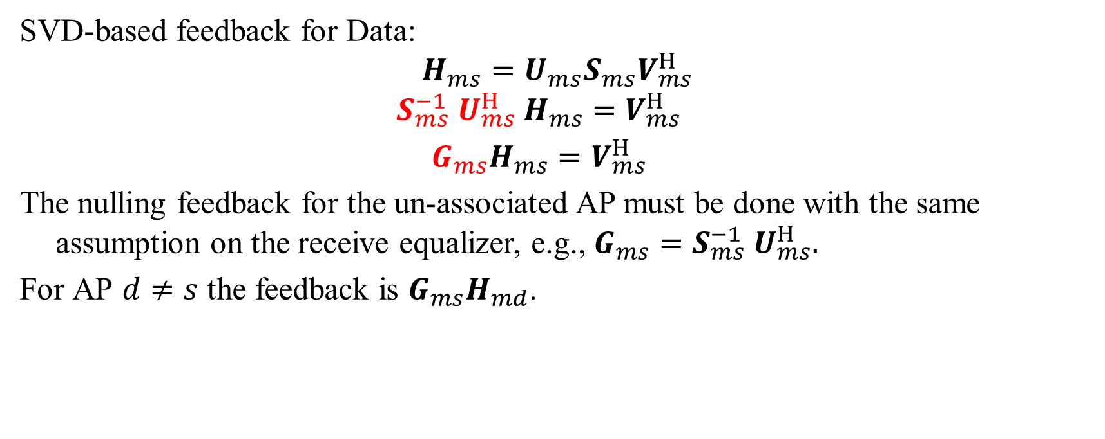
Sounding Math (Independent sounding)
SVD-based feedback for Data:
$$H_{ms}=U_{ms}S_{ms}V_{ms}^{H}$$
$$S_{ms}^{−1} U_{ms}^{H} H_{ms}=V_{ms}^{H}$$
$$G_{ms}H_{ms}=V_{ms}^{H}$$
The nulling feedback for the un-associated AP must be done with the same assumption on the receive equalizer, e.g., $G_{ms}=S_{ms}^{−1} U_{ms}^{H}.$
For AP $d≠s$ the feedback is $G_{ms}H_{md}$.
Nomenclature: $H_{STA index, m AP index s}$

Slide 6
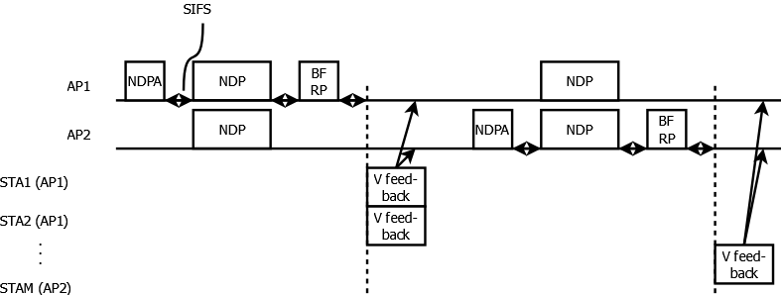
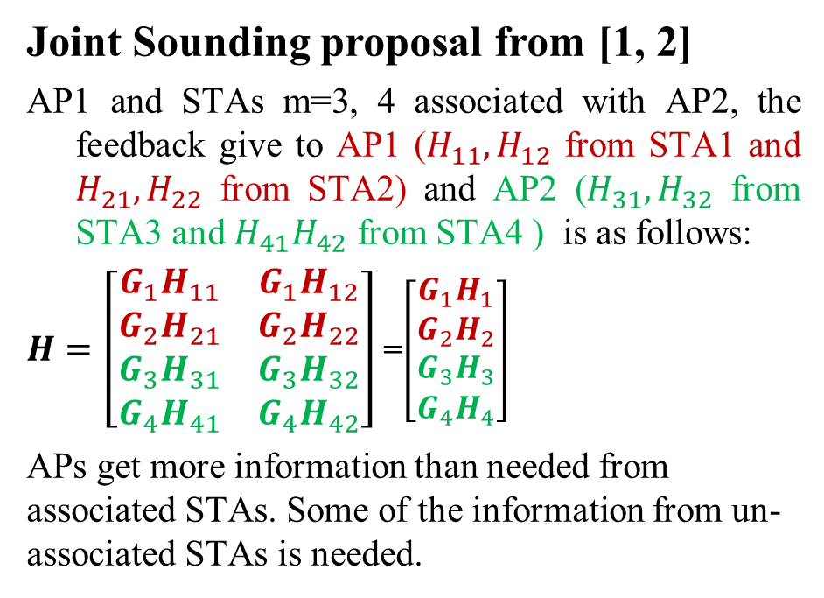
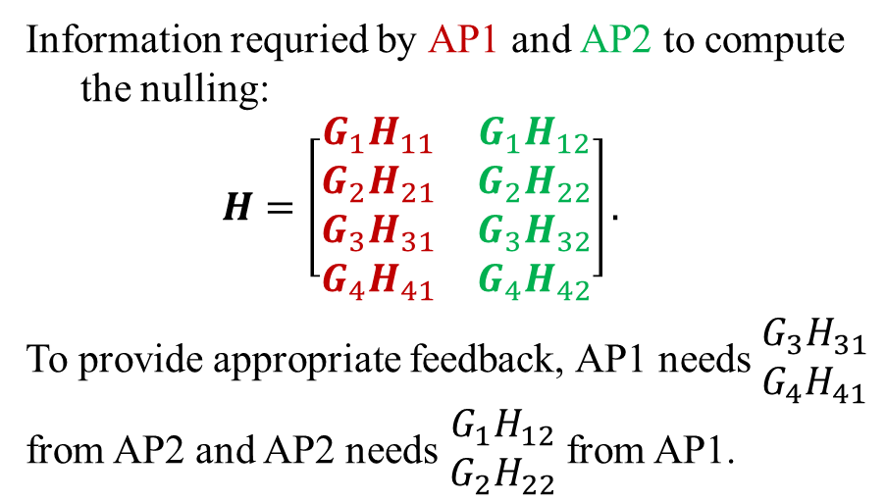
Sounding
Joint Sounding proposal from [1, 2]
AP1 and STAs m=3, 4 associated with AP2, the feedback give to AP1 ($H_{11},H_{12}$ from STA1 and $H_{21}, H_{22}$ from STA2) and AP2 ($H_{31}, H_{32}$ from STA3 and $H_{41}H_{42}$ from STA4 ) is as follows:
$H=\left[\begin{matrix}\begin{matrix}{G_{1}H}_{11} \\ G_{2}H_{21}\end{matrix} & \begin{matrix}{G_{1}H}_{12} \\ G_{2}H_{22}\end{matrix} \\ \begin{matrix}{G_{3}H}_{31} \\ {G_{4}H}_{41}\end{matrix} & \begin{matrix}{G_{3}H}_{32} \\ {G_{4}H}_{42}\end{matrix}\end{matrix}\right]$ =$\left[\begin{matrix}\begin{matrix}{G_{1}H}_{1} \\ G_{2}H_{2}\end{matrix} \\ \begin{matrix}{G_{3}H}_{3} \\ {G_{4}H}_{4}\end{matrix}\end{matrix}\right]$
APs get more information than needed from associated STAs. Some of the information from un-associated STAs is needed.
Information requried by AP1 and AP2 to compute the nulling:
$$H=\left[\begin{matrix}\begin{matrix}{G_{1}H}_{11} \\ {G_{2}H}_{21}\end{matrix} & \begin{matrix}{G_{1}H}_{12} \\ {G_{2}H}_{22}\end{matrix} \\ \begin{matrix}{G_{3}H}_{31} \\ {G_{4}H}_{41}\end{matrix} & \begin{matrix}{G_{3}H}_{32} \\ {G_{4}H}_{42}\end{matrix}\end{matrix}\right].$$
To provide appropriate feedback, AP1 needs $\begin{matrix}{G_{3}H}_{31} \\ {G_{4}H}_{41}\end{matrix}$ from AP2 and AP2 needs $\begin{matrix}{G_{1}H}_{12} \\ {G_{2}H}_{22}\end{matrix}$ from AP1.

Slide 7
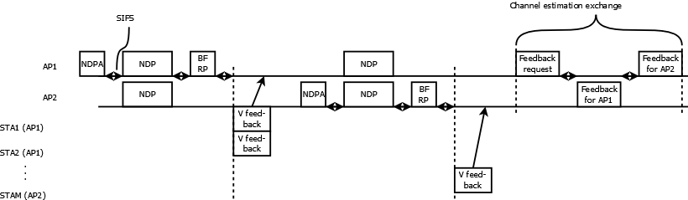
AP-AP Communication
How to do the exchange:
Option 1 [1,2]: STAs send feedback in a way that all APs can receive it.
  requires very conservative transmission settings for large amount of data (inefficient).
  For spatial nulling a lower resolution of the feedback may be acceptable
Option 2: Dedicated feedback exchange

Slide 8
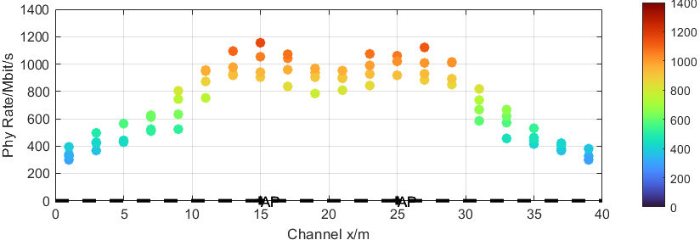
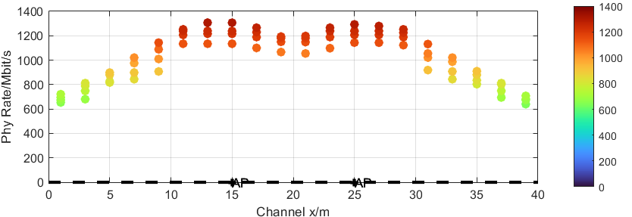
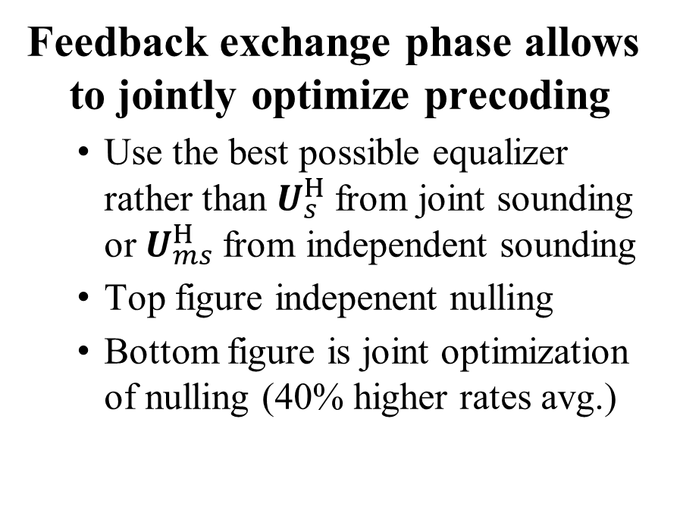
Joint Optimization
Feedback exchange phase allows to jointly optimize precoding
  Use the best possible equalizer rather than $U_{s}^{H}$from joint sounding or $U_{ms}^{H}$from independent sounding
  Top figure indepenent nulling
  Bottom figure is joint optimization of nulling (40% higher rates avg.)
STAs associated
STAs associated
with AP1
with AP2
AP1
AP2
STAs associated
STAs associated
with AP1
with AP2
AP1
AP2

Slide 9
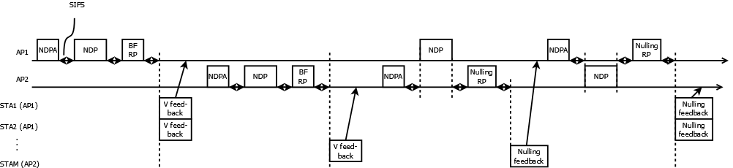

Independent Sounding
Independent sounding
  No need for an exchange phase, because nulling feedback and regular feedback are separated, already. Each feedback packet has a dedicated recipient.
  How to get $G_{ms}$ equalizer for the nulling feedback? ➔ can be derived from the equalizing used for any packet, e.g. the Nulling RP (no issue with scheduling or memory).

Slide 10
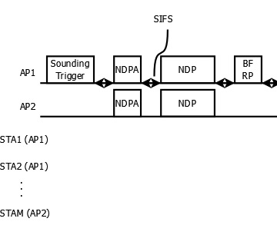
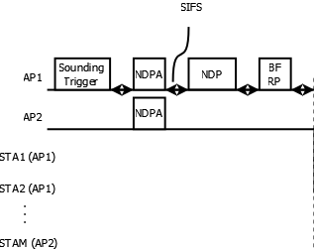
Dupliate Transmission of NDPs
In [1, 2], it is proposed to send the NDPs twice, ONLY to remove the requirement for the STAs to listen to non-associated APs NDPA packets.
To satisfy that, only the NDPA packets must be duplicated, not the NDPs
Joint Sounding
Independent Sounding

Slide 11
Concusions
Jointly optimized spatial nulling pvovides a performance advantage
  Simulation results show approx. 40% increased PHY rate
Feedback exchange for joint sounding
  Feedback exchange between APs allows for joint optimization of precoding
  STAs are not required to transmit to un-associated STAs, which can be inefficient due to a lack of channel knowledge
Independent sounding has advantages
  Dedicated feedback for data and nulling, which can be optimized for the needs (e.g., do sounding for nulling less frequently).
  Feedback packets have a specific recipient, which allows higher rates
  Joint optimization is easier to implement
Duplicate transmission of NDPs, as in [1, 2] can be avoided by duplicating NDPA, only

Slide 12
References
[1] Sameer Vermani et.al., “Sounding Schemes for Coordinated Beamforming”, IEEE 802.11-24/1542 September 2024
[2] Ron Porat et.al., “Sounding Design for C-BF”, IEEE 802.11-24/1568 September 2024
[3] Insing Jung et.al., “Coordinated Beamforming for 11bn – Follow Up”, IEEE 802.11-24/1515r2 September 2024
[3] Aiguo Yan et.al., “Unified CoBF/MUMIMO Schemes with Zero-MUI”, IEEE 802.11-24/1432r2 August 2024
[4] Shimi Shilo et.al., „Coordinated BF: Figures of Merit”, IEEE 802.11-24/1484r0 September 2024
[5] Shimi Shilo et.al., „Zero MUI Coordinated BF”, IEEE 802.11-23/1998r0 November 2023
[6] Rainer Strobel et.al, “Coordinated Spatial Nulling (C-SN) Concept”, , IEEE 802.11-24/0011r0 January 2024
[7] Rainer Strobel et.al, “Coordinated Spatial Nulling (C-SN) Simulations”, , IEEE 802.11-24/0012r0 January 2024
[8] Rainer Strobel et.al, “Coordinated Spatial Re-Use and Coordinated Spatial Nulling Follow-Up”, , IEEE 802.11-24/0635r0 March 2024

Slide 13
APPENDIX

Slide 14
Simulation parameters
Parameter | Value
TX/RX Antennas | 4/2
APs/STAs | 2/4
Spatial streams | 1
Bandwidth | 160 MHz
AP TX Power | 21 dBm
Channel model | D NLOS [8]
MCS | 0-13 (optimized)
Frequency | 5 GHz
GI | 1.6µs
TX/RX SNR | As on 42/40dB
Channel aging/Doppler | 1.2km/h, 6Hz
BF quantization | ideal
Precoder type | Zero-forcing, joint or independent
Overhead | Sounding and MAC overhead not considered

Slide 15
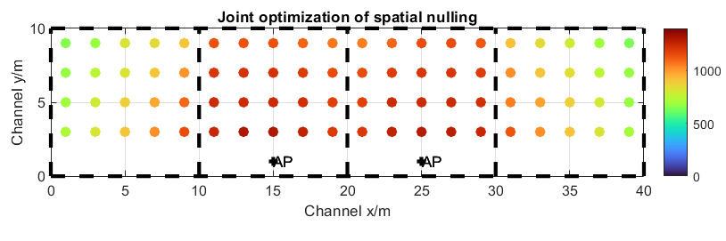
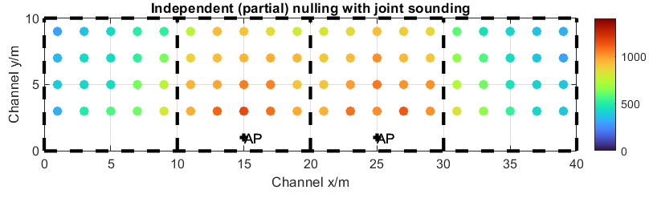
More Simulation Results
Rate vs. Channel SNR

Slide 16
Terminology I
Coordinated Beamforming
  Multiple APs simultaneously transmit to 1 STA, each.
Coordinated Spatial Re-use with Spatial Nulling
  Multiple APs simultaneously transmit to their respective STAs. Each AP serves one or more STAs. Interference between diffent APs is reduced by power optimization or spatial nulling.
Partial Nulling
  Interference between different Aps is not perfectly canceled, but only to a certain level. This is done by
  Control of the number of spatial nulls generated (not all STAs served require a spatial null)
  Control of the nulling depth by a regularized inversion when calculating the transmit precoder
Primary AP (Sharing AP)
  The AP which gained channel access and triggers the coordinated transmission for spatial nulling.
Secondary APs (Shared APs)
  Other APs which transmit simultaneously with the primary AP. For spatial nulling, transmission is triggered by the primary AP for a joint transmission.
Half-coordinated Spatial Re-Use
  The primary AP transmits without any measures (e.g. Power back-off, spatial null) to protect other APs. Secondary APs transmit simultaneously, but reduce the interference to the primary AP to a level that doesn‘t impact the primary APs beyond a certain threshold.

Slide 17
Terminology II
Fully Coordinated Spatial Re-Use
The primary AP and the secondary APs mutually perform power back-off and spatial nulling to protect each other‘s transmission.
Independent Sounding
Sounding NDPs are transmitted from each AP to the STAs independently. The STAs may receive the NDPs from an associated or un-associated AP.
Joint Sounding
Sounding NDPs are transmitted simultaneously from multiple APs, using a longer sequence of LTFs such that all antennas of all APs can be separated.
Independent Nulling Precoding
Each AP performs spatial nulling, assuming the receive equalizer as given by the (joint) sounding feedback.
Joint Nulling Precoding
APs jointly optimize the predoding by a feedback exchange or by independent sounding with a dedicated nulling NDP.

