Slide 1
Distributed RU Distortion, Beamforming, Power Control
Date: 08-November-24

Slide 2
Introduction
Distributed RU will be introduced in 802.11bn
  The goal is to improve uplink OFDMA performance [1]
    in the 6 GHz band by overcoming the -1dBm/MHz PSD limit
    at low to medium SNR (not interference or TX EVM limited)
  Previous contributions evaluated the performance impact of CFO[2 ,3], smoothing in [4, 5] and PAPR [6]
This contribution
  This contribution focuses on the performance impact of nonlinear transmitter and receiver distortion in DRU and methods reduce negative performance impacts by
    Proper tone plan design
    Power control
  In addition, the importance of beamforming for the overall performance is discussed

Slide 3
Transmitter and Receiver Distortion – DRU OFDMA
DRU Transmitter Distortion
  In regular OFDMA, TX distortion mainly affects neighboring channels
  In distributed RUs, transmitter distortion affects all RUs
  The TX EVM requirements currently depend on the mcs used (e.g., Table 36-65 in 802.11be):
  But low TX EVM will impact other STAs in the dRU OFDMA group
MCS | 0 | 1 | 2 | 3 | 4 | 5 | 6 | 7 | 8 | 9 | 10 | 11 | 12 | 13
TX EVM | -13 | -13 | -13 | -16 | -19 | -22 | -25 | -27 | -30 | -32 | -35 | -35 | -38 | -38

Slide 4
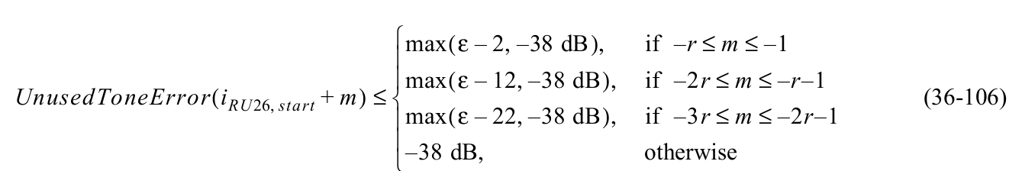
Unused Tone Error (Spec)
Unused tone error
  For a regular RU, the distortion into neighboring bands is 2, 12 or 22 dB below the in-band distortion (as specified, e.g., in Table 36-65 in 802.11be)
  For a distributed RU, the in-band distortion will apply, unless it is specified differently.

Slide 5
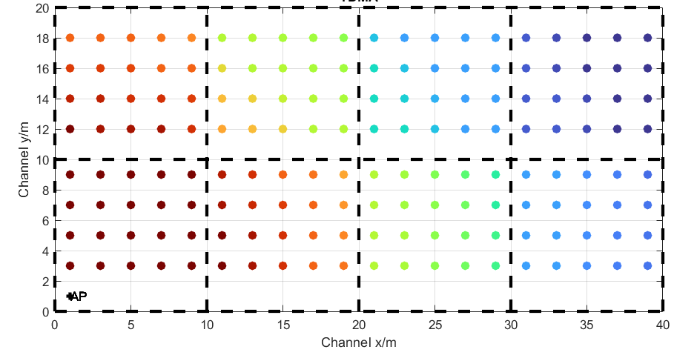

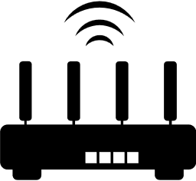
Residential Scenario
Residential Scenario
  TDMA at full bandwidth vs. Trigger-based uplink OFDMA RRU and DRU
  4-antenna AP, 2 antenna STAs
  4 STAs simultaneous
STA
STA
STA
STA
AP

Slide 6
Beamforming and Trigger-Based Uplink
Beamforming and Trigger-Based Uplink Transmission
  Distributed Rus are useful for trigger-based uplink. In a non trigger-based transmission, the distributed RU would waste a lot of spectrum, transmitting at a low rate while a large bandwidth is occupied.
  Long reach is an important use case and thus, 1 spatial stream transmission from a multi-antenna client is an important use case
  In the case of 2-antenna STAs transmitting 1 spatial streams, the beamforming gain is around 4dB
  To allow for a beamformed trigger-based uplink transmission, trigger-based sounding is needed (same as for uplink MU-MIMO)
  ➔ Define trigger-based uplink sounding

Slide 7
Residential Scenario
TDMA
  160MHz
  21dBm tx power
  1 spatial stream, beamforming
OFDMA RRU
  15dBm tx power for 40MHz
  1 spatial stream, no beamforming
OFDMA DRU
  21dBm tx power, no BF
6dB power boost gain, but 4dB beamforming gain lost and losses due to tx evm.

Slide 8
Importance of Beamforming
TDMA
  160MHz
  21dBm tx power
  1 spatial stream, beamforming
OFDMA RRU
  15dBm tx power for 40MHz
  1 spatial stream, no beamforming
OFDMA DRU
  21dBm tx power, beamforming

Slide 9
Transmitter Nonlinear Distortion
RRU, SNR of 8 RUs
Nonlinear distortion, e.g., IP3 distortion depends on the TX spectrum
  For a regular RU, mainly the neighboring Rus are affected, because the spectrum of a dRU is flat within the used band
Low MCS,
High TX distortion
Low TX
distortion

Slide 10
Transmitter Nonlinear Distortion
Nonlinear distortion in a dRU
  The dRU spectrum is not flat
  Thus, the TX distortion is not flat
  ➔ Distortion impact on other Rus depends on the tone plan design

Slide 11
Transmitter distortion evaluation of DRU Tone Plans
242-tone and 484-tone DRU design are fine in the proposals ([6, 7, 8])
26-tone RU in [6] is ok
52-tone RU in [6] is not ok (example)
Affected tones in RU 3 and 4
DRU2 with
high distortion

Slide 12
Receiver Distortion
Power Back-off for DRU
Arrangement:
  2 STAs transmit to the AP
  One STA is very close, the other one is far away
  TX EVM according to 802.11be spec (2dB better than worst case)
  TX power of nearby STA is varied
  40dB RX SNR
➔ Power back-off is important for high performance, especially for the weak link

Slide 13
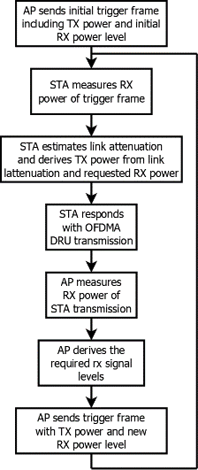
Current Power-Backoff Procedure
Power back-off effectively depends on two measurments
  AP receiver measures receive power of each each STA to destinguish the desired rx power levels
  STA receiver measures the RX power to evaluate the link loss and derive the TX power that achieves the desired AP RX power level
➔ STAs usually have limited capabilities and the measurement is less accurate

Slide 14
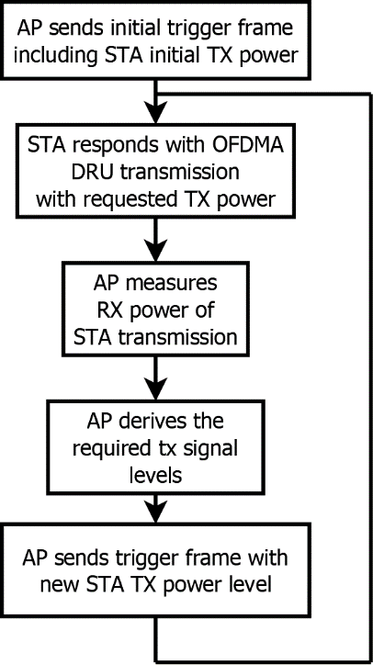
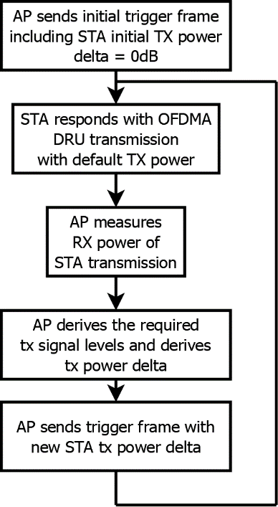
Procedure with a single Measurement
The STA-side power measurement can be eliminated from the process
  Option 1: Signal the desired tx power (requires knowledge of the link attenuation and the tx power limitations of the STA)
  Option 2 (preferred): Signal the tx power delta w.r.t. the previous packet

Slide 15
Conclusion and Next Steps
Important aspects for efficient dRU operation:
Allow beamforming by introducing triggered uplink sounding
Consider nonlinear transmitter distortion in the tone plan design
Re-evaluate unused tone error and TX EVM specs
Improve power control accuracy to reduce performance impact of rx distortion

Slide 16
References
[1] Jianhan Liu et.al., “UHR Feature to Overcome PSD Limitations: Distributed-Tone Resource Units”, IEEE 802.11-23/0037r0, December 2022
[2] Eunsung Park et.al., “CFO Impact and Pilot Design for dRU” 11-23-1115-00-0
[3] Eunsung Park et.al., “CFO Impact and Pilot Design for dRU Follow up” IEEE 802.11-23/1447r0, September 2023
[4] Shengquan Hu et.al., “Principle and Methodology for dRU Tone Plan Design” IEEE 802.11-23/2021 November 2023
[5] Mahmoud Kamel et.al., “Data Tones Grouping in Tone-Distributed RUs”, IEEE 802.11-23/2031r2, January 2024
[6] Shengquan Hu et.al., “DRU Tone Plan for 11bn” IEEE 802.11-24/0468r2 May 2024
[7] Chenchen Liu et.al., “Updated Proposal for 80MHz DRU Tone Plan” IEEE 802.11-24/1465r1 September 2024
[8] Eunsung Park et.al., “Proposal for DRU Tone Plan” IEEE 802.11-24/1470r0 September 2024

Slide 17
APPENDIX

Slide 18
Simulation parameters
Parameter | Value
TX/RX Antennas | 4/2
APs/STAs | 1/4
Spatial streams | 1
Bandwidth | 160 MHz
AP TX Power | 21 dBm
Channel model | D NLOS [8]
MCS | 0-13 (optimized)
Frequency | 6.GHz
GI | 1.6µs
TX/RX SNR | As on slide8/40dB
Channel aging/Doppler | 1.2km/h, 6Hz
BF quantization | ideal
Precoder type | SVD-based beamforming
Sounding interval | 100ms
Overhead | Sounding and MAC overhead not considered
TDMA time allocation | 25% for each STA

