Slide 1
Details of AMP trigger procedure
Nov 2024
Doc.: IEEE 802.11-24/1774r1
Date: 2024-11-05
Authors:
Name | Affiliation | Address | Phone | Email
Chuanfeng He | OPPO |  |  | hechuanfeng@oppo.com
Weijie Xu |  |  |  | xuweijie@oppo.com
Yinan Qi |  |  |  | v-qiyinan@oppo.com

Slide 2
Abstract
Doc.: IEEE 802.11-24/1774r1
In this contribution, we discuss some details of trigger based AMP communications procedure.
Terminology of trigger based AMP communications
Trigger based backscatter uplink communications
Signaling from AMP trigger

Slide 3
Nov 2024
Doc.: IEEE 802.11-24/1774r1
Recap: Trigger based AMP communications
For AMP STA with backscatter, transmission is not autonomous and can only be excited by carrier wave from AP or energizer. [1]
For AMP STA with active transmitter, autonomous transmission is not supported. The transmission of AMP STA can only be initialized by trigger from AP.
AP performs channel access and shares its TXOP to AMP STA.
One trigger can initialize transmission from one or multiple AMP STAs, which can be TDMed, FDMed or CDMed. [2]
Trigger can initialize transmission from AMP STA with backscatter and active transmitter.[1]
Known transmission request from AMP STA
Predicted potential transmission request from AMP STAs
Slide 3
Chuanfeng He (OPPO)

Slide 4
Nov 2024
Doc.: IEEE 802.11-24/1774r1
Terminology of trigger based AMP communications
Currently used AMP terminology about trigger based AMP communication.
Trigger: already used for trigger based mechanism in 802.11be
Polling: already used for PSM of 802.11 standard
Query: used in RFID standard
Preferred to unify AMP terminology about trigger to ease further discussion.
Proposed AMP terminology
AMP trigger: A frame to trigger AMP transmission from AMP STAs.
Slide 4
Chuanfeng He (OPPO)

Slide 5
Nov 2024
Doc.: IEEE 802.11-24/1774r1
Trigger based backscatter uplink communications
The motion about the requirement of an AMP-only device with active uplink communication in 2.4GHz was approved [5][6].
PM-2: 11bp defines at least one mode of MAC/PHY that allows an AMP-only device with active uplink communication in 2.4GHz subject to the following requirements:
clock accuracy requirement is relaxed compared to legacy 802.11 devices;
the active uplink communication can only be sent in response to being polled by the AP.
As discussed in [1], the AMP STA with backscatter can only be excited by excitation signal from AP or energizer, and further triggered by AP for backscatter uplink transmission.
We propose the following requirement of an AMP-only device with backscatter uplink communication:
11bp defines at least one mode of MAC/PHY that allows an AMP-only device with backscatter uplink communication subject to the following requirements:
the backscatter uplink communication can only be sent in response to being polled by the AP.
Slide 5
Chuanfeng He (OPPO)

Slide 6
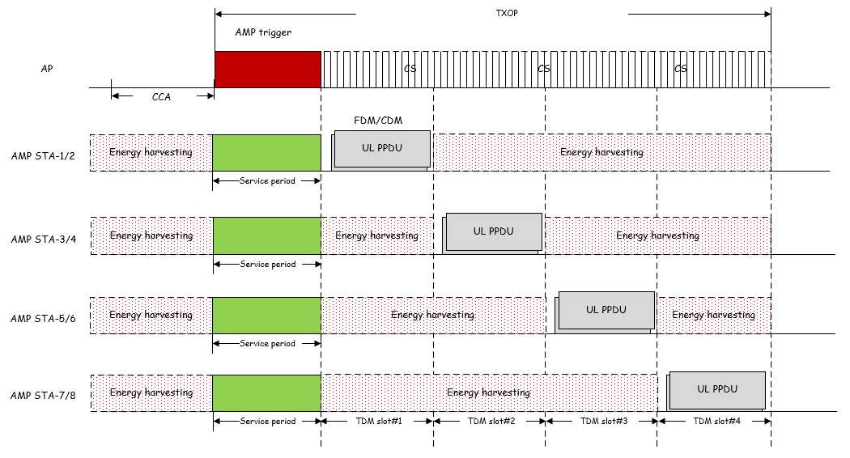
Nov 2024
Doc.: IEEE 802.11-24/1774r1
Signaling from AMP trigger: Resource grants
Resource grants
TDM resource
Time slots set for AMP STAs to perform TDM transmission
FDM or CDM resource
Number of FDM/CDM resources, including frequency subchannel/orthogonal code
An example of TDM/FDM/CDM backscatter transmission from multiple AMP STAs
AMP STA1-2 share the same TDM slot, and multiplex in FDM/CDM manner.
AMP trigger schedules resources for transmission from potential AMP STAs.
AMP STAs select resource in time/frequency/code domain, and perform data transmission using corresponding resource.
Slide 6
Chuanfeng He (OPPO)

Slide 7
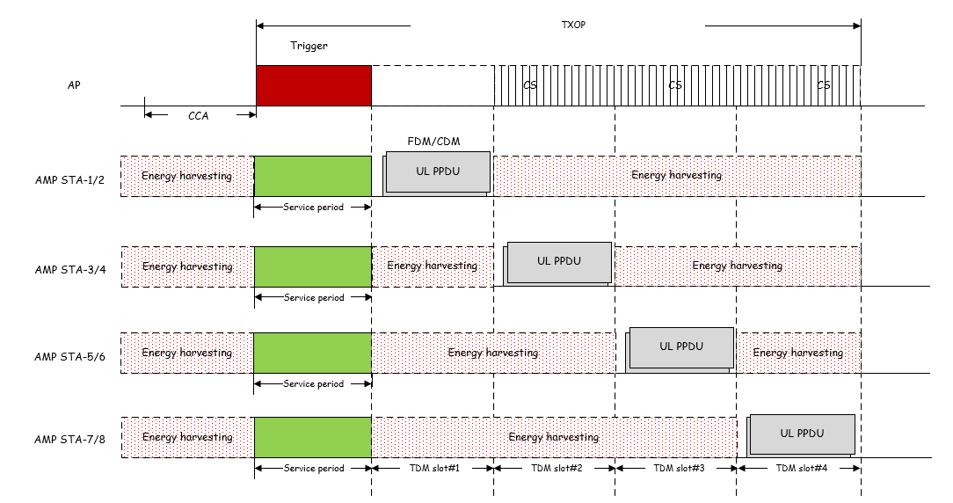
Nov 2024
Doc.: IEEE 802.11-24/1774r1
Signaling from AMP trigger: AMP TX mode
AMP transmission mode
The AMP transmission mode signaling is associated with the granted resources.
The AMP STAs with backscatter should select the granted resources for backscatter transmission, since AP will provide carrier signal for backscatter.
The AMP STAs with active transmitter should select the granted resources for active transmission.
An example of TDM resource associated with AMP transmission mode
AMP STA1-2 with active transmitter select TDM slot #1 for AMP transmission.
AMP STA3-6 with backscatter select TDM slot #2-4 for AMP transmission.
Slide 7
Chuanfeng He (OPPO)

Slide 8
Nov 2024
Doc.: IEEE 802.11-24/1774r1
Signaling from AMP trigger: Power control
Power control for active transmitter
Motivation: To reduce the interference to the legacy WiFi devices, reduce power consumption, and optimize link adaptation.
Mechanism
Fixed power levels due to the simplicity of AMP STAs, e.g., high, mid and low power levels.
Procedure
Controlled by the AP
Power control signaling contained in the DL signaling, e.g., AMP trigger.
Can be applied to use cases such as sensors with multiple signaling exchange.
Initiated by the AMP STAs
AMP STAs choose power level autonomously and adjust based on measuring DL signals when possible.
Can be applied to use case such as inventory.
Slide 8
Chuanfeng He (OPPO)

Slide 9
Nov 2024
Doc.: IEEE 802.11-24/1774r1
Signaling from AMP trigger: Timestamp
Timestamp for AMP TSF
AMP trigger will be frequently transmitted to satisfy potential AMP uplink transmission requirement. Therefore, it should be easier to obtain timestamp from AMP trigger.
When initially powered on, AMP STA will search AMP trigger for uplink transmission. It is not necessary to obtain timestamp through other frame types.
AMP STA can obtain a short timestamp through AMP trigger signalling to start ,restart or renew local TSF timer. [3]
The operation time duration for successful UL transmission may be short, e.g. in logistics and warehouse scenarios.
The local TSF timer only need to span a short time period to support the transmission during at least one AMP trigger session.
The timestamp in AMP trigger can be used to support TDM multiple access and duty-cycle operation.[3][4]
Slide 9
Chuanfeng He (OPPO)

Slide 10
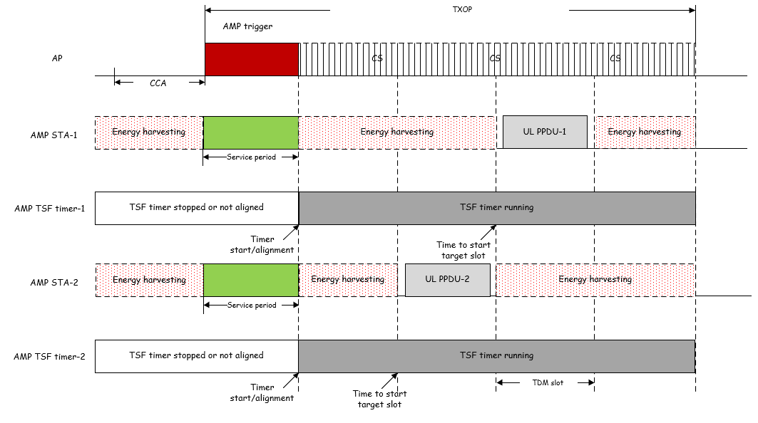
Nov 2024
Doc.: IEEE 802.11-24/1774r1
Signaling from AMP trigger: Timestamp
TSF timer start or alignment based on timestamp in AMP trigger.
TDM slot starting determination based on TSF timer.
TSF timer spanning at least during one AMP trigger session.
Slide 10
Chuanfeng He (OPPO)

Slide 11
Nov 2024
Doc.: IEEE 802.11-24/1774r1
Signaling from AMP trigger: Duty cycle configuration
Duty cycle configuration
Signaling to support duty cycle operation, e.g.
AMP trigger interval for AMP STA to detect AMP trigger.
Duration of service period for AMP STA to detect AMP trigger.
Service period aligned to periodic AMP Trigger
Slide 11
Chuanfeng He (OPPO)

Slide 12
Nov 2024
Doc.: IEEE 802.11-24/1774r1
Proposal
AMP terminology about trigger is unified to AMP trigger
Trigger based backscatter uplink communications is supported.
Signaling from AMP trigger should include the following necessary information:
Resource grant
AMP transmission mode
Power control
Timestamp
Duty cycle configuration
Slide 12
Chuanfeng He (OPPO)

Slide 13
Nov 2024
Doc.: IEEE 802.11-24/1774r1
Straw Poll #1
Do you agree with the following text:
AMP terminology about trigger is defined as “AMP trigger”.
Yes
No
Abstain
Slide 13
Weijie Xu (OPPO)

Slide 14
Nov 2024
Doc.: IEEE 802.11-24/1774r1
Straw Poll #2
Do you agree with the following text:
11bp defines at least one mode of MAC/PHY that allows an AMP-only device with backscatter uplink communication in 2.4GHz subject to the following requirements:
the backscatter uplink communication can only be sent in response to being polled by the AP.
Yes
No
Abstain
Slide 14
Weijie Xu (OPPO)

Slide 15
Nov 2024
Doc.: IEEE 802.11-24/1774r1
Straw Poll #3
Do you agree with the following text:
The following signaling are delivered by AMP trigger:
Resource grant
AMP transmission mode
Power control
Timestamp
Duty cycle configuration
Yes
No
Abstain
Slide 15
Weijie Xu (OPPO)

Slide 16
Reference
Nov 2024
Doc.: IEEE 802.11-24/1774r1
IEEE 802. 11-24/1534r0, Trigger based amp communications
IEEE 802.11-24/1501r0, Multiple Access for AMP IoT
IEEE 802.11-24/1775r0, Duty-cycle AMP operation
IEEE 802.11-24/1776r0, Multiple access mechanisms for AMP
IEEE 802.11-24/1322r4, IEEE 802.11 TGbp Motion Dock
IEEE 11-24/1613r2, Specification-framework-for-tgbp

