Slide 1
Details of AMP trigger procedure
Nov 2024
Doc.: IEEE 802.11-24/1774r0
Date: 2024-11-05
Authors:
Name | Affiliation | Address | Phone | Email
Chuanfeng He | OPPO |  |  | hechuanfeng@oppo.com
Weijie Xu |  |  |  | xuweijie@oppo.com
Yinan Qi |  |  |  | v-qiyinan@oppo.com

Slide 2
Abstract
Doc.: IEEE 802.11-24/1774r0
In this contribution, we discuss some details of trigger based AMP communications procedure.
  Terminology of trigger based AMP communications
  Trigger based backscatter uplink communications
  Signaling from AMP trigger

Slide 3
Nov 2024
Doc.: IEEE 802.11-24/1774r0
Recap: Trigger based AMP communications
  For AMP STA with backscatter, transmission is not autonomous and can only be excited by carrier wave from AP or energizer. [1]
  For AMP STA with active transmitter, autonomous transmission is not supported. The transmission of AMP STA can only be initialized by trigger from AP.
    AP performs channel access and shares its TXOP to AMP STA.
    One trigger can initialize transmission from one or multiple AMP STAs, which can be TDMed, FDMed or CDMed. [2]
  Trigger can initialize transmission from AMP STA with backscatter and active transmitter.[1]
    Known transmission request from AMP STA
    Predicted potential transmission request from AMP STA
Slide 3
Chuanfeng He (OPPO)

Slide 4
Nov 2024
Doc.: IEEE 802.11-24/1774r0
Terminology of trigger based AMP communications
  Currently used AMP terminology about trigger based AMP communication.
    Trigger: already used for trigger based mechanism in 802.11be
    Polling: already used for PSM of 802.11 standard
    Query: used in RFID standard
  Preferred to unify AMP terminology about trigger to ease further discussion.
  Proposed AMP terminology
    AMP trigger: A frame to trigger AMP transmission from AMP STA.
Slide 4
Chuanfeng He (OPPO)

Slide 5
Nov 2024
Doc.: IEEE 802.11-24/1774r0
Trigger based backscatter uplink communications
  The motion about the requirement of an AMP-only device with active uplink communication in 2.4GHz was approved [5][6].
  PM-2: 11bp defines at least one mode of MAC/PHY that allows an AMP-only device with active uplink communication in 2.4GHz subject to the following requirements:
    clock accuracy requirement is relaxed compared to legacy 802.11 devices;
    the active uplink communication can only be sent in response to being polled by the AP.
  As discussed in [1], the AMP STA with backscatter can only be excited by excitation signal from AP or energizer, and further triggered by AP for backscatter uplink transmission.
  We propose the following requirement of an AMP-only device with backscatter uplink communication:
  11bp defines at least one mode of MAC/PHY that allows an AMP-only device with backscatter uplink communication subject to the following requirements:
    the backscatter uplink communication can only be sent in response to being polled by the AP.
Slide 5
Chuanfeng He (OPPO)

Slide 6
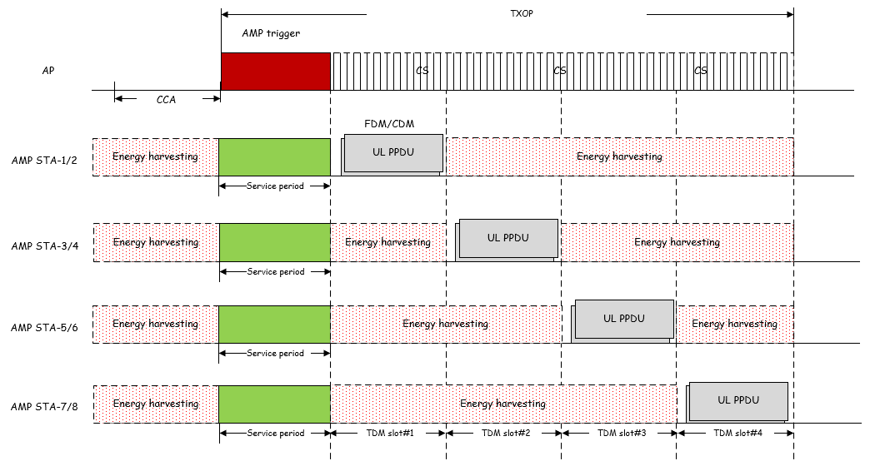
Nov 2024
Doc.: IEEE 802.11-24/1774r0
Signaling from AMP trigger: Resource grants
  Resource grants
    TDM resource
      Time slots set for AMP STA to perform TDM transmission
    FDM or CDM resource
      Number of FDM/CDM resources, including frequency subchannel/orthogonal code
An example of TDM/FDM/CDM backscatter transmission from multiple AMP STA
    AMP STA1-2 share the same TDM slot, and multiplex in FDM/CDM manner.
    AMP trigger schedules resources for transmission from potential AMP STAs.
    AMP STAs select resource in time/frequency/code domain, and perform data transmission using corresponding resource.
Slide 6
Chuanfeng He (OPPO)

Slide 7
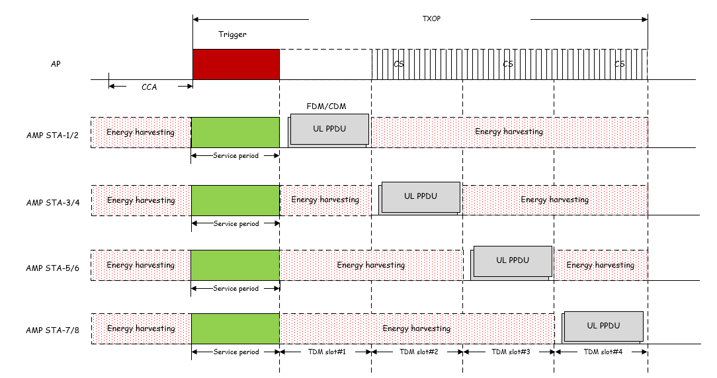
Nov 2024
Doc.: IEEE 802.11-24/1774r0
Signaling from AMP trigger: AMP TX mode
  AMP transmission mode
    The AMP transmission mode signaling is associated with the granted resources.
      The AMP STA with backscatter should select the granted resources for backscatter transmission, since AP will provide carrier signal for backscatter.
      The AMP STA with active transmitter should select the granted resources for active transmission.
An example of TDM resource associated with AMP transmission mode
    AMP STA1-2 with active transmitter select TDM slot #1 for AMP transmission.
    AMP STA3-6 with backscatter select TDM slot #2-4 for AMP transmission.
Slide 7
Chuanfeng He (OPPO)

Slide 8
Nov 2024
Doc.: IEEE 802.11-24/1774r0
Signaling from AMP trigger: Power control
  Power control for active transmitter
    Motivation: To reduce the interference to the legacy WiFi devices, reduce power consumption, and optimize link adaptation.
    Mechanism
      Fixed power levels due to the simplicity of AMP devices, e.g., high, mid and low power levels.
    Procedure
      Controlled by the AP
        Power control signaling contained in the DL signaling, e.g., AMP trigger.
        Can be applied to use cases such as sensors with multiple signaling exchange.
      Initiated by the AMP devices
        AMP devices choose power level autonomously and adjust based on measuring DL signals when possible.
        Can be applied to use case such as inventory.
Slide 8
Chuanfeng He (OPPO)

Slide 9
Nov 2024
Doc.: IEEE 802.11-24/1774r0
Signaling from AMP trigger: Timestamp
  Timestamp for AMP TSF
    AMP trigger will be frequently transmitted to satisfy potential AMP uplink transmission requirement. Therefore, it should be easier to obtain timestamp from AMP trigger.
    When initially powered on, AMP STA will search AMP trigger for uplink transmission. It is not necessary to obtain timestamp through other frame types.
    AMP STA can obtain a short timestamp through AMP trigger signalling to start ,restart or renew local TSF timer. [3]
      The operation time duration for successful UL transmission may be short, e.g. in logistics and warehouse scenarios.
      The local TSF timer only need to span a short time period to support the transmission during at least one AMP trigger session.
      The timestamp in AMP trigger can be used to support TDM multiple access and duty-cycle operation.[3][4]
Slide 9
Chuanfeng He (OPPO)

Slide 10
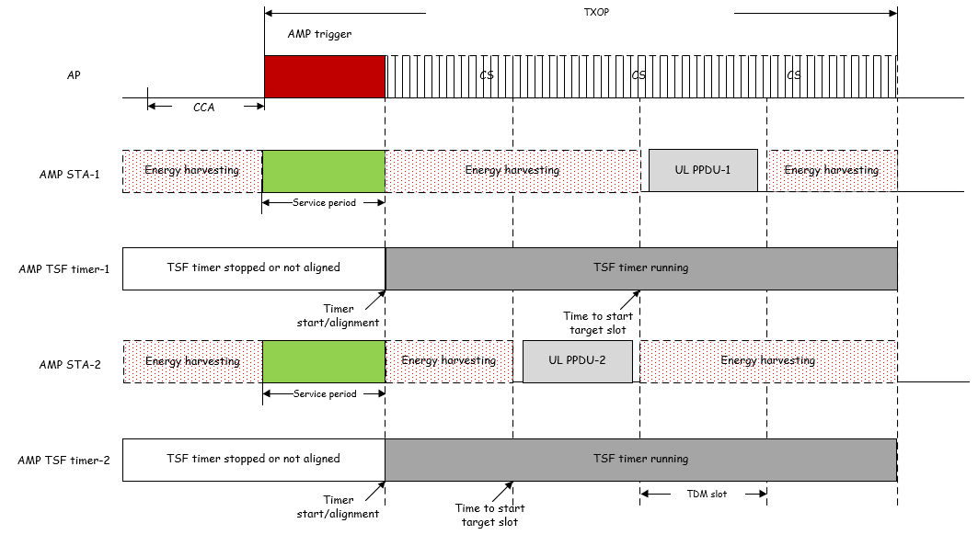
Nov 2024
Doc.: IEEE 802.11-24/1774r0
Signaling from AMP trigger: Timestamp
  TSF timer start or alignment based on timestamp in AMP trigger.
  TDM slot starting determination based on TSF timer.
  TSF timer spanning at least during one AMP trigger session.
Slide 10
Chuanfeng He (OPPO)

Slide 11
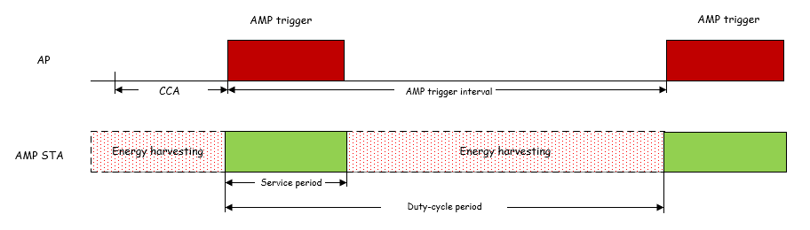
Nov 2024
Doc.: IEEE 802.11-24/1774r0
Signaling from AMP trigger: Duty cycle configuration
  Duty cycle configuration
    Signaling to support duty cycle operation, e.g.
      AMP trigger interval for AMP STA to detect AMP trigger.
      Duration of service period for AMP STA to detect AMP trigger.
Service period aligned to periodic AMP Trigger
Slide 11
Chuanfeng He (OPPO)

Slide 12
Nov 2024
Doc.: IEEE 802.11-24/1774r0
Proposal
  AMP terminology about trigger is unified to AMP trigger
  Trigger based backscatter uplink communications is supported.
  Signaling from AMP trigger should include the following necessary information:
    Resource grant
    AMP transmission mode
    Power control
    Timestamp
    Duty cycle configuration
Slide 12
Chuanfeng He (OPPO)

Slide 13
Nov 2024
Doc.: IEEE 802.11-24/1774r0
Straw Poll #1
Do you agree with the following text:
  AMP terminology about trigger is defined as “AMP trigger”.
Yes
No
Abstain
Slide 13
Weijie Xu (OPPO)

Slide 14
Nov 2024
Doc.: IEEE 802.11-24/1774r0
Straw Poll #2
Do you agree with the following text:
  11bp defines at least one mode of MAC/PHY that allows an AMP-only device with backscatter uplink communication in 2.4GHz subject to the following requirements:
    the backscatter uplink communication can only be sent in response to being polled by the AP.
Yes
No
Abstain
Slide 14
Weijie Xu (OPPO)

Slide 15
Nov 2024
Doc.: IEEE 802.11-24/1774r0
Straw Poll #3
Do you agree with the following text:
  The following signaling are delivered by AMP trigger:
      Resource grant
      AMP transmission mode
      Power control
      Timestamp
      Duty cycle configuration
Yes
No
Abstain
Slide 15
Weijie Xu (OPPO)

Slide 16
Reference
Nov 2024
Doc.: IEEE 802.11-24/1774r0
IEEE 802. 11-24/1534r0, Trigger based amp communications
IEEE 802.11-24/1501r0, Multiple Access for AMP IoT
IEEE 802.11-24/1775r0, Duty-cycle AMP operation
IEEE 802.11-24/1776r0, Multiple access mechanisms for AMP
IEEE 802.11-24/1322r4, IEEE 802.11 TGbp Motion Dock
IEEE 11-24/1613r2, Specification-framework-for-tgbp

