Slide 1
UL/DL Indication for ELR PPDU
Date: 2024-11-10
Authors:
Name | Affiliations | Address | Phone | Email
Bo Gong | Huawei |  |  | gongbo8@huawei.com
Jian Yu (Ross) |  |  |  | ross.yujian@huawei.com
Ming Gan |  |  |  | ming.gan@huawei.com

Slide 2
Background
Nov 2024
In EHT PPDU, there exist BSS color sub-field and UL/DL sub-field in U-SIG to filter the packets out of the preferred BSS and direction.
L-STF
L-LTF
L-SIG
RL-SIG
U-SIG1
U-SIG2
EHT-SIGs
EHT-STF
EHT-LTFs
Data
PE
In ELR PPDU, the BSS color is indicated in the ELR-mark symbol [1] and the UL/DL is indicated in ELR-SIG symbol 1 [2].
L-STF
3dB
L-LTF
3dB
L-SIG
RL-SIG
U-SIG1
U-SIG2
ELR-mark1
ELR-mark2
ELR-STF
ELR-LTF
ELR-SIG
ELR-Data
Note that for EHT-PPDU, the packet filtering of UL/DL is before the EHT-STF/EHT-LTF; Whilst for ELR-PPDU, the packet filtering of UL/DL is after the ELR-STF/ELR-LTF. In this proposal, a way of UL/DL indication in ELR-mark field is proposed to filter the packets earlier and improve the power saving for ELR STAs.

Slide 3
Nov 2024
Proposed UL/DL indication in ELR-mark field
In the current design in ref [1], ELR-Mark Field carries a sequence with length 96. There are 64 orthogonal sequences formulating a matrix ${\acute{H}}_{64×96}$ to indicate BSS Color with 6 bits.
The UL/DL indication can also be carried in ELR-mark field as the following way.
For UL transmission, one row of ${\acute{H}}_{64×96}$ will be carried in ELR Mark field.
For DL transmission, one row of -${\acute{H}}_{64×96}$ will be carried in ELR Mark field.

Slide 4
Performance Analysis
Nov 2024
The false alarm rate of the ELR PPDU identification may be affected by the Hamming Distance of the candidate sequences set. Based on the following analysis, it can be seen that the Hamming Distance of $\left[\begin{matrix}{\acute{H}}_{64×96} \\ −{\acute{H}}_{64×96}\end{matrix}\right]$ isn’t smaller than ${\acute{H}}_{64×96}.$ Thus, the false alarm rate won’t be increased.
Rows of ${\acute{H}}_{64×96}$ are orthogonal. The Hamming distance between any two rows is 48.
For the matrix $\left[\begin{matrix}{\acute{H}}_{64×96} \\ −{\acute{H}}_{64×96}\end{matrix}\right]$, the Hamming distance between any two rows isn’t smaller than 48.
 | The j-th row of ${\acute{H}}_{64×96}$ ($i≠j$) | The i-th row of -${\acute{H}}_{64×96}$ | The j-th row of -${\acute{H}}_{64×96}$ ($i≠j$)
The i-th row of ${\acute{H}}_{64×96}$ | 48 | 96 | 48

Slide 5
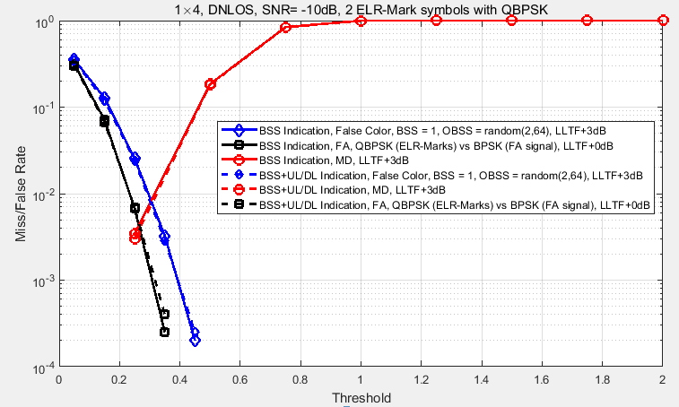
Performance Analysis
Nov 2024
Simulation Parameters
Detection metric: $D=\sum_{data tones}{real(\hat{x}∗x_{mark}^{H})}$,
$\hat{x}$ is output of equalizer, and $x_{mark}$ is the targeted signal corresponding to a BSS Color and a UL/DL direction.
3dB boosting on two L-LTF symbols in ELR PPDU
No boosting on two L-LTF symbols and BPSK for FA signal from other PPDU formats.
Observation
No obvious difference in MD/FA rate for carrying UL/DL
indication in ELR-Mark symbol.

Slide 6
Nov 2024
Performance Analysis
No obvious changes for PAPR.
Pilot values for ELR-Mark symbols are [-1 -1 -1 1];
QBPSK modulation;
PAPR for ${\acute{H}}_{64×96}$
Sym1
Sym2
PAPR for -${\acute{H}}_{64×96}$
Sym1
Sym2
$$\acute{H}=\left(\begin{matrix}H & HJ \\ H & −HJ\end{matrix}\right)$$
$$−\acute{H}=\left(\begin{matrix}−H & −HJ \\ −H & HJ\end{matrix}\right)$$
 | Min PAPR | Median PAPR | Max PAPR
Ref [1] | 4.92 | 5.65 | 6.46
HW | 3.85 | 4.58 | 4.8
 | Min PAPR | Median PAPR | Max PAPR
Ref [1] | 4.88 | 5.73 | 6.44
HW | 3.85 | 4.58 | 4.8
 | Min PAPR | Median PAPR | Max PAPR
Ref [1] | 4.92 | 5.65 | 6.46
HW | 3.85 | 4.58 | 4.8

Slide 7
Summary
Nov 2024
In this proposal, a way of UL/DL indication in ELR-mark field is proposed, which provides earlier packet filtering and improved power saving for ELR STAs. Meanwhile, the MD/FA rate and the PAPR haven’t been changed.

Slide 8
References
Nov 2024
[1] 11-24-1571-01-00bn-extended-long-range-elr-mark-symbol-design.pptx
[2] 11-24-1590-01-00bn-extended-long-range-signaling.pptx

