Slide 1
AMP Energizer
Date: 11 Nov 2024
Name | Affiliation | Address | Phone | Email
Ian Bajaj | Huawei | Singapore |  | ian.bajaj@huawei.com
Lei Huang
Rojan Chitrakar
Bin Qian |  | Shenzhen, China
Notes:
Jul 12, 2010
Page 1

Slide 2
Introduction
IEEE TGbp PAR [1] defines at least one mode of wireless power transfer in the sub-1 GHz band to support RF energy harvesting
[2] describes the topology for non-collocated Energizer, that receives control frames from an AP, and transmits the wireless power transfer (WPT) waveform to the AMP STAs
[3] describes the topology for bi-static backscatter with a Carrier Source device that sends the carrier source PPDU to the AMP STA to enable backscattering
[4] describes the topology for non-collocated Energizer, that sends a wake up trigger to AMP assisted STAs to support a low-power receiver
This contribution serves to define the AMP Energizer, and its function.

Slide 3
Definition
AMP Energizer is a new entity in IEEE 802.11 device architecture.
A non-collocated AMP Energizer may include a non-AMP non-AP STA (non-HT/HT/VHT/HE/EHT/UHR STA) that receives WPT control or Carrier Source control signaling from the AP.
The AMP Energizer has an Energizing Function that can transmit different PPDUs as instructed by the AP to provide to the AMP STAs:
  WPT
  Excitation signal (Carrier Signal) for Backscattering (CSB)
  Wake-up trigger (WUT) for AMP assisted STAs
An Energizer can share WPT/CSB capability information during probing or association with an AP.

Slide 4
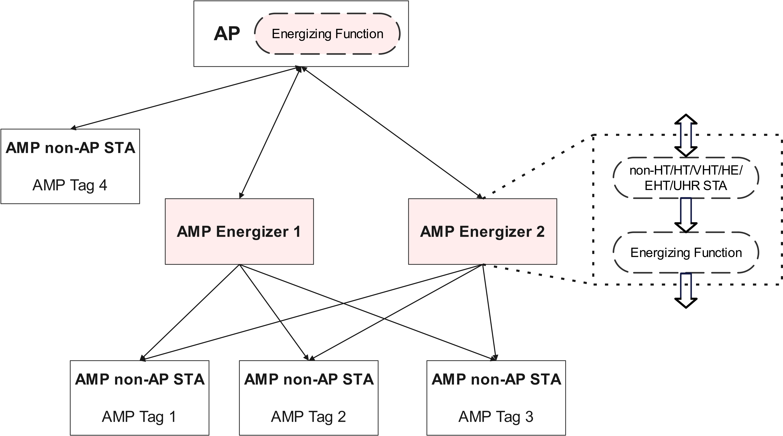
Architecture
An AP can associate with multiple AMP Energizers.
The Energizer non-AP STA receives control information from an AP that is associated with to determine its Energizing Function.
The Energizing function may be a logical entity for a integrated AP-Energizer architecture.

Slide 5
Control Signaling
The control signaling from the AP to the a non-collocated AMP Energizer can encapsulate WPT, CSB and WUT instructions, and carried in a new frame, with:
  PPDU type indicating WPT/CSB/WUT
  Duration field indicating the duration of the charging/excitation field, and/or the duration of the control field
  Interval field indicating the duration between PPDU transmissions
  Waveform type depending on PPDU type
  Transmit power indication depending on PPDU type
  Start Time indication to transmit the PPDU

Slide 6
Summary
A new AMP Energizer entity with its corresponding architecture is defined.
The AMP Energizer changes its Energizing Function based on the control signaling from the AP, to support WPT, backscatter operation and wake-up triggering.
An new frame carrying the control information from the AP to the AMP Energizer is discussed.

Slide 7
SP1
Do you agree to add the following text to TGbp SFD?
IEEE 802.11bp shall define an AMP Energizer that contains an IEEE 802.11 non-AP STA, and an Energizing Function which is capable of transmitting PPDUs for the purpose of WPT and/or backscattering operation and/or wake-up triggering.

Slide 8
References
[1] 11-24/0575r1, P802.11bp PAR.
[2] 11-24/1524r2, Follow-up on the AMP WPT protocol
[3] 11-24/1214r2, Carrier PPDU Discussion for Long-range Backscatter Operation
[4] 11-24/1263r0, AMP Supported Legacy Mode

