Slide 1
Aspects of M-AP Coordination (MAPC) agreement
Date: 2024-10-25
Authors:
Name | Affiliations | Address | Phone | email
Arik Klein | Huawei |  |  | Arik.Klein@huawei.com
Genadiy Tsodik |  |  |  | Genadiy.tsodik@huawei.com
Shimi Shilo |  |  |  | Shimi.Shilo@huawei.com
Oded Redlich |  |  |  | Oded.Redlich@huawei.com

Slide 2
Background
802.11bn SFD (Motion #51) defines a common framework of a Multi-AP Coordination that can enable the following procedures:
  Multi-AP Coordination (MAPC) discovery procedure
  Multi-AP Coordination (MAPC) agreement negotiation procedure
The M-AP Coordination framework supports both TXOP-based coordination schemes (such as: Co-SR, Co-BF, Co-TDMA) and SP-based coordination schemes (such as: CR-TWT)
This contribution discusses several aspects of the Multi-AP Coordination agreement negotiation procedure.

Slide 3
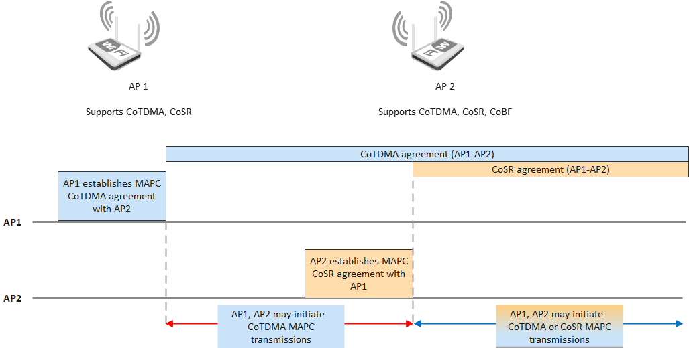
MAPC agreement procedure guidelines
Any set of APs can negotiate more than a single MAPC agreement
  Example:
    Agreements are established by different APs in different times.
    For TXOP-based schemes: Each AP may initiate MAPC transmission in the TXOP it obtains according to an agreement it is member of.
  Maximal number of MAPC agreements per AP – TBD.

Slide 4
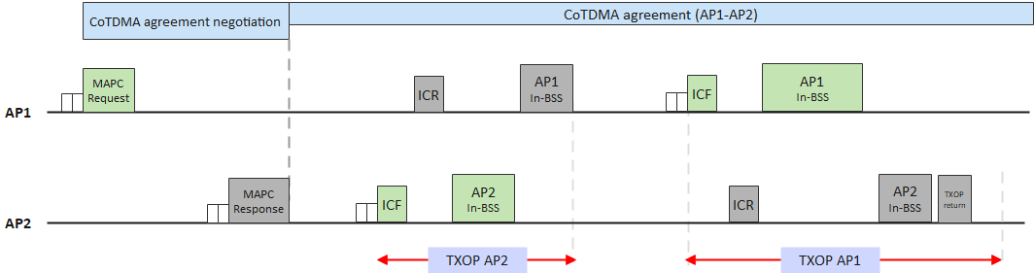
MAPC agreement procedure guidelines
The MAPC agreement should be valid for more than a single TXOP (long-term process). Thus, for a TXOP-based coordination scheme agreement:
  A MAPC transmission that is based on a specific agreement may occur in a different TXOP than the TXOP in which the agreement has been established.
  An individual MAPC transmission may use a different set of parameters than those negotiated during the agreement established (will be detailed later).

Slide 5
M-AP Coordination agreement setup
During the MAPC discovery phase, the individual AP which supports the MAPC is monitoring the MAPC capabilities of other OBSS APs in its range.
The negotiation procedure for MAPC agreement provides the AP with the means to setup an agreement based on a specified set of coordination parameters with one or more OBSS APs.
Any MAPC agreement shall include at least the following parameters:
  A single coordination scheme.
  One (or more) AP ID(s) that are members of this agreement.
  Whether an agreement includes more than a single AP ID - TBD
  Optional: Maximal / minimal values of parameters required from each member AP
  Other parameters - TBD

Slide 6
M-AP Coordination agreement parameters
2-step MAPC agreement negotiation
  In a TXOP-based coordination scheme agreements, further negotiation is required between the sharing AP and the APs under a specific agreement
  The sharing AP needs to further negotiate:
    Which member APs will be involved in MAPC transmission in the current TXOP (or part of thereof)
      Required for efficient resource allocation
    The resources allocated per each participant member AP (i.e. shared AP) of this agreement that is involved in the MAPC transmission.
    Further transmission/reception parameters per each participant member AP (i.e. shared AP) of this agreement that is involved in the MAPC transmission
  Therefore, several transmission parameters are finalized prior to the initiation of the MAPC transmission within a TXOP.

Slide 7
MAP Coordination agreement identifier
Any set of APs can set more than a single M-AP coordination agreement
Consequently, each M-AP coordination agreement should have a unique identifier (suggested name: MAPC AGID).
  The MAPC AGID is used by any AP when exchanging management or control frames between any subset of APs that are members of this agreement:
    For example:
      AP1, AP2 and AP3 have established a MAPC agreement for Co-TDMA (with MAPC AGID=1).
      AP1 and AP4 also have established a MAPC agreement for Co-BF (with MAPC AGID=3).
      For a specified TXOP obtained by AP1:
      In the ICF/ICR exchange between AP1 and AP2 and/or AP3 prior to the Co-TDMA MAPC transmission, MAPC AGID=1 will be used.
      In the ICF/ICR exchange between AP1and AP4 prior to the Co-BF MAPC transmission, MAPC AGID=1 will be used.

Slide 8
Summary
The MAPC agreement negotiation setting is a vital part of the common MAPC framework.
Each agreement shall correspond to a single coordination scheme
Each agreement may include one or more OBSS APs.
For a TXOP-based coordination scheme agreement, the parameters allocated per each agreement are negotiated in a 2-step procedure:
  During the TXOP in which the agreement is established
  prior to the imitation of the MAPC transmission (in a TXOP obtained by any of the agreement members)
Each MAPC agreement will have a unique identifier.

Slide 9
SP1
Do you agree to support defining a MAPC agreement that will correspond to a single coordination scheme?
Yes / No / Abstain

Slide 10
SP2
Do you agree to support defining a unique identifier for a MAPC agreement?
  The exact name of the identifier - TBD
Yes / No / Abstain

Slide 11
SP3
Do you agree to support defining a MAPC agreement that will correspond to one or more OBSS APs?
Yes / No / Abstain

Slide 12
Reference
[1] 11-23/767r0 M-AP Coordination Agreement
[2] 11-23/1066r0 M-AP Coordination Agreement – follow up
[3] 11-24/1871r5 M-AP Coordinated Transmission framework

