Slide 1
Low Latency Buffer Status Report
Date: 2024-10-08
Authors:
Name | Affiliations | Address | Phone | email
Jason Yuchen Guo | Huawei Technologies |  |  | guoyuchen@huawei.com
Yunbo Li
Guogang Huang
Ming Gan
Yue Zhao
Maolin Zhang
Zhenpeng Shi
Lyutianyang Zhang
Yulin Hu | Wuhan University |  |  | Yulin.hu@whu.edu.cn

Slide 2
Introduction
Improving the latency performance is an important target of TGbn according to the PAR of UHR [1].
Reducing the delay of channel access is essential to the improvement the latency performance.
For triggered UL channel access, the AP needs to know the buffer status of the non-AP STAs. However, the current SPEC only provide ways for the non-AP STAs to report the number of pending bytes to be transmitted, the urgency of the pending data is missing.
The QoS characteristics element can only provide long term “delay requirement” of a traffic stream, the real-time status of low latency traffic is not known to the AP.
In this contribution, we provide a way for the non-AP STAs to indicate their low latency buffer status report to the AP

Slide 3
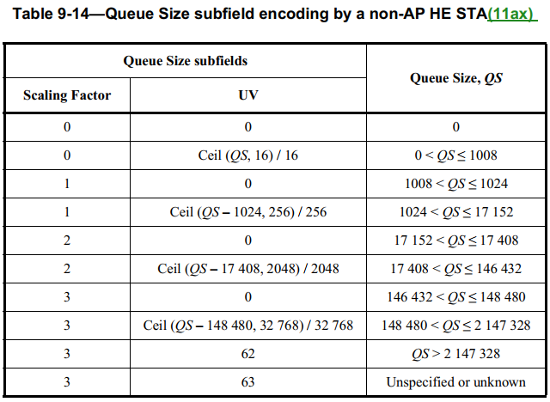
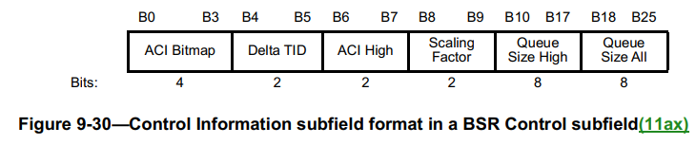
BSR Recap
In the baseline, the queue size/buffer status can be indicated in the QoS Control field or A-control field

Slide 4
BSR for Low Latency Traffic
In order to inform the AP how urgent the low latency traffic is, the non-AP STA can indicate the following information to the AP:
  HOL delay budget: the expiration time of the most urgent batch of packets in the queue for the low latency traffic
  HOL batch size: the number of bytes of the most urgent batch of packets in the queue for the low latency traffic
The above information can be carried in the A-Control field
In 11bn we have the motivation to modify the A-Control field to carry buffer related information according the following motion:
TGbn enables per-TID buffer size reporting of a larger queue in UHR.
  Note: It is an optional feature.
  Note: In the baseline, the maximum approximate per-TID queue size to report is 2,147,328 octets

Slide 5
Conclusion
We propose to enable the non-AP STA to report the low latency buffer status to the AP to let the AP schedule the non-AP STA to meet the low latency requirement
The information to be reported to the AP includes:
  HOL delay budget: the expiration time of the most urgent batch of packets in the queue for the low latency traffic
  HOL batch size: the number of bytes of the most urgent batch of packets in the queue for the low latency traffic

Slide 6
References
[1] 11-23-0480-03-0uhr-uhr-proposed-par

