Slide 1
Signaling for DRU in Trigger Frame
Follow-up
Date: 2024-11-10
Authors:
Name | Affiliation | Address | Phone | Email
Eunsung Park | LG Electronics | 19, Yangjae-daero 11gil, Seocho-gu, Seoul 137-130, Korea |  | esung.park@lge.com
Dongguk Lim |  |  |  | dongguk.lim@lge.com
Jinyoung Chun |  |  |  | jiny.chun@lge.com
Insik Jung |  |  |  | insik0618.jung@lge.com
Jinsoo Choi |  |  |  | js.choi@lge.com
HanGyu Cho |  |  |  | hg.cho@lge.com

Slide 2
Introduction
In [1], we discussed a common indication based DRU signaling method in the Trigger frame
  We introduced two subfields, RRU/DRU Flag subfield and DBW Mode subfield
In this contribution, we discuss more details about the RRU/DRU Flag subfield
In addition, we check on if there is enough room for DBW indication in the User Info field and discuss how to enable it

Slide 3
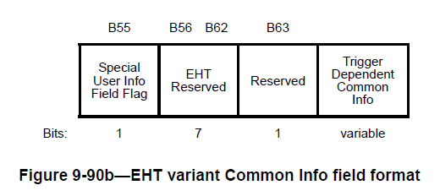
RRU/DRU Flag subfield (1/3)
RRU/DRU Flag subfield can be basically defined in the Common Info field or the Special User Info field
  4-bit bitmap can be used as shown in [1][2]
    Each bit is mapped to a 80 MHz channel and indicates whether DRU or RRU is used in the corresponding channel
  For example, we can use B56 to B59 in the Common Info field
    Default value for each bit is 1, and thus, 0 and 1 can be used to indicate DRU and RRU, respectively
For a 320 MHz TB PPDU, we can apply the above approach directly
  Four bits are mapped to 80 MHz channels in ascending order and indicate the RU types used in the corresponding channels

Slide 4
RRU/DRU Flag subfield (2/3)
For a 160 MHz TB PPDU, the first two bits can be used for the indication and the other two bits can be reserved or used for other purpose
  The first two bits are mapped to 80 MHz channels in ascending order and indicate the RU types used in the corresponding channels
For a 20 / 40 / 80 MHz TB PPDU, the first bit can be used for the indication and the other three bits can be reserved or used for other purpose
  The first bit is mapped to the entire bandwidth, i.e., 20 / 40 / 80 MHz channel for 20 / 40 / 80 MHz TB PPDU, respectively, and indicates the RU type used in the TB PPDU
  If we adopt an 80 MHz hybrid PPDU, we need to make an exception of the 4-bit bitmap for the RRU/DRU Flag subfield in the Trigger frame which solicits an 80 MHz TB PPDU

Slide 5
RRU/DRU Flag subfield (3/3)
In [3], an 80 MHz hybrid PPDU was proposed
  Either DRU or RRU is used in each 40 MHz, i.e., there is no mix of DRU and RRU within a 40 MHz channel
  The rationale behind proposing the 80 MHz hybrid PPDU is as follows
    80 MHz is the maximum mandatory bandwidth for non-AP STAs and it is widely used for a PPDU transmission
    If the 80 MHz hybrid PPDU is not supported, we cannot support DRU incapable STAs or cannot benefit from DRU since DRU and RRU are not applicable to an 80 MHz transmission simultaneously
Considering the hybrid PPDU, for an 80 MHz TB PPDU, the first two bits can be used for the indication and the other two bits can be reserved or used for other purpose
  The first two bits are mapped to 40 MHz channels in ascending order and indicate the RU types used in the corresponding channels

Slide 6
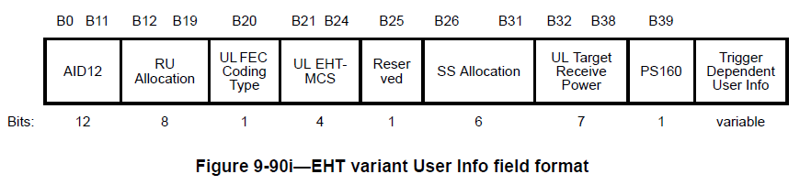
DBW Indication in User Info Field (1/5)
We would like to check on if DBW indication is possible in the User Info field
  To this end, we take into account signaling for various features which need to be indicated and available bits in the User Info field
UHR variant User Info field can be defined based on the EHT variant User Info field
  Given the features supported in UHR, the EHT variant User Info field can be modified

Slide 7
DBW Indication in User Info Field (2/5)
Additional required signaling bits for DRU and other new features
  DBW: 2 bits
    The last two bits of SS Allocation subfield can be used as proposed in [2]
  NSS: 1 bit
    The group approved to support up to 2 SS and not to support MU-MIMO for DRU
    If UEQM is on, NSS should be 2 and NSS indication may not be required
  UEQM: 1 bit
  UEQM Pattern: 1 bit
    It is required only when UEQM is on and 1 bit is sufficient considering the number of supported NSS for DRU and the supported UEQM patterns when NSS is 2
  MCS extension: 1 bit
  2x LDPC: 1 bit
  CSD: 3 bits
    In [4], it was proposed that a CSD value applied to the UHR-STF for a DRU transmission is indicated in the User Info field
→ The same bit index can be used for NSS indication and UEQM pattern indication when UEQM is off and on, respectively

Slide 8
DBW Indication in User Info Field (3/5)
Available bits are as follows
  Reserved bit B25: 1 bit
  SS Allocation subfield: 6 bits
    We can change the definition of this subfield to accommodate UHR features
  UL FEC Coding subfield: 1 bit
    This subfield can be reserved when UEQM is on
Available bits are not enough to cover all of the required signaling
  9 bits are required but 8 bits and 7 bits are available when UEQM is on and off, respectively
We may still need a couple of available bits and we consider several ways to address this problem
  Reduce the bit size of the UL Receive Power subfield [5]
  Not support 2x LDPC or not indicate 2x LDPC
  Allow only LDPC for DRU

Slide 9
DBW Indication in User Info Field (4/5)
Reduce the bit size of the UL Receive Power subfield [5]
  One or two more bits are available
  The range of the expected received signal power is the same although the resolution may be worse
Not support 2x LDPC or not indicate 2x LDPC
  One required bit is reduced
  2x LDPC and DRU may be optional features and it may be not a good direction to apply an optional feature on top of another optional one
  Or, based on the capability and several parameters, it can be decided whether 2x LDPC is used or not
Allow only LDPC for DRU
  Even when UEQM is off, UL FEC Coding Type subfield can be always reserved
  BCC is not supported for large RUs and higher MCSs such as 1024/4096 QAMs
  There may be higher chance that high modulation level is used for a DRU transmission considering the power boosting gain
  LDPC is commonly used and has a better performance than BCC

Slide 10
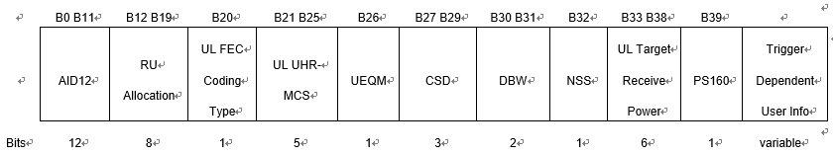
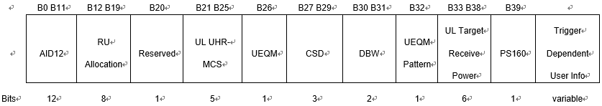
DBW Indication in User Info Field (5/5)
We can choose or combine the ways shown in the previous slide to enable DBW indication in the User Info field
The following figures show an example of the User Info field when assuming to reduce one bit of the UL Receive Power subfield and no 2x LDPC indication
  When UEQM is off
  When UEQM is on
→ The same bit index is used for NSS indication and UEQM pattern indication

Slide 11
Summary
We have discussed the detailed design for the RRU/DRU Flag subfield considering various bandwidths and the 80 MHz hybrid PPDU
We have also investigated if there is a room for DBW indication in the User Info field
  We have analyzed the required additional signaling bits for new UHR features and available bits in the User Info field
  Several ways to enable DBW indication in the User Info field have been also discussed

Slide 12
Straw Poll #1
Do you agree to add the following text to the TGbn SFD?
  Subfields to indicate RU types and DBW are defined in the common part (i.e., the Common Info field or the Special User Info field) and the User Info field, respectively, of the Trigger frame
Y/N/A: //

Slide 13
Straw Poll #2
Do you agree to add the following text to the TGbn SFD?
  TGbn supports an 80 MHz hybrid PPDU where DRU is used in one 40 MHz channel and RRU is used in the other 40 MHz channel
    There is no mix of DRU and RRU within a 40 MHz channel
Y/N/A: //

Slide 14
Straw Poll #3
Do you agree to add the following text to the TGbn SFD?
  4-bit bitmap is defined in the Common Info field or the Special User Info field of the Trigger frame to indicate RU types in a TB PPDU
    For a 320 MHz TB PPDU, four bits are mapped to 80 MHz channels in ascending order and indicate whether DRU or RRU is used in the corresponding 80 MHz channels
    For a 160 MHz TB PPDU, the first two bits are mapped to 80 MHz channels in ascending order and indicate whether DRU or RRU is used in the corresponding 80 MHz channels and the other bits are reserved
    For an 80 MHz TB PPDU, the first two bits are mapped to 40 MHz channels in ascending order and indicate whether DRU or RRU is used in the corresponding 40 MHz channels and the other bits are reserved
    For a 20 / 40 MHz TB PPDU, the first bit is mapped to the entire bandwidth and indicates whether DRU or RRU is used in the TB PPDU and the other bits are reserved
Y/N/A: //

Slide 15
Straw Poll #3-1
Do you agree to add the following text to the TGbn SFD?
  4-bit bitmap is defined in the Common Info field or the Special User Info field of the Trigger frame to indicate RU types in a TB PPDU
    For a 320 MHz TB PPDU, four bits are mapped to 80 MHz channels in ascending order and indicate whether DRU or RRU is used in the corresponding 80 MHz channels
    For a 160 MHz TB PPDU, the first two bits are mapped to 80 MHz channels in ascending order and indicate whether DRU or RRU is used in the corresponding 80 MHz channels and the other bits are reserved
    For a 20 / 40 / 80 MHz TB PPDU, the first bit is mapped to the entire bandwidth and indicates whether DRU or RRU is used in the TB PPDU and the other bits are reserved
Y/N/A: //

Slide 16
Straw Poll #4
Do you agree to add the following text to the TGbn SFD?
  UEQM is supported for a DRU transmission
    1-bit subfield to indicate whether UEQM is applied or not is defined in the UHR variant User Info field of the Trigger frame for a DRU transmission
Y/N/A: //

Slide 17
Straw Poll #5
Do you agree to add the following text to the TGbn SFD?
  When UEQM is off, 1-bit subfield to indicate NSS is defined in the UHR variant User Info field of the Trigger frame for a DRU transmission
Y/N/A: //

Slide 18
Straw Poll #6
Do you agree to add the following text to the TGbn SFD?
  When UEQM is on, 1-bit subfield to indicate UEQM pattern is defined in the UHR variant User Info field of the Trigger frame for a DRU transmission
Y/N/A: //

Slide 19
Straw Poll #7
Do you agree to add the following text to the TGbn SFD?
  The same bit index is used for NSS indication and UEQM pattern indication when UEQM is off and on, respectively, in the UHR variant User Info field of the Trigger frame for a DRU transmission
Y/N/A: //

Slide 20
Straw Poll #8
Do you agree to add the following text to the TGbn SFD?
  3-bit subfield to indicate a CSD value applied to the UHR-STF in the TB PPDU is defined in the UHR variant User Info field of the Trigger frame for a DRU transmission
Y/N/A: //

Slide 21
Straw Poll #9
Do you agree to add the following text to the TGbn SFD?
  There is no 2x LDPC indication for a DRU transmission
Y/N/A: //

Slide 22
Straw Poll #10
Do you agree to add the following text to the TGbn SFD?
  BCC is not supported for a DRU transmission
Y/N/A: //

Slide 23
References
[1] 11-24-1471-00-00bn-signaling-for-dru-in-trigger-frame
[2] 11-24-1489-00-00bn-signaling-for-dru-transmission
[3] 11-24-0400-00-00bn-hybrid-ppdu-and-distribution-bandwidth-for-dru
[4] 11-24-1172-01-00bn-csd-indication-design
[5] 11-24-1507-00-00bn-uhr-trigger-frame-design

