Slide 1
Dynamic QoS Profiles - Follow Up
Date: 2024-11-02
Authors:

Slide 2
Introduction
In [1] we covered that there are applications such as video collab, robotics/IIoT, real-time gaming where QoS requirements can dynamically change at run time. e.g.
  Video collaboration: session starts with 4K codec, then changes to 1K codec and goes back to 4K codec
  Industrial IoT: higher latency req periodically when a robotic arm is doing more precise task
For these, AP should be notified of dynamic changes to QoS requirements so that it can better serve to meet QoS req. across different applications in its UL & DL scheduling
We propose that a STA can provide multiple QoS profiles based on different set of QoS requirements for an app and then dynamically change the active QoS profile
We also note that there can be some throughput variability within a given QoS profile due to jitter or VBR nature associated with app traffic generation
In this presentation we provide signaling details for supporting Dynamic QoS Profiles and throughput variability within a QoS profile

Slide 3
Recap: Dynamic QoS Profiles
We proposed a STA can signal multiple QoS Profiles in the SCS Request
  Multiple QoS profiles are associated with same SCS ID
  For each QoS profile, STA signals QoS parameters in a separate QoS Char.
  Each QoS profile is identified by a QoS profile ID
  AP can accept all or a subset of QoS profiles indicated
STA indicates which QoS Profile is currently active in the SCS Request
Later STA can dynamically signal to activate a different QoS profile
  Preferred to signal QoS profile change using A-Control for faster signalling
AP allocates UL resources to the STA based on active QoS profile

Slide 4
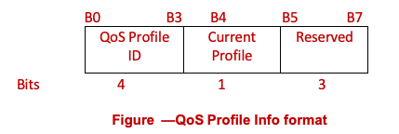
Dynamic QoS Profiles - SCS enhancements (1)
SCS Request can include multiple QoS Char elements in the SCS Descriptor for an SCSID, one for each QoS Profile for that SCSID
In the QoS Char element, a new QoS Profile Info field is added to indicate QoS profile information

Slide 5
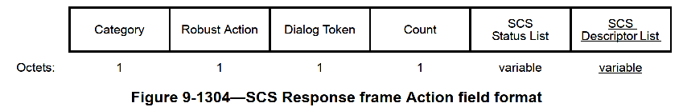
Dynamic QoS Profiles - SCS enhancements (2)
SCS Response includes a ‘QoS Profile Status’ subelement providing accept/reject status for each QoS profile
If at least one QoS Profile is accepted by the AP, overall SCSID Status in SCS Status duple is set to SUCCESS
QoS Profile Status – ‘Accepted_With_Best_Effort_SLA’ may be sent when AP does not have enough resources currently and hence will attempt to meet QoS as best effort

Slide 6
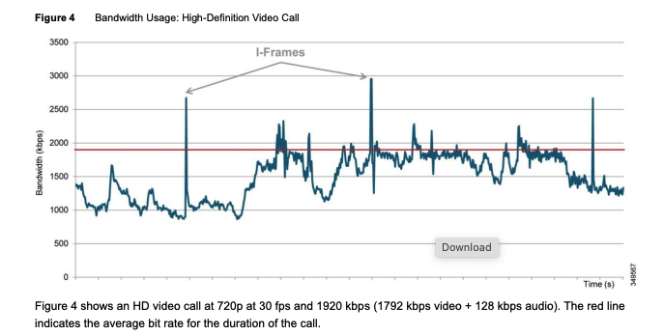
Throughput variability within a QoS profile (1)
For many applications even within a specific QoS quality level/profile, the throughput requirement can vary within a limit, e.g. in a Video call higher data rate req. when I-frames are transmitted
Data rate in a video call can also change for other factors such as changes in view layout (active speaker vs grid view), sharing of screen, scene changes, speaker motion etc.
Source: https://www.cisco.com/c/dam/en/us/td/docs/solutions/CVD/Collaboration/AltDesigns/BWM-Wbx.pdf

Slide 7
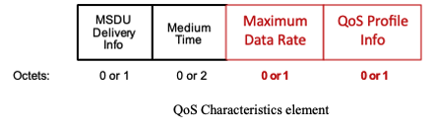
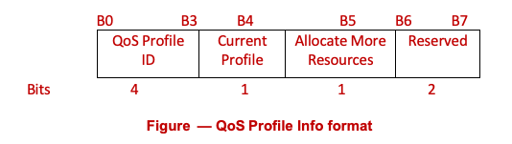
Throughput variability within a QoS profile (2)
For AP to account for such data rate variability within a QoS profile, we propose to add a Maximum Data Rate field in QoS Characteristics
In a QoS Profile, STA can:
  Include a Maximum Data Rate indicating throughput variability up to the max data rate, plus
  Explicitly request AP for allocation of more resources up to ‘Maximum Data Rate’ using an “Allocate More Resources” bit
    For UL SCS flow this implies trigger more in the same SI up to ‘Maximum Data Rate’ if BSR for the TID is non-zero
    For DL SCS flow this implies supporting DL data rate up to ‘Maximum Data Rate’ within the Delay Bound
  AP can accept or reject such a QoS Profile – per status listed on slide 5
If QoS Profile is accepted by the AP, then STA can later dynamically signal and activate that QoS profile (via A-Control),
  e.g. when due to changes in the video call STA still has buffered traffic after being served by triggers

Slide 8
Throughput variability within a QoS profile (3)
For an UL SCS flow, if STA’s buffer for a TID is filling up, it can dynamically signal (in A-Control) the QoS Profile that requests for more UL triggers in same service interval to drain the buffers
  NOTE: If multiple flows are mapped to same TID, and remaining MPDUs in the TID buffer are for the other flow that does not have high QoS requirement, then STA should not signal this QoS Profile
When AP receives such dynamic QoS profile change, it will attempt to trigger STA more (based on BSR) and up to ‘Maximum Data Rate’ in same service interval (per resource availability)
When STA no longer needs more UL triggering to meet QoS requirement, it should dynamically change the QoS Profile to one that does not require more triggering

Slide 9
A-Control to Signal Dynamic QoS profile
We propose to add a new Dynamic QoS Profile (DQP) A-Control field to signal dynamic changes to the QoS Profile

Slide 10
Summary
When QoS requirement changes dynamically, AP needs to be notified so it can perform efficient scheduling for resources in UL and DL to meet QoS requirements across all its flows
We propose that a STA can signal multiple QoS Profiles in the SCS Request and later STA can dynamically signal to activate a different QoS profile when app requirement changes at run time
We propose to enhance QoS Characteristics element with QoS Profile Info and enable accept/reject for each QoS Profile by the AP
For applications that have throughput variability within the same QoS level/profile (e.g. Video call), we propose to add a Maximum Data Rate field in QoS Chars and enable STA to request more triggering to drain its buffer for such use cases up to the max data rate
Finally, we propose to define a new ‘Dynamic QoS Profile’ Control subfield to enable STA to signal dynamic changes to QoS profile

Slide 11
References
[1] 11-24-0660 “Dynamic QoS Profiles with SCS”

Slide 12
Straw Poll 1
Do you support to add following to 11bn SFD?
Define a mechanism in 11bn that enables:
  A non-AP MLD to provide multiple QoS profiles in the SCS Request for an SCS stream, each indicating a different set of QoS characteristics parameters for the SCS stream, and
  The non-AP MLD indicates which QoS profile is currently active, and
  AP can accept or reject individual QoS profiles for the SCS stream

Slide 13
Straw Poll 2
Do you support to add following to 11bn SFD?
Define a mechanism in 11bn that enables a non-AP MLD to dynamically update the active QoS profile for an SCS stream by signaling a different QoS profile to the AP in an A-Control field, where the QoS profile is selected from one of the previously accepted QoS profiles for that SCS stream.

