Slide 1
Managed on-channel P2P communication – Follow up
Date: 2-20-2025

Slide 2
Introduction
802.11bn targets the improvement of packet delivery by reducing the transmission latency and enhancing network reliability [1]
Applications and use cases with QoS-related requirements (e.g., bounded latency and reliability) have been growing in recent times [2]
  The critical QoS services can be mainly characterized by periodic traffic patterns, and strict timing requirements for data exchange [2, 3]
Some of these specific applications would employ Peer-to-peer (P2P) links [4, 5], which could be beneficial in terms of latency and efficiency, offloading the AP workload

Slide 3
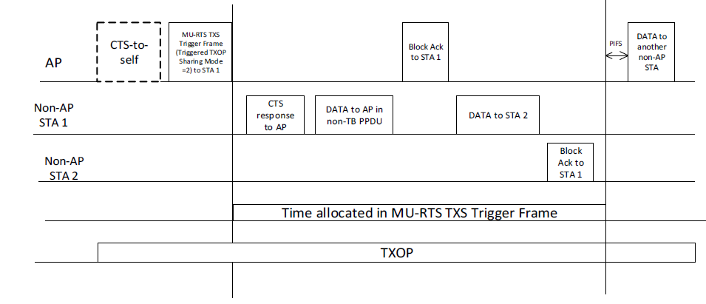
P2P: Recap
Peer-to-peer links allow direct communication between two non-AP STA devices, without any intervention of the AP, except for setting up the link in the case of on-channel P2P.
The AP uses a triggered TXOP sharing (mode 2) mechanism to grant airtime to a non-AP STA that would send data frames to another non-AP STA.
  Other P2P mechanisms exist but the focus of this proposal is on extending TXOP sharing P2P mechanism

Slide 4
Problem Statement (1/2)
Some P2P target applications, such as VR/AR/XR, are based on bidirectional data exchange (closed-loop communication).
  Another example would be any application layer based on TCP communication.
The triggered TXOP sharing (mode 2) mechanism is limited to transferring data in one direction.
  The granted non-AP STA1 can send data to another non-AP STA2, but non-AP STA2 is not allowed to transmit.
  Grouping TXS frames in the same TXOP requires that the AP knows the exact transmission order and internal data processing delays
  The AP needs to be aware of the service data flows

Slide 5
Problem Statement (2/2)
Using the existing TXS Mode 2 would require several consecutive TXOP grants, requiring the continuous action of the AP.
AP shares the gained TXOP with one P2P STA, and it is used to send data to another P2P STA, each P2P link is mapped over an individual shared TXOP.
Scheduled P2P STA1 to STA2 transaction
Scheduled P2P STA2 to STA1 transaction
MU-RTS TXS (Mode 2) Trigger frame
MU-RTS TXS (Mode 2) Trigger frame
AP
CTS to Self
AP -> STA1
CTS to Self
AP -> STA2
STA1
CTS
STA1 -> STA2
Ack
STA2
Ack
CTS
STA2 -> STA1
Other STAs
Other TXOPs
Time
P2P Period
P2P Period
STA1 P2P TXOP
STA2 P2P TXOP
STA1 P2P TXOP
STA2 P2P TXOP
STA1 P2P TXOP
Time
Therefore, the current TXOP sharing (mode 2) mechanism does not provide the optimal functionality to support new latency-sensitive P2P applications that would require fluid bidirectional data exchange.

Slide 6
P2P Group
P2P groups were introduced [6] to allow the AP to recognize a STA group involved within the same P2P application, and allocate resources on a per-group basis.
The P2P communication could be generalized to more than two devices, but can be expected to be limited to a small number of devices (e.g., up to four devices).
The granted TXOP should serve the entire P2P group in any direction, as they share the same target application.
  Specified during the initial negotiation phase.
The P2P group members should request the resources from the AP in a previous negotiation phase.
  One of the P2P group members may centralize the negotiation phase

Slide 7
Light-weight Contention
TXOP
RTS TXS Trigger frame
Light-weight contention start
Light-weight contention end
SIFS
Light-weight contention
Sharing AP
CTS to Self
TF
RA: GID
TA: AP
RA: STA1
STA1
CTS
TA: STA1
RA: STA2
Ack
TA: STA1
RA: STA2
Ack
STA2
CTS
Ack
TA: STA2
RA: STA1
Ack
Time
Time Allocated to P2P group
After the sharing AP sends the TF to the P2P group (GID), the light-weight contention starts between the STA members, until the allocated time ends, and the AP recovers the TXOP
  GID is a group identifier
In case of having PS constraints, a pre-negotiated TWT window ensures the STAs are awake for receiving the starting frame
The TXOP is protected by the AP (e.g., RTS/CTS exchange), therefore no other STA may interrupt the ongoing P2P exchange

Slide 8
Light-weight Contention
There could be several options for implementing the light contention within the P2P group contention period
  High-performance EDCA parameters (AISFN and CW)
    The Voice access category could be a good starting point to define these values. We assume that there are a very small number the devices within the contention period, whose QoS data traffic is driven by the application, and most likely there will be an order of transmission that would avoid the collisions
  No contention with fixed IFS
    Assuming the application has a fixed order of data transmission, the contention could be removed, and set a fixed xIFS separation between the frames, as there will be no collisions
  Token-based arbitration
    As an additional mechanism for avoiding collisions, there could be a token-based arbitration mechanism for allowing a P2P group member to transmit. The token will be passed through the members (different strategies could be used).

Slide 9
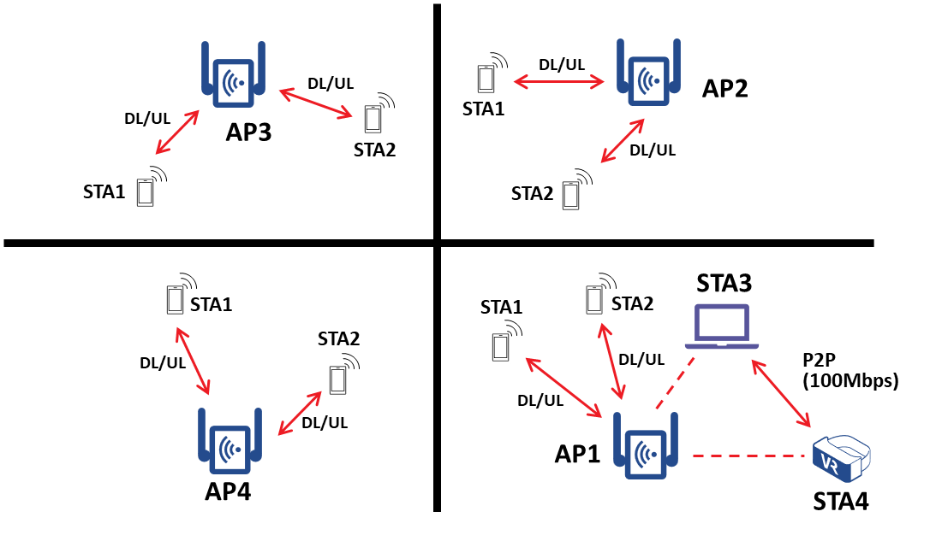
Simulation Topology
Scenario composed of 4 BSSs sharing the same channel
All the BSSs have common traffic patterns and characteristics for two associated STAs with bidirectional UDP traffic (BE background traffic)
  Background UDP traffic: STA1: 60Mbps DL / 60Mbps UL & STA2: 30Mbps DL / 30Mbps UL
AP1 has additional P2P STAs (two or three devices), transferring TCP data (asymmetric bidirectional Data – ACK) – BE or VI access category

Slide 10
P2P Mechanisms
There are three different mechanisms to transfer data between P2P STAs
  Transferring data frames through the AP, using regular UL and DL frames, the data traffic needed is the double, as every data frame is repeated
  Using TXOP sharing Mode 2 defined in IEEE 802.11be amendment (a.k.a. Legacy P2P)
  Using P2P Group channel access mechanism defined in [7]

Slide 11
P2P Results (BE / Two Devices)
The use of P2P direct communication increases the performance in terms of throughput and latency.
The results obtained for “P2P Group” are consistent with the assumption that the probability of collision occurrence is low
The overall network traffic is not affected, maintaining the fairness

Slide 12
P2P Results (VI / Two Devices)
Throughput performance (VI AC) with “Through AP” and “P2P Group” mechanisms reach similar results, including latency
  For the first case, the devices must set the AC, while for P2P is the AP who set the AC
“Through AP” mechanism pays a price regarding the network fairness, in terms of throughput and latency
P2P mechanisms maintain the fairness over the network

Slide 13
P2P Results (BE / Three Devices)
Similar results are obtained for the use case where there are three P2P devices. P2P Group mechanism offers improved performance, having the advantage that AP offloads the flow scheduling complexity to the P2P STAs
The overall network traffic is not affected, maintaining the fairness

Slide 14
P2P Results (VI / Three Devices)
Throughput performance (VI AC) with “Through AP” and “P2P Group” mechanisms reach similar results
In terms of latency, “Through AP” mechanism obtains the best results, but at the cost of reducing the fairness
The overall network performance is not affected by P2P mechanisms, as opposed to “Through AP” mechanism

Slide 15
Conclusion
P2P Group channel access mechanism offloads the P2P flow scheduling to the involved P2P STAs, reducing the setup complexity (simpler SCS rules would be needed)
  For example, a three devices P2P group with three bidirectional links, would need to set up six flow rules
The AP may provide the desired traffic priority to the allocated TXOP for P2P transactions, being independent from the P2P device's capabilities
The P2P Group mechanism improves the performance and maintains network fairness

Slide 16
References
[1] IEEE 802.11-23/0028r6, UHR PAR discussion
[2] Inaki Val and et al. (MaxLinear), “High Criticality Use Cases and Requirements”, 23/1522r0, September 2023.
[3] Oliver Holland and et al. “Low Latency Communication White Paper”, P802.24-23-0010r4, July 2023.
[4] Dibakar Das and et al. (Intel), “TXOP sharing extensions for XR use-cases”, 23/1387r1, August 2023.
[5] Guoqing Li and et al. (Meta), “Proxy QoS management for XR use cases”, 23/1958r0, November 2023.
[6] Rubayet Shafin and et al., “P2P Resource Management”, 23/1929r0, November 2023.
[7] Inaki Val and et al. (MaxLinear), “Managed on-channel P2P communication”, 24/0403r2, June 2024.

