Slide 1
Discussion on Coordinated Sounding
Date: 2024-11-10
Authors:

Slide 2
Introduction
At the July 2024 meeting, it was decided to add Coordinated BF to SFD as one of the Multi-AP Coordination features [1].
To implement Coordinated BF, the AP needs to collect channel state information (such as BF matrix feedback) of the interfering signals received by the oBSS AP from the STA, and several sounding procedures (Coordinated Sounding) have been proposed recently [2] – [4].
In this contribution, we propose an improvement of the Coordinated Sounding procedure.

Slide 3
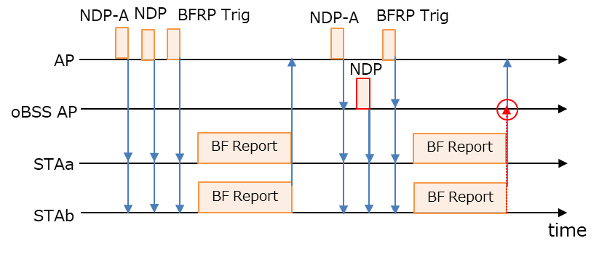
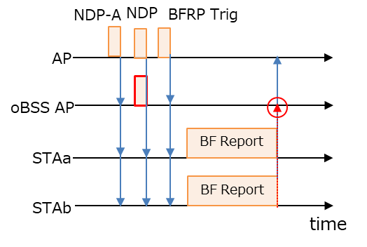
Recap on Coordinated Sounding [2]-[4]
Supports both Sequential and Joint Sounding, which were being discussed at TGbe.
  Joint Sounding is better in terms of performance, but there are concerns that the frame length of the BF report will increase, and STA will not be able to handle this as the number of receiving streams increases, so it is desirable to be able to select Sequential Sounding as well.
Considering security risks, control frame exchanges are only performed within BSS.
  In this case, oBSS AP needs to receive BF Reports from STAs sent to the AP.
Sequential Sounding
Joint Sounding

Slide 4
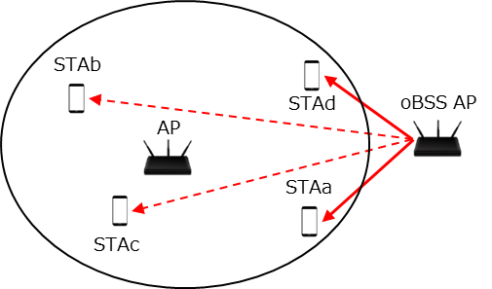
Problems
In Coordinated BF, the CSI needs to be updated frequently, so long sounding duration will reduce throughput due to the high overhead (Sequential Sounding in particular is severely affected).
To reduce the overhead, it is desirable for the AP to collect BF Reports only from the STAs with high interference levels from oBSS AP.
  For example, in the figure below, STAb/c, which are far from oBSS AP, do not need to request C-BF, and BF Reports (especially BF Feedback Matrix) measured from NDP sent from oBSS AP is not necessary
  It may be possible to select the STAs with high interference levels before the coordinated sounding, but it is more efficient to check this during the coordinated sounding.

Slide 5
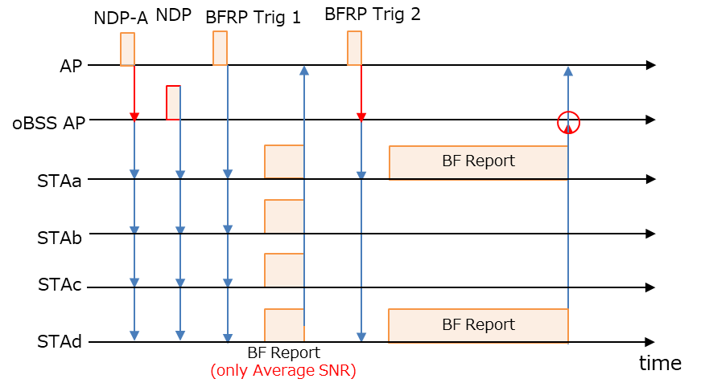
Proposed Coordinated Sounding
After the AP has obtained SNR feedback of the interference link from the STAs, it should be able to select “C-BF target STAs” from which to collect the BF feedback matrix.
  Since C-BF is only used for the STAs with high interference levels from the oBSS AP, the overhead can be reduced by selecting C-BF target STAs to solicit the BF feedback matrix for C-BF.
  Efficient operation is achieved by performing the measurement and C-BF target STA selection within the same sounding process.
  RSSI/SNR fluctuations are milder than the BF matrix, so SNR feedback may not always be required.
C-BF target STAs
Non C-BF target STAs

Slide 6
UHR BFRP Trigger Design
The UHR AP sending the BFRP Trigger frame to the STAs must indicate whether it requires SNR feedback only or normal BF report.
We propose that “Feedback Segment Retransmission Bitmap subfield” of Trigger Dependent User Info subfield be used to indicate whether only SNR feedback or normal BF report is to be solicited.
  When soliciting EHT Compressed Beamforming/CQI report, Feedback Segment Retransmission Bitmap subfield is defined to be set to all ‘1’s in the spec.
  When soliciting UHR Compressed Beamforming/CQI report, the LSB of Feedback Segment Retransmission Bitmap subfield can be set to '0' to request only SNR feedback or set to '1' to request normal BF report from STA.

Slide 7
Negotiation on Coordinated Sounding
OBSS AP may not need to receive BF Reports containing only SNR feedback transmitted in UL MU transmission from multiple STAs, so it should be aware when AP requests SNR feedback from STAs.
Two methods of implementation can be considered:
  Add a field to the STA Info List for oBSS AP included in the NDP-A frame to indicate that the first BFRP Trigger does not need to be received.
  Notify that the first BFRP Trigger does not need to be received in the frame exchange (like ICF/RCF) between APs before NDP-A frame is transmitted.
Considering the spec impact, we prefer Option 2.
  The oBSS AP may not be able to participate in Coordinated Sounding depending on the channel status, so prior confirmation by the frame exchange (like ICF/RCF) is essential.
  By pre-notifying the Coordinated Sounding operation, the spec impact of NDP-A frame can be reduced, and the frame design can be simplified.

Slide 8
Summary
We propose that the AP should be able to first collect only SNR feedback of the interference link from many STAs initially and determine the “C-BF target STA” from which to collect the BF feedback matrix during the coordinated sounding process.
  We proposed to use the “Feedback Segment Retransmission Bitmap subfield” of Trigger Dependent User Info subfield to indicate whether only SNR feedback or normal BF report should be requested.
  We have provided two options on how to inform the oBSS AP when the AP requests the only SNR feedback to the STA. Considering the spec impact, we prefer option 2.
    Add a field to the STA Info List for oBSS AP included in the NDP-A frame to indicate that the first BFRP Trigger does not need to be received.
    Notify that the first BFRP Trigger does not need to be received in the frame exchange (like ICF/RCF) between APs before NDP-A frame is transmitted.

Slide 9
References
[1] Laurent Cariou (Intel), “UHR proposed PAR,” 23/0480r0, March 2023
[2] Sameer Vermani (Qualcomm), “Sounding Schemes for Coordinated Beamforming,” 24/1542r0
[3] Ron Porat (Broadcom), “Sounding Design for C-BF,” 24/1568r0
[4] You-Wei Chen (MediaTek), “Coordinated Sounding for CoBF,” 24/1582r0

Slide 10
SP #1
Do you agree that the AP should be able to collect SNR information first to determine which STAs should be requested to collect the BF Feedback Matrix by BFRP trigger frame during the sounding procedure for Coordinated BF?

Slide 11
SP #2
Do you agree that “Feedback Segment Retransmission Bitmap subfield” of Trigger Dependent User Info subfield be used to indicate whether only SNR feedback or normal BF report should be requested in BFRP Trigger frame?

