Slide 1
Comparison Between Enhanced FT and distributed SMD
Nov. 2024
Date: 2024-11-01
Authors:
Notes:
September 2012

Slide 2
Introduction
Nov. 2024
Roaming is one important MAC topic in 11bn. But now there is a fundamental divergence on the roaming architecture and security.
  Enhanced fast BSS transition (FT), in which different PTKSAs are used when roaming from the current AP MLD to target AP MLD. [1-3]
    Assuming both current AP MLD and target AP MLD belongs to the same mobility domain (MD) which is identified by a MD ID (2 octets).
    The PTKSA is bound with each AP MLD itself MAC address and non-AP MLD MAC address.
  Distributed SMD with PTK sharing, in which the same PTKSA is used and transferred when roaming from the current AP MLD to target AP MLD. [4-5]
    Assuming both current AP MLD and target AP MLD belongs to the same distributed SMD which is identified by a common MAC address.
    The PTKSA is bound with this common MAC address and non-AP MLD MAC address.
In this contribution, we will provide some detailed comparisons between enhanced FT and distributed SMD with PTK sharing.

Slide 3
Enhanced FT
Nov. 2024
In previous contributions [1-3], some candidate improvements are proposed to improve the performance of the current FT protocol, e.g.
  Improvement 1. Enable the context transfer and data forwarding to avoid the packet loss resulting from flushing the Tx/Rx buffer
    Reduce layer-2 packet loss
  Improvement 2. Enable the over-the-DS probing nearby APs
    which can avoid the transmission rate drop due to the off-channel scanning, especially for the EMLSR non-AP MLD.
    Simultaneously, define NDPR+NDPA+NDP to realize the RSSI measurement and time synchronization. [6]
  Improvement 3. Enable the over-the-DS reassociation without DS mapping change (e.g. defining FT Multi-link Setup Request/Response frame exchange) and use another Request/Response frame exchange (e.g. Roaming Request/Response) to trigger the DS mapping change and the context transfer.
    Multi-link setup
    PTK rederivation

Slide 4
Roaming Through Current AP MLD
Nov. 2024
MD
Distributed SMD
Non-AP MLD
Current AP MLD
Target AP MLD
DS
Non-AP MLD
Current AP MLD
Target AP MLD
DS
11kvr (Optional)
11kvr (Optional)
FT Probe Request
Probe Request
FT Probe Response
Monitor RSSI with target AP MLD by using a short frame exchange (e.g. NDPA/NDP) and select a propriate roaming point to change DS mapping and dynamic context transfer by sending Roaming Request.
Probe Response
FT Multi-link Setup Request
Link Reconfiguration Setup Request
FT Multi-link Setup Response
Link Reconfiguration Setup Response
.
.
.
.
.
.
Roaming Request
Roaming Request
Context Transfer Request
DS-STA-NOTIFY
.Request
(MOVE)
Context Transfer Request
DS-STA-NOTIFY
.Request
(MOVE)
Context Transfer Response
Context Transfer Response
Roaming Response
Roaming Response
Figure 1. Procedure of over-the-DS enhanced FT
Figure 2. Roaming through current AP MLD under distributed SMD

Slide 5
Roaming Through Target AP MLD
Nov. 2024
Note. Since the Link Reconfiguration Request is protected, the target AP MLD doesn’t know which PTK shall be used to decrypt the received Link Reconfiguration Request frame. Hence, the non-AP MLD shall send an unprotected frame to inform the mapping relationship between TA and non-AP MLD MAC Address.
MD
Non-AP MLD
Current AP MLD
Target AP MLD
DS
Authentication-Request
Authentication-Response
Reassociation Request
Context Transfer Request
DS-STA-NOTIFY
.Request
(MOVE)
Context Transfer Response
xx frame
Reassociation Response
Figure 3. Over-the-air enhanced FT protocol
Figure 4. Roaming through target AP MLD under distributed SMD

Slide 6
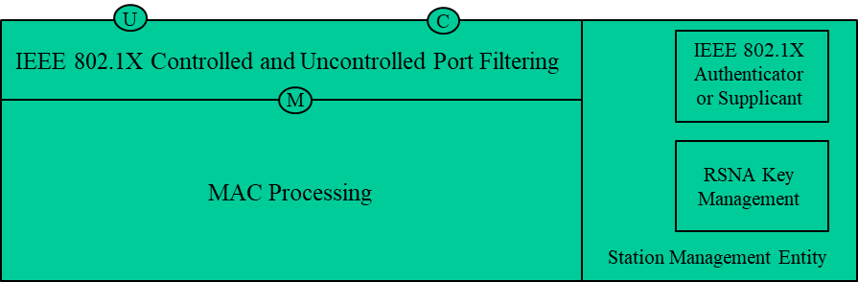
Bad Backward Compatibility of Distributed SMD
“Each association between a pair of STAs creates a unique pair of IEEE 802.1X Ports.”
For the distributed SMD with the PTK sharing, the following questions shall be clarified:
  Which AP MLD does the UHR non-AP MLD associate with? SMD or a specific AP MLD
    If the non-AP MLD associates with the SMD, then it conflicts with the above Spec. text. Because each AP MLD will create an IEEE 802.1X Controlled Port when the non-AP LD roams to it.
    If the non-AP MLD associates with a specific AP MLD, then the PTK shall be derived by using AA (i.e. AP MLD MAC address) and SPA (i.e. non-AP MLD MAC address)
      The AP MLD always acts as the IEEE 802.1X Authenticator, which is identified by the AP MLD’s MAC address, and the non-AP MLD always acts as the IEEE 802.1X supplicant, which is identified by the non-AP MLD’s MAC address.
      In other words, the distributed SMD with the PTK sharing conflicts the IEEE 802.1X protocol, which is outside the scope of the IEEE 802.11 protocol.

Slide 7
Bad Backward Compatibility of Distributed SMD (Cont.)
Note that although we already had changed the PTK derivation which bounds with the corresponding MLD MAC addresses instead in 11be, this change is fine.
  Because each association with an AP MLD still has only one corresponding IEEE 802.1X authenticator, which is identified by the corresponding AP MLD MAC address.
However, the distributed SMD with the PTK sharing is totally different from the above case, which requires the same PTKSA which bounds with a common SMD MAC address rather than the IEEE 802.1X authenticator itself MAC Address.
In addition, the distributed SMD with the PTK sharing directly challenges the current three-level key hierarchy (See next slide).

Slide 8
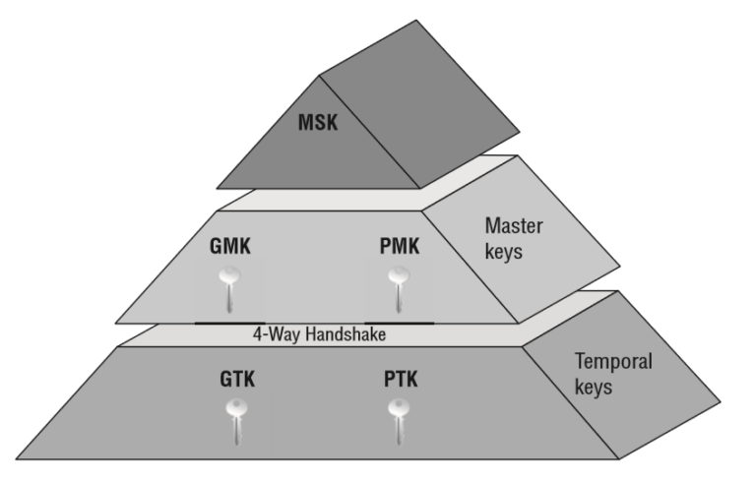
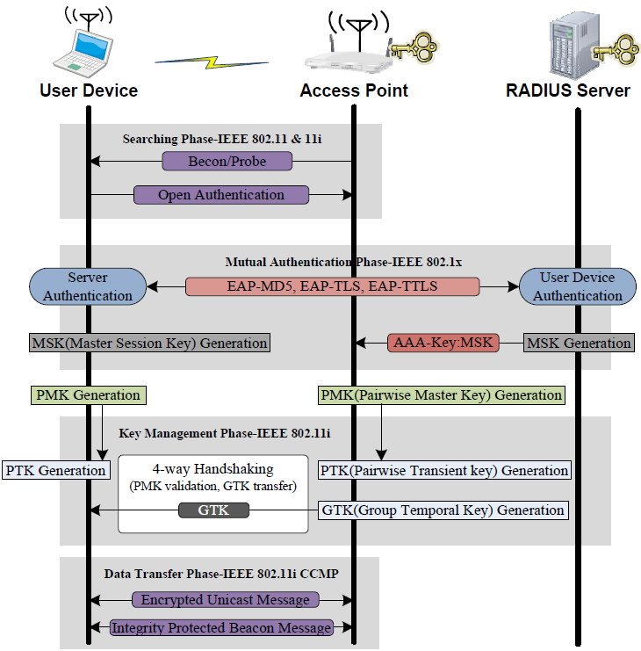

My Question
If the PTK can be shared and bounded with a common MAC address, why not directly use the PMK for the individually address MPDU encryption?
  In other words, there is no need for the third level key.
Figure. Three-level Key Hierarchy
The MSK (Master Session Key) is generated between the user device and RADIUS server. The AP does not know the MSK because the AP is not an end point of the EAP authentication protocol. The server delivers the generated MSK to the AP using a RADIUS packet. At this time, the MSK is encrypted using the shared secret between the AP and the server. Then the user device and the AP generate a PMK using the MSK.
Comment: the above procedure is very similar to the PTK sharing.
Figure. 802.11X association

Slide 9
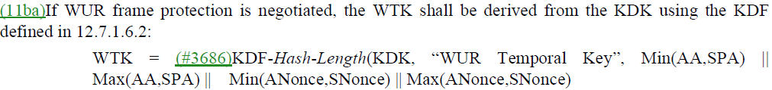
Bad Backward Compatibility of Distributed SMD (Cont.)
There are other cases which requires rekey? For example,
  Assuming the current AP MLD doesn’t support the WUR operation, the target AP MLD supports the WUR operation. Then the non-AP MLD shall rederive a new PTK when roaming to the target AP MLD .
    This is also true if the Control frame protection is considered in 11bn.
      The proposed solution in doc. 11-24/2055r0 doesn’t work. Because it conflicts the security principle, i.e. the PN shall never repeat for a series of encrypted MPDUs using the same temporal key.

Slide 10
Conclusions
Nov. 2024
Compared with the enhanced FT, the distributed SMD with the PTK sharing has no any benefit other than increasing the security risk.
  11bn is expected to improve the Wi-Fi security, rather than regression in security. The distributed SMD with the PTK sharing significantly conflicts with the goal of 11bn, i.e. ultra high reliability (UHR).
The distributed SMD with the PTK sharing is incompatible with the current IEEE 802.1X and has no easy way to incorporate into the current 802.11 Spec.
Suggest that any SP about the same PTKSA or the PTK sharing shall NOT be run before the distributed SMD architecture with the PTK sharing is clearly discussed.

Slide 11
References
Nov. 2024
[1] 11-23-1897-00-00bn-thoughts-on-improving-roaming-under-existing-architecture
[2] 11-24-0349-03-00bn-enhanced-fast-bss-transition
[3] 11-24-0679-04-00bn-thoughts-on-functionality-and-security-architecture-for-uhr-seamless-roaming
[4] 11-24-0052-00-00bn-seamless-roaming-details
[5] 11-23-2157-02-00bn-seamless-roaming-within-a-mobility-domain
[6] 11-24-1414-02-00bn-channel-measurement-based-on-control-frame-exchange

Slide 12
SP
Nov. 2024
Do you support in 11bn to improve the existing FT protocol?
  Note. According to the existing FT protocol, the FTO remains in state 4 during and after roaming to the other AP MLD. Specifically, at the time of receiving a Reassociation Response frame with SUCCESS from the target AP MLD, the FTO shall transition from State 2 to State 4 with the target AP MLD and delete any corresponding PTKSA with the current AP MLD.

