Slide 1
Comparison Between Enhanced FT and distributed SMD
Nov. 2024
Date: 2024-11-01
Authors:
Notes:
September 2012

Slide 2
Introduction
Nov. 2024
Roaming is one important MAC topic in 11bn. But now there is a fundamental divergence on the roaming architecture and security.
  Enhanced fast BSS transition (FT), in which different PTKSAs are used when roaming from the current AP MLD to target AP MLD. [1-3]
    Assuming both current AP MLD and target AP MLD belongs to the same mobility domain (MD) which is identified by a MD ID (2 octets).
    The PTKSA is bound with each AP MLD itself MAC address and non-AP MLD MAC address.
  Distributed SMD with PTK sharing, in which the same PTKSA is used and transferred when roaming from the current AP MLD to target AP MLD. [4-5]
    Assuming both current AP MLD and target AP MLD belongs to the same distributed SMD which is identified by a common MAC address.
    The PTKSA is bound with this common MAC address and non-AP MLD MAC address.
In this contribution, we will provide some detailed comparisons between enhanced FT and distributed SMD with PTK sharing.

Slide 3
Enhanced FT
Nov. 2024
In previous contributions [1-3], some candidate improvements are proposed to improve the performance of the current FT protocol, e.g.
  Improvement 1. Enable the context transfer and data forwarding to avoid the packet loss resulting from flushing the Tx/Rx buffer
    Reduce layer-2 packet loss
  Improvement 2. Enable the over-the-DS probing nearby APs
    which can avoid the transmission rate drop due to the off-channel scanning, especially for the EMLSR non-AP MLD.
    Simultaneously, define NDPR+NDPA+NDP to realize the RSSI measurement and time synchronization. [6]
  Improvement 3. Enable the over-the-DS reassociation without DS mapping change (e.g. defining FT Multi-link Setup Request/Response frame exchange) and use another Request/Response frame exchange (e.g. Roaming Request/Response) to trigger the DS mapping change and the context transfer.
    Multi-link setup
    PTK rederivation

Slide 4
Roaming Through Current AP MLD
Nov. 2024
MD
Distributed SMD
Non-AP MLD
Current AP MLD
Target AP MLD
DS
Non-AP MLD
Current AP MLD
Target AP MLD
DS
11kvr (Optional)
11kvr (Optional)
FT Probe Request
Probe Request
FT Probe Response
Monitor RSSI with target AP MLD by using a short frame exchange (e.g. NDPA/NDP) and select a propriate roaming point to change DS mapping and dynamic context transfer by sending Roaming Request.
Probe Response
FT Multi-link Setup Request
Link Reconfiguration Setup Request
FT Multi-link Setup Response
Link Reconfiguration Setup Response
.
.
.
.
.
.
Roaming Request
Roaming Request
Context Transfer Request
DS-STA-NOTIFY
.Request
(MOVE)
Context Transfer Request
DS-STA-NOTIFY
.Request
(MOVE)
Context Transfer Response
Context Transfer Response
Roaming Response
Roaming Response
Figure 1. Procedure of over-the-DS enhanced FT
Figure 2. Roaming through current AP MLD under distributed SMD

Slide 5
Roaming Through Target AP MLD
Nov. 2024
Note. Since the Link Reconfiguration Request is protected, the target AP MLD doesn’t know which PTK shall be used to decrypt the received Link Reconfiguration Request frame. Hence, the non-AP MLD shall send an unprotected frame to inform the mapping relationship between TA and non-AP MLD MAC Address.
MD
Non-AP MLD
Current AP MLD
Target AP MLD
DS
Authentication-Request
Authentication-Response
Reassociation Request
Context Transfer Request
DS-STA-NOTIFY
.Request
(MOVE)
Context Transfer Response
xx frame
Reassociation Response
Figure 3. Over-the-air enhanced FT protocol
Figure 4. Roaming through target AP MLD under distributed SMD

Slide 6
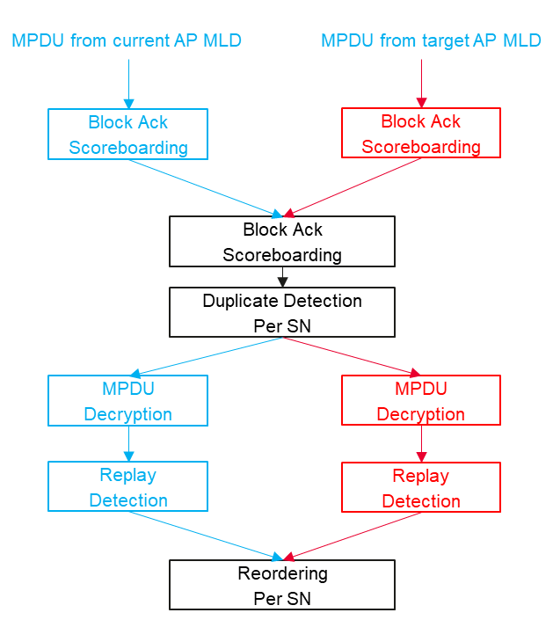
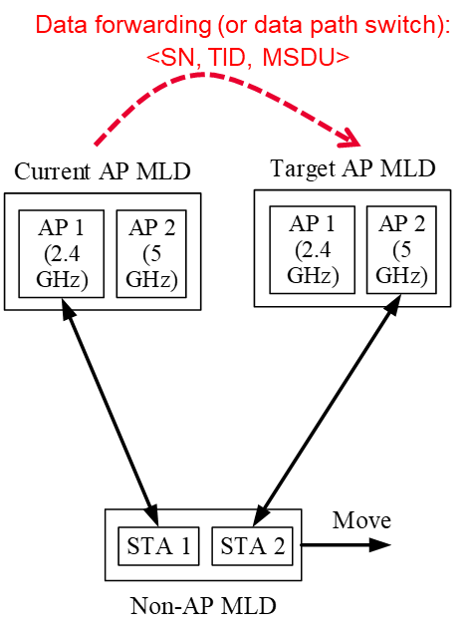
Comparison on Retrieving Buffer Packets
Nov. 2024
Simultaneously exchanging data with current AP MLD and target AP MLD
  The processing procedure is very similar to the one of DAPS (Dual Active Protocol Stack) handover defined in 5G cellular network.
Figure 5. During roaming
Figure 6. MAC Processing at non-AP MLD’s side

Slide 7
Backward Compatibility
“At any given instant, a STA is associated with no more than one AP. This allows the DS to determine a unique answer to the question, “Which AP is serving STA X?”
“Each association between a pair of STAs creates a unique pair of IEEE 802.1X Ports”
“Once an association is completed, the IEEE 802.1X Controlled port unblocks and a STA can make full use of a DS (via the AP) to communicate.”
Based on the above spec. texts, we can see there is a fundamental logical conflict between the existing ESS architecture and the proposed distributed SMD architecture with the PTK sharing. Specifically,
  Under the distributed SMD architecture with the PTK sharing, the associated non-AP MLD remains in state 4 with each AP MLD within the same SMD and then has multiple connections (i.e. IEEE 802.1X Controlled Ports unblock due to the same PTKSA) to the DS.

Slide 8
Conclusions
Nov. 2024
Compared with the enhanced FT, the distributed SMD with the PTK sharing has no any benefit other than increasing the security risk.
The distributed SMD with the PTK sharing is incompatible with the current ESS architecture and has less possibility to incorporate into the current 802.11 Spec.
11bn is expected to improve the Wi-Fi security, rather than regression in security. The distributed SMD with the PTK sharing significantly conflicts with the goal of 11bn, i.e. ultra high reliability (UHR).
Suggest that any SP about the same PTKSA shall Not be run before the distributed SMD architecture is clear.

Slide 9
References
Nov. 2024
[1] 11-23-1897-00-00bn-thoughts-on-improving-roaming-under-existing-architecture
[2] 11-24-0349-03-00bn-enhanced-fast-bss-transition
[3] 11-24-0679-04-00bn-thoughts-on-functionality-and-security-architecture-for-uhr-seamless-roaming
[4] 11-24-0052-00-00bn-seamless-roaming-details
[5] 11-23-2157-02-00bn-seamless-roaming-within-a-mobility-domain
[6] 11-24-1414-02-00bn-channel-measurement-based-on-control-frame-exchange

Slide 10
SP
Nov. 2024
Do you support in 11bn to improve the existing FT protocol?
  Note. According to the existing FT protocol, the FTO remains in state 4 during and after roaming to the other AP MLD.

Slide 11
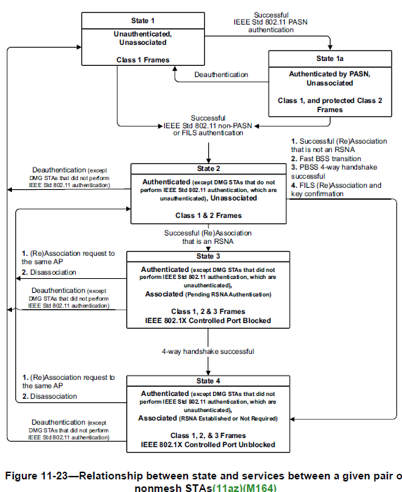
Appendix State Transition

