Slide 1
Discussion on DRU Indication Follow-up
Date: 2024-11-10
Authors:
Name | Affiliations | Address | Phone | email
Mengshi Hu | Huawei |  |  | humengshi@huawei.com
Ross Jian Yu
Ming Gan

Slide 2
Background
11bn supports the distributed tone RU (DRU) for a TB PPDU transmission, where the DRU means an RU consisting of subcarriers spreading across a certain bandwidth [1].
As discussed in [2], to know which DRU is allocated, the following information is needed:
  RRU Indication
  It is actually a DRU & The corresponding DBW (distribution bandwidth)
  In this contribution, we further discuss the details of DRU indication.
After knowing it is a DRU and its corresponding DBW, the indicated RRU is mapped to a specific DRU.
Figure 1 DRU Indication

Slide 3
Indication of DBW
After knowing the corresponding RRU and DBW of a DRU, the accurate position of a DRU can be determined.
  The corresponding RRU could be indicated by the conventional method.
  To indicate whether it is a DRU and its corresponding DBW, two directions have been discussed [2-4]:
  Per-User Indication
  Common Indication
In the subsequent slides, we further discuss the performance of three options related to the above two directions .

Slide 4
Per-User Indication of DRU: Opt. A
  To indicate the DRU, one simple and natural thought is to convey the DBW related information in the User Info field of each user.
  The following green block shows an example:
Figure 2 Per-User Indication of DBW

Slide 5
Example of Per-User Indication: Opt. A
Regarding the details of the DBW related information, an example is further shown below:
  Each User Info field comprises 2 or 3 additional bits to indicate the DBW related information.
Note that it may be hard to get so many additional bits for the DBW related indication. Thus in [4], repurposing several bits in the User Info field for DRU indication is proposed, which is shown in the next slide (Opt. B).
Table 1 DBW Related Information
Value | Meaning
000 | RRU
001 | DRU (20 MHz DBW)
010 | DRU (40 MHz DBW)
011 | DRU (80 MHz DBW)
100 | DRU (160 MHz DBW)
101 - 111 | Reserved

Slide 6
Per-User Indication of DRU: Opt. B
  To enable repurposing some bits in the User Info field for DBW indication, a 4-bit bitmap is proposed in [4] to show the DRU/RRU status of each 80 MHz.
  Three parts are needed for the DRU indication:
  RRU indication
  DRU/RRU Indication per 80 MHz
  DBW indication
  Because of the 4-bit bitmap, the DBW Indication could reuse some existing bits.
Table 2 DBW Indication in DRU Transmission
Value | Meaning (If the RRU indication and the 4-bit bitmap corresponds to a DRU) | Meaning (If the RRU indication and the 4-bit bitmap corresponds to a RRU)
00 | 20 MHz DBW | Other meanings (such as being part of the SS Allocation)
01 | 40 MHz DBW
10 | 80 MHz DBW
11 | Reserved
Figure 3 DRU/RRU Indication per 80 MHz

Slide 7
Common Indication of DRU: Opt. C
Different from the per-user indication, the common indication can also be used to notify the DRU, saving the overhead in User Info fields:
  Since the DBW pattern in each 80 MHz is limited to only several types, a table with 80 MHz granularity could be used to indicate the DBW of RUs related to that 80 MHz.
  Opt. C shows the DBW patterns with a granularity of 80 MHz.
  Note 1: The common indication could be in the Common Info field or Special User Info fields.
  Note 2： DBW 60 MHz, DBW 160 MHz, DBW 20 + 20 MHz and DBW 40 MHz (for puncturing case 1001) can also be included in the indication.
Table for each 80 MHz
Value | Meaning
00 | RRU
01 | DRU (DBW: Left 20 + Right 40)
10 | DRU (DBW: Left 40 + Right 20)
11 | DRU (DBW: min(PPDU BW, 80)
20 + 20 + 40 (DBW)
40 + 20 + 20 (DBW)
The same table
The same table
The same table
Containing sixteen 20 MHz sub-channels (320 MHz)
Figure 4 An example of common Indication

Slide 8
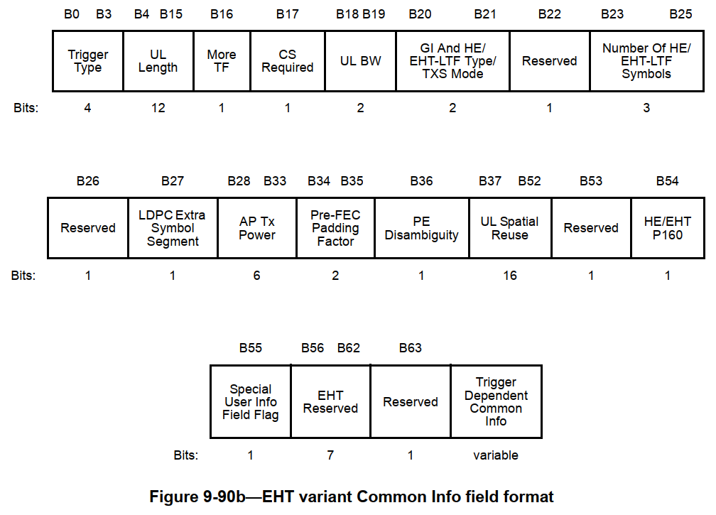
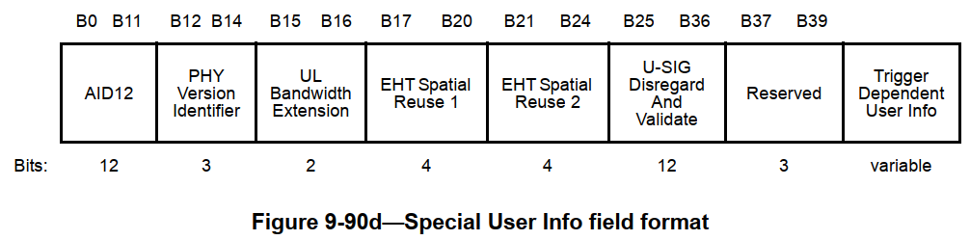
Available Bits for Opt. C
The DRU indication could be in the following places:
  Common Info field
  Special User Info field
  Additional Special User Info field used for DRU (No need to exist if there is no DRU)

Slide 9
Comparison
The comparison of the previous three DRU indications is shown below: (Note: The RRU indication is not considered in the comparison because all the options need it):
  Opt. A: Per-User Indication (without Common Part)
  Opt. B: Per-User Indication + Common Part
  Opt. C: Common Indication
Suggest using this Opt. C
Options | Opt. A [2] | Opt. B [4] | Opt. C [2, 3]
Pros | Needs only one additional subfield | / | Needs only one additional subfield Knows the DRU pattern in advance
Cons | Needs additional bits in each User Info field | Needs two additional subfields Needs additional bits in each User Info field in the case of DRU Transmission (repurposing) | Needs additional bits in the common part
Minimum Overhead | 2*number of User Info fields | 4 bits + 2*number of the User Info fields corresponding to DRU transmissions | 8 bits
Note: For Opt. C, if the indication is put into a special DRU related User Info field, there is no overhead in the case of pure RRU transmission.

Slide 10
Summary
In this contribution, we further share some thoughts on the DRU indication:
  Compared with Opt. B and Opt. A, Opt. C is relatively simple and saves the overhead in User Info fields.
  Suggest indicates the DRU in the common part (such as the Common Info field or Special User Info field).

Slide 11
References
[1] Alfred Asterjadhi, TGbn Motions List - Part 1, 802.11 DCN 2024/171r6
[2] Mengshi Hu, et al., Distribution Bandwidth of DRU - Follow up, 802.11 DCN 2024/1130r1
[3] Eunsung Park, et al., Signaling for DRU in Trigger Frame, 802.11 DCN 2024/1471r1
[4] Shengquan Hu, et al., Signaling for DRU Transmission, 802.11 DCN 2024/1489r0

