Slide 1
Complementary Sequence-Based LTF Design for DRU
Date: 2024-11-10
Authors:

Slide 2
Abstract
In this contribution, we propose a complementary sequence (CS) based LTF design for DRU in UHR
  The proposed approach ensures low PAPR theoretically while allowing low-complexity and low-memory implementation as it constructs the master sequence from seed sequences
  It is also applicable to signal stream pilots

Slide 3
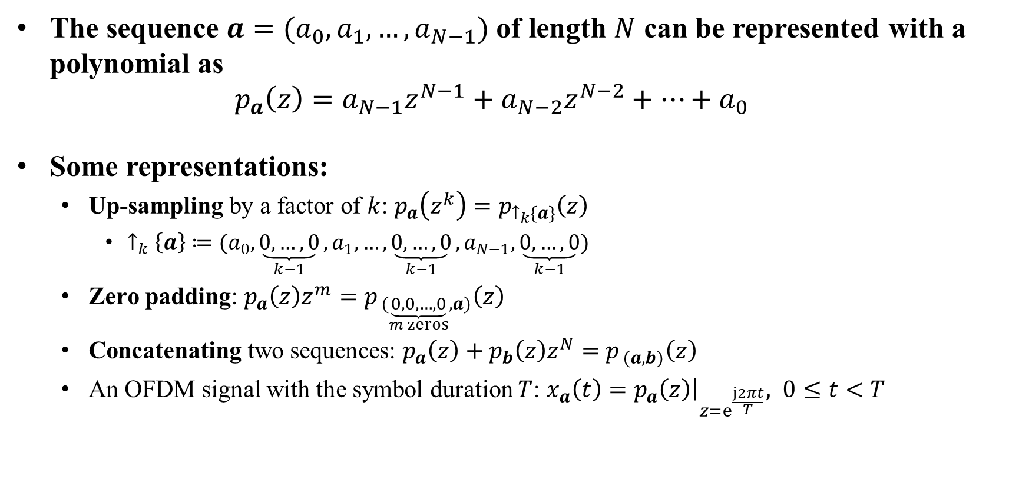
Representation of Sequences
The sequence $a=(a_{0},a_{1},…,a_{N−1})$ of length $N$ can be represented with a polynomial as
$$p_{a}\left(z\right)=a_{N−1}z^{N−1}+a_{N−2}z^{N−2}+…+a_{0}$$
Some representations:
  Up-sampling by a factor of $k$: $p_{a}\left(z^{k}\right)=$ $p_{↑_{k}\{a\}}\left(z\right)$
    $↑_{k}\left\{a\right\}≔(a_{0},\underset{k−1}{\underbrace{0,…,0}},a_{1},…,\underset{k−1}{\underbrace{0,…,0}},a_{N−1},\underset{k−1}{\underbrace{0,…,0}})$
  Zero padding: $p_{a}\left(z\right)z^{m}=$ $p_{ (\underset{m zeros}{\underbrace{0, 0,…,0}},a)}\left(z\right)$
  Concatenating two sequences: $p_{a}\left(z\right)+p_{b}\left(z\right)z^{N}=$ $p_{ (a,b)}\left(z\right)$
  An OFDM signal with the symbol duration $T$: $x_{a}\left(t\right)=p_{a}\left(z\right){\left.​\right|}_{z=e^{\frac{j2πt}{T}}}, 0≤t<T$

Slide 4


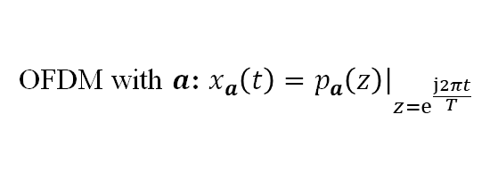



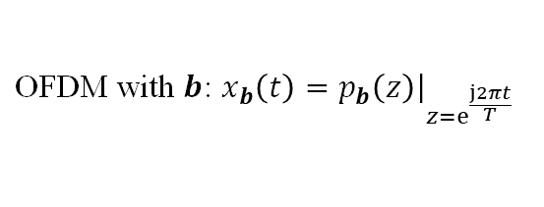

Complementary Sequences [5]
A pair of $(a,b)$ is called a Golay complementary pair (GCP) if
$${\left|x_{a}\left(t\right)\right|}^{2}+{\left|x_{b}\left(t\right)\right|}^{2}={\left\|a\right\|}_{2}^{2}+{\left\|b\right\|}_{2}^{2}, t∈[0,T)$$
Instantaneous power
Complement each other
$${\left|x_{a}\left(t\right)\right|}^{2}+{\left|x_{b}\left(t\right)\right|}^{2}={\left\|a\right\|}_{2}^{2}+{\left\|b\right\|}_{2}^{2}$$
$${\left|x_{a}\left(t\right)\right|}^{2}$$
OFDM with $a$: $x_{a}\left(t\right)=p_{a}\left(z\right){\left.​\right|}_{z=e^{\frac{j2πt}{T}}}$
$${\left|x_{b}\left(t\right)\right|}^{2}$$
$\text{OFDM} \text{with} b$: $x_{b}\left(t\right)=p_{b}\left(z\right){\left.​\right|}_{z=e^{\frac{j2πt}{T}}}$
time $t$
OFDM symbol duration
$$T$$
OFDM symbol duration: $T$

Slide 5
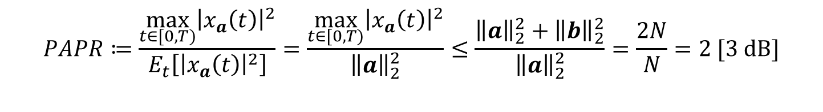

Complementary Sequences + OFDM = Low PAPR
For ${\left\|a\right\|}_{2}^{2}={\left\|b\right\|}_{2}^{2}$, the PAPR of the OFDM symbol using a complementary sequence is less than or equal to 2 (i.e., 3 dB)
  For example, if the sequence elements are QPSK, ${\left\|a\right\|}_{2}^{2}={\left\|b\right\|}_{2}^{2}=N$ holds
$$PAPR≔\frac{\max_{t∈[0,T)}{{\left|x_{a}\left(t\right)\right|}^{2}}}{E_{t}\left[{\left|x_{a}\left(t\right)\right|}^{2}\right]}=\frac{\max_{t∈[0,T)}{{\left|x_{a}\left(t\right)\right|}^{2}}}{{\left\|a\right\|}_{2}^{2}}≤\frac{{\left\|a\right\|}_{2}^{2}+{\left\|b\right\|}_{2}^{2}}{{\left\|a\right\|}_{2}^{2}}=\frac{2N}{N}=2 [3 dB]$$

Slide 6



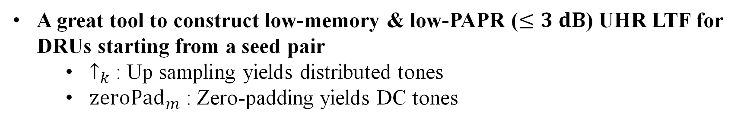





Constructing Complementary Sequences
Let $a$ and $b$ be a complementary pair of length $N.$ Then, a new pair (c, d) can be constructed as
$c=↑_{k}\left\{a\right\}+{zeroPad}_{kN−k+1+m}(↑_{k}\{b\})$
$$≡$$
$$p_{c}\left(z\right)=p_{a}\left(z^{k}\right)+p_{b}\left(z^{k}\right)z^{kN−k+1+m}$$
A new
pair
$$d=↑_{k}\left\{a\right\}−{zeroPad}_{kN−k+1+m}(↑_{k}\{b\})$$
$$≡$$
$$p_{d}\left(z\right)=p_{a}\left(z^{k}\right)−p_{b}\left(z^{k}\right)z^{kN−k+1+m}$$
$$a$$
$$b$$
$$N=4,k=2,m=5⇒$$
$$c$$
A great tool to construct low-memory & low-PAPR ($≤3 dB$) UHR LTF for DRUs starting from a seed pair
  $↑_{k}$: Up sampling yields distributed tones
  ${zeroPad}_{m}$: Zero-padding yields DC tones

Slide 7
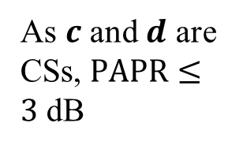
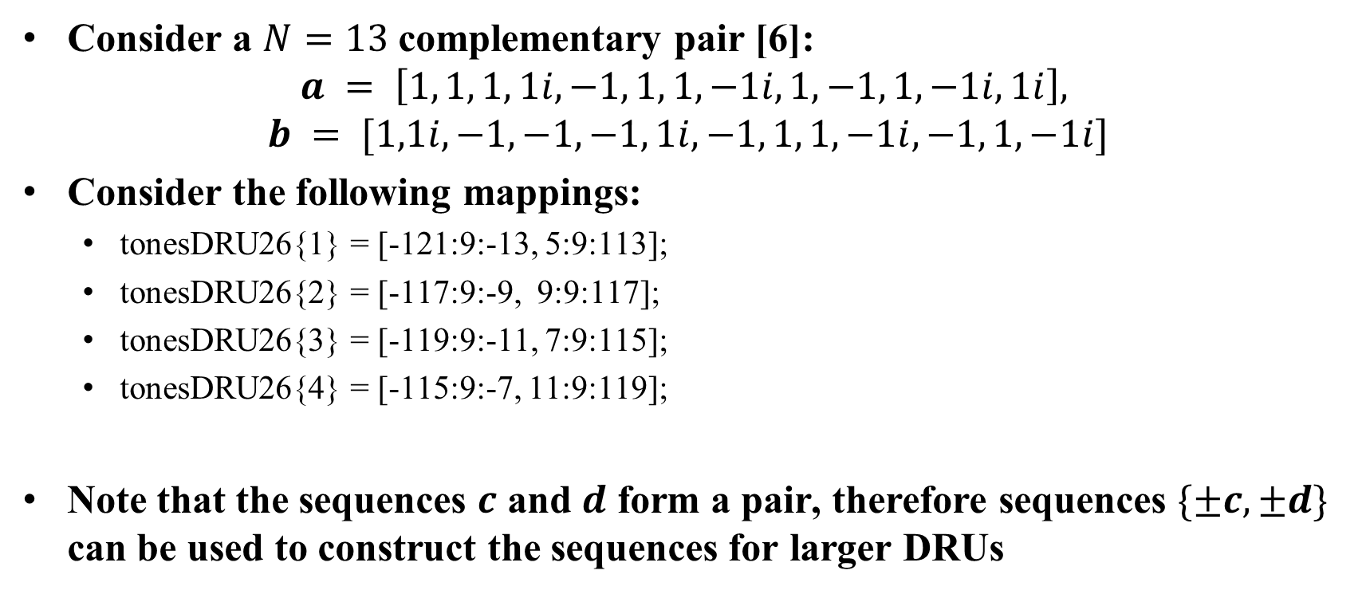





Examples for 26-DRUs 20 MHz (1/2)
Consider a $N=13$ complementary pair [6]:
$$a = \left[1, 1, 1, 1i, −1, 1, 1, −1i, 1, −1, 1, −1i, 1i\right],$$
$$b = [1,1i, −1, −1, −1, 1i, −1, 1, 1, −1i, −1, 1, −1i]$$
Consider the following mappings:
  tonesDRU26{1} = [-121:9:-13, 5:9:113];
  tonesDRU26{2} = [-117:9:-9, 9:9:117];
  tonesDRU26{3} = [-119:9:-11, 7:9:115];
  tonesDRU26{4} = [-115:9:-7, 11:9:119];
Note that the sequences $c$ and $d$ form a pair, therefore sequences $\{±c, ±d\}$ can be used to construct the sequences for larger DRUs
$$i≔\sqrt{−1}$$
$$c=↑_{9}\left\{a\right\}+{zeroPad}_{126}(↑_{9}\{b\})$$
$$d=↑_{9}\left\{a\right\}−{zeroPad}_{126}(↑_{9}\{b\})$$
As $c$ and $d$ are CSs, $PAPR≤3$ dB
$$c=↑_{9}\left\{a\right\}+{zeroPad}_{126}(↑_{9}\{b\})$$
$$−d=−↑_{9}\left\{a\right\}+{zeroPad}_{126}(↑_{9}\{b\})$$

Slide 8
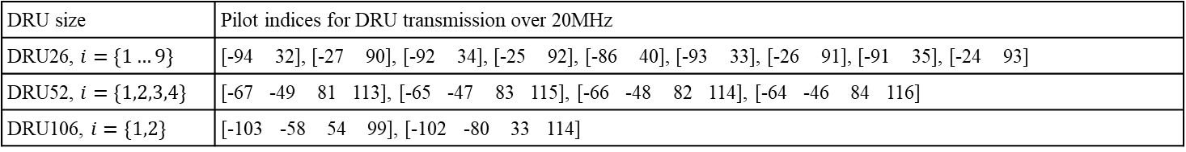
20 MHz DRU Tone Map and Pilots
Data and pilot subcarrier indices for Distributed Tone RUs (DRUs) in a 20 MHz UHR PPDU (Proposed)
DRU type | DRU index and subcarrier range
26-tone DRU i=1:9 | DRU1 [-121:9:-13, 5:9:113] | DRU2 [-117:9:-9, 9:9:117] | DRU3 [-119:9:-11, 7:9:115] | DRU4 [-115:9:-7, 11:9:119] | DRU5 [-113:9:-5, 13:9:121]
 | DRU6 [-120:9:-12, 6:9:114] | DRU7 [-116:9:-8, 10:9:118] | DRU8 [-118:9:-10, 8:9:116] | DRU9 [-114:9:-6, 12:9:120]
52-tone DRU i=1:4 | DRU1 26-tone [DRU1, DRU2] |  | DRU2 26-tone [DRU3, DRU4]
 | DRU3 26-tone [DRU6, DRU7] |  | DRU4 26-tone [DRU8, DRU9]
106-tone DRU i=1:2 | DRU1 26-tone [DRU1~4], [-4, 3] |  | DRU2 26-tone [DRU6~9], [-3, 4]
DRU size | Pilot indices for DRU transmission over 20MHz
DRU26, $i=\{1…9\}$ | [-94 32], [-27 90], [-92 34], [-25 92], [-86 40], [-93 33], [-26 91], [-91 35], [-24 93]
DRU52, $i=\{1,2,3,4\}$ | [-67 -49 81 113], [-65 -47 83 115], [-66 -48 82 114], [-64 -46 84 116]
DRU106, $i=\{1,2\}$ | [-103 -58 54 99], [-102 -80 33 114]
The 20-MHz tone plan is based on [4]

Slide 9

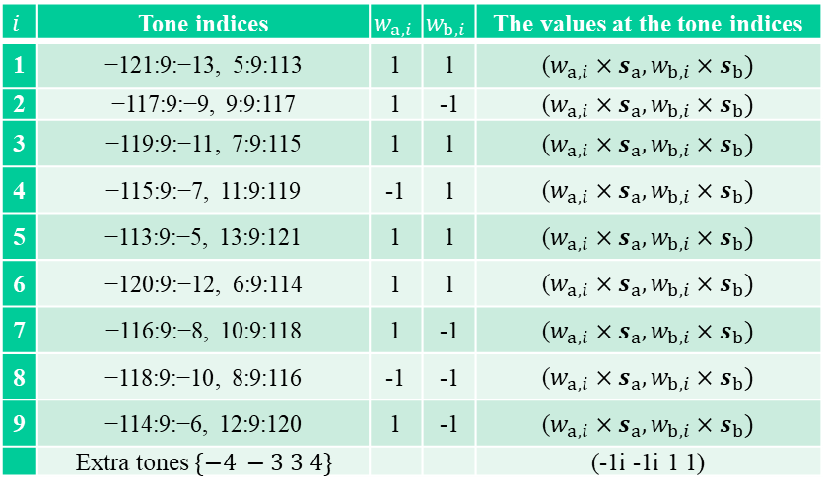
20 MHz DRU 4xLTF
$$i$$ | Tone indices | $$w_{a,i}$$ | $$w_{b,i}$$ | The values at the tone indices
1 | −121:9:−13, 5:9:113 | 1 | 1 | ($w_{a,i}×s_{a}, w_{b,i}×s_{b})$
2 | −117:9:−9, 9:9:117 | 1 | -1 | ($w_{a,i}×s_{a}, w_{b,i}×s_{b})$
3 | −119:9:−11, 7:9:115 | 1 | 1 | ($w_{a,i}×s_{a}, w_{b,i}×s_{b})$
4 | −115:9:−7, 11:9:119 | -1 | 1 | ($w_{a,i}×s_{a}, w_{b,i}×s_{b})$
5 | −113:9:−5, 13:9:121 | 1 | 1 | ($w_{a,i}×s_{a}, w_{b,i}×s_{b})$
6 | −120:9:−12, 6:9:114 | 1 | 1 | ($w_{a,i}×s_{a}, w_{b,i}×s_{b})$
7 | −116:9:−8, 10:9:118 | 1 | -1 | ($w_{a,i}×s_{a}, w_{b,i}×s_{b})$
8 | −118:9:−10, 8:9:116 | -1 | -1 | ($w_{a,i}×s_{a}, w_{b,i}×s_{b})$
9 | −114:9:−6, 12:9:120 | 1 | -1 | ($w_{a,i}×s_{a}, w_{b,i}×s_{b})$
 | Extra tones $\{−4 −3 3 4\}$ |  |  | (-1i -1i 1 1)
DLTF_{-122:122} = [0 1 1 1 -1 1 1 -1 1 1 1 1 1 -1 1 1 -1 1 1 1 1 1 -1 1 1 -1 1 1 1i 1i 1i -1i 1i 1i -1i 1i 1i -1 -1 -1 1 -1 -1 1 -1 -1 1 1 1 -1 1 1 -1 1 1 1 1 1 -1 1 1 -1 1 1 -1i -1i -1i 1i -1i -1i 1i -1i -1i 1 1 1 -1 1 1 -1 1 1 -1 -1 -1 1 -1 -1 1 -1 -1 1 1 1 -1 1 1 -1 1 1 -1i -1i -1i 1i -1i -1i 1i -1i -1i 1i 1i 1i -1i 1i 1i -1i 1i 1i -1i -1i 0 0 0 0 0 1 1 -1 -1 -1 1 1 1 -1 1 -1 1i 1i 1i -1i -1i -1i 1i -1i 1i -1i -1i -1i 1i 1i 1i -1i 1i -1i -1 -1 -1 1 1 1 -1 1 -1 1i 1i 1i -1i -1i -1i 1i -1i 1i 1i 1i 1i -1i -1i -1i 1i -1i 1i -1i -1i -1i 1i 1i 1i -1i 1i -1i 1 1 1 -1 -1 -1 1 -1 1 -1i -1i -1i 1i 1i 1i -1i 1i -1i -1i -1i -1i 1i 1i 1i -1i 1i -1i -1i -1i -1i 1i 1i 1i -1i 1i -1i 1 1 1 -1 -1 -1 1 -1 1 1i 1i 1i -1i -1i -1i 1i -1i 1i 0]
$$s_{a}=\left(1, 1,1,1i,−1,1,1,−1i, 1,−1,1,−1i,1i\right)$$
$$s_{b}=\left(−1, 1i,−1i,−1,1i,1i,−1i,1,−1i,−1i,−1i,1,1i\right)$$
Note that extra tones (i.e., for DRU106) and the single stream pilots will distort the pair in some cases, but their impact on PAPR can be minimized by exhaustive searching

Slide 10
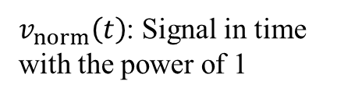
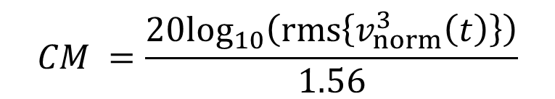
Cubic Metric
PAPR and cubic metric (CM) are both metrics used to evaluate the efficiency and quality of signal transmission, especially for OFDM systems
CM is a more sophisticated measure introduced by 3GPP, specifically designed to predict power amplifier behavior under non-linear conditions
  Unlike PAPR, CM takes into account the third-order non-linearity of amplifiers, making it more closely related to actual distortion caused in practical systems
  CM reflects how much a signal would stress a power amplifier in a real-world scenario. Since it accounts for amplifier non-linearity, it's generally more accurate than PAPR in predicting a signal's impact on amplifier performance
CM calculation [3]:
$$CM =\frac{20\log_{10}\left(rms\left\{v_{norm}^{3}\left(t\right)\right\}\right)}{1.56}$$
$v_{norm}\left(t\right)$: Signal in time with the power of 1

Slide 11
PAPR and CM Results for 20 MHz DRU LTF
PAPR [dB] | 1 | 2 | 3 | 4 | 5 | 6 | 7 | 8 | 9
DRU26 | 3.12,3.79 | 3.29,3.56 | 3.58,3.67 | 3.8,3.53 | 2.96,2.97 | 2.99,3.47 | 2.79,3.7 | 3.77,3.72 | 3.3,3.42
DRU52 | 4.78,4.78 |  | 4.81,4.75 |  |  | 4.85,4.85 |  | 4.84,4.76
DRU106 | 4.59,4.77 |  |  |  |  | 4.8,4.79
PAPR [dB] | 1 | 2 | 3 | 4 | 5 | 6 | 7 | 8 | 9
DRU26 | 3.01,3.94 | 2.96,4.22 | 3.01,3.94 | 2.96,4.22 | 3.01,3.94 | 3.01,3.94 | 2.96,4.22 | 3.01,3.94 | 2.96,4.22
DRU52 | 3.01,4.35 |  | 3.01,4.34 |  |  | 3.01,4.35 |  | 3.01,4.34
DRU106 | 3.94,4.65 |  |  |  |  | 3.93,4.62
CM [dB] | 1 | 2 | 3 | 4 | 5 | 6 | 7 | 8 | 9
DRU26 | 0.85,1.46 | 1.06,1.22 | 1.13,1.53 | 0.91,0.95 | 0.08,1.04 | 0.58,1.3 | 0.3,1.29 | 1.44,0.85 | 1.01,0.93
DRU52 | 2.08,1.86 |  | 2.01,1.82 |  |  | 2.01,1.89 |  | 1.87,2.12
DRU106 | 1.67,1.81 |  |  |  |  | 1.95,2.02
CM [dB] | 1 | 2 | 3 | 4 | 5 | 6 | 7 | 8 | 9
DRU26 | 0.99,1.29 | 0.93,1.54 | 0.99,1.29 | 0.93,1.54 | 0.99,1.29 | 0.99,1.29 | 0.93,1.54 | 0.99,1.29 | 0.93,1.54
DRU52 | 0.95,1.32 |  | 0.95,1.32 |  |  | 0.95,1.32 |  | 0.95,1.32
DRU106 | 1.06,1.73 |  |  |  |  | 1.09,1.87
[2]
CS-based
[2]
CS-based
Nss=1&2

Slide 12
PAPR CDFs for 20 MHz DRU LTF
DRU26
DRU52
DRU106
Note: If masked LTF is used, the PAPR of the second SS will be the same as the first SS for all BWs

Slide 13
CM CDFs for 20 MHz DRU LTF
DRU26
DRU52
DRU106

Slide 14
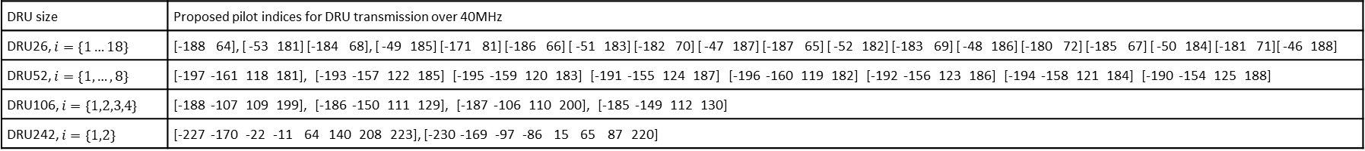
40 MHz DRU Tone Map & Pilots
Data and pilot subcarrier indices for Distributed Tone RUs (DRUs) in a 40 MHz UHR TB PPDU
DRU type | DRU index and subcarrier range
26-tone DRU i=1:18 | DRU1 [-242:18:-26, 10:18:226] | DRU2 [-233:18:-17, 19:18:235] | DRU3 [-238:18:-22, 14:18:230] | DRU4 [-229:18:-13, 23:18:239] | DRU5 [-225:18:-9, 27:18:243] | DRU6 [-240:18:-24, 12:18:228]
 | DRU7 [-231:18:-15, 21:18:237] | DRU8 [-236:18:-20, 16:18:232] | DRU9 [-227:18:-11, 25:18:241] | DRU10 [-241:18:-25, 11:18:227] | DRU11 [-232:18:-16, 20:18:236] | DRU12 [-237:18:-21, 15:18:231]
 | DRU13 [-228:18:-12, 24:18:240] | DRU14 [-234:18:-18, 18:18:234] | DRU15 [-239:18:-23, 13:18:229] | DRU16 [-230:18:-14, 22:18:238] | DRU17 [-235:18:-19, 17:18:233] | DRU18 [-226:18:-10, 26:18:242]
52-tone DRU i=1:8 | DRU1 [-242:9:-17, 10:9:235] |  | DRU2 [-238:9:-13, 14:9:239] |  | DRU3 [-240:9:-15, 12:9:237]
 | DRU4 [-236:9:-11, 16:9:241] |  | DRU5 [-241:9:-16, 11:9:236] |  | DRU6 [-237:9:-12, 15:9:240]
 | DRU7 [-239:9:-14, 13:9:238] |  | DRU8 [-235:9:-10, 17:9:242]
106-tone DRU i=1:4 | DRU1 26-tone [DRU1~4], [-8,5] |  | DRU2 26-tone [DRU6~9], [-6,7] |  | DRU3 26-tone [DRU10~13], [-7,6]
 | DRU4 26-tone [DRU15~18], [-5,8]
242-tone DRU i=1:2 | DRU1 106-tone [DRU1~2],26-tone DRU5, [-244,-4,3,9] |  | DRU2 106-tone [DRU3~4],26-tone DRU14, [-243,-3,4,244]
We use the same tone map in [1]
DRU size | Proposed pilot indices for DRU transmission over 40MHz
DRU26, $i=\{1…18\}$ | [-188 64], [ -53 181] [-184 68], [ -49 185] [-171 81] [-186 66] [ -51 183] [-182 70] [ -47 187] [-187 65] [ -52 182] [-183 69] [ -48 186] [-180 72] [-185 67] [ -50 184] [-181 71][ -46 188]
DRU52, $i=\{1,…,8\}$ | [-197 -161 118 181], [-193 -157 122 185] [-195 -159 120 183] [-191 -155 124 187] [-196 -160 119 182] [-192 -156 123 186] [-194 -158 121 184] [-190 -154 125 188]
DRU106, $i=\{1,2,3,4\}$ | [-188 -107 109 199], [-186 -150 111 129], [-187 -106 110 200], [-185 -149 112 130]
DRU242, $i=\{1,2\}$ | [-227 -170 -22 -11 64 140 208 223], [-230 -169 -97 -86 15 65 87 220]

Slide 15

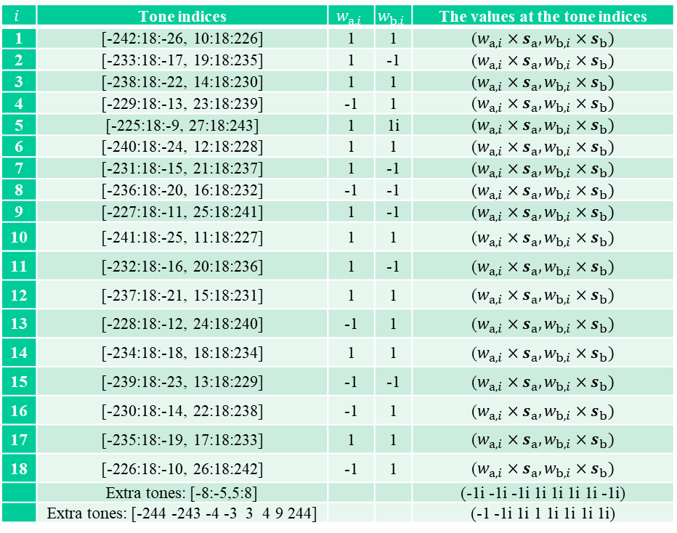
40 MHz DRU 4xLTF
$$i$$ | Tone indices | $$w_{a,i}$$ | $$w_{b,i}$$ | The values at the tone indices
1 | [-242:18:-26, 10:18:226] | 1 | 1 | ($w_{a,i}×s_{a}, w_{b,i}×s_{b})$
2 | [-233:18:-17, 19:18:235] | 1 | -1 | ($w_{a,i}×s_{a}, w_{b,i}×s_{b})$
3 | [-238:18:-22, 14:18:230] | 1 | 1 | ($w_{a,i}×s_{a}, w_{b,i}×s_{b})$
4 | [-229:18:-13, 23:18:239] | -1 | 1 | ($w_{a,i}×s_{a}, w_{b,i}×s_{b})$
5 | [-225:18:-9, 27:18:243] | 1 | 1i | ($w_{a,i}×s_{a}, w_{b,i}×s_{b})$
6 | [-240:18:-24, 12:18:228] | 1 | 1 | ($w_{a,i}×s_{a}, w_{b,i}×s_{b})$
7 | [-231:18:-15, 21:18:237] | 1 | -1 | ($w_{a,i}×s_{a}, w_{b,i}×s_{b})$
8 | [-236:18:-20, 16:18:232] | -1 | -1 | ($w_{a,i}×s_{a}, w_{b,i}×s_{b})$
9 | [-227:18:-11, 25:18:241] | 1 | -1 | ($w_{a,i}×s_{a}, w_{b,i}×s_{b})$
10 | [-241:18:-25, 11:18:227] | 1 | 1 | ($w_{a,i}×s_{a}, w_{b,i}×s_{b})$
11 | [-232:18:-16, 20:18:236] | 1 | -1 | ($w_{a,i}×s_{a}, w_{b,i}×s_{b})$
12 | [-237:18:-21, 15:18:231] | 1 | 1 | ($w_{a,i}×s_{a}, w_{b,i}×s_{b})$
13 | [-228:18:-12, 24:18:240] | -1 | 1 | ($w_{a,i}×s_{a}, w_{b,i}×s_{b})$
14 | [-234:18:-18, 18:18:234] | 1 | 1 | ($w_{a,i}×s_{a}, w_{b,i}×s_{b})$
15 | [-239:18:-23, 13:18:229] | -1 | -1 | ($w_{a,i}×s_{a}, w_{b,i}×s_{b})$
16 | [-230:18:-14, 22:18:238] | -1 | 1 | ($w_{a,i}×s_{a}, w_{b,i}×s_{b})$
17 | [-235:18:-19, 17:18:233] | 1 | 1 | ($w_{a,i}×s_{a}, w_{b,i}×s_{b})$
18 | [-226:18:-10, 26:18:242] | -1 | 1 | ($w_{a,i}×s_{a}, w_{b,i}×s_{b})$
 | Extra tones: [-8:-5,5:8] |  |  | (-1i -1i -1i 1i 1i 1i 1i -1i)
 | Extra tones: [-244 -243 -4 -3 3 4 9 244] |  |  | (-1 -1i 1i 1 1i 1i 1i 1i)
DLTF_{-244:244} = [ ...
-1 -1i 1 1 1 -1 1 1 -1 1 1 1 1 1 -1 -1 -1 1 -1 1 1 1 1 -1 1 1 -1 1 1 1 1 1 -1 -1 -1 1 -1 1 1 1 1 -1 1 1 -1 1 1 1 1 1 -1 -1 -1 1 -1 1 1i 1i 1i -1i 1i 1i -1i 1i 1i 1i 1i 1i -1i -1i -1i 1i -1i 1i -1 -1 -1 1 -1 -1 1 -1 -1 -1 -1 -1 1 1 1 -1 1 -1 1 1 1 -1 1 1 -1 1 1 1 1 1 -1 -1 -1 1 -1 1 1 1 1 -1 1 1 -1 1 1 1 1 1 -1 -1 -1 1 -1 1 -1i -1i -1i 1i -1i -1i 1i -1i -1i -1i -1i -1i 1i 1i 1i -1i 1i -1i 1 1 1 -1 1 1 -1 1 1 1 1 1 -1 -1 -1 1 -1 1 -1 -1 -1 1 -1 -1 1 -1 -1 -1 -1 -1 1 1 1 -1 1 -1 1 1 1 -1 1 1 -1 1 1 1 1 1 -1 -1 -1 1 -1 1 -1i -1i -1i 1i -1i -1i 1i -1i -1i -1i -1i -1i 1i 1i 1i -1i 1i -1i 1i 1i 1i -1i 1i 1i -1i 1i 1i 1i 1i 1i -1i -1i -1i 1i -1i 1i -1i -1i -1i 1i 1i 1 0 0 0 0 0 1i 1i 1i 1i 1i -1i 1i -1 -1 -1 1 -1 -1 1 -1 -1 1 1 1 -1 -1 -1 1 -1 -1 1i 1i 1i -1i 1i 1i -1i 1i 1i -1i -1i -1i 1i 1i 1i -1i 1i 1i -1i -1i -1i 1i -1i -1i 1i -1i -1i 1i 1i 1i -1i -1i -1i 1i -1i -1i -1 -1 -1 1 -1 -1 1 -1 -1 1 1 1 -1 -1 -1 1 -1 -1 1i 1i 1i -1i 1i 1i -1i 1i 1i -1i -1i -1i 1i 1i 1i -1i 1i 1i 1i 1i 1i -1i 1i 1i -1i 1i 1i -1i -1i -1i 1i 1i 1i -1i 1i 1i -1i -1i -1i 1i -1i -1i 1i -1i -1i 1i 1i 1i -1i -1i -1i 1i -1i -1i 1 1 1 -1 1 1 -1 1 1 -1 -1 -1 1 1 1 -1 1 1 -1i -1i -1i 1i -1i -1i 1i -1i -1i 1i 1i 1i -1i -1i -1i 1i -1i -1i -1i -1i -1i 1i -1i -1i 1i -1i -1i 1i 1i 1i -1i -1i -1i 1i -1i -1i -1i -1i -1i 1i -1i -1i 1i -1i -1i 1i 1i 1i -1i -1i -1i 1i -1i -1i 1 1 1 -1 1 1 -1 1 1 -1 -1 -1 1 1 1 -1 1 1 1i 1i 1i -1i 1i 1i -1i 1i 1i -1i -1i -1i 1i 1i 1i -1i 1i 1i 1i]
$$s_{a}=\left(1, 1,1,1i,−1,1,1,−1i, 1,−1,1,−1i,1i\right)$$
$$s_{b}=\left(−1, 1i,−1i,−1,1i,1i,−1i,1,−1i,−1i,−1i,1,1i\right)$$

Slide 16
PAPR and CM Results for 40 MHz DRU 4xLTF
PAPR [dB] | 1 | 2 | 3 | 4 | 5 | 6 | 7 | 8 | 9 | 10 | 11 | 12 | 13 | 14 | 15 | 16 | 17 | 18
DRU26 | 3.26,3.87 | 3.6,3.89 | 3.8,3.6 | 3.74,3.87 | 3.29,3.87 | 3.9,3.74 | 3.89,3.13 | 3.78,3.8 | 3.72,3.84 | 3.08,3.52 | 3.22,3.68 | 3.85,3.8 | 3.61,3.73 | 3.19,3.45 | 3.85,3.44 | 3.8,3.79 | 2.95,3.67 | 3.68,3.89
DRU52 | 4.13,4.04 |  | 3.85,4.01 |  |  | 4.07,4.06 |  | 4.05,4.09 |  | 4.14,4.11 |  | 3.88,3.67 |  |  | 3.55,3.89 |  | 3.89,4.03
DRU106 | 5.17,4.92 |  |  |  |  | 5.23,5.23 |  |  |  | 5.32,5.08 |  |  |  |  | 5.38,5.11
DRU242 | 5.39,5.39 |  |  |  |  |  |  |  |  | 5.47,5.57
PAPR [dB] | 1 | 2 | 3 | 4 | 5 | 6 | 7 | 8 | 9 | 10 | 11 | 12 | 13 | 14 | 15 | 16 | 17 | 18
DRU26 | 3.01,3.94 | 2.96,4.22 | 3.01,3.94 | 2.96,4.22 | 3.01,3.94 | 3.01,3.94 | 2.96,4.22 | 3.01,3.94 | 2.96,4.22 | 3.01,3.94 | 2.96,4.22 | 3.01,3.94 | 2.96,4.22 | 3.01,3.94 | 3.01,3.94 | 2.96,4.22 | 3.01,3.94 | 2.96,4.22
DRU52 | 3.01,4.08 |  | 3.01,4.08 |  |  | 3.01,4.08 |  | 3.01,4.08 |  | 3.01,4.08 |  | 3.01,4.08 |  |  | 3.01,4.08 |  | 3.01,4.08
DRU106 | 3.98,4.69 |  |  |  |  | 3.94,4.67 |  |  |  | 3.98,4.69 |  |  |  |  | 3.94,4.67
DRU242 | 5.1,5.31 |  |  |  |  |  |  |  |  | 5.15,5.31
CM [dB] | 1 | 2 | 3 | 4 | 5 | 6 | 7 | 8 | 9 | 10 | 11 | 12 | 13 | 14 | 15 | 16 | 17 | 18
DRU26 | 0.82,1.32 | 1.12,1.61 | 1.23,1.29 | 1.58,1.54 | 1.13,0.83 | 1.42,0.92 | 1.56,0.8 | 1.38,1.5 | 0.94,1.28 | 0.63,1.32 | 1.03,0.88 | 1.1,1.06 | 1.45,1.19 | 0.85,1.15 | 1.15,0.79 | 1.02,1.45 | 0.78,1.54 | 0.87,1.85
DRU52 | 1.4,1.37 |  | 1.3,1.85 |  |  | 1.47,1.18 |  | 1.2,1.8 |  | 1.11,1.79 |  | 1.44,1.19 |  |  | 1.08,1.38 |  | 1.48,1.31
DRU106 | 2.03,1.78 |  |  |  |  | 1.94,1.95 |  |  |  | 2.27,1.94 |  |  |  |  | 1.97,1.91
DRU242 | 2.26,2.24 |  |  |  |  |  |  |  |  | 2.2,2.13
CM [dB] | 1 | 2 | 3 | 4 | 5 | 6 | 7 | 8 | 9 | 10 | 11 | 12 | 13 | 14 | 15 | 16 | 17 | 18
DRU26 | 0.99,1.29 | 0.93,1.54 | 0.99,1.29 | 0.93,1.54 | 0.99,1.29 | 0.99,1.29 | 0.93,1.54 | 0.99,1.29 | 0.93,1.54 | 0.99,1.29 | 0.93,1.54 | 0.99,1.29 | 0.93,1.54 | 0.99,1.29 | 0.99,1.29 | 0.93,1.54 | 0.99,1.29 | 0.93,1.54
DRU52 | 1.28,1.53 |  | 1.28,1.53 |  |  | 1.28,1.53 |  | 1.28,1.53 |  | 1.28,1.53 |  | 1.28,1.53 |  |  | 1.28,1.53 |  | 1.28,1.53
DRU106 | 0.94,1.58 |  |  |  |  | 0.89,1.41 |  |  |  | 0.94,1.58 |  |  |  |  | 0.89,1.41
DRU242 | 1.89,2.08 |  |  |  |  |  |  |  |  | 1.97,2.13
[2]
CS-based
[2]
CS-based
Nss=1&2

Slide 17
DRU26
DRU52
PAPR CDFs for 40 MHz DRU LTF
DRU106
DRU242
Note: If masked LTF is used, the PAPR of the second SS will be the same as the first SS for all BWs

Slide 18
DRU26
DRU52
CM CDFs for 40 MHz DRU LTF
DRU106
DRU242

Slide 19
80 MHz DRU Tone Map
Data and pilot subcarrier indices for Distributed Tone RUs (DRUs) in a 80 MHz UHR TB PPDU
DRU type | DRU index and subcarrier range
52-tone DRU i=1:16 | DRU1 [-483:36:-51, 17:36:449],[-467:36:-35, 33:36:465] | DRU2 [-475:36:-43, 25:36:457],[-459:36:-27, 41:36:473] | DRU3 [-479:36:-47, 21:36:453],[-463:36:-31, 37:36:469] | DRU4 [-471:36:-39, 29:36:461],[-455:36:-23, 45:36:477]
 | DRU5 [-477:36:-45, 23:36:455],[-461:36:-29, 39:36:471] | DRU6 [-469:36:-37, 31:36:463],[-453:36:-21, 47:36:479] | DRU7 [-481:36:-49, 19:36:451],[-465:36:-33, 35:36:467] | DRU8 [-473:36:-41, 27:36:459],[-457:36:-25, 43:36:475]
 | DRU9 [-482:36:-50, 18:36:450],[-466:36:-34, 34:36:466] | DRU10 [-474:36:-42, 26:36:458],[-458:36:-26, 42:36:474] | DRU11 [-478:36:-46, 22:36:454],[-462:36:-30, 38:36:470] | DRU12 [-470:36:-38, 30:36:462],[-454:36:-22, 46:36:478]
 | DRU13 [-476:36:-44, 24:36:456],[-460:36:-28, 40:36:472] | DRU14 [-468:36:-36, 32:36:464],[-452:36:-20,48:36:480] | DRU15 [-480:36:-48, 20:36:452],[-464:36:-32, 36:36:468] | DRU16 [-472:36:-40, 28:36:460],[-456:36:-24, 44:36:476]
106-tone DRU i=1:8 | DRU1 52-tone [DRU1~2], [-495, 485] | DRU2 52-tone [DRU3~4],[-491, 489] | DRU3 52-tone [DRU5~6],[-489, 491] | DRU4 52-tone [DRU7~8],[-493, 487]
 | DRU5 52-tone [DRU9~10],[-494, 486] | DRU6 52-tone [DRU11~12],[-490,490] | DRU7 52-tone [DRU13~14],[-488,492] | DRU8 52-tone [DRU15~16],[-492,488]
242-tone DRU i=1:4 | DRU1 [-499:4:-19, 17:4:497] |  | DRU2 [-497:4:-17, 19:4:499]
 | DRU3 [-498:4:-18, 18:4:498] |  | DRU4 [-496:4:-16, 20:4:500]
484-tone DRU i=1:2 | DRU1 [-499:2:-17, 17:2:499] |  | DRU2 [-498:2:-16, 18:2:500]
We use the same tone map in [1]

Slide 20
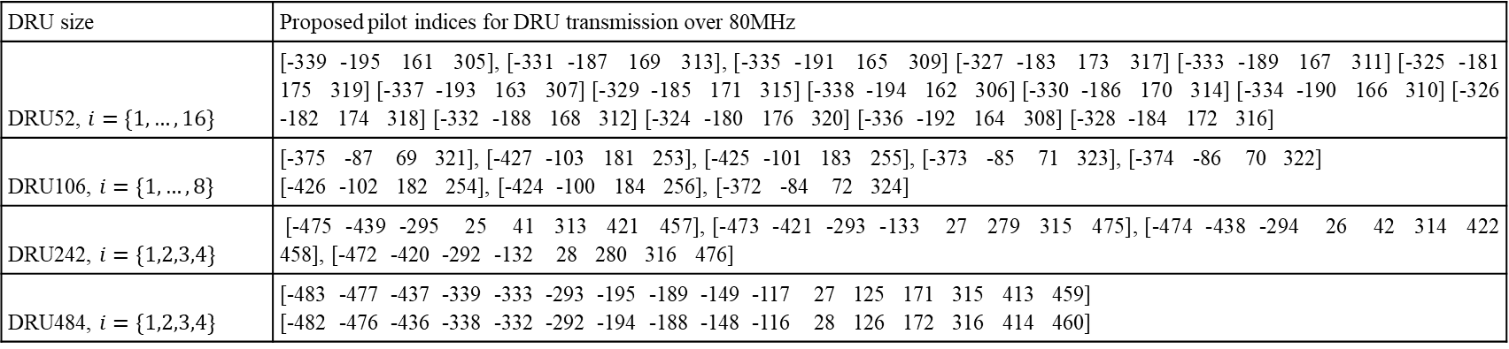
80 MHz DRU Pilots
DRU size | Proposed pilot indices for DRU transmission over 80MHz
DRU52, $i=\{1,…,16\}$ | [-339 -195 161 305], [-331 -187 169 313], [-335 -191 165 309] [-327 -183 173 317] [-333 -189 167 311] [-325 -181 175 319] [-337 -193 163 307] [-329 -185 171 315] [-338 -194 162 306] [-330 -186 170 314] [-334 -190 166 310] [-326 -182 174 318] [-332 -188 168 312] [-324 -180 176 320] [-336 -192 164 308] [-328 -184 172 316]
DRU106, $i=\{1,…,8\}$ | [-375 -87 69 321], [-427 -103 181 253], [-425 -101 183 255], [-373 -85 71 323], [-374 -86 70 322] [-426 -102 182 254], [-424 -100 184 256], [-372 -84 72 324]
DRU242, $i=\{1,2,3,4\}$ | [-475 -439 -295 25 41 313 421 457], [-473 -421 -293 -133 27 279 315 475], [-474 -438 -294 26 42 314 422 458], [-472 -420 -292 -132 28 280 316 476]
DRU484, $i=\{1,2,3,4\}$ | [-483 -477 -437 -339 -333 -293 -195 -189 -149 -117 27 125 171 315 413 459] [-482 -476 -436 -338 -332 -292 -194 -188 -148 -116 28 126 172 316 414 460]

Slide 21
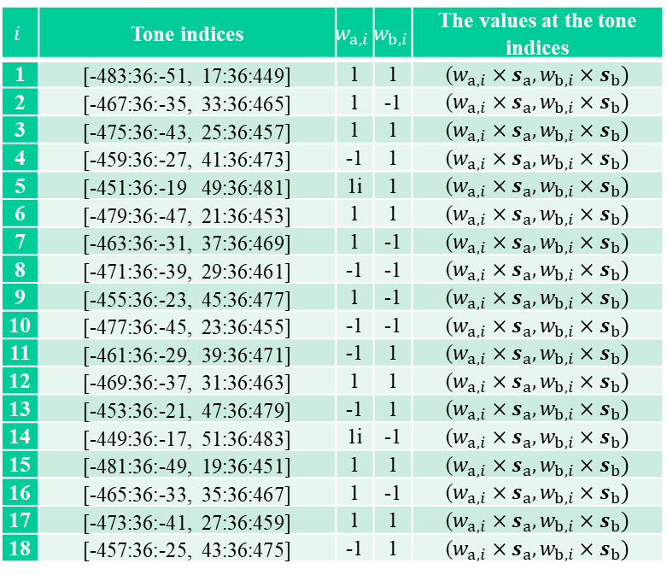
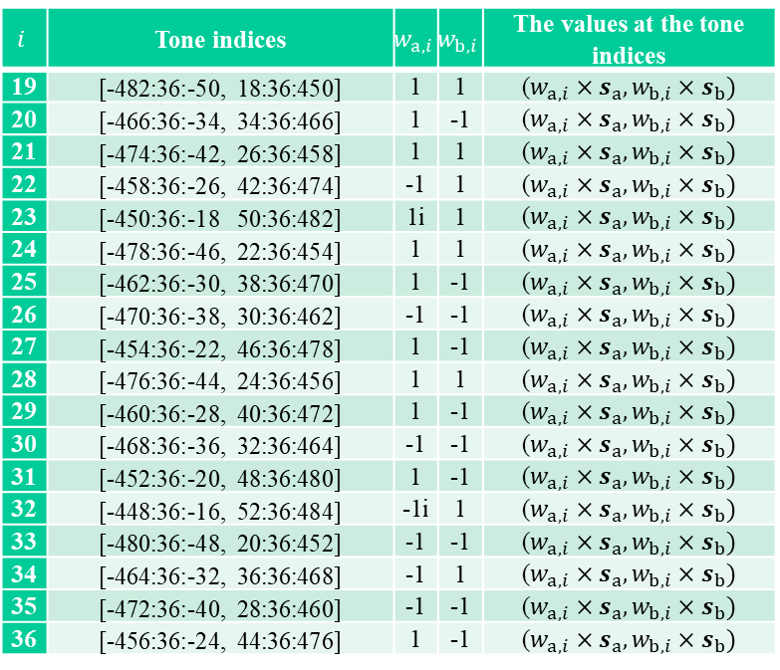
80 MHz DRU 4xLTF
$$i$$ | Tone indices | $$w_{a,i}$$ | $$w_{b,i}$$ | The values at the tone indices
1 | [-483:36:-51, 17:36:449] | 1 | 1 | ($w_{a,i}×s_{a}, w_{b,i}×s_{b})$
2 | [-467:36:-35, 33:36:465] | 1 | -1 | ($w_{a,i}×s_{a}, w_{b,i}×s_{b})$
3 | [-475:36:-43, 25:36:457] | 1 | 1 | ($w_{a,i}×s_{a}, w_{b,i}×s_{b})$
4 | [-459:36:-27, 41:36:473] | -1 | 1 | ($w_{a,i}×s_{a}, w_{b,i}×s_{b})$
5 | [-451:36:-19 49:36:481] | 1i | 1 | ($w_{a,i}×s_{a}, w_{b,i}×s_{b})$
6 | [-479:36:-47, 21:36:453] | 1 | 1 | ($w_{a,i}×s_{a}, w_{b,i}×s_{b})$
7 | [-463:36:-31, 37:36:469] | 1 | -1 | ($w_{a,i}×s_{a}, w_{b,i}×s_{b})$
8 | [-471:36:-39, 29:36:461] | -1 | -1 | ($w_{a,i}×s_{a}, w_{b,i}×s_{b})$
9 | [-455:36:-23, 45:36:477] | 1 | -1 | ($w_{a,i}×s_{a}, w_{b,i}×s_{b})$
10 | [-477:36:-45, 23:36:455] | -1 | -1 | ($w_{a,i}×s_{a}, w_{b,i}×s_{b})$
11 | [-461:36:-29, 39:36:471] | -1 | 1 | ($w_{a,i}×s_{a}, w_{b,i}×s_{b})$
12 | [-469:36:-37, 31:36:463] | 1 | 1 | ($w_{a,i}×s_{a}, w_{b,i}×s_{b})$
13 | [-453:36:-21, 47:36:479] | -1 | 1 | ($w_{a,i}×s_{a}, w_{b,i}×s_{b})$
14 | [-449:36:-17, 51:36:483] | 1i | -1 | ($w_{a,i}×s_{a}, w_{b,i}×s_{b})$
15 | [-481:36:-49, 19:36:451] | 1 | 1 | ($w_{a,i}×s_{a}, w_{b,i}×s_{b})$
16 | [-465:36:-33, 35:36:467] | 1 | -1 | ($w_{a,i}×s_{a}, w_{b,i}×s_{b})$
17 | [-473:36:-41, 27:36:459] | 1 | 1 | ($w_{a,i}×s_{a}, w_{b,i}×s_{b})$
18 | [-457:36:-25, 43:36:475] | -1 | 1 | ($w_{a,i}×s_{a}, w_{b,i}×s_{b})$
$$i$$ | Tone indices | $$w_{a,i}$$ | $$w_{b,i}$$ | The values at the tone indices
19 | [-482:36:-50, 18:36:450] | 1 | 1 | ($w_{a,i}×s_{a}, w_{b,i}×s_{b})$
20 | [-466:36:-34, 34:36:466] | 1 | -1 | ($w_{a,i}×s_{a}, w_{b,i}×s_{b})$
21 | [-474:36:-42, 26:36:458] | 1 | 1 | ($w_{a,i}×s_{a}, w_{b,i}×s_{b})$
22 | [-458:36:-26, 42:36:474] | -1 | 1 | ($w_{a,i}×s_{a}, w_{b,i}×s_{b})$
23 | [-450:36:-18 50:36:482] | 1i | 1 | ($w_{a,i}×s_{a}, w_{b,i}×s_{b})$
24 | [-478:36:-46, 22:36:454] | 1 | 1 | ($w_{a,i}×s_{a}, w_{b,i}×s_{b})$
25 | [-462:36:-30, 38:36:470] | 1 | -1 | ($w_{a,i}×s_{a}, w_{b,i}×s_{b})$
26 | [-470:36:-38, 30:36:462] | -1 | -1 | ($w_{a,i}×s_{a}, w_{b,i}×s_{b})$
27 | [-454:36:-22, 46:36:478] | 1 | -1 | ($w_{a,i}×s_{a}, w_{b,i}×s_{b})$
28 | [-476:36:-44, 24:36:456] | 1 | 1 | ($w_{a,i}×s_{a}, w_{b,i}×s_{b})$
29 | [-460:36:-28, 40:36:472] | 1 | -1 | ($w_{a,i}×s_{a}, w_{b,i}×s_{b})$
30 | [-468:36:-36, 32:36:464] | -1 | -1 | ($w_{a,i}×s_{a}, w_{b,i}×s_{b})$
31 | [-452:36:-20, 48:36:480] | 1 | -1 | ($w_{a,i}×s_{a}, w_{b,i}×s_{b})$
32 | [-448:36:-16, 52:36:484] | -1i | 1 | ($w_{a,i}×s_{a}, w_{b,i}×s_{b})$
33 | [-480:36:-48, 20:36:452] | -1 | -1 | ($w_{a,i}×s_{a}, w_{b,i}×s_{b})$
34 | [-464:36:-32, 36:36:468] | -1 | 1 | ($w_{a,i}×s_{a}, w_{b,i}×s_{b})$
35 | [-472:36:-40, 28:36:460] | -1 | -1 | ($w_{a,i}×s_{a}, w_{b,i}×s_{b})$
36 | [-456:36:-24, 44:36:476] | 1 | -1 | ($w_{a,i}×s_{a}, w_{b,i}×s_{b})$
$s_{a}=\left(1, 1,1,1i,−1,1,1,−1i, 1,−1,1,−1i,1i\right)$, $s_{b}=\left(1, 1i, −1, −1, −1, 1i, −1, 1, 1, −1i,−1,1, −1i\right)$
Extra tones [-495 485 -491 489 -489 491 -493 487 -494 486 -490 490 -488 492 -492 488] | [1 -1 -1 -1 1 1 1 -1 1 -1 -1 -1 -1 -1 -1 1]
Extra tones [-499 -487 493 497 -497 -485 495 499 -498 -486 494 498 -496 -484 496 500] | [1 1 1 -1 1 -1 -1 -1 1 1 1 -1 -1 1 1 1]

Slide 22
80 MHz DRU 4xLTF
DLTF_{-500:500} = [ ...
0 1 1 1 -1 1 1 1 -1 -1 -1 1 -1 1 1 -1 1 1 1 1 -1 1 1 -1 1 1 1 1 -1 -1 -1 1 -1 1 1 1 -1 1 1 -1 1 -1 -1 -1 1 1 1 -1 1 1i 1i 1i -1i 1 1 1 -1 1 1 -1 1 1 1 1 -1 -1 -1 1 -1 1 1 1 -1 1 1 -1 1 -1 -1 -1 1 1 1 -1 1 1i 1i 1i -1i 1 1 1 -1 1 1 -1 1 1 1 1 -1 -1 -1 1 -1 1 1 1 -1 1 1 -1 1 -1 -1 -1 1 1 1 -1 1 1i 1i 1i -1i 1i 1i 1i -1i 1i 1i -1i 1i 1i 1i 1i -1i -1i -1i 1i -1i 1i 1i 1i -1i 1i 1i -1i 1i -1i -1i -1i 1i 1i 1i -1i 1i -1 -1 -1 1 -1 -1 -1 1 -1 -1 1 -1 -1 -1 -1 1 1 1 -1 1 -1 -1 -1 1 -1 -1 1 -1 1 1 1 -1 -1 -1 1 -1 -1i -1i -1i 1i 1 1 1 -1 1 1 -1 1 1 1 1 -1 -1 -1 1 -1 1 1 1 -1 1 1 -1 1 -1 -1 -1 1 1 1 -1 1 1i 1i 1i -1i 1 1 1 -1 1 1 -1 1 1 1 1 -1 -1 -1 1 -1 1 1 1 -1 1 1 -1 1 -1 -1 -1 1 1 1 -1 1 1i 1i 1i -1i -1i -1i -1i 1i -1i -1i 1i -1i -1i -1i -1i 1i 1i 1i -1i 1i -1i -1i -1i 1i -1i -1i 1i -1i 1i 1i 1i -1i -1i -1i 1i -1i 1 1 1 -1 1 1 1 -1 1 1 -1 1 1 1 1 -1 -1 -1 1 -1 1 1 1 -1 1 1 -1 1 -1 -1 -1 1 1 1 -1 1 1i 1i 1i -1i -1 -1 -1 1 -1 -1 1 -1 -1 -1 -1 1 1 1 -1 1 -1 -1 -1 1 -1 -1 1 -1 1 1 1 -1 -1 -1 1 -1 -1i -1i -1i 1i 1 1 1 -1 1 1 -1 1 1 1 1 -1 -1 -1 1 -1 1 1 1 -1 1 1 -1 1 -1 -1 -1 1 1 1 -1 1 1i 1i 1i -1i -1i -1i -1i 1i -1i -1i 1i -1i -1i -1i -1i 1i 1i 1i -1i 1i -1i -1i -1i 1i -1i -1i 1i -1i 1i 1i 1i -1i -1i -1i 1i -1i 1 1 1 -1 1i 1i 1i -1i 1i 1i -1i 1i 1i 1i 1i -1i -1i -1i 1i -1i 1i 1i 1i -1i 1i 1i -1i 1i -1i -1i -1i 1i 1i 1i -1i 1i -1 -1 -1 1 0 0 0 0 0 0 0 0 0 0 0 0 0 0 0 0 0 0 0 0 0 0 0 0 0 0 0 0 0 0 0 0 1 1 1 -1 1 1 -1 1 1 1 1 -1 -1 -1 1 -1 -1 -1 -1 1 -1 -1 1 -1 1 1 1 -1 -1 -1 1 -1 1 1 -1 1 1i 1i 1i -1i 1i 1i -1i 1i 1i 1i 1i -1i -1i -1i 1i -1i -1i -1i -1i 1i -1i -1i 1i -1i 1i 1i 1i -1i -1i -1i 1i -1i 1i 1i -1i 1i -1 -1 -1 1 -1 -1 1 -1 -1 -1 -1 1 1 1 -1 1 1 1 1 -1 1 1 -1 1 -1 -1 -1 1 1 1 -1 1 -1 -1 1 -1 -1 -1 -1 1 -1 -1 1 -1 -1 -1 -1 1 1 1 -1 1 1 1 1 -1 1 1 -1 1 -1 -1 -1 1 1 1 -1 1 -1 -1 1 -1 -1 -1 -1 1 -1 -1 1 -1 -1 -1 -1 1 1 1 -1 1 1 1 1 -1 1 1 -1 1 -1 -1 -1 1 1 1 -1 1 -1 -1 1 -1 1i 1i 1i -1i 1i 1i -1i 1i 1i 1i 1i -1i -1i -1i 1i -1i -1i -1i -1i 1i -1i -1i 1i -1i 1i 1i 1i -1i -1i -1i 1i -1i 1i 1i -1i 1i -1 -1 -1 1 -1 -1 1 -1 -1 -1 -1 1 1 1 -1 1 1 1 1 -1 1 1 -1 1 -1 -1 -1 1 1 1 -1 1 -1 -1 1 -1 1 1 1 -1 1 1 -1 1 1 1 1 -1 -1 -1 1 -1 -1 -1 -1 1 -1 -1 1 -1 1 1 1 -1 -1 -1 1 -1 1 1 -1 1 1 1 1 -1 1 1 -1 1 1 1 1 -1 -1 -1 1 -1 -1 -1 -1 1 -1 -1 1 -1 1 1 1 -1 -1 -1 1 -1 1 1 -1 1 -1i -1i -1i 1i -1i -1i 1i -1i -1i -1i -1i 1i 1i 1i -1i 1i 1i 1i 1i -1i 1i 1i -1i 1i -1i -1i -1i 1i 1i 1i -1i 1i -1i -1i 1i -1i -1 -1 -1 1 -1 -1 1 -1 -1 -1 -1 1 1 1 -1 1 1 1 1 -1 1 1 -1 1 -1 -1 -1 1 1 1 -1 1 -1 -1 1 -1 1 1 1 -1 1 1 -1 1 1 1 1 -1 -1 -1 1 -1 -1 -1 -1 1 -1 -1 1 -1 1 1 1 -1 -1 -1 1 -1 1 1 -1 1 -1i -1i -1i 1i -1i -1i 1i -1i -1i -1i -1i 1i 1i 1i -1i 1i 1i 1i 1i -1i 1i 1i -1i 1i -1i -1i -1i 1i 1i 1i -1i 1i -1i -1i 1i -1i -1 -1 -1 1 -1 -1 1 -1 1 1 -1 1 -1 -1 -1 1]

Slide 23
PAPR and CM Results for 80 MHz DRU 4xLTF
PAPR [dB] | 1 | 2 | 3 | 4 | 5 | 6 | 7 | 8 | 9 | 10 | 11 | 12 | 13 | 14 | 15 | 16
DRU52 | 5.01,5.01 | 4.4,4.49 | 5.13,4.87 | 4.98,5.19 | 4.9,4.9 | 4.91,4.94 | 4.68,4.2 | 5,4.92 | 4.7,4.99 | 4.97,5.04 | 4.89,4.92 | 5.08,5.09 | 5.08,5.08 | 4.93,5.12 | 4.97,5.02 | 5.28,4.6
DRU106 | 5.1,5.12 |  | 5.15,5.09 |  | 5.07,5.2 |  | 5.03,5.07 |  | 5.31,5.15 |  | 4.86,5.13 |  | 5.07,5.15 |  | 5.18,5.17
DRU242 | 5.52,5.11 |  |  |  | 5.26,5.42 |  |  |  | 5.31,5.38 |  |  |  | 5.36,5.16
DRU484 | 5.49,5.42 |  |  |  |  |  |  |  | 5.5,5.41
PAPR [dB] | 1 | 2 | 3 | 4 | 5 | 6 | 7 | 8 | 9 | 10 | 11 | 12 | 13 | 14 | 15 | 16
DRU52 | 3.01,4.8 | 3.01,4.75 | 3.01,4.8 | 3.01,4.75 | 3.01,4.8 | 3.01,4.75 | 3.01,4.8 | 3.01,4.75 | 3.01,4.8 | 3.01,4.75 | 3.01,4.8 | 3.01,4.75 | 3.01,4.8 | 3.01,4.75 | 3.01,4.8 | 3.01,4.75
DRU106 | 3.8,4.64 |  | 3.84,4.71 |  | 3.84,4.71 |  | 3.8,4.64 |  | 3.8,4.64 |  | 3.84,4.71 |  | 3.84,4.71 |  | 3.8,4.64
DRU242 | 5.05,4.99 |  |  |  | 5.33,5.15 |  |  |  | 5.05,4.99 |  |  |  | 5.33,5.15
DRU484 | 5.24,5.35 |  |  |  |  |  |  |  | 5.24,5.35
CM [dB] | 1 | 2 | 3 | 4 | 5 | 6 | 7 | 8 | 9 | 10 | 11 | 12 | 13 | 14 | 15 | 16
DRU52 | 1.88,1.94 | 1.58,1.55 | 2.09,1.78 | 2.1,2.22 | 2.06,2.01 | 2.06,2.01 | 1.32,1.3 | 1.79,1.78 | 1.57,2 | 2.03,1.87 | 2.09,1.79 | 2.12,2 | 2.11,2.19 | 1.89,2.09 | 2.22,2.17 | 2.05,1.48
DRU106 | 2.16,2.11 |  | 1.84,1.81 |  | 1.67,1.76 |  | 1.89,1.8 |  | 1.67 |  | 1.76 |  | 1.89 |  | 1.80
DRU242 | 2.28,2.11 |  |  |  | 2.33,2.16 |  |  |  | 2.19,2.12 |  |  |  | 2.36,2.32
DRU484 | 2.06,2.19 |  |  |  |  |  |  |  | 2.38,2.27
CM [dB] | 1 | 2 | 3 | 4 | 5 | 6 | 7 | 8 | 9 | 10 | 11 | 12 | 13 | 14 | 15 | 16
DRU52 | 0.97,1.61 | 0.97,1.61 | 0.97,1.61 | 0.97,1.61 | 0.97,1.61 | 0.97,1.61 | 0.97,1.61 | 0.97,1.61 | 0.97,1.61 | 0.97,1.61 | 0.97,1.61 | 0.97,1.61 | 0.97,1.61 | 0.97,1.61 | 0.97,1.61 | 0.97,1.61
DRU106 | 1.03,1.57 |  | 1.04,1.65 |  | 1.04,1.65 |  | 1.03,1.57 |  | 1.04 |  | 1.65 |  | 1.03 |  | 1.57
DRU242 | 1.73,1.97 |  |  |  | 1.81,2.07 |  |  |  | 1.73,1.97 |  |  |  | 1.81,2.07
DRU484 | 1.84,2.15 |  |  |  |  |  |  |  | 1.84,2.15
[2]
CS based
[2]
CS based

Slide 24
DRU52
DRU106
PAPR CDFs for 80 MHz DRU LTF
DRU242
DRU484
Note: If masked LTF is used, the PAPR of the second SS will be the same as the first SS for all BWs

Slide 25
DRU52
DRU106
CM CDFs for 80 MHz DRU LTF
DRU242
DRU484

Slide 26
Conclusions
The proposed approach constructs the master sequences for 20/40/80 MHz based on two seed sequences
  Enables low-memory implementation
  The approach is scalable as it uses the variants of the same seed sequence for 20/40/80 MHz
It ensures low-PAPR theoretically without sequence search
It is applicable to signal stream pilots

Slide 27
SP
Do you agree that the DRU LTF sequences can be QPSK modulated?

Slide 28
References
[1] 11/24-0468r2 DRU Tone Plan for 11bn
[2] 11-24-1567r0 LTF Design or DRU
[3] R1-163437, Ericsson, Nokia, Lenovo, LG, and ZTE, “WF on DMRS multi-tone evaluation methods,” Apr. 2016.
[4] 11-24-1712r0 DRU Tone Plan for 20 MHz Distribution Bandwidth
[5] Parker, M.G., Paterson, K.G. and Tellambura, C. “Golay Complementary Sequences.” In Wiley Encyclopedia of Telecommunications, J.G. Proakis (Ed.), 2003, https://doi.org/10.1002/0471219282.eot367
[6] W. H. Holzmann, H. Kharagani, “A Computer Search for Complex Golay Sequences”, Australasian Journal of Combinatorics, pp.251-258, 10 (1994) 4,10

