Slide 1
FRER for 802.11bn
Date: 2024-10-22
Authors:

Slide 2
Abstract
Transmission of replicated frames between MLDs on multiple links in a way somewhat analogous to IEEE Std 802.1CB can improve reliability in 802.11bn.

Slide 3
IEEE Std 802.1CB
(Frame Replication and Elimination for Reliability)
TSN:
802.1CB is part of 802.1’s Time Sensitive Networking (TSN). TSN’s goals are extremely low packet loss and finite, low, and stable end-to-end latencies. (The parallel IETF effort is called DETNET (Deterministic Networking).
FRER:
802.1CB Frame Replication and Elimination for Reliability (FRER) is a part of TSN that duplicates packets in a Stream changing it into a Compound Stream with two or more Member Streams.
At some points, packets in a Stream are (1) assigned a sequence number with an R-TAG (Redundancy Tag), (2) replicated and sent of different paths. At some points extra copies are dropped and packet may be reordered in sequence.

Slide 4
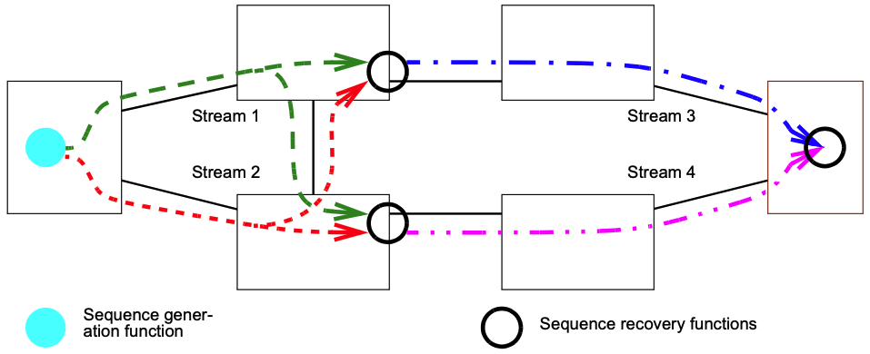
IEEE Std 802.1CB
(Frame Replication and Elimination for Reliability)
Examples:

Slide 5
IEEE Std 802.1CB
(Frame Replication and Elimination for Reliability)
R-TAG:
Simplified 802.1 Placement:
802.1 is working on a revision PAR for 802.1CB-2017
Octets: 1 2 3 4 5 6
Ethertype 0xF1C1
Reserved
Sequence Number
Destination
MAC
Source
MAC
VLAN
TAG
R-TAG
Ethertype / Length
Data
CRC

Slide 6
Mapping 802.1CB to 802.11
Stream identification => assignment of TID to packet
R-TAG => mostly already exists in the sequence and packet numbers and the duplicate elimination for infrastructure and other modes
With 802.11be Multi-Link Devices, the different links provide redundant paths over which copies can be sent
    But does 802.11be permit simultaneous transmission of the same MPDU on different links? Probably…

Slide 7
Draft P802.11be_D7.0 provisions
TID-To-Link Mapping (TTLM) gives the set of links on which an MPDU may be sent.
Various 802.11be Clauses say:
  Clause 35.3.16.9: If an MLD has an established block ack agreement with another MLD for a TID, and the transmission of a QoS Data frame of the TID on a link is unsuccessful, the MLD may attempt retransmissions of the frame on any link to which the TID is mapped, subject to …
  Clause 35.3.13: An MLD may deliver individually addressed QoS Data frames belonging to a TID without block ack negotiation to an associated MLD on the setup links subject to …
    For an MLD, the frame retry count and retry limit for each MSDU or A-MSDU that belongs to a TID that requires acknowledgment is implementation specific.
  Clause 5.1.5.1: … the TTLM process that forwards the MPDU(s) based on the TID of the MPDU(s) down to one or more of the MLD lower MAC entities and then to the corresponding PHY SAP.

Slide 8
802.1CB for 802.11bn
So, what could be done other than clarifying in 802.11bn that an MLD upper MAC sublayer can replicate MPDUs to lower MAC entities for “simultaneous” transmission on more than one link for reliability?
  802.11 could optionally detect R-TAG presence in frames received at the MAC SAP. The presence of such a tag would be a strong indication that the frames has a particularly strong requirement for reliability. This could be used to help classify frames.
  Using functions outside of 802.11, as specified by 802.1CB, optionally eliminate redundant frames received at a MAC SAP based on R-TAG. If desired, the R-TAG could be removed.
    Removal might be desirable for frames received at an (MLD) AP for transmission to (MLD) non-AP STAs. Less likely to be desirable for a GLK or mesh which can appear as links in the middle of a network.
  Also [more to be added]

Slide 9
References
IEEE Std 802.1CB
IEEE Std 802.11be

