Slide 1
The trust model between STA and OBSS AP in MAPC scheme

Slide 2
Introduction
11bn agreed on the C-BF with the following motioned text:
  TGbn defines multi-AP Coordinated Beamforming (Co-BF).
  Other multi-AP coordination modes are TBD.
  [Motion #29, [1] and [49-65]]
In this contribution, we would like to discuss the trust mode between STA and OBSS AP, which can be applied but not restricted to C-BF scheme

Slide 3
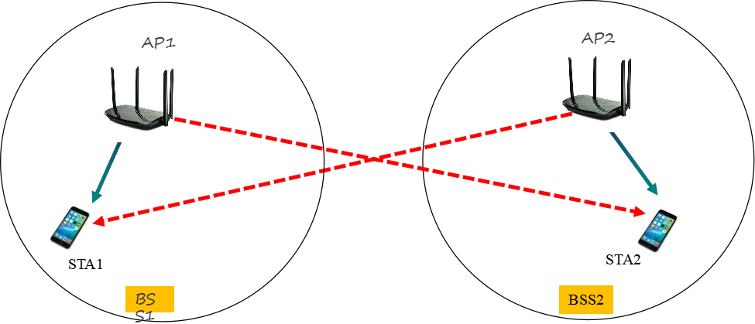
Recap-1: one proposed sounding sequences in C-BF
  Reference[1] proposes one frame exchange sequences in sounding procedure between STA and OBSS AP.
    E.g., NDPA, NDP and BFRP are transmitted by AP1, while CSI report is sent by STA2.

Slide 4
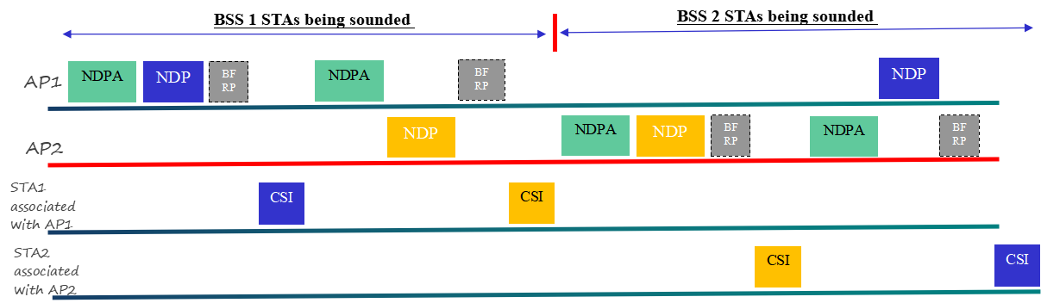
Recap-2: another proposed sounding sequences in C-BF
  Reference[2] proposes another frame exchange sequences in sounding procedure
  E.g., NDPA and BFRP are sent by AP1, while NDP is sent by AP2 and CSI report is sent by STA2.

Slide 5
Trust issue and motivation
How the STA trust the frames sent from an OBSS AP in the proposed sounding procedure?
  In reference[1], how the STA decide to make the response or NOT to the NDPA ,NDP and BFRP frame sent from OBSS AP?
  In reference[1], how the AP know which OBSS STAs make the response to the BFRP?
  In reference[2], how the STA decide to make the response or NOT to the NDP frame sent from OBSS AP?
Motivation
  We propose to set up a trust mode between OBSS AP and STA before the sounding procedure

Slide 6
The proposed security model between STA and OBSS AP
Assuming STA1 associated with AP1 and STA2 associated with AP2, and a trust link is set up between AP1 and AP2.
Based on frame exchange sequences in reference[1]
  AP1 provides the participated STA list to AP2, and gets the assigned USID(unassociated ID) from AP2 for each participated STAs, and vice versa.
  AP1 synchronizes the assigned USID and AP2’s BSSID to each associated STA.
  Same operation on AP2(BSS2) sides.
  AP includes both AID and USID in the NDPA and BFRP to solicit the response from both associated STA and OBSS STA.
Based on the frame exchange sequences in reference[2]
AP1 provides its BSS color to AP2.(or AP2 can detect the BSS color of AP1)
AP2 synchronizes the coordinated BSS(AP1) color to its associated STA2.
STA2 will save the received NDP frame from AP1 and calculate the CSI informaiton.

Slide 7
The following figure depicts one example of the trust model between STA and OBSS AP
non-AP STA1
AP(1)
AP(2)
non-AP STA2
Association
Association
Trust link
Precondition
（1）STAs lists(non-AP STA2x) for C-BF
（2）AP(1) provides USID for each STA in STAs lists
（3）Synchronize the assigned
USID to each STA
（4）STAs lists(non-AP STA1x) for C-BF
（5）AP(2) provides USID for each STA in STAs lists
（6）Synchronize the assigned
USID to each STA

Slide 8
Summary
Analyze the trust issues in two proposed frame exchange sequences in C-BF
Provide the corresponding solution for the trust issue

Slide 9
THANK YOU ☺

Slide 10
Reference
1. 20/0123r0 Channel Sounding for Multi-AP CBF
2. 24/1542r0 Sounding Schemes for Coordinated Beamforming
3. 24/209r5 Specification Framework for TGbn

