Slide 1
NPCA fairness for unsupported STA
Date: 2024-10-11
Authors:
Name | Affiliations | Address | email
Haorui Yang | China Mobile | Hangzhou, Zhejiang, China | yanghaorui0217@163.com
Hangbin Zhao | China Mobile | Hangzhou, Zhejiang, China

Slide 2
Introduction
In [1], it has been agreed to specify NPCA feature in 11bn.
Also a lot of contributions are proposing NPCA details from the different perspective, mainly focusing on the procedure after switching.
This submission provides a scenario that needs to be considered before the STAs swtich to the NPCA primary channel.

Slide 3
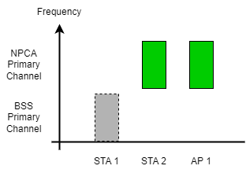
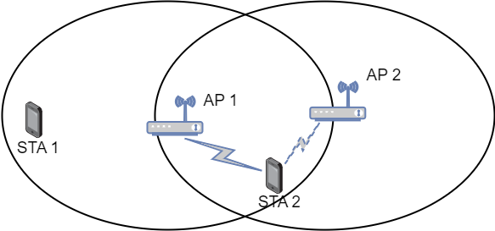
Scenario
There is the possible and usual scenario as below based on the passed NPCA Motion#11 in [1]:
In one BSS, there are STAs (e.g., STA 2) supporting NPCA and may receive the OBSS PPDU, while the other STAs (e.g., STA 1) do not support NPCA.
STA 1 and STA 2 are contending the WM and running their own backoff timer.
During the backoff, OBSS PPDU is received, then the STA 2 and the AP 1 switch to the idle NPCA primary channel, in the result, STA 1 loses its chance to obtain the TXOP.

Slide 4
Issue during EDCA
Channel access fairness issue for the STA 1:
The STA 1 cannot obtain the TXOP even when it has smaller BO timer, which is not fair.
If without NPCA, the STA 1 should have contended fairly to access the WM, but now it has lower chance than the STA 2.
No matter using the primary channel or secondary channel, the STAs should have the fair chance to get the TXOP.
TXOP should be independent from which access mechanism is used.
Therefore, the NPCA procedure design should consider all the STAs in the BSS from the system performance perspective, instead of only focusing on the NPCA supported STA.
otherwise, at least the performance/user experience of legacy STA will be badly impacted.

Slide 5
Solution 1
Follow the current EDCA principle no matter which channel will be used.
The STA 1 and STA 2 continue the EDCA procedure when the STA 2 receives the OBSS PPDU.
This can achieve the same level of fairness as the legacy mechanism since the STA 1 can also have chance to obtain the TXOP.
This can apply to the case where all the STAs support NPCA and receive the OBSS PPDU.

Slide 6
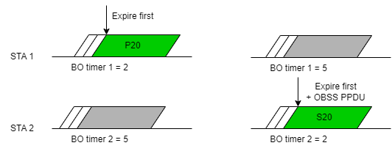
Solution 1
If the BO timer of STA 1 expires first, the STA 1 obtains the TXOP and NPCA is not possible.
Assuming the AP cannot communicate with the different STAs over both the primary channel and secondary channel simaltaneously.
If the BO timer of STA 2 expires first, the STA 2 can perform the NPCA, if the basic NAV is still nonzero or above the threshold.
This can somehow equate part of contend time over the NPCA primary channel for the potential NPCA STAs.
Case 1
Case 2

Slide 7
Solution 2
Limiting the NPCA scope to the STAs utilizing the TXOP on the BSS primary channel
The STAs already utilizing the TXOP receives the OBSS PPDU then switch to NPCA primary channel.
Since the TXOP owner already won the competition, there is no faireness issue if they continue the transmission on the NPCA primary channel in the TXOP duration.
The other STAs in the same BSS can avoid the unnecessary NPCA swtich and there is no difference in their perspective.
The TXOP owner does not change after NPCA switching back.

Slide 8
Summary
The channel access fairness of all the STAs in the same BSS should be considered to not harm the legacy STAs.
It is proposed that:
Option 1: the STAs receving the OBSS PPDU shall continue the EDCA and obtain the TXOP before NPCA.
Option 2: only the STAs participating in the current TXOP perform the NPCA.

Slide 9
References
[1]: 24/0209r7, Specification Framework for TGbn

