Slide 1
Frequency Shifting in Backscatter Operations
Date: 2024-11-05
Authors:

Slide 2
Abstract
This presentation discusses the concept of frequency shifting as an effective method to reducing self-jamming in long range backscatter operations.

Slide 3
Background: Self Jamming in Backscatter Operations
In the context of 802.11, backscattering a signal involves reflecting a signal already present on the air, and modifying its contents while reflecting it.
In long range backscattering, the original (the interferer) and reflected (the desired) signals compete with each other over the air.
The original signal is often the loudest interferer.
The limiting factor in link margins is often determined by the power in the original signal versus the power of the reflected signal as seen by the receiver.
We call this interference “self-jamming”.

Slide 4
Self-Jamming Mitigation: Frequency Shifting
We can increase orthogonality at the receiver by using frequency shifting.
We can shift the reflected signal up or down in frequency by mixing the signal with a clock.
Shifting the original signal away in frequency introduces more link margin in that it separates the desired signal from the interferer in frequency.
All else being equal, the receiver is tuned to a different channel than the transmitter. Its ability to successfully decode the reflected signal becomes a function of
  The receiver’s ability to reject adjacent channel interference.
  The receiver’s ability to decode a signal in the presence of an in-band and co-channel interferer.

Slide 5
Self-Jamming Mitigation: Frequency Diversity
[1] the authors presented a frequency diversity method that used Miller encoding to create sub-carriers within a given channel.
Shifting the original signal into a separate channel has the following advantages.
  Biggest advantage: it introduces > 50 dB signal-to-interference margin, enabling long range backscatter.
  Simple cost-efficient architecture.
  It reuses existing PHY functions at the transmitter and receiver.
  It increases the interference-to-noise ratio by shifting further in frequency. (This modulation scheme is not limited to the same channel width)
  Shifting by multiples of the channel width maintains PHY compatibility at the receiver.
  This method uses the full bandwidth of the channel.
  This method is compatible with different waveforms (it doesn’t propose creating a new waveform specifically for backscattering).

Slide 6
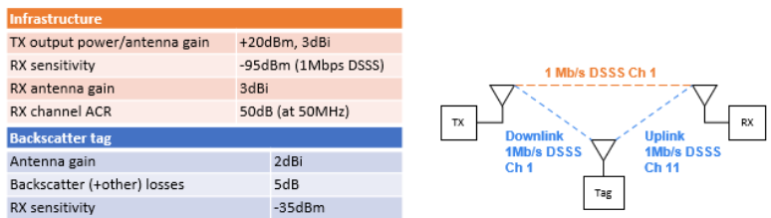
Self-Jamming Mitigation: Frequency Shifting (2)
50 dB due mostly to frequency shift from channel 1 to 11 (“at 50MHz”).
5 dB lost at the tag due to backscatter efficiency, other losses.
-35 dBm “RX sensitivity”; the threshold below which the tag cannot hear downlink sequences, and thus cannot backscatter.

Slide 7
References
[1] Dunna et al., “Frequency translation backscatter,” IEEE 802.11-24/1543r1, Sept. 10, 2024.

Slide 8
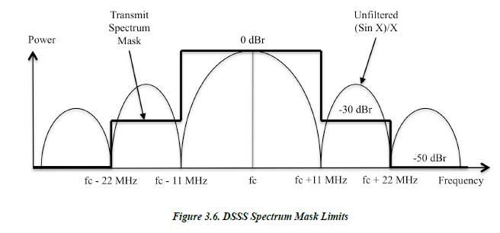
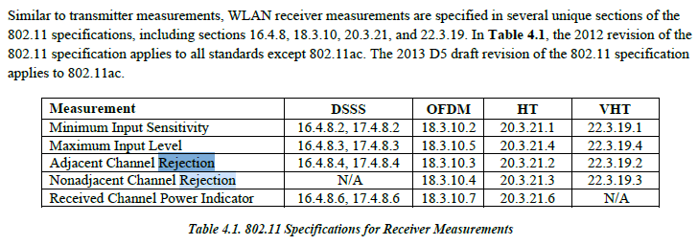
Self-Jamming Mitigation: Frequency Shifting (3)

Slide 9
Notes: Adjacent Channel Rejection in 802.11
16.4.8.4 (DSSS PHY) Conditions, rejection shall be ≥ 35 dB
  Adjacent channel is ≥ 30 MHz (Channel (1 -> 7 -> 13 (!))
  8% FER
  2 Mbps DQPSK
  1024 byte MPDU
  Our case is worse; receivers are more sensitive to lower order modulation (DBPSK), which shows up as higher sensitivity to adjacent interference.
  There are no other definitions at any other modulation nor channel separation.
  Our testing with 1 Mbps DBPSK shows we need ≥ 52 dB separation at a 50 MHz separation (Interferer on channel 1, receiver on channel 11)

