Slide 1
802.11 WG November 2024 Session Report
Date: 2024-11-18
Authors:

Slide 2
Abstract
This document is a digest of the closing reports of all 802.11 sub-groups for presentation at the November 2024 closing plenary meeting. Liaison reports (including liaison reports from the opening plenary) are also included.

Slide 3
Attendance Data

Slide 5
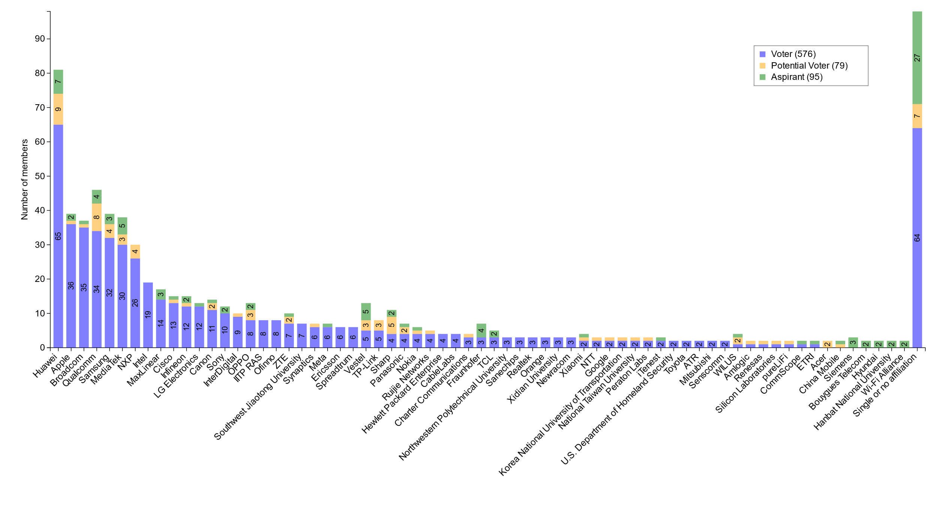
Members by affiliation

Slide 6
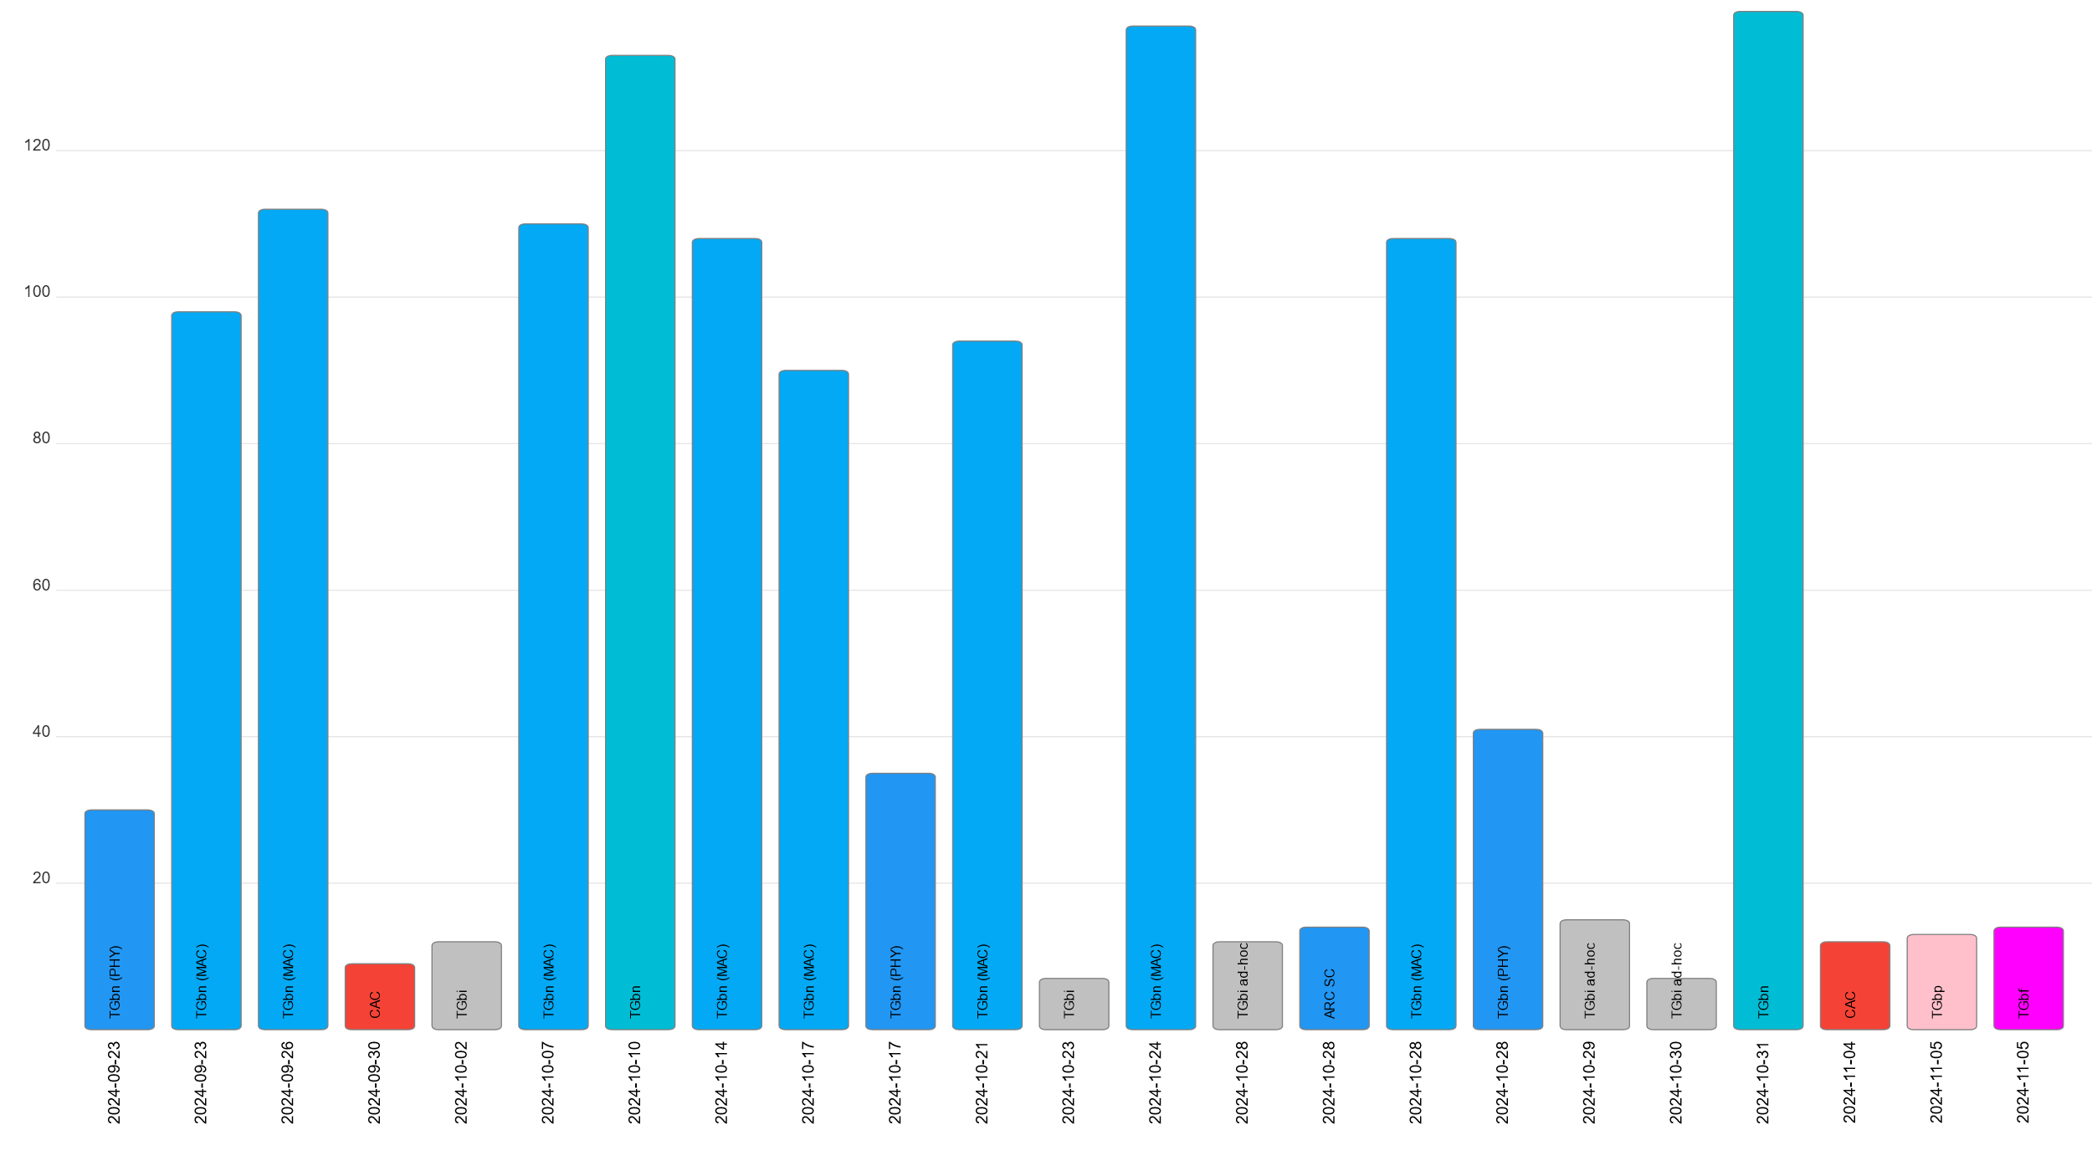
Attendance by subgroup (September to November)

Slide 7
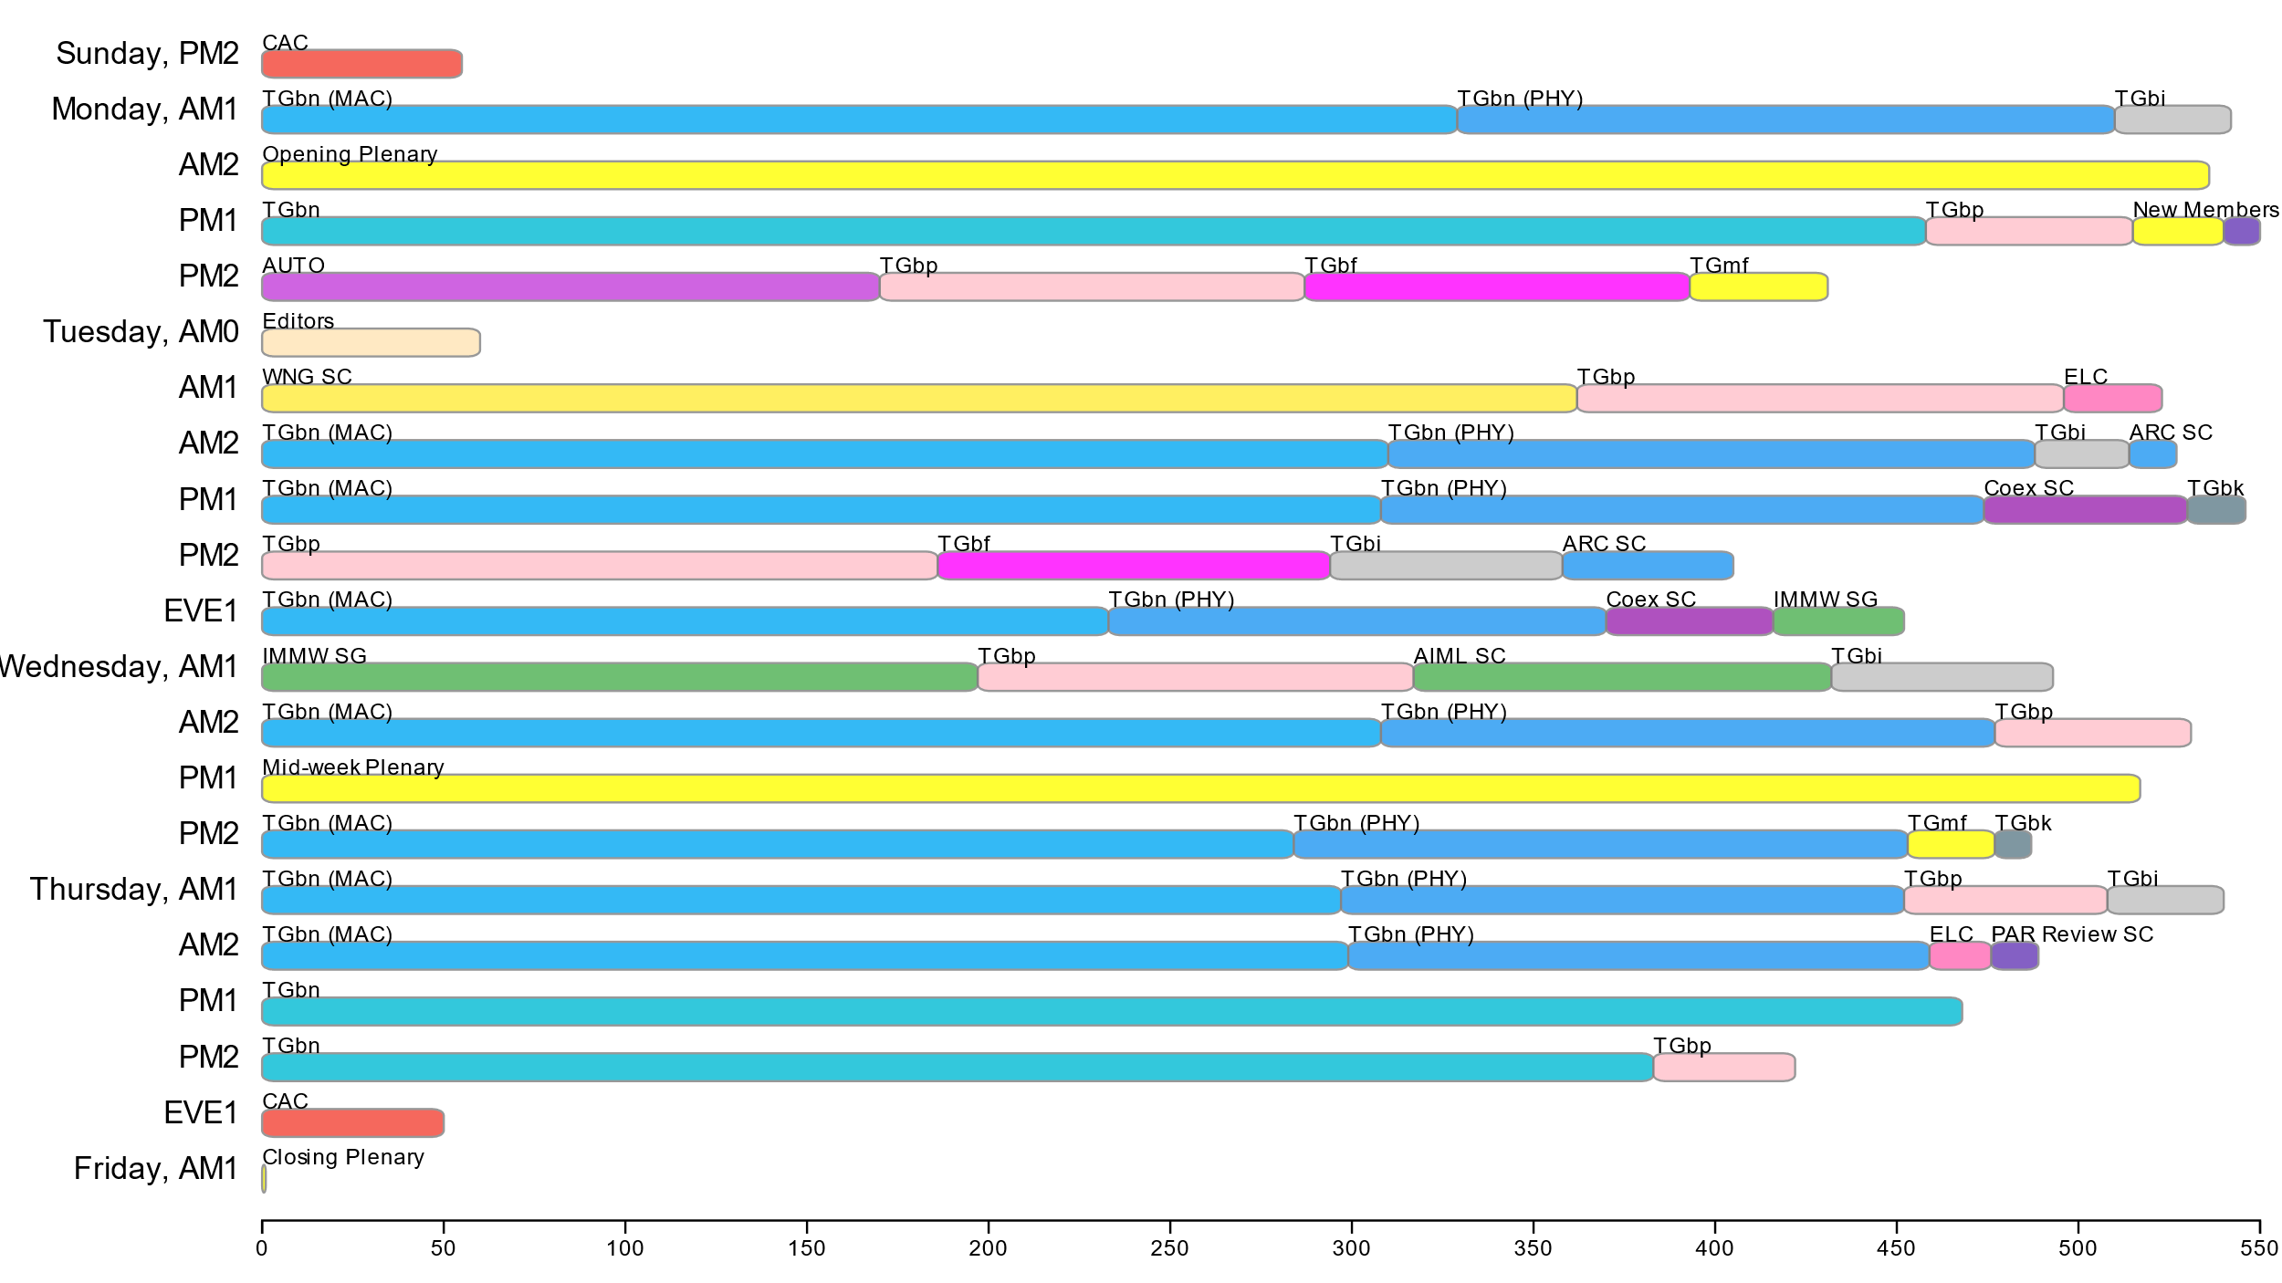
Attendance by breakout (November plenary session)

Slide 8
Editors’ Meeting Agenda and Report
Roll Call / Contacts / Reflector
Brief status report
Amendment alignments and draft development snapshot
Review Publication Process
Form the publication review committees
Editorial Style Guide updates and issues for feedback
ANA number spaces

Slide 9
Volunteer Editor Contacts
  WG – Robert Stacey – robert.stacey@intel.com, Emily Qi – emily.h.qi@gmail.com
  TGbe – Edward Au – edward.ks.au@gmail.com
  TGbh – Carol Ansley – carol@ansley.com
  TGbi – Po-kai Huang – po-kai.huang@intel.com
  TGbn- Ross Jian Yu ross.yujian@huawei.com
TGbk – Roy Want RoyWant@google.com
TGbf – Claudio da Silva – claudiodasilva@meta.com
  REVme – Emily Qi – emily.h.qi@gmail.com, Edward Au – edward.ks.au@gmail.com
  REVmf – Po-Kai Huang - po-kai.huang@intel.com, Edward Au – edward.ks.au@gmail.com

Slide 10
Roundtable status report
REVme – D7.0, approved by IEEE SASB, will be published as IEEE Std 802.11™-2024
11bh – D6.0, approved by IEEE SASB, will be published as IEEE Std 802.11bh™-2024
11be – D7.0, approved by IEEE SASB, will be published as IEEE Std 802.11be™-2024
11bk –D3.0. Started the initial SA ballot and received 78 comments from the initial SB. Plan for the second SA ballot in January.
11bf – D5.0. Started the first recirc SA ballot and received 36 comments. Plan to go recirc when D6.0 is ready (perhaps next week).
11bi – D0.6 is available. 200 comments need to be resolved. D1.0 will be available in January. Plan to start WG LB out of January meeting.
11bn – Plan to have D0.1 in January 2025.
REVmf – Plan to have the initial draft (0.0 or 0.1) in January/Feb 2025.

Slide 11
Editor Amendment Ordering
See http://grouper.ieee.org/groups/802/11/Reports/802.11_Timelines.htm
Changes are usually based on MDR readiness.
As discussed in November 2024
Amendment Number | Task Group | Page Count | Projected RevCom Date (submission)
REVme | TGm | 6213 | September 2024 - Approved
802.11-2024 Amendment 1 | TGbh | 34 | September 2024 - Approved
802.11-2024 Amendment 2 | TGbe | 1089 | September 2024 – Approved
802.11-2024 Amendment 3 | TGbk | 111 | March 2025
802.11-2024 Amendment 4 | TGbf | 220 | March 2025
802.11-2024 Amendment 5 | TGbi | 100 | ?
802.11-2024 Amendment 6 | TGbn | ? | May 2028
REVmf | TGm | 6000+ | Feb 2028

Slide 12
Draft Development Snapshot
Changes from last report shown in red.
November 2024
TG | Published or Draft Baseline Document |  |  |  |  |  |  | Source | MDR | Editor | Snapshot Date
 | Published | me | bh | be | bk | bf | bi
me | Y | 7.0 |  |  |  |  |  | FrameMaker 2020 | Yes | Emily Qi, Edward Au | July 29, 2024
bh | Y | 7.0 | 6.0 |  |  |  |  | FrameMaker | Yes | Carol Ansley | July 16, 2024
be | Y | 7.0 | 6.0 | 7.0 |  |  |  | FrameMaker (old) | Yes | Edward Au | July 15, 2024
bk | Y | 5.0 | 4.0 | 5.01 | 3.0 |  |  | Word | No | Roy Want | November 12, 2024
bf | Y | 7.0 | 6.0 | 7.0 | 3.0 | 5.0 |  | FrameMaker 2020 | Yes | Claudio da Silva | November 12, 2024
bi | Y | 5.0 | 2.0 | 5.0 | 1.0 | 3.0 | 0.6 | FrameMaker 2020 |  | Po-kai Huang | November 12, 2024
bn | Y | 5.0 | 2.0 | 5.0 | 1.0 | 3.0 | 0.1 |  |  | Ross Jian Yu | November 12, 2024
mf

Slide 13
Publication process
Publication editor creates a marked-up PDF with editorial changes highlighted
802.11 WG technical editor forms a review committee, which includes:
- TG editor(s) +WG editor(s) + TG chair + others.
Each member of the committee should review each change proposed by the publication editor
Pay particular attention to
  Reconstructed sentences
  Tables with number changes
  - for example, the order in the Beacon frame body table should not be changed
  ANA assignments
The review process is complete when all publication changes have been reviewed

Slide 14
Publication Review Committees
REVme Review Committee
Emily Qi (lead): emily.h.qi@gmail.com
Edward Au: edward.ks.au@gmail.com
Mike Montemurro: montemurro.michael@gmail.com
Robert Stacey: robert.stacey@intel.com
Carol Ansley: carol@ansley.com
Po-kai Huang: po-kai.huang@intel.com
?
11bh Review Committee
Carol Ansley (lead);
Mark Hamilton: mark.hamilton2152@gmail.com
Emily Qi;
Robert Stacey;
?
11be Review Committee
Edward Au (lead);
Alfred Asterjadhi: aasterja@qti.qualcomm.com
Emily Qi;
Robert Stacey;
Carol Ansley
?

Slide 15
802.11 Style Guide
See https://mentor.ieee.org/802.11/dcn/09/11-09-1034-21-0000-802-11-editorial-style-guide.docx
We update 802.11 Style Guide based on IEEE Standards Style Manual and consistency changes in final publication of the 802.11 standard
Editor’s responsibility includes checking the 2021 IEEE Standards Style Manual when creating or updating drafts. Policy (inclusive terms), key words and pronouns (e.g., he, she) were revised.
https://mentor.ieee.org/myproject/Public/mytools/draft/styleman.pdf
Submissions with draft text should conform to both the WG11 Style Guide and IEEE Standards Style Manual
Note that the 802.11 Style Guide evolves with our practice

Slide 16
ANA managed number space
Protocol Version subfield: 9.2.4.1.2
Frame types and subtypes: 9.2.4.1.3, Tables 9-1 and 9-2
Element ID and Element ID extension: Table 9-128
Capability Information field: 9.4.1.4
Extended Capabilities: 9.4.2.25, Table 9-190
Reason codes: 9.4.1.7, Table 9-77
Status codes: 9.4.1.9, Table 9-78
Action frame categories: 9.4.1.11, Table 9-79
Authentication algorithm: 9.4.1.1
RSNE: 9.4.2.23
Cypher suites: Table 9-186
AKM suites: Table 9-188
RSN Capabilities: Figure 9-345
RSNXE Capabilities: 9.4.2.240, Table 9-365
ANQP-element (Info ID): 9.4.5.1, Table 9-412
Neighbor Report subelements: 9.4.2.35, Table 9-210
FTE subelements: 9.4.2.46, Table 9-219
Public Action frames: 9.6.7.1, Table 9-450
WMN-Notification Types: 9.6.13.29, Table 9-516
Mesh Configuration Active Path: 9.4.2.96.2, Table 9-277
TLV encodings: 9.4.4
KDE Selector Data Type: 12.7.2
Operating classes: Annex E
global, USA, Europe, Japan
MIB objects: Annex C
ieee802dot11, dot11smt, dot11phy, dot11mac, dot11StationConfigEntry, dot11OperationEntry, dot11Compliances, dot11Groups

Slide 17
November 2024 AIML SC Closing Report
Date: 2024-11-14
Authors:

Slide 18
Work Completed
  1 Meeting Slot
    Wednesday AM 1
    Agenda: 11-24/1648r0
    SP and Motion Booklet: 11-24/765r2
  Achievements
    Two technical presentations
    Approved minutes of AIML SC for July 2024 Plenary: 11-24/1325r0
    Approved the AIML SC 1st Technical Report Draft Outline

Slide 19
Plans for January 2025
No teleconference planned
Technical presentations
  Additional results, exploration and feasibility for existing use cases
  Additional AIML use cases
  Technical report drafts

Slide 20
ARC Closing Report
Date: 2024-11-14
Authors:

Slide 21
Work Completed - 1
Agenda is here: 11-24/1728r6
IEEE Std 802 revision:
  Received a report on the P802REV activities
    SA recirculation is completed (assuming the LMSC approves).
    Moving to publication editor.
  There are at least two items that impact 802.11, and are planned to be discussed at future ARC meetings:
    Change of terminology and removal of EPD and LPD terms
    MAC address bit and octet ordering description

Slide 22
Work Completed - 2
Annex G:
  Progressed the proposal for Annex G replacement: 11-23/0880r4. Consensus that this is useful work, and in the right direction. Will continue discussion in January.
WBA L4S presentation
  Incoming liaison letter: 11-24/1569r0
  Proposed (interim) response: 11-24/1933r1
  Plan to continue discussion in January

Slide 23
Future activities
    Will start working on these alignment topics, once IEEE Std 802 is known to be stable (final SA ballot complete and/or wait for publication):
    Related to IEEE Std 802 updates:
      EPD and LPD terms are going away – we need to update 802.11 to align
      Review MAC address ordering discussion, and 802.11 assumptions
      802.1AC mapping from ISS to 802.11 MAC SAP interface
      Consider any changes to remove 802.2/LLC terms?
      802.11’s “Portal”, and mapping to/usage of IEEE Std 802 terminology
      Access Domains: “802 Access Domains”? In 802.11, an ESS? TGbe implications?
      Is the DS a bridge (small ‘b’)?
      Consider adding something about VLANs (just informational?) into 802.11? Relationship (if we talk about it) to security domains (e.g. Authenticator relationship)? VLAN-aware STAs? What about GLK/non-GLK STAs? (cf 11-08/0114r0)

Slide 24
Pending activities
    MLME-RESET, versus MLME-JOIN, MLME-START, MLME-SCAN and MLME-END
      One aspect is how MAC address is set/controlled – related to IEEE 1609/TGbd activities

Slide 25
Plans
Next session/teleconference topics:
Start progress on EPD/LPD clean-up, MAC address bit/octet ordering, other “Future activities” on slide 5
Annex G replacement phase 2, continued
L4S technical work, and WBA L4S liaison response coordination, continued
MLME clean-up
Teleconference – None
Three meeting slots requested in January

Slide 26
Coex SC Closing Report
Date: 2024-11-14
Authors:

Slide 27
Coex SC’s week at a glance
Coex SC met twice this week
Technical discussion topics
ETSI BRAN Update
Bluetooth SIG Update
Simulation results NB operation in 40 MHz / ACL

Slide 28
ETSI BRAN Update to 802.11 (1/2)
EN 303 687 (Wireless Access System/Radio Local Area Network (WAS/RLAN) in the license-exempt 6 GHz band)
Version 1.1.1 published
Publication in OJEU still on hold:
  Open question on potential lack of technology neutrality
  Request for clarification arrived after BRAN #125
  ETSI’s response to the EC is available from BRAN(24)127006r1
discuss proposals related to requirements for NB FH operation
contribution discusses the inclusion of Client-to-Client (C2C)

Slide 29
ETST BRAN Update to 802.11 (2/2)
EN 301 893 (Wireless Access System/Radio Local Area Network (WAS/RLAN) in the license-exempt 5 GHz band)
Normative reference to IEEE 802.11-2020 replaced by ISO/IEC/IEEE 8802-11:2022
Version 2.2.0f of the HS published
Final national voting (approval) ongoing until 2024‑11‑25 – so far, no comments

Slide 30
ETSI BRAN Other Items
  ETSI asks TC BRAN to review and decide about the status of standards older than five years until the end of March 2025
  Among others, this relates to the family of HiperLAN standards
  This will be discussed at future meetings

Slide 31
Update from Bluetooth SIG Work
  Continued work on technical proposal for ETSI BRAN – to be agreed:
  LBT: nearly complete; some concern with “overlap” issues
  EDT: Ericsson and Meta EDT proposals are being discussed
  SCS: 5% duty cycle with no LBT at issue
  OOBE: scaled for 20 MHz channels or NBE channel width

Slide 32
Technical Submissions
Example NB operation in 40 MHz (11-24/1912)
  2 MHz narrowband (NB) operation in 40 MHz of spectrum
  comparing between LBT with secondary channel deferral (SCD) and no-LBT
  NB ACL simulations (11-24/1913)
  Simulation showing system performance when having 30% load on Wi-Fi and NB links carrying high duty cycle asynchronous traffic (ACL)
  each Wi-Fi network operates on a different 160 MHz channel
  Comparison of several coex mechanisms

Slide 33
Coex SC – 15.4ab Joint Session
Thoughts for Consideration in the Joint 802.11/802.15 Coex Forum (15-24/637 & 11-24/1940)
Discussion 15.407 and associated KDB 987594 D02
  definition of ”contention-based protocol”
  Test procedure to avoid co-channel interference with incumbent devices sharing the band
Controversial discussion if .15.4ab devices are already in the market
Proposes to keep existing joint discussions and additional (new) means for collaboration and addressing coexistence.

Slide 34
Plans for January
Two dot11 Coex (only) slots
Wednesday PM2
Thursday PM2
Topics:
Update on ETSI BRAN
Update on Bluetooth SIG
Technical submissions (tba)
Note: coexistence-related topics are welcome. Please contact the Chair

Slide 35
Telcos
No telco scheduled.
May be announced with 10-day notice. Member feeling the need for telco and have submissions ready for discussion are asked to approach the Chair.

Slide 36
References for this week
Agenda for this week: 11-24/1757
Snapshot Slide: 11-24/1758
Meeting / Chair’s Slide Deck: 11-24/1759
Closing report: 11-24/1760
Meeting minutes: 11-24/1784

Slide 37
PAR Review SC
After reviewing the proposed PARs/CSDs that were available for the 2024 November IEEE 802 Mixed-mode Plenary, 802.11 made comments on 2 of the 3 PARs/CSDs.
The feedback on our comments was generally positive and most of our changes were accepted or accepted with minor modification by the respective WG. 802.15 missed the response deadline, but the changes to 802.15 were generally acceptable. A further comment was sent to the WG to clarify the Need for the project (5.5) and an addition needed in 8.1.

Slide 38
WNG SC Closing Report
Date: 2024-11-15
Authors:

Slide 39
Summary
Final Agenda
  https://mentor.ieee.org/802.11/dcn/24/11-24-1673-00-0wng-agenda-for-wng-sc-2024-november.pptx
Presentations at November 2024 meeting
  “Quality of Outcome”, Bjørn Ivar Teigen (Domos)
    https://mentor.ieee.org/802.11/dcn/24/11-24-1910-00-0wng-quality-of-outcome.pdf
  “Segregated Data Services”, Donald Eastlake (Independent)
    https://mentor.ieee.org/802.11/dcn/24/11-24-1904-04-0wng-vlan-segregated-data-services.pptx
  “Proposal on intelligent radio path control technique to improve SNR and resolve the radio shadow zone in millimeter wave band system”, Ryutaro Ohmoto (Dengyo)
    https://mentor.ieee.org/802.11/dcn/24/11-24-1554-01-0wng-proposal-on-intelligent-radio-path-control-technique-to-improve-snr-and-resolve-the-radio-shadow-zone-in-millimeter-wave-band-system.pptx
Minutes
  https://mentor.ieee.org/802.11/dcn/24/11-24-1932-00-0wng-wng-meeting-minutes-2024-november-vancouver-meeting.docx
Plans for January
  Call for presentations will be sent out in December
No motions in the SG, one straw poll
  Support for creation of a TIG to explore additional uses of and management of VLANs inside WLANs
    Y:47 / N 41 / A 71

Slide 40
IEEE 802 JTC1 Standing Committee
November 2024 (mixed-mode) closing report
Date: 2024-11-14
Author:

Slide 41
The IEEE 802 JTC1 SC reviewed the PSDO process status, including IPR issues holding up 802.11
Agenda - ec-24/0229r05; Minutes – ec-24/0292
WG | Completed | In-process | Stalled
802.1 | 52 | 15 | 0
802.3 | 32 | 8 | 0
802.11 | 13 | 0 | 14
802.15 | 4 | 7 | 0
802.16 | 0 | 0 | 0
802.19 | 0 | 0 | 0
802.21 | 3 | 0 | 0
802.22 | 4 | 0 | 0
All | 108 | 30 | 14
802.11 IPR issue
Situation: IPR holding up PSDO process
  Going forward, 802.11 will not be shown as in-process; some 802.15 and 802.19 standards will also not be advanced in the PSDO process
Next steps:
  Reach out to IEEE BoG for insights into actions they are taking towards issue resolution
  Consider appealing to patent holders to supply LOAs under the ISO patent policy
  Observe how IEEE 802.3 fares in the parallel ITU-T SG15 process

Slide 42
The IEEE 802 JTC1 SC will undertake its usual work at its mixed-mode meeting in Kobe in January ’25
IEEE 802 JTC1 SC plans for January 2025 …
  Execute PSDO process, to the extent possible
    There are current ballots open for IEEE 802.1Qdx (CIB: 27 November), IEEE 802.15.3-2023 (CIB: 27 November), IEEE 802.1ASdm (CIB: 31 December), IEEE 802.1ASdn (CIB: 31 December), IEEE 802f (FDIS: 12 February), IEEE 802.1Qcw (FDIS: 12 February), IEEE 802.1Qcj (FDIS: 3 March), and IEEE 802.1ASdr (FDIS: 10 March)
  Monitor ISO/IEC JTC 1/SC 6 activities

Slide 43
REVmf Closing Report – November 2024
Date: 2024-11-14
Authors:

Slide 44
Work Completed
Established TG leadership:
  Vice Chairs: Mark Hamilton, Mark Rison
  Editors: Po-Kai Huang, Edward Au, (with Emily Qi in supervisory role)
  Secretary: Jon Rosdahl
Established initial timeline
Considered contributions on REVme D7.0

Slide 45
Plans for January 2025
Teleconferences scheduled
  None. Will be announced on 10 days notice if one is needed.
January: 2 meetings
Objectives:
  Discuss contributions on changes to REVme D7.0 (in advance of IEEE 802.11-2024 publication)

Slide 46
TGmf Timeline
Nov 2024 – PAR Approval
Nov 2024 – Initial meeting, contributions on REVme D7.0
Jan/Mar 2025 – Contributions on REVme D7.0/IEEE 802.11-2024
Jan - Mar 2025 – Publication of 802.11-2024 and roll-in of TGbh and TGbe
May 2025 – Initial D1.0 WG Letter ballot
May-Nov 2025 – Roll-in TGbf and TGbk
Jan 2026 – D2.0 Recirculation LB
Jul 2026 – D3.0 Recirculation
Jan 2027 – D4.0 Initial SA Ballot – Roll-in TGbi
Jul 2027 – D5.0 Recirculation SA Ballot
Nov 2027 – D6.0 Recirculation SA Ballot
Jan 2028 – D6.0 Recirculation SA Ballot (clean recirculation)
Feb 2028 – RevCom/SASB Approval

Slide 47
Task Group BF
November 2024 Closing Report
Date: 2024-11-13
Authors:
Name | Affiliation | Address | Phone | Email
Tony Xiao Han | Huawei Technologies Co., Ltd. | F3, Huawei Base, Shenzhen, China |  | Tony.hanxiao@huawei.com

Slide 48
TGbf (WLAN Sensing)– November 2024
Progress during November 2024 session
  2 slots scheduled for TGbf
  Comment resolution for the first SA Ballot Recirculation (D5.0)
    100 % of all the first SA Ballot Recirculation (D5.0) comments are now resolved or marked as “ready for motion” (36/36)
  Approved TGbf motion:
    P802.11bf second recirculation SA ballot
Goals for the next two months
  Release IEEE802.11bf D6.0
  Start and complete the second SA Ballot Recirculation (D6.0)
  Start comment resolution for D6.0
  Requested 2 calls

Slide 49
TGbf Timeline
  PAR approved Sep 2020
  First TG meeting Oct 2020
  Comment Collection (D0.1) Jan 2022→Mar 2022 → April 2022
  Initial Letter Ballot (D1.0) Jul 2022→ Sep 2022→ Nov 2022→ Jan 2023
  Recirculation LB (D2.0) Jan 2023 → Mar 2023 → July 2023
  Recirculation LB (D3.0) May 2023 → Nov 2023
  Conditional EC Approval–SA Ballot Mar 2024
  Recirculation LB (D4.0) July 2023 à Jan 2024à Apr 2024
  SA Ballot pool formation Apr 2024
  Initial SA Ballot (D4.0) Sep 2023 à Mar 2024à May 2024
  1st SA Ballot Recirculation (D5.0) Sep 2024
  2nd SA Ballot Recirculation (D6.0) Jan 2025
  3rd SA Ballot Recirculation (D7.0) Mar 2025
  Final 802.11 WG approval July 2024à Jan 2025à Mar 2025
  802 EC approval July 2024à Jan 2025à Mar 2025
  RevCom and SASB approval Sep 2024à Mar 2025à Jun 2025
PAR modification approved by the WG Nov 2023
802EC approval Mar 2024
NesCom/SASB approval Mar 2024

Slide 50
Teleconference Times (plan after November Plenary)
  Confirmed:
    Dec 19 (Thursday) 22：00 - 00:00 ET
    Jan 7 (Tuesday) 9：00 - 11:00 ET

Slide 51
TGbi Closing Report
Date: 2024-11-14
Authors:
Name | Affiliation | Address | Phone | Email
Carol Ansley | Cox Communications |  | +1 404 229 1672 | carol@ansley.com

Slide 52
IEEE 802.11 TGbi
TGbi met 5 times during this plenary session.
We reviewed CID resolution submissions and technical submissions on open topics. Across the plenary and our earlier ad hoc session, we achieved consensus on 144 CIDs and ran out of time for additional submissions.
We approved directing our editor to generate a new draft (D0.7) incorporating these texts to serve as a new reference for submissions.
We continue to call for submissions of text that address requirements as well as submissions to resolve comments from our comment collection as we work toward a D1.0 in January.

Slide 53
IEEE 802.11 TGbi
We will have 4 teleconferences planned.
If needed, a telecon with motions might be scheduled with 10 day notice in December.
  Wednesday 10am ET
  Dates: Dec. 4, 11, 18 and Jan. 8

Slide 54
Timeline
TG use case start: March 2021
Use case completion: February 2022
Features identified: September 2022
Comment collection: May 2024
LB initial: January 2025
LB re-circ: July 2025
MDR: July 2025
Ballot Pool: September 2025
SA ballot: January 2026
SA re-circ: March 2026
802.11/LMSC approval: May 2026
RevCom/SASB approval: July 2026

Slide 55
TGbk 320MHz Positioning
Nov. Meeting Closing Report
Date: 2024-11-14
Authors:

Slide 56
Nov. Meeting Progress and Targets Till the Jan. Meeting
Work completed during the meeting week:
  Completed assignment of CIDs.
  Resolved all editorial CID
  Resolved 8 Technical CIDs.
Targets towards January session:
  Complete CR and recirculate.

Slide 57
Scheduled TGbk telecons
Nov. 21st 10:00 am PT/13:00 ET (2hrs)
Dec. 5th 10:00 am PT/13:00 ET (2hrs)
Dec. 12th 10:00 am PT/13:00 ET (2hrs)
Jan. 9th 10:00 am PT/13:00 ET (2hrs)

Slide 58
TGbn November Closing Report
Date: 2024-11-14
Authors:

Slide 59
TGbn (Ultra High Reliability)
TGbn had scheduled 11 meetings during the November plenary
  Discussed around 60 technical submissions, covering a variety of topics:
    Spatial Reuse, Feedback, low latency, channel access, distributed RU (dRU), preemption, power save (PS),
    Non-primary channel access (NPCA), coexistence, coordinated beamforming (CBF), sounding, security,
    Enhanced long range (ELR), multi-AP (MAP), coordinated rTWT (CrTWT), L4S, coordinated TDMA (C-TDMA),
    Preamble and PPDU, multi-AP, control, roaming, unequal modulation (UEQM), QoS enhancements.
  Approved over 110 motions that added additional concepts to the SFD such as 2xLDPC, ELR, (joint/sequential) CBF sounding, high priority EDCA, coexistence modes, more details for DRU, ELR, UEQM, C-TDMA, PS, NPCA, MAP, C-RTWT, AP PS, eMLSR, roaming, etc.
Agenda is available in 11-24/1667r15,
Motions are available in 11-24/0171r21.
Goals for January 2025:
  Discuss technical submissions
  Continue populating the TGbn SFD
  Deliver TGbn D0.1

Slide 60
Teleconference Plan
November 18-29 (Monday-Friday) Holiday
December 02 (Monday) – Joint 19:00-21:00 ET
December 05 (Thursday) – MAC/PHY 10:00-12:00 ET
December 9 (Monday) – MAC/PHY 19:00-21:00 ET
December 12 (Thursday) – MAC/PHY 10:00-12:00 ET
December 16 (Monday) – MAC/PHY 19:00-21:00 ET
December 19 (Thursday) – Joint (Motions)* 10:00-12:00 ET
December 23-January 03 (Monday-Friday) Holiday
January 06 (Monday) – MAC/PHY 19:00-21:00 ET
January 09 (Thursday) – MAC/PHY 10:00-12:00 ET
* TGbn joint session during which there can be motions, subject to WG chair approval and with 10-day advanced notice.

Slide 61
TGbn Timeline And Status
  PAR approved July 2023
  First TG meeting Nov 2023
  D0.1 Jan 2025
  D1.0 Letter Ballot May 2025
  D2.0 LB May 2026
  D3.0 LB Jan 2027
  Initial SA ballot (D4.0) May 2027
  Final 802.11 WG approval Mar 2028
  802 EC approval Mar 2028
  RevCom and SASB approval May 2028

Slide 62
IEEE 802.11 Nov 2024 Plenary
TGbp Closing Report
Chair: Bo Sun (Sanechips)
Elected Vice Chairs: Steve Shellhammer (Qualcomm)
Rakesh Taori (Infineon)
Secretary : Sebastian Max (Ericsson)
Tech Editor: Yinan Qi (OPPO)

Slide 63
TGbp’s Progress during this week
8 TGbp meetings were planned and held during Nov plenary session, with the agenda include in the latest revision of 11-24/1671.
TGbp approved the updated FRD and SFD documents incorporating approved motions in Sep.
More than 30 tech contributions were presented and discussed, on functional requirements, PHY/MAC solutions and Wireless Power Transmission.
Lots of technical Motions for FRD/SFD were approved as captured in last revision of 11-24/1322.
The 11bp timeline was revisited without change.
2 teleconferences were arranged after Nov plenary session.
Goal of future TGbp work:
  Continue developing FRD and SFD based on consensus
  Open technical discussion

Slide 64
TGbp Timeline Plan
(Subject to change based on development progress)
  PAR approved Mar 2024
  First TG meeting May 2024
  D0.1 (ready for CC) Mar, 2025
  D1.0 Letter Ballot Feb, 2026
  D2.0 LB recirculation Nov, 2026
  Form SA Ballot Pool Mar 1 to Mar 31, 2027
  Initial SA Ballot (D4.0) Aug, 2027
  Final 802.11 WG approval Jan 2028
  802 EC approval Mar 2028
  RevCom and SASB approval May 2028

Slide 65
TGbp Teleconference Plan
  Dec 3rd (Tuesday), 9:00am, ET, 2 hours; Webex
  Jan 7th (Tuesday), 9:00am, ET, 2 hours; Webex

Slide 66
Enhanced Light Communications Study Group (ELC)
November 2024 Closing Report
Date: 2024-11-14
Authors:

Slide 67
ELC activities at the November 2024 meeting
  Content
  ELC reviewed the proposed draft Project Authorization Request as well as the Criteria for Standards Development (CSD) documents
  Contributions discussed included:
    Low-Power Enhanced-Range PHY Mode for ELC (doc. 11-24/1926r1)
    Underwater Interoperability and Backwards Compatibility (doc. 11-24/1928r0)
    ELC Support for positioning (doc. 11-24/1956r0)
  The draft PAR and CSD were agreed.
  Meeting agenda and motions are available in doc. 11-24/1675r2.
  Minutes of the meeting are available in doc. 11-24/1948r2.

Slide 68
ELC SG moving forward
Nov. 2024
  PAR almost completed
  CSD almost completed
Jan. 2025
  Finalize PAR and CSD
  WG approval of the PAR and CSD
Mar. 2025
  802 LMSC approval of the PAR and acceptance of the CSD
  Submit to NesCom
May 2025
  TG start

Slide 69
November 2024 IMMW SG Closing Report
Date: 2024-11-14
Authors:

Slide 70
Work Completed
Completed work
  We responded to comments received from other 802 WGs
  and approved the response to comments and the updated PAR and CSD documents
    PAR 44Y, 0N, 6A
    CSD 47Y, 0N, 5A
  PAR and CSD document were then approved in the WG during mid-week plenary
  Minutes:
    https://mentor.ieee.org/802.11/dcn/24/11-24-1943-00-immw-immw-meeting-minutes-for-november.docx

Slide 71
Plans for January
Teleconference plan:
No conf calls
In January 2025:
  Plan to have first meeting for TGbq

Slide 72
Automotive TIG Closing Report
Date: 2024-11-15
Authors:

Slide 73
Summary
Final Agenda
  https://mentor.ieee.org/802.11/dcn/24/11-24-1674-00-auto-agenda-for-automotive-tig-2024-november.pptx
Editor appointment – Carol Ansley
Presentation of submissions
  “Passpoint & OpenRoaming for Automotive Connectivity”, Necati Canpolat (Intel)
    https://mentor.ieee.org/802.11/dcn/24/11-24-1858-01-auto-passpoint-openroaming-for-automotive-connectivity.pptx
  “Consideration on existing systems and standards for ITS using IEEE802.11 technologies”, John Kenney (Toyota Motor North America), Friedbert Berens (FBConsulting)
    https://mentor.ieee.org/802.11/dcn/24/11-24-1845-02-auto-consideration-on-existing-systems-and-standards-for-its-using-ieee802-11-technologies.pptx
Minutes
  https://mentor.ieee.org/802.11/dcn/24/11-24-1950-00-auto-automotive-tig-meeting-minutes-for-november-11-2024.docx
Plans for January
  Presentations on use cases, requirements and KPIs
No motions, straw polls, or teleconferences

Slide 74
802.15 Liaison Report – November 2024
Date: 2024-11-14
Authors:

Slide 75
Working Group 15 November Agenda
https://mentor.ieee.org/802.15/dcn/24/15-24-0545-05-0000-nov-2024-802-15-agenda.xlsx

Slide 76
802.15 Overview
Wireless Specialty Networks Active standards:
802.15.3 - no active projects
802.15.4 - many current projects (see next slide)
802.15.6a Body Area Networks: Revision project, WG ballot comment resolutions
802.15.7a Higher Rate, Longer Range Optical, on December RevCom agenda
802.15.9a KMP Transport, extensions to key management: Techinical proposals
802.16t Extension to 802.16 for specific bands: Initial SA ballot complete, comment resolution and recirculation
Interest Group Access: exploring potential new features to support more efficient spectrum usage via effective shared access.
SC THz: discussing future THz communications with Terabit/second data rates (preview: some demonstrations scheduled for January WNG!)

Slide 77
802.15.4 Projects
802.15.4ab Next Generation UWB: First WG Ballot complete, in comment resolution
802.15.4ac Enhanced Privacy: pre-ballot draft in preparation
802.15.4ad Next Generation SUN PHYs: Pre-draft, use case evaluation and Technical Characteristics definition
802.15.4ae ASCON light weight encryption extension for 802.15.4: pre-draft.
802.15.4me Revision E of 802.15.4: In publication process

Slide 78
802.15.4ab Next generation UWB: Amendment to IEEE Std 802.15.4-2024 (rev E)
Initial ballot complete
  1471 comments received on draft – 895 technical, 606 editorial
  47 comments received on CAD
Meeting objectives: Comment resolution
Closing report: https://mentor.ieee.org/802.15/dcn/24/15-24-0665-01-04ab-tg4ab-closing-report.pptx
 | Current Schedule
First letter ballot | June 2024
Initial LB comment resolution | Start: July 2024
First recirculation | Jan 2025
Recirculation comment resolution | Feb/March 2025
Second recirculation | March 2025
Recirculation comment resolution | March/April 2025
First SA-Ballot | May 2025
SA-Ballot comment resolution | Start July 2025

Slide 79
802.15.4ac Enhanced Privacy
This amendment specifies modifications to the IEEE Std 802.15.4 medium access control (MAC) specification to specify mechanisms that address and improve user privacy. These mechanisms include randomized addresses, and exchanges that support session continuity. This amendment maintains backward compatibility with the base standard.
State: developing initial draft
Opening and closing report: https://mentor.ieee.org/802.15/dcn/24/15-24-0599-01-04ac-november-opening-and-closing.pptx

Slide 80
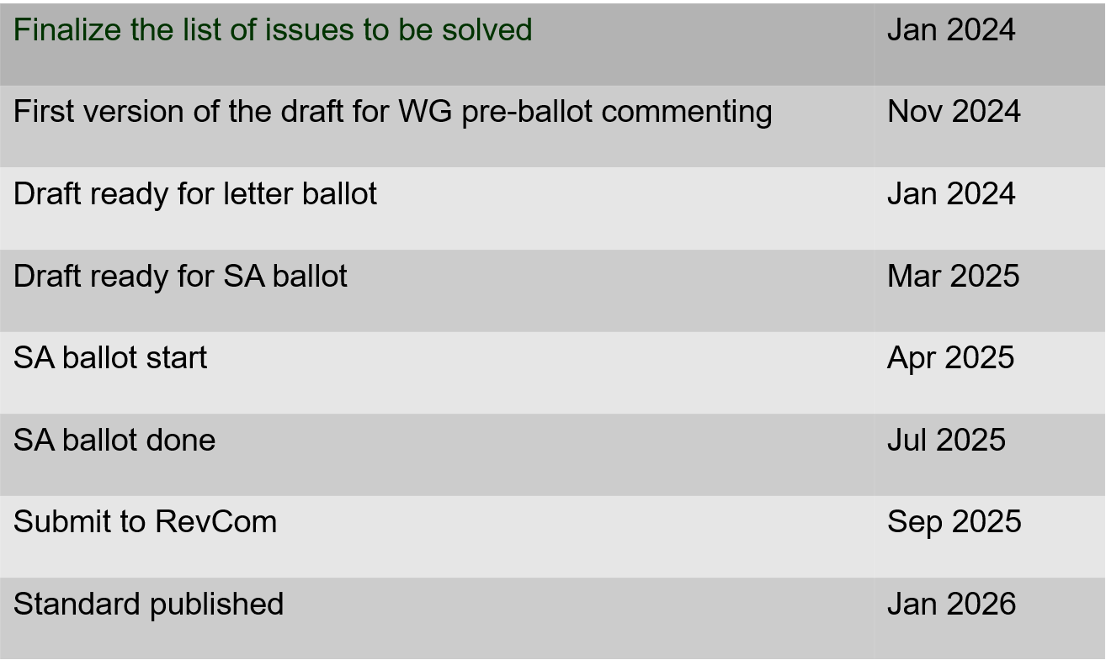
802.15.4ac Enhanced Privacy Timeline

Slide 81
802.15.4ad Next Generation SUN PHYs
Developing enhancements to the 802.15.4 SUN PHYs (FSK, OFDM)
State: pre-draft development
Meeting goals:
  Finalize and approve technical guidance document
  Finalize call pro proposals
Objectives completed
Closing report: https://mentor.ieee.org/802.15/dcn/24/15-24-0597-01-04ad-tg4ad-agenda-opening-and-closing-report-nov-2024.pptx

Slide 82
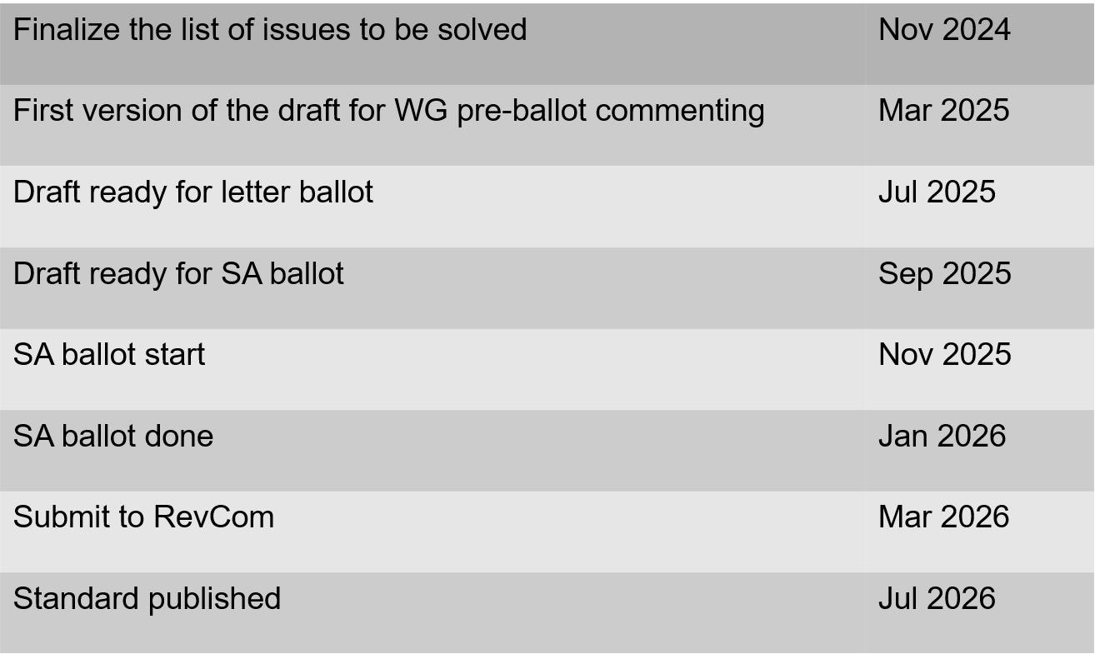
802.15.4ae (ASCON)
ASCON light weight encryption extension for 802.15.4
Pre-draft development
Reviewing required changes to 802.15.4 to support ASCON
Prepared comments on the NIST document

Slide 83
802.15.6a
Draft in WG ballot
  Initial ballot complete
  Comment resolution in progress
Session objectives:
  Resolve comments
Closing report: https://mentor.ieee.org/802.15/dcn/24/15-24-0653-01-006a-tg15-6ma-closing-report-for-november-2024.pptx

Slide 84
TG 6ma Timeline(expected)
Tech Req Doc July 2022
Presentation of proposals
May 2023
Comment Resolutionfor LB
Nov. 2024
Comment Resolutionfor LB2
Jan. 2025
EC approval to SB, SB submission
March 2025
SB recirculation
May 2025
WG PreBallot submission for Draft2.5 August 2024
SB recirculation if required
July 2025
Revcom Approve
Sept 2025
^{Draft V1,18 Com}
May. 2024
Recirculation (LB2)
Dec. 2024
RevcomSubmission
August 2025
Comment Resolution fo Draft v2.3 on WG for PreBallot July 2024
1st Letter Ballot(LB)
Sept. 2024
Conditional approval for Sponsor Ballot (SB)
February 2025
TRD,CMD
Call Proposals Sept 2022
Std. Draf V1.9 Proposals
Nov. 2023

Slide 85
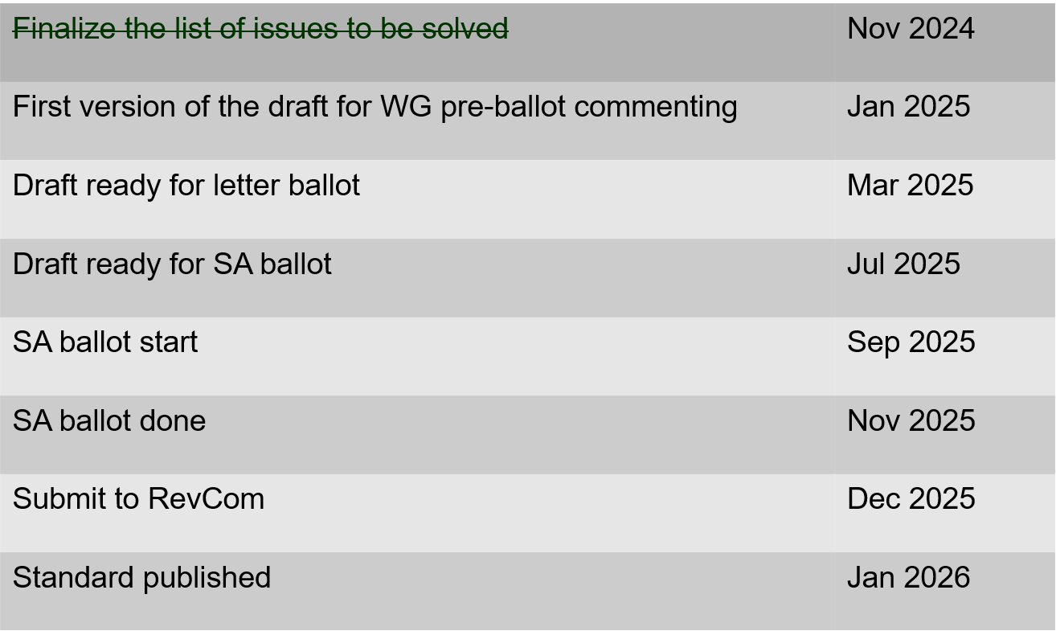
802.15.9a KMP Transport
Extensions to key management: extending to support EDHOC
State: draft development
Session objectives
  Update and send out call for participation and call for proposals.
  Update list of changes needed to the IEEE Std 802.15.9 for adding EDHOC KMP
Opening and closing report: https://mentor.ieee.org/802.15/dcn/24/15-24-0601-01-009a-november-opening-and-closing.pptx

Slide 86
IG Access
Purpose: to explore potential enhancements to support better spectrum access to support sharing through coexistence
Output: recommendations or information for the Working Group
Short term focus: U-NII 6 GHz band
  Consider present occupants (includes UWB)
  Consider future growth in occupation and use
Support (Not preempt or disrupt) efforts in other projects
Some goals:
  Support for a diversity of uses
  Equal access and improved performance for all 802 wireless technologies
Technical contribution and discussion (to continue in January)
  Summarize key differences in requirements for various regulatory regions
Participation encouraged!
NOTE: IG Access met only ad-hoc during the November plenary session

Slide 87
Licensed Narrowband Amendment TG16t
State: In SA ballot
  SA Ballot on P802.16t D4.0 closed October 19th
  Comment Resolution Spreadsheet in 802.15-24-0561r0
Session objectives:
  Complete comment resolution and initiation recirculation
Closing report: https://mentor.ieee.org/802.15/dcn/24/15-24-0644-02-016t-nov-2024-tg16t-meeting-closing-report.pptx

Slide 88
Terahertz Standing Committee
Plans for January Interim: An extended WG15 WNG meeting to accommodate multiple technical presentations including live demonstrations of THz implementations!

Slide 89
802.18 Liaison Report – November 2024
Date: 13 November 2024
Author:
Name | Company | Address | Phone | Email
Edward Au | Huawei Technologies |  |  | edward.ks.au@gmail.com
Al Petrick | Skyworks Solutions |  |  | apetrick123@gmail.com

Slide 90
RR-TAG at a glance
Membership as of 15 September 2024
  63 voters (including 10 on LMSC)
  6 nearly voters
  6 aspirants
Officers
  Chair: Edward Au (Huawei Technologies)
  Co-Vice Chair: Gaurav Patwardhan (Hewlett Packard Enterprise)
  Co-Vice Chair: Al Petrick (Skyworks Solutions)
  IEEE SA Program Manager: Jodi Haasz (IEEE SA)

Slide 91
Progress since the 2024 September interim
Reviewed the latest ongoing consultations
Approved the following IEEE 802 LMSC submissions:
  Qatar CRA: Public Consultation - Position Paper on IoT and M2M in the State of Qatar
  Mexico IFT: Public consultation re the 64 GHz - 71 GHz frequency band
  Saudi Arabia CST: Spectrum Outlook for Commercial and Innovative Use 2024-2027
  Belgium BIPT: Consultation on radio interfaces related to devices using the ultra wideband technology (UWB)
  Japan MIC: Call for opinions on the Frequency Reorganization Action Plan (FY2024 edition)
  Czech CTU: Call for comments on the draft Radio Spectrum Management Strategy
Discussed the latest topics related to spectrum and regulation in Europe, North America, and Asia Pacific.

Slide 92
Achievements this week
Reviewed and approved the following consultations:
  Japan MIC: Call for opinions on the proposed ministerial ordinance to amend part of the Radio Law Enforcement Regulations: Addition of systems and bands to the special exemption system for non-technical equipment
  Saudi Arabia CST: Light Licensing Regulations Annex for the 6 GHz Frequency Band
Reviewed and approved the following consultations:
  Australia ACMA: Proposed update to Australian radiofrequency spectrum plan
  Vietnam MIC: Consultation re lower 6 GHz band for Wi-Fi
Discussed the latest topics related to spectrum and regulation in Europe, North America, and Asia Pacific:
  ETSI BRAN November 2024 update
  Liaisons from ITU-R Working Party 5D

Slide 93
Future RR-TAG meetings
Events | Date and time
Weekly teleconference | 3:00pm ET to 3:55pm ET, Thursday, 21 November 2024 Thursdays, 5 December 2024 through 20 March 2025
2025 January interim | Opening meeting: Tuesday, 14 January 2025, 10:30am JST to 12:30pm JST Closing meeting: Thursday, 16 January 2025, 8:00am JST to 10:00am JST
*Call in info is available at the 802.18 Google Calendar

Slide 94
802.19 WG November 2024 Liaison Report
Date: 2024-11-13
Authors:

Slide 95
IEEE 802.19 Overview
IEEE 802.19 group reviews coexistence assessment documents (CAD) produced by working groups developing new wireless standards for unlicensed devices.
IEEE 802.19 develops standards for coexistence between wireless standards of unlicensed devices.
Meeting times: Monday PM3 and Thursday PM3 (6:30 PM).
Position | Person
Working Group Chair | Tuncer Baykas (Ofinno)
Working Group Vice Chair | Steve Shellhammer (Qualcomm)
Work Group Secretary | Yukimasa Nagai (Mitsubishi Electric)
Task Group 3a Chair | Ben Rolfe (Blind Creek Associates)
Liaison To/From 802.11 | Tuncer Baykas (Ofinno)

Slide 96
Coexistence Assessment Documents
No ballots before November meeting.

Slide 97
802.19.3a Task Group
Scope of the project: This amendment updates and expands coexistence recommendations to address new market requirements, increasing data traffic, greater device density of devices, and increased potential for congestion based on both IEEE Std 802.11-2020 and IEEE Std 802.15.4 sub-1 GHz standards.
19-24/0038, “Measurement results of radio noise over Sub-1 GHz band emitted from mini PC and laptop PC” Kazuni Yato et. al.
19-24/0032, “IEEE 802.11ah and IEEE 802.15.4g SUN OFDM PHY Coexistence Simulation” Takenoro Sumi et. al

Slide 98
802.24 Vertical Applications TAG
Closing Report
November 2024 Plenary Meeting
Vancouver, BC, Canada

Slide 99
802.24 Overview
802.24 Vertical Applications TAG
802.24.1 Smart Grid TG
802.24.2 IoT TG
Officers
  TAG Chair: Tim Godfrey
  Secretary & TAG Vice Chair: Ben Rolfe
Task Groups
  802.24.1 Smart Grid TG Tim Godfrey
  802.24.2 IoT TG Chris DiMinico
25 Voting Members

Slide 100
Agenda
Call session to order / “Guidelines for IEEE SA meetings”
Review of Agenda / Approval of Agenda / Approve Minutes
Liaison Updates / Regulatory
Publication of “Low Latency White Paper”
IoT white paper Development and Contributions
Development of update to Smart Grid White paper.
AFV Infrastructure communications white paper: Review contributions and white paper draft

Slide 101
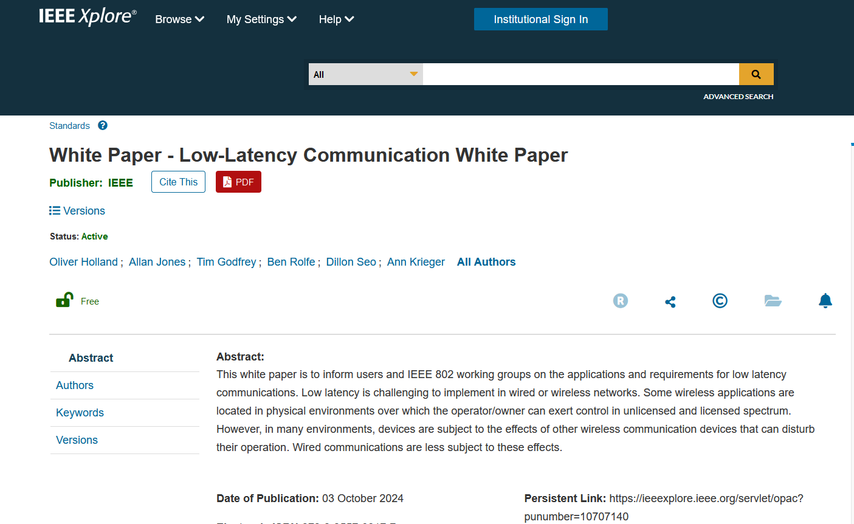
Low Latency White Paper
Published October 3rd.
https://ieeexplore.ieee.org/document/10707142

Slide 102
IoT White Paper Discussion
Discussions Notes
  Disambiguate the general poor state of available information on IoT,and highlight the IEEE 802 solutions that address them.
  Need to distinguish “Internet” public vs private. OT network for highly secure, isolated networks.
  Embedded comments need text contributions
  How to incorporate wired IoT – specifically Single Pair Ethernet.
    Add section 5 for Connectivity Technologies
    Revise closing section
  Nov 2024
    Smart Home section – Ben will seek Wi-Sun text for this.
    New section needs text: “7.Looking back at the Hype, and what has actually been delivered.” (Ben will find a volunteer)
    Fill in section on IoT with high reliability (Tim)
    Closing statement (Ann)
Latest Version Internet of Things White Paper 24-22-0011-07-IoTg-internet-of-things-white-paper

Slide 103
Smart Grid White Paper Revision Plan
Update of first Smart Grid white paper to address latest amendments of 802.15.4 u, v, w, x, y, Rev-me, and new organization of documents to clarify UWB vs Narrowband
New Standards
  Amendments of 802.15.4 (SUN) u, v, x, y, ac, ad/NG, (4me revision) Phil Beecher, Gary Stuebing, Don Sturek, Jeorg
  LECIM/LPWAN 802.15.4w Jeorg
  802.15.9 Tero
  802.1 TSN Reference to the TSN White Paper (Janos)
  802.11ah and 11ax (Dave Halasz)
  802.16s, 16t (Tim, Harry)
  802.19.3 sub-1 GHz coexistence (Ben)
New topics
  Integration of Gas/Water into electric metering
  Battery leaf nodes for low power
  Sensors
  Situational Awareness
  Physical Security
  Wildfire detection and prevention
  Any others identified by contributors.
Complementary role of IEEE 802 with cellular technologies

Slide 104
Areas discussed and Edited Nov 2024
Companion document update - 24-24-0029-00-sgtg-2025-update-package-of-802-smart-grid-standards.docx
Version at end of November meeting: 802.24-24-0014r4

Slide 105
AFV Communications - White Paper
Types of AFV sites: residential, commercial vehicle depot, public transport site, long haul freight transportation. (Public parking facilities)
Communications requirements: data volume, resilience, reliability.
  Ancillary communication to vehicles (maps, firmware and software updates for vehicles, inventory tracking, logistics, media, etc)
Relate to the use of IEEE 802 technologies as the solution

Slide 106
Contributions related to AFV White Paper
12-Nov-2024 ET | 2024 | 28 | 0 | TAG documents | Fresh AFV WP outline | Craig Rodine (Sandia) | 12-Nov-2024 19:49:14 ET | Download, Revise, Correct, Delete
27-Oct-2024 ET | 2024 | 27 | 0 | TAG documents | Proposed an extended outline for adding use cases of 'Integrated Charging Infrastructure with Distributed Energy Resources, Building and Grid-Level Energy Management Systems' in Clause 3 of the AFV draft outline (Doc. 24-24-0025-00-0000) | Jin Seek Choi (Hanyang University), Hyeong Ho Lee (Seoul National University of Science & Technology/NetvisionTelecom Inc.) | 27-Oct-2024 20:16:45 ET | Download, Revise, Correct, Delete

Slide 107
AFV Next Steps
Output document of combined outline:
  24-24-0027-01-0000-proposed-an-extended-outline-for-adding-use-cases-of-integrated-charging-infrastructure-with-distributed-energy-resources-building-and-grid-level-energy-management-systems-in-clause-3—1
Possible topic follow up on AFV.
  Future state of integrated networks for Energy Management Systems across electric vehicle, home, building, and grid.

Slide 108
802.24 TAG closing
Action Items
  Text contributions for SG white paper update, IoT White Paper. (AI’s inside document)
Any New Business?
Next Meeting
    January 2025 – Kobe, Japan (Ben Rolfe will Chair)
    March 2025 – Atlanta, GA, USA
Adjourn

Slide 109
802REVc Status November 2024 Update
Date: 2024-11-13
Authors:

Slide 110
IEEE Std 802-REVc Overview
PAR was approved on 24 March 2022 to create:
802-REVc - “Standard for Local and Metropolitan Area Networks: Overview and Architecture”
A maintenance roll up of the outstanding amendments of IEEE std 802-2014 – 802.c, 802d, 802f
  Assigned to 802.1 Maintenance – Mark Hantel Maintenance TG Chair, Glenn Parsons 802.1 Chair
  Status/documents/comments are available: https://1.ieee802.org/maintenance/802-revc/
  Files available: https://www.ieee802.org/1/files/private/802-REVc-drafts/ (members only, .11 members)
  Editor: James Gilb
Draft Status Overview:
  WG ballot phase has completed.
  SA ballot phase has “Completed”:
    Ballot pool established 13 Apr 2024
    P802-REVc D2.0 – SA ballot – all comments received were resolved
    P802-REVc D2.1 – 1st Recirculation ballot – all comments received were resolved
    P802-REVc D2.2 – 2nd Recirculation ballot – all comments received were resolved – no change
  Non-conditional LMSC approval to submit to RevCom will be requested this week, for RevCom review/SASB approval at their December 2024 meeting

Slide 111
IEEE Std 802-REVc Details
802 - 802REVc has resolved all comments received on Draft 2.2
  Comment resolution report can be found: 1-24/0054r1
  One comment was received and was resolved:
    Rejected. The comment is out of scope as it is not a comment on a changed portion of the draft. Refer this change to IEEE SA Editorial staff for consideration during preparation for publication.

Slide 112
Next Steps
For the balloting process there are no next steps for 802.11 or 802.11 ARC SC
It is anticipated that the LMSC will agree to unconditionally forward P802 REVc D2.2 to RevCom on Friday 15 November (this week)
It is also anticipated that RevCom will recommend approval of the draft and that the SASB will approve the draft for publication at the upcoming December SASB meeting.
For 802.11 the next steps will be aligning 802.11 with the updated IEEE Std 802
  It is anticipated that this activity will be assigned to the 802.11 ARC SC and implemented in 802.11 TGmf.

Slide 113
Wi-Fi Alliance (WFA) Liaison November 2024 Update
Date: 2024-11-13
Authors:

Slide 114
Meetings
This year marks the 25th Anniversary of the WFA
Celebration of W-Fi future at Malaga, Spain in the Europe member meeting, Oct 15-17 after covering future earlier in the year in Singapore and Austin, TX
  Keynote speeches by industry experts
  Panel discussions on expanding enterprise opportunity, innovation, connected healthcare, market segment insights and demos
  Meeting reports available for members
The next WFA F2F (Asia) member meeting will take place on Feb 18th-20th, 2024, in Tokyo, Japan

Slide 115
Activities
Technical activity at WFA that has recently led to certification
  Wi-Fi 7
  QoS Management
  EasyMesh
  WPA3
Technical activity at WFA that is expected to lead to certification
  Wi-Fi 7 R2
  6 GHz standard power
  Wi-Fi Direct
  Wi-Fi proximity ranging
  XR (Augmented / Virtual / Mixed Reality)
  QoS Management
Increased use of interoperability events with commercial products after program launches

Slide 116
Additional Work Areas
Examples of additional WFA technical work
  Security
  Automated Frequency Coordination
  Customer Experience
  EasyConnect
  Wi-Fi HaLow
  Wi-Fi Data Elements
  Wi-Fi Aware
Examples of additional WFA activity that may lead to technical work
  Sensing
  Automotive
  Healthcare
  Internet of things
  Operators
Spectrum regulatory

Slide 117
Recent publications
Wi-Fi Alliance® applauds ISED Canada for forward-thinking decision to adopt rules for 6 GHz Very Low Power devices
Wi-Fi Alliance® commends Federal Communications Commission (FCC) Chairwoman’s proposal to allow very low power (VLP) devices to access 6 GHz spectrum
New study: Lack of Wi-Fi® spectrum bandwidth undermines China’s investments in fiber
Tackling the spectrum crunch with mobile data offloading
From niche to mainstream: Wi-Fi Alliance® founders share the story behind the early days of Wi-Fi®
Wi-Fi 7 market momentum: Fueling the evolution of XR

Slide 118
Further information
For more information on current areas of work, see http://www.wi-fi.org/who-we-are/current-work-areas
If these sound like interesting topics, please plan to sign up and participate
Further general information at http://www.wi-fi.org/

Slide 119
Wireless Broadband Alliance (WBA) Liaison Report – November 2024
Date: 2024-11-13
Authors:
Name | Company | Address | Phone | Email
Necati Canpolat | Intel |  |  | necati.canpolat@intel.com

Slide 120
Wireless Broadband Alliance (WBA)
Drives enabling seamless & interoperable Wi-Fi services
Addresses business and technical issues, as well as opportunities in the industry
IEEE 802.11 (std dev) WFA (cert) WBA (enablement)

Slide 121

Wireless Global Congress & Members Meeting
WBA has three events per year
The last event was on October 7-10 in Paris co-located with Network X
https://www.wirelessglobalcongress.com/2024-Post-Event-Report
The presentations will be made public in December 2024

Slide 122
WBA Annual Industry Report 2024
Producing the Annual Wireless Industry Report
It will be publicly available in December 2024

Slide 123






TECHNICAL ACTIVITIES ROADMAP FOR 2024
WBA WORK GROUPS & PROJECTS
5G
Work Group
IoT
Work Group
NextGen
Work Group
Roaming
Work Group
OpenRoaming
Work Group
Testing & Interop
Work Group
Private & 5G Wi-Fi Convergence
IoT & Smart Home
Wi-Fi 7
RADIUS Accounting
Assurance
Federated Onboarding Service for OpenRoaming
Access Network Metrics
Mission Critical
& Emergency Services
Wi-Fi HaLow
for IoT Applications
Wi-Fi Experience
for Moving Networks
Wi-Fi Security Guidelines
OpenRoaming for Private LTE/5G
E2E Wi-Fi QoS & L4S
Enterprise Security
for Private 5G Networks
Wi-Fi Sensing
Operator Managed
Wi-Fi
OpenRoaming for IoT & FIDO Device Onboarding
Wi-Fi User & Device Identification
AIML for Wi-Fi
WBA Tools
& Testing Platforms
Policy & Regulatory Affairs
Work Group
Market
Work Group
OpenRoaming Certification
Innovation Forum
- Led by CTO Group
Connected
Communities Forum
Enterprise Connectivity Forum
https://wballiance.com/wba-program-overview-2024/
https://wballiancec.com/proejcts-details
See the updates in the following slides

Slide 124
Wi-Fi 7 Field Trials
Ongoing with several operators covering different deployments and geographies.
The trial results will be made public in December 2024

Slide 125

WBA OpenRoaming Introduction Guide
Published the WBA OpenRoaming™ Introduction Guide
OpenRoaming simplifies connectivity for users, enhancing user experiences while maintaining robust security standards.
Covers the technicalities, benefits, and strategic implementation of OpenRoaming to revolutionize public, guest, and enterprise Wi-Fi networks.
https://wballiance.com/wp-content/uploads/2024/10/WBA-OpenRoaming-Guide-APAC-TG_v1.0.0-FINALPublic.pdf

Slide 126

WBA Access Network Metrics – Phase 1
Addresses the challenges present in current Wi-Fi networks, reaffirms the value of explicit QoE evidence, and demonstrates the advantages for users and providers.
Specifies essential metrics and introduces a framework for assessing and sharing Wi-Fi network quality, aiming to foster a more dependable and efficient Wi-Fi future.
The working group is now embarking on Phase 2, focusing on industry alignment.
https://wballiance.com/wp-content/uploads/2024/08/Access-Network-Metrics-Whitepaper-Outline-v1.0.0-Public.pdf

Slide 127

Zero Touch Onboarding of IoT Devices
New framework to enable a ‘zero-touch’ onboarding process for Internet of Things (IoT) Wi-Fi devices
Integrates the simplicity and security of WBA OpenRoaming with FIDO Device Onboard
Ensures device security through ownership vouchers and cryptographic mechanisms
Details how these technologies work together to simplify and secure the onboarding process for IoT devices.
https://wballiance.com/openroaming-for-iot-fido-device-onboard-framework/
Download

Slide 128

Wi-Fi Experience for Moving Networks
Highlights solutions for seamless connectivity in moving networks like trains, ships, airplanes, public buses etc.
Details how today’s Wi-Fi standards can be used to enhance commutes, travel & daily errands with reliable & secure Wi-Fi networks covering:
  Challenges in Moving Networks
  Innovative Solutions
  Practical Use Cases
  Industry Benefits
https://wballiance.com/wi-fi-experience-for-moving-network/
Download

Slide 129
Further information
WBA information at https://wballiance.com/
Current work areas https://wballiance.com/wba-program-overview-2024/
WBA resource center https://wballiance.com/resource/
WBA events https://wballiance.com/events-awards/
WBA memberships: https://wballiance.com/membership/

Slide 130
Backup

Slide 131






WBA ORGANIZATION
WBA IS A NONPROFIT ASSOCIATION WITH THE VISION TO ACCELERATE THE DEVELOPMENT OF
“SEAMLESS AND INTEROPERABLE WI-FI SERVICES”
Seamless, Secure and Interoperable Wi-Fi
Convergence and Coexistence of Wireless Technologies
Accelerate Next Generation Wi-Fi Networks
Established
in 2003
+200 MEMBERSHIP
COMMUNITY
PROJECTS &
PROGRAMS
3 ANNUAL
EVENTS
PROMOTION AND
GO-TO-MARKET
THOUGHT LEADERSHIP &
MARKET RESEARCH

Slide 132


WBA Focus Areas
WBA MEMBERS SOLVE
REAL BUSINESS ISSUES
Fosters success for its members
WBA’s mission is to enable collaboration between service providers, technology companies and organizations to drive positive change and enable opportunities for growth.
Standards & Specifications - Setting the scene, requirements and creating specifications
Testing & Interoperability - Creating test plans to showcase the technology capabilities
End-to-End Trials - Running field trials/ proof of concept on real-world environment
Guidelines & Best Practices – Accelerate deployments of services and technologies
Certification & Plug Fests - Addressing gaps and helping the industry to maximizing biz opportunities
Think Thank & Advocacy – Industry leaders roundtables and targeted verticals analysis

Slide 133
IEEE 802.11-IETF Liaison Report
Date: 2024-11-13
Authors:

Slide 134
IETF Meetings
Upcoming Meetings:
  March 15-21, 2025 – Bangkok, TH
  July 19-25, 2025 – Madrid, ES
IETF meeting fee waivers
http://www.ietf.org
  Newcomer training: https://www.ietf.org/about/participate/get-started/
  April 2016: Wireless Tutorial (Donald Eastlake), 802.11 & 802.15 tutorials (Dorothy Stanley, Charlie Perkins), see 11-16/500, September 2016: Pat Thaler & Juan Carlos – 802.1E (Privacy Considerations) and 802.c (Local MAC address usage) https://datatracker.ietf.org/group/edu/materials/

Slide 135
IETF- IEEE 802 Liaison Activity
Joint meetings, agenda and presentations
  http://www.iab.org/activities/joint-activities/iab-ieee-coordination/
  Proceedings: https://datatracker.ietf.org/iabasg/ietfieee/meetings/
  Coordination topics include: Capability Discovery, Data Center Bridging, use of Local Address in virtualization and IoT, MAC address randomization, DETNET/TSN/RAW, YANG models, pervasive monitoring
  IETF-IEEE 802 coordination teleconferences: October 23, 2024

Slide 136
IETF protocol use with 802.11 technology
There were no RFCs issued in the last two months that mention IEEE 802.11.
RFC-to-be-9672 (RFC 8110 to IEEE) is in the RFC Editor’s queue awaiting the assignment by IEEE of IEEE 802.11-2024’s DOI.

Slide 137
BOFs at IETF 121 November 2-8, 2024
See https://datatracker.ietf.org/wg/bofs/
alldispatch | IETF-Wide "Dispatch" Session
diem | Digital Emblems
nasr | Network Attestation for Secure Routing
hpwan | High Performance Wide Area Network
rpp | RESTful Provisioning Protocol
deepspace | Deep Space

Slide 138
IETF/IRTF groups being (re-)chartered
See https://datatracker.ietf.org/group/chartering/
hrpc | Human Rights Protocol Considerations
ccamp | Common Control and Measurement Plane
ianabis | Update to IANA Considerations
modpod | MODeration PrOceDures
opsawg | Operations and Management Area Working Group
roll | Routing Over Low power and Lossy networks
spring | Source Packet Routing in Networking

Slide 139
YANG Model Catalog
YANG catalog development
  A YANG model catalog and registry that allows users to find models relevant to their use cases from the large and growing number of YANG modules being published.
  YANG Catalog was developed through a collaboration between the IETF and the Broadband Forum, and contains many data models, including from other Standards Development Organizations (SDOs) such as the IEEE, as well as some vendor-specific data models. Interest and participation from other SDOs, equipment vendors, open source projects and network operators is encouraged.
See https://www.ietf.org/blog/yang-catalog-latest-developments-ietf-100-hackathon/
See https://yangcatalog.org/ and https://1.ieee802.org/yangsters/

Slide 140
IoT-related work
6LO
  Working Group website: http://datatracker.ietf.org/wg/6lo/
  Focus: IPv6 over Networks of Resource-constrained Nodes
Updates
  Revised: IPv6 Neighbor Discovery Prefix Registration: https://datatracker.ietf.org/doc/draft-ietf-6lo-prefix-registration/ (November 2024)
  Revised: Transmission of IPv6 Packets over Short-Range Optical Wireless Communications: https://datatracker.ietf.org/doc/draft-ietf-6lo-owc/ (October 2024)
  Revised: Transmission of SCHC-compressed packets over IEEE 802.15.4 networks: https://datatracker.ietf.org/doc/draft-ietf-6lo-schc-15dot4/ (October 2024)

Slide 141
IoT-related work (cont.)
ROLL: Working Group website: http://datatracker.ietf.org/wg/roll/
  Focus: Routing over Low Power and Lossy Networks
CORE: (Constrained RESTful Environments) Working Group website: http://datatracker.ietf.org/wg/core/
  Focus: framework for resource-oriented applications intended to run on constrained IP networks.
IoT Directorate:
  Reviews IETF drafts that are IoT related
  See: https://datatracker.ietf.org/group/iotdir/about/

Slide 142
MADINAS WG
See http://datatracker.ietf.org/wg/madinas/
MAC Address Device Identification for Network and Application Services
  This is the IETF’s equivalent of IEEE 802.11bh – how to deal with the implications of the deployment of random and changing MAC addresses.
Updates
  Submitted for publication and in AD evaluation: Randomized and Changing MAC Address Use Cases and Requirements: https://datatracker.ietf.org/doc/draft-ietf-madinas-use-cases/ (November 13, 2024!)

Slide 143
EAP Method Update (EMU)
See http://datatracker.ietf.org/wg/emu/
  This working group has been chartered to provide updates to some commonly used Extensible Authentication Protocol methods including of EAP-TLS, EAP-AKA, EAP-AKA’ (for 5G), EAP-SIM, etc.
  The group should document any recently gained new knowledge on vulnerabilities or the possible implications of pervasive surveillance or other new concerns.
Updates
  Completed WGLC: The eap.arpa domain and EAP provisioning: https://datatracker.ietf.org/doc/draft-ietf-emu-eap-arpa/ (November 2024)
  Revised: Bootstrapped TLS Authentication with Proof of Knowledge: https://datatracker.ietf.org/doc/draft-ietf-emu-bootstrapped-tls/ (October 2024)
  Revised: Using the Extensible Authentication Protocol (EAP) with Ephemeral Diffie-Hellman over COSE (EDHOC): https://datatracker.ietf.org/doc/draft-ietf-emu-eap-edhoc/ (October 2024)
  In RFC Editor’s queue and waiting on other document: Tunnel Extensible Authentication Protocol (TEAP) Version 1: https://datatracker.ietf.org/doc/draft-ietf-emu-rfc7170bis/ (June 2024)

Slide 144
Operations Area Working Group
http://datatracker.ietf.org/wg/opsawg/
Updates
  Revised: Guidelines for Characterizing "OAM”: https://datatracker.ietf.org/doc/draft-ietf-opsawg-oam-characterization/ (November 2024)
  Revised: YANG Data Models for Bearers and 'Attachment Circuits'-as-a-Service (ACaaS): https://datatracker.ietf.org/doc/draft-ietf-opsawg-teas-attachment-circuit/ (November 2024)
  Revised: An Information Model for Packet Discard Reporting: https://datatracker.ietf.org/doc/draft-ietf-opsawg-discardmodel/ (October 2024)
Background
  Of interest: RFC 6632, An Overview of the IETF Network Management Protocols, see https://tools.ietf.org/html/rfc6632
  Automated network management, including YANG data models, see https://www.ietf.org/topics/netmgmt/

Slide 145
Internet Area Working Group
https://datatracker.ietf.org/wg/intarea/
Updates
  Nothing terribly relevant at the moment

Slide 146
Transport Layer Security (TLS)
See: http://datatracker.ietf.org/wg/tls/
Updates
  Revised: IANA Registry Updates for TLS and DTLS: https://datatracker.ietf.org/doc/draft-ietf-tls-rfc8447bis/ (November 2024)
  Revised: Hybrid key exchange in TLS 1.3: https://datatracker.ietf.org/doc/draft-ietf-tls-hybrid-design/ (October 2024)

Slide 147
Deterministic Networking (DETNET)
DETNET: https://datatracker.ietf.org/wg/detnet/
  The Deterministic Networking (DetNet) Working Group focuses on deterministic data paths that operate over Layer 2 bridged and Layer 3 routed segments, where such paths can provide bounds on latency, loss, and packet delay variation (jitter), and high reliability.
  The IEEE 802.11be activities seem like they may fit in with DetNet and there was a joint IEEE-IETF DetNet discussion in Bangkok (November 2018).
  Addresses Layer 3 aspects in support of applications requiring deterministic networking.
  The Working Group collaborates with IEEE 802.1 Time Sensitive Networking (TSN), which is responsible for Layer 2 operations, to define a common architecture for both Layer 2 and Layer 3.
  Example applications for deterministic networks include professional and home audio/video, multimedia in transportation, engine control systems, and other general industrial and vehicular applications being considered by the IEEE 802.1 TSN Task Group.
Updates:
  In WGLC: Reliable and Available Wireless Architecture: https://datatracker.ietf.org/doc/draft-ietf-raw-architecture/ (October 2024)
  Waiting for AD Go-ahead: Reliable and Available Wireless Technologies: https://datatracker.ietf.org/doc/draft-ietf-raw-technologies/ (October 2024)

Slide 148
Autonomic Networking Integrated Model and Approach (ANIMA)
ANIMA: https://datatracker.ietf.org/group/anima/
  ANIMA designs protocols to allow network operations (e.g., on-boarding) to be carried out without requiring low-level management of individual devices
Updates:
  Revised: Discovery for BRSKI variations: https://datatracker.ietf.org/doc/draft-ietf-anima-brski-discovery/ (October 2024)
  In Expert Review: BRSKI Cloud Registrar: https://datatracker.ietf.org/doc/draft-ietf-anima-brski-cloud/ (October 2024)

Slide 149
References
RFC 7241, “The IEEE 802/IETF Relationship” (RFC 4441 update)
  https://datatracker.ietf.org/doc/rfc7241/
IEEE 802 Liaisons list is available
  http://ieee-sa.centraldesktop.com/802liaisondb/FrontPage

