Slide 1
802.19 WG September 2024 Liaison Report
Date: 2024-9-11
Authors:

Slide 2
IEEE 802.19 Overview
IEEE 802.19 group reviews coexistence assessment documents (CAD) produced by working groups developing new wireless standards for unlicensed devices.
IEEE 802.19 develops standards for coexistence between wireless standards of unlicensed devices.
Meeting times: Monday PM3 and Thursday PM3.
Position | Person
Working Group Chair | Tuncer Baykas (Ofinno)
Working Group Vice Chair | Steve Shellhammer (Qualcomm)
Work Group Secretary | Yukimasa Nagai (Mitsubishi Electric)
Task Group 3a Chair | Ben Rolfe (Blind Creek Associates)
Liaison To/From 802.11 | Tuncer Baykas (Ofinno)

Slide 3
Coexistence Assessment Documents
No ballots before September meeting.

Slide 4
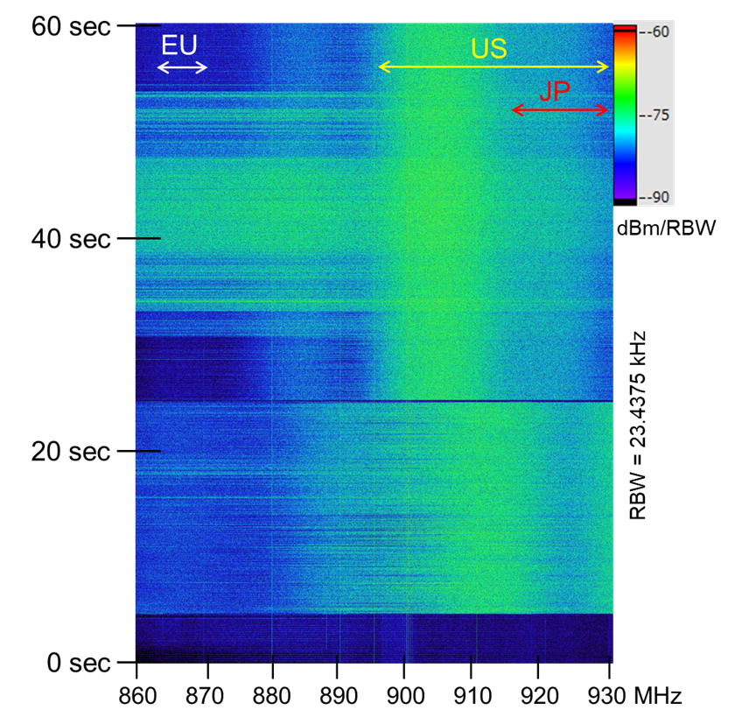
802.19.3a Task Group
Scope of the project: This amendment updates and expands coexistence recommendations to address new market requirements, increasing data traffic, greater device density of devices, and increased potential for congestion based on both IEEE Std 802.11-2020 and IEEE Std 802.15.4 sub-1 GHz standards.
19-24/0029, “Measurement result of radio noise over 920 MHz band emitted from mini PC”
Kazuni Yato et. al.

