Slide 1
Use Cases and Requirements for
Enhanced Light Communication (ELC)
Date: 2023-09-11
Authors:

Slide 2
Abstract
This contribution considers a use case that can be uniquely enabled by enhanced light communication (ELC). The idea is to exploit the favourable qualities of light propagation under water – namely the wide bandwidth and relatively small attenuation. The current push for further understanding and exploration of our oceans and seas coupled with the recent advent of autonomous underwater vehicles have laid bare the need for a high-speed reliable means of wireless communication underwater. ELC can provide a vastly superior data rate compared to incumbent technologies, as well as provide positioning services in currently challenging environments. Moreover, ELC can provide a fully featured standardized modern networking solution which is currently missing. The contribution proposes some features to be considered in the scope of the ELC project.

Slide 3
Outline
Underwater Wireless Communication Technologies – Overview
Underwater Wireless Communication ELC Use Case
Proposed Addition of Spectrum
  Motivation
  Issues of Backwards Compatibility

Slide 4
Underwater Wireless Communication Technologies – Overview
Acoustic Communications
Long range
Low data rate (low kbps range)
Susceptible to environmental interference
Cannot go through air-water boundary
Magnetic Field Communications
Short range
Low data rate (lower than acoustic)
Less susceptible to noise
Can go through air-water boundary
Underwater Wireless Communications
Standardization body exists, but unified standard does not
No true modern fully featured standardized networking solutions exist
Inter-product operation not guaranteed

Slide 5
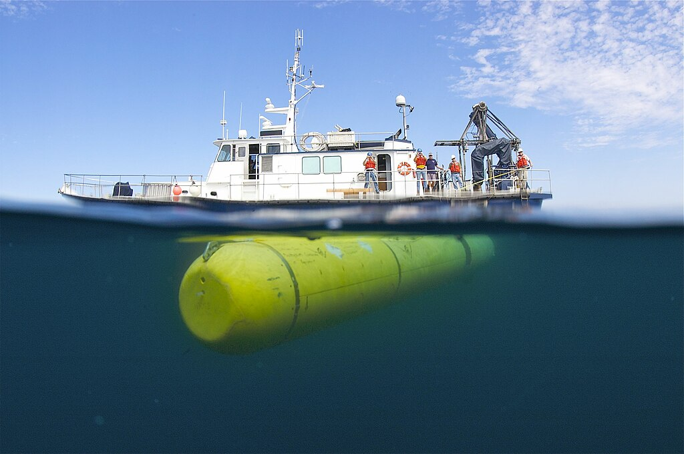
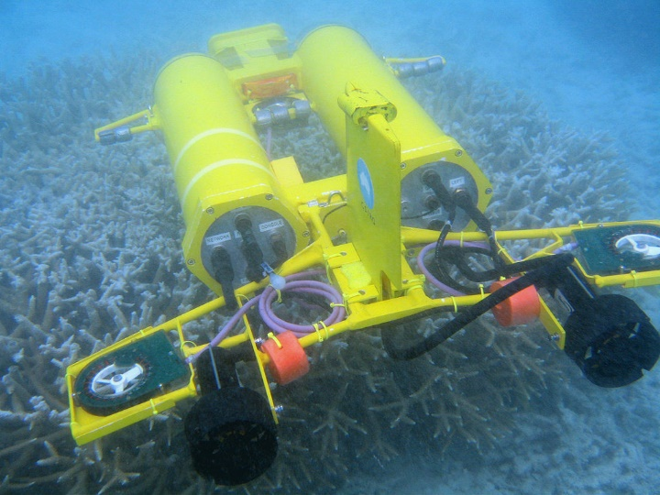
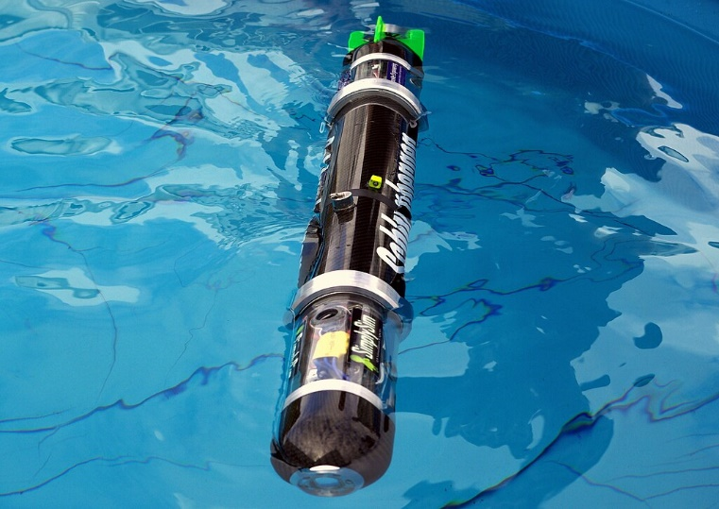
Underwater Wireless Communication ELC Use Case
With deployment of sensors underwater (either standalone or on AUVs there is a growing requirement to exfiltrate data from underwater into the terrestrial data networks.
Wireless connectivity is one of the best options as it potentially has a lower operational cost (vs physical retrieval) and the lowest risk of damaging equipment during data retrieval.
Potentially large amounts of data are generated by sensors (imaging or other) and exfiltrating said data requires a high-speed means of doing so.
[3]
[2]
[1]

Slide 6
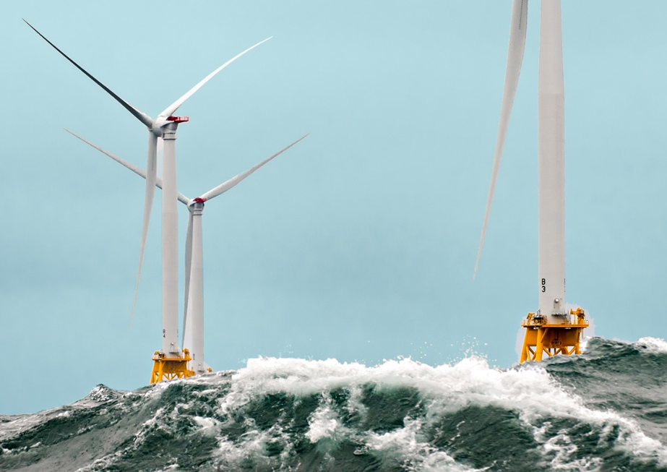
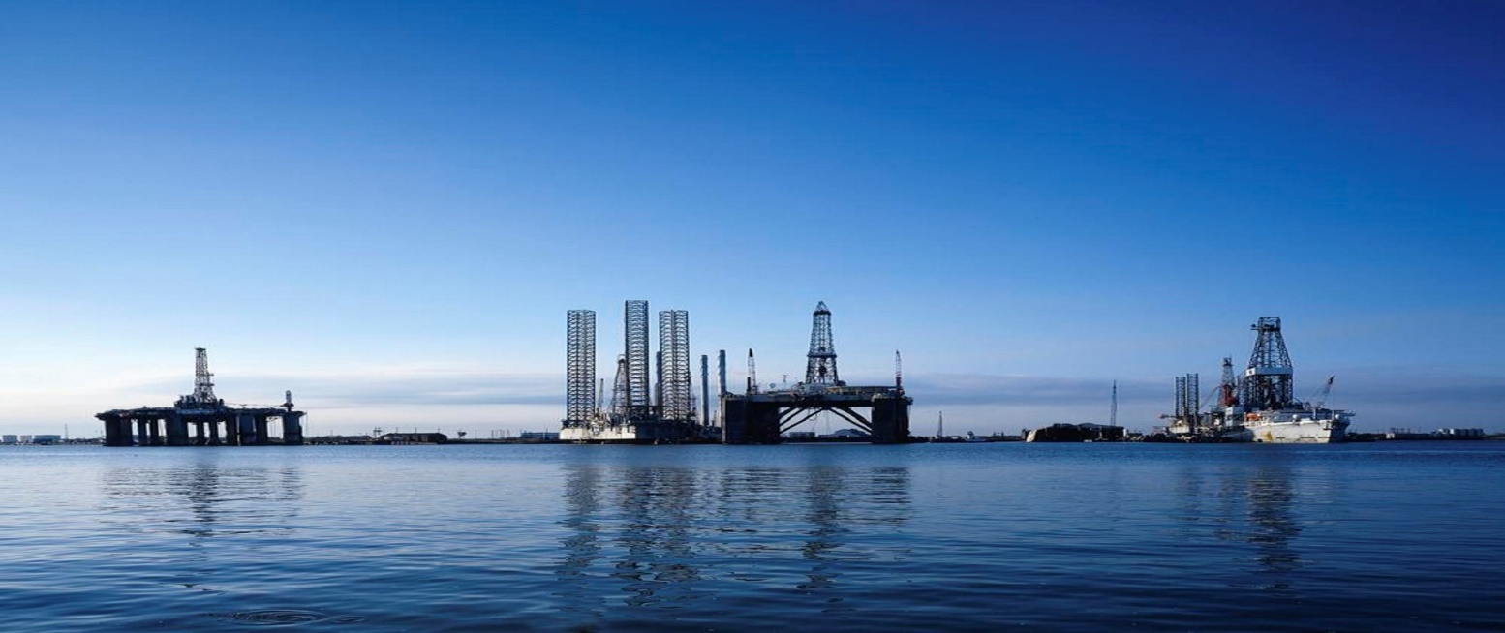
Underwater Wireless Communication ELC Use Case
Further to data connectivity, the ELC system can provide ranging and positioning services which can prove invaluable in complex environments.
The modern standardized networking capability would also enable complex deployments that will reduce complexity of deployment versus current solutions.
Furthermore, the ELC systems could provide ranging and positioning services which can be invaluable in complex environments.

Slide 7
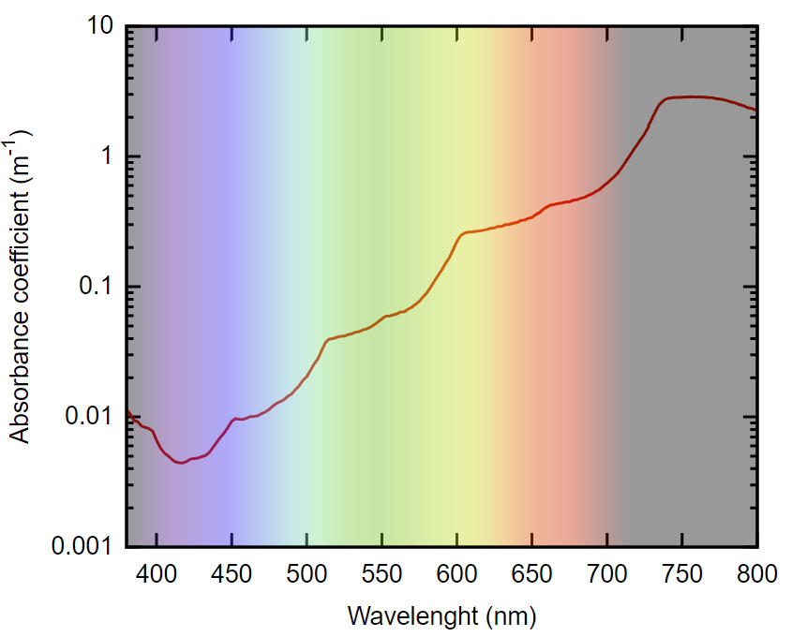
Summary: Proposed features in scope of ELC
The scope for Enhanced Light Communication (ELC) should include the following additions:
  Additional spectrum in the 450 nm region
  Functionality on the PHY & MAC layers that would allow for ranging and positioning services to be delivered
[4]

Slide 8
References
[1] Paul Esparon, Sunil Shah, Dr Timothy Nickels and the 2008 CAUV team., CC BY-SA 3.0 <https://creativecommons.org/licenses/by-sa/3.0>, via Wikimedia Commons
[2] CSIRO, CC BY 3.0 <https://creativecommons.org/licenses/by/3.0>, via Wikimedia Commons
[3] Picture taken by unknown photographer. Photo taken for MBARI Research Institute., CC BY-SA 4.0 <https://creativecommons.org/licenses/by-sa/4.0>, via Wikimedia Commons
[4] Own work - Data from 380-728 nm: Pope R. M., Fry E. S. 1997. Absorption spectrum (380-700 nm) of pure water. II. Integrating cavity measurements. Appl. Opt. 36, 8710-8723 728-800 nm: Kou L., Labrie D., Chýlek P. 1993. Refractive indices of water and ice the 0.65- to 2.5-µm spectral range. Appl. Opt. 32, 3531-3540 Combined data: Jonasz M. 2007. Absorption coefficient of water: Data sources (Data of Pope RM and Fry 1997 and of Kou L et al 1993). In: Top. Part. Disp. Sci. ( ISBN 0-9780628-0-9, Archive) Colour gradient: File:Spectrum4websiteEval.svg by Deborah S Krolls and Sakurambo
Absorption coefficient of pure water from 380 nm to 800 nm at 22 °C.

