Slide 1
Benefits of using WDM and MLO for ELC
Sept 2024
Date: 2024-09-11
Authors:

Slide 2
Abstract
Sept 2024
This presentation provides description into the benefits of using wavelength division multiplexing (WDM) and multi-link operation (MLO) for Enhanced Light Communication (ELC).

Slide 3
How can we achieve higher DR based on Wi-Fi MIMO?
Sept 2024
Data rate = N x DR(MCS(EVM))
MCS index | Modulation type | Coding rate | Data rate (Mbit/s) |  |  | EVM (dB)
 |  |  | 320 MHz channels
 |  |  | 3200 ns GI | 1600 ns GI | 800 ns GI
0 | BPSK | 1/2 | 123 | 136 | 144 | -5
1 | QPSK | 1/2 | 245 | 272 | 288 | -10
2 | QPSK | 3/4 | 368 | 408 | 432 | -13
3 | 16-QAM | 1/2 | 490 | 544 | 577 | -16
4 | 16-QAM | 3/4 | 735 | 817 | 865 | -19
5 | 64-QAM | 2/3 | 980 | 1089 | 1153 | -22
6 | 64-QAM | 3/4 | 1103 | 1225 | 1297 | -25
7 | 64-QAM | 5/6 | 1225 | 1361 | 1441 | -27
8 | 256-QAM | 3/4 | 1470 | 1633 | 1729 | -30
9 | 256-QAM | 5/6 | 1633 | 1815 | 1922 | -32
10 | 1024-QAM | 3/4 | 1838 | 2042 | 2162 | -35
11 | 1024-QAM | 5/6 | 2042 | 2269 | 2402 | -35
12 | 4096-QAM | 3/4 | 2205 | 2450 | 2594 | -38
13 | 4096-QAM | 5/6 | 2450 | 2722 | 2882 | -38

Slide 4
Wavelength division multiplexing
Sept 2024
Optical wireless channels with wide coverage usually have strong spatial correlations, which leads to rank-deficient channel matrix.
Wavelength division can effectively decorrelate the channel and form full-rank/diagonal channel matrices.
Proposal: Implement optical wireless wavelength division multiplexing channels and map them to multiple spatial streams in 802.11.
Benefits: improving link data rate.
Spatial streams
Spatial streams
$$λ_{1}$$
$$λ_{1}$$
802.11 module
Up/Down convertors
$$λ_{2}$$
$$λ_{2}$$
Up/Down convertors
802.11 module
$$λ_{3}$$
$$λ_{3}$$
$$λ_{4}$$
$$λ_{4}$$
OFEs
OFEs

Slide 5
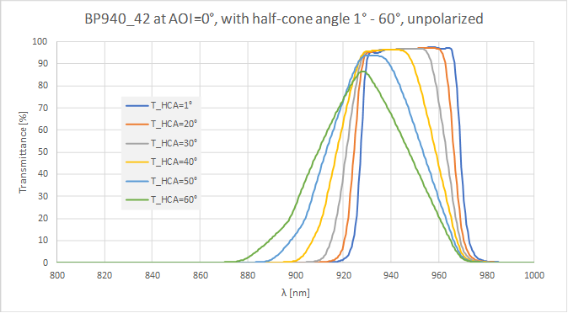
Optical filter blue shift (1/2)
Sept 2024
The transmittance profile of optical filters changes based on the light angle of incidence. This is known as the blue shift of optical filters.
The transmission band shifts to shorter wavelength regimes and gets distorted at high angle of incidence.
The blue shift of optical filters varies based on the optics material and manufacturer.

Slide 6
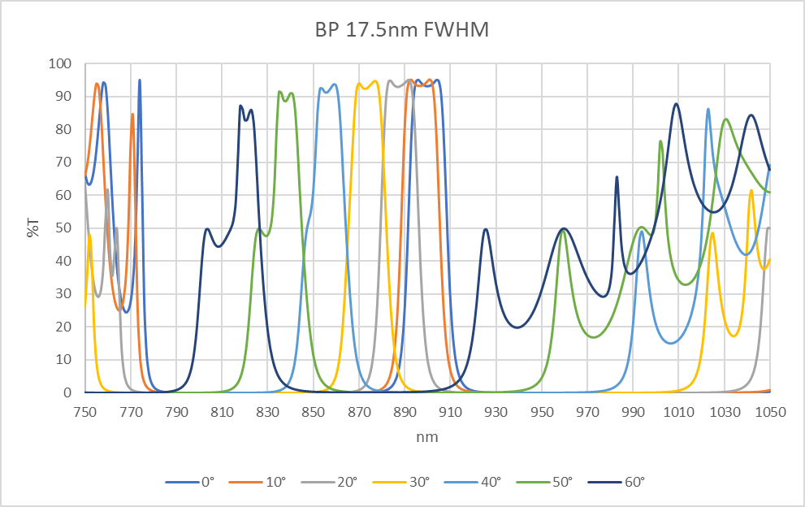
Optical filter blue shift (2/2)
Sept 2024
The study group needs to investigate the selection of the number of supported optical bands and their width.
This also might need to include the maximum angle of incidence that can be tolerated. However, this is a system design parameter that vendors might like to keep it flexible.
Blue shift could result in interference that can be partially tolerated but need to be investigated in order to quantify the benefits of using WDM at the expense of added complexity.

Slide 7
Multi-link operation (MLO)
Sept 2024
MLO provides an additional dimension on top of the spatial MIMO channels that can significantly enhance LC.
MLO has multiple modes and unlike spatial MIMO, it takes place in the MAC layer: multi-link single radio or multi radio.
Use MLD (multilink device) with a radio frequency (RF) interface (IF) and a light communication (LC) IF to serve a MLD client with MLO.
Benefits:
Improved link reliability with RF link
Enhanced link data rate when client entering LC coverage
802.11 AP
RF IF
LC IF
802.11 MLD client

Slide 8
Multi-link operation (MLO)
Sept 2024
Use MLD (multilink device) with multiple spatially separated light communication (LC) IFs to serve a MLD client with MLO.
Benefits:
Improving link data rate
Improve link robustness against blockage/misalignment
802.11 AP
LC IF2
LC IF1
blockage
802.11 MLD client

Slide 9
Summary
Sept 2024
Enhanced utilization of WDM will results in improved transmission speeds and better utilization of the available MIMO spatial streams.
Blue shift and optical filters performance variability might result in interference and needs to be quantified and managed by controlling the number and width of optical bands.
MLO provides an additional dimension on top of spatial MIMO channels that can enhance LC, and enable enhanced hybrid operations with RF interfaces within the same AP.

