Slide 1
SN assignment and inter-AP MLD interaction for Seamless Roaming
Date: 2024-09-10
Authors:

Slide 2
Introduction
Some contributions [1-6] discuss SN (Sequence Number) handling during Seamless Roaming.
In this contribution, we discuss the following topics:
  SN handling between AP MLDs for Seamless Roaming
  Whether to define the interaction between AP MLDs during Seamless Roaming

Slide 3
Introduction
Some contributions [1-6] discuss SN (Sequence Number) handling during Seamless Roaming.
In this contribution, we discuss the following topics:
  SN handling between AP MLDs for Seamless Roaming
  Whether to define the interaction between AP MLDs during Seamless Roaming

Slide 4
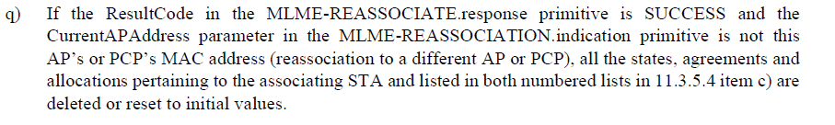
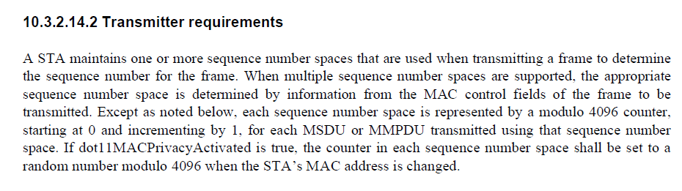
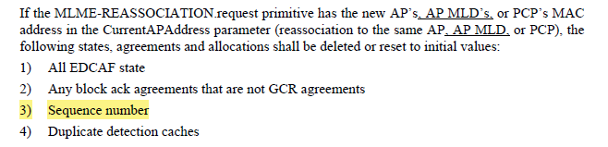
Background (1/2)
According to 10.3.2.14.2, SN (sequence number) is assigned to each MSDU
According to Section 11.3.5.4 and 11.3.5.5, SN is reset to initial value during reassociation procedure.
11.3.5.5
11.3.5.4

Slide 5
Background (2/2)
It has been already agreed to forward DL data from the current AP MLD to the target AP MLD in the process of Seamless Roaming [7].
  Move to add the following text to the TGbn SFD:
    As part of the seamless roaming procedure, during roaming,
      after the request/response exchange that initiates notification of the DS mapping change from the current AP MLD to the target AP MLD,
        The current AP MLD may deliver buffered DL data frames for a TBD period of time.
        The non-AP MLD may retrieve buffered DL data frames from the current AP MLD
        The non-AP MLD may send UL data to target AP MLD.
        It is assumed that the target AP MLD is able to deliver data frames to non-AP MLD after the DS mapping change
      The current AP MLD may forward DL data to the target AP MLD.
        When and how to initiate the forwarding of DL data is TBD

Slide 6
3GPP handover [8][9]
In 3GPP, handover procedures with DL data forwarding has been specified already [8][9], where consecutive Sequence numbers (SNs) are assigned before and after the handover.

Slide 7
Proposal: Consecutive SN assignment
During seamless roaming procedure, SN is assigned to DL data consecutively across the current AP MLD and the target AP MLD.
  SN is not reset to initial value during the seamless roaming procedure, when current AP MLD forwards DL data to target AP MLD.

Slide 8
Introduction
Some contributions [1-6] discuss SN (Sequence Number) handling during Seamless Roaming.
In this contribution, we discuss the following topics:
  SN handling between AP MLDs for Seamless Roaming
  Whether to define the interaction between AP MLDs during Seamless Roaming

Slide 9
Interaction between AP MLDs during Seamless Roaming
Some contributions discuss whether to define the interaction between AP MLDs during Seamless Roaming and are categorized into the following two options:
  Option 1: Specification does not define the interaction between AP MLDs (e.g. it can be left to implementation) [1][5][6]
  Option 2: Specification defines the interaction between AP MLDs [10][11]

Slide 10
Ref) Two Procedures of 3GPP handover
3GPP specs [8][9] have defined two different types of handover procedures, and both of them follow the consecutive SN assignment rule.
  3GPP Normal handover [8]
  3GPP DAPS handover [9]

Slide 11
Ref) 3GPP Normal handover [8]
In 3GPP Normal handover:
  At the handover initiation, the Source gNB stops DL Data transmission to the UE and starts DL Data Forwarding.
  Context (SN) transfer from the Source gNB to the Target gNB is performed when DL Data Forwarding starts.
  The Target gNB keeps buffering the forwarded DL Data until the handover completion, and then starts transmission of the forwarded DL Data after hand over completion.
UE
Source gNB
Target gNB
AMF
UPF
DL data transmission via Source gNB
Normal handover initiation
Context (SN) transfer
DL Data Forwarding
Normal handover completion
DL Data Forwarding
Path Switch
AMF: Access and Mobility Management Function
UPF: User Plane Function
DL data transmission via Target gNB

Slide 12
Ref) 3GPP DAPS handover [9]
In 3GPP DAPS handover:
  At the handover initiation, the Source gNB starts DL Data Forwarding but keeps DL Data transmission to the UE.
  Early Context (SN) transfer from the Source gNB to the Target gNB is performed when DL Data Forwarding starts.
  At the handover completion, the Source gNB stops DL Data transmission to the UE and Context (SN) transfer is performed again.
  The Target gNB starts transmission of the forwarded DL Data based upon the 2nd Context transfer.
UE
Source gNB
Target gNB
AMF
UPF
DL data transmission via Source gNB
DAPS handover initiation
Early Context (SN) transfer
DL data transmission via Source gNB
DL Data Forwarding
DAPS handover completion
Context (SN) transfer
DL Data Forwarding
Path Switch
DAPS: Dual Active Protocol Stack
AMF: Access and Mobility Management Function
UPF: User Plane Function
DL data transmission via Target gNB

Slide 13
Proposal for Interaction between AP MLDs during Seamless Roaming
We prefer not to define the interaction between AP MLDs
  11bn should allow any kinds of inter-AP MLD interactions including the one similar to 3GPP Normal handover, the one similar to 3GPP DAPS handover, etc.
    Defining a particular interaction in 11bn specification would prevent another type of seamless roaming.
  What kind of inter-AP MLD interaction is implemented should be left to AP vendors.
    The main use case of 11bn Seamless Roaming is enterprise use, and AP vendors can deal with how to satisfy the requirements for 11bn Seamless Roaming (e.g. consecutive SN assignment before and after roaming, etc)

Slide 14
Conclusion
During seamless roaming procedure, SN is assigned to DL data consecutively across the current AP MLD and the target AP MLD.
Specification does not define the interaction between AP MLDs for Seamless Roaming.

Slide 15
References
[1] 23/1416, Seamless Roaming for UHR Follow-Up, Duncan Ho
[2] 23/1971, Further thoughts on seamless roaming, Ryuichi Hirata
[3] 24/0083, Smooth Roaming Follow Up, Liwen Chu
[4] 24/0101, MLD Roaming scenarios, Gabor Bajko
[5] 24/0655, Thoughts on SMD Roaming and FT Roaming, Binita Gupta
[6] 24/0830, Improve Roaming Between MLDs follow up, Po-Kai Huang
[7] 24/0171, TGbn Motions List - Part 1
[8] 3GPP TS 38.300 V15.5.0 (2019-03)
[9] 3GPP TS 38.300 V16.5.0 (2021-03)
[10] 24/0480, Details of Context Transfer and Data Forwarding under Enhanced FT Protocol, Guogang Huang
[11] 24/0679, Thoughts on functionality and security architecture for UHR seamless roaming, Thomas Derham

Slide 16
Appendix: Normal handover in 3GPP [8]
Figure 9.2.3.2.1-1: Intra-AMF/UPF Handover [8]

Slide 17

Appendix: DAPS (Dual Active Protocol Stack) handover in 3GPP [9]
DAPS handover, which has a similar flamework with Roaming for 11bn, has introduced in 3GPP.
  DAPS handover: a handover procedure that
  maintains the source gNB (base station)
  connection (including downlink user data
  reception and uplink user data transmission)
  after reception of handover command and
  until releasing the source cell after successful
  connection to the target gNB
Source gNB
Target gNB
UE

Slide 18
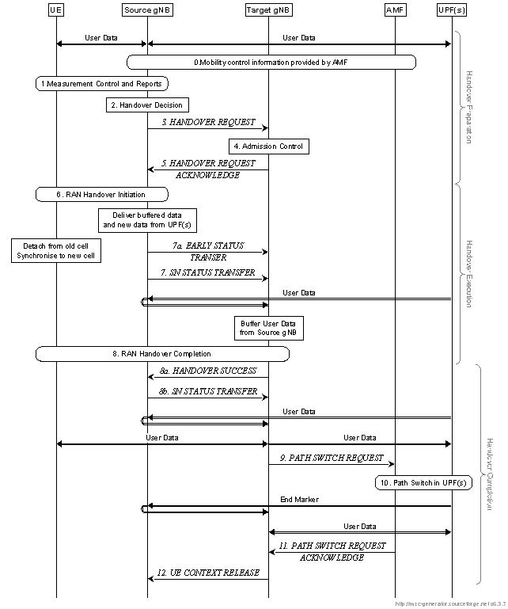
Appendix: DAPS (Dual Active Protocol Stack) handover in 3GPP [9]
Figure 9.2.3.2.1-1: Intra-AMF/UPF Handover [9]

